Slide 2
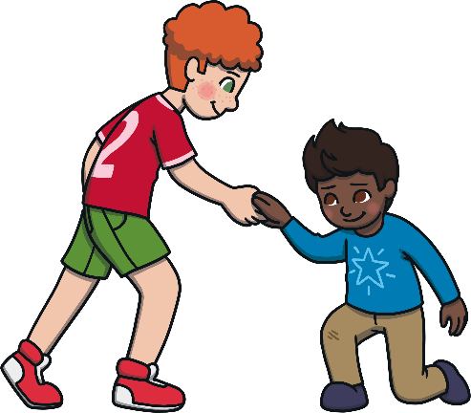
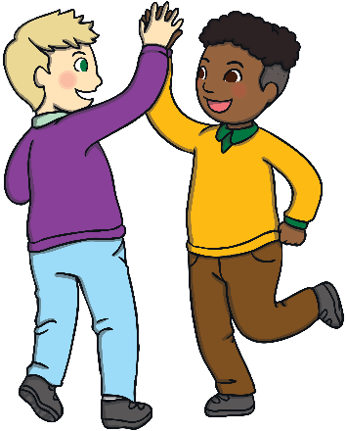
What Is Kindness?
Kindness is:
Being friendly
Looking after other people
Helping people
Being nice to others

Slide 3
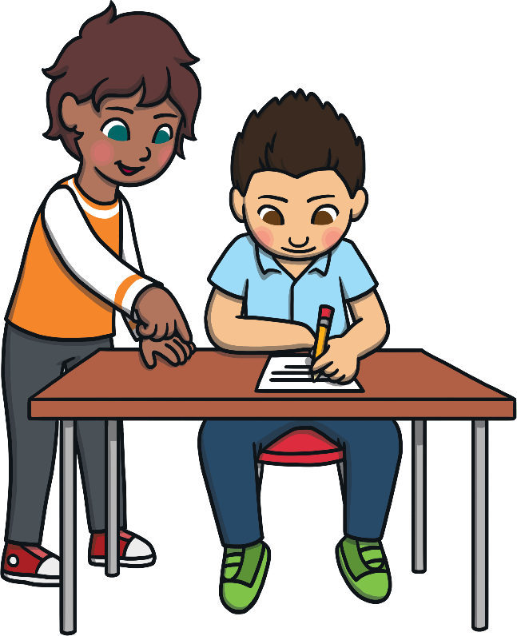

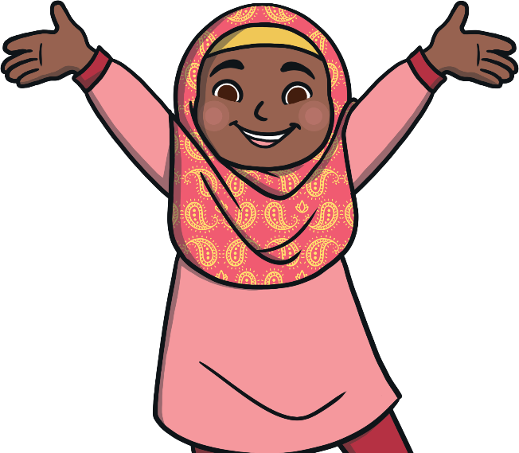
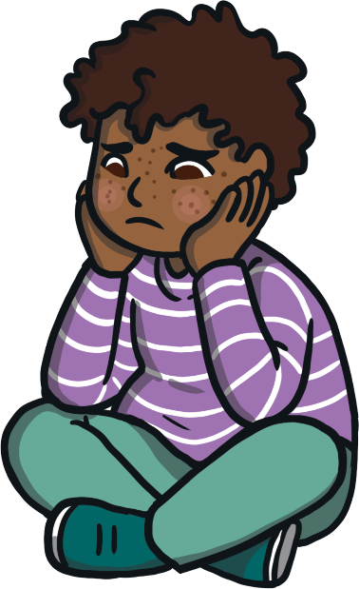
How Could You Show Kindness?
Smile at people.
Volunteer to help people.
If somebody is upset, ask if they are okay.

Slide 4
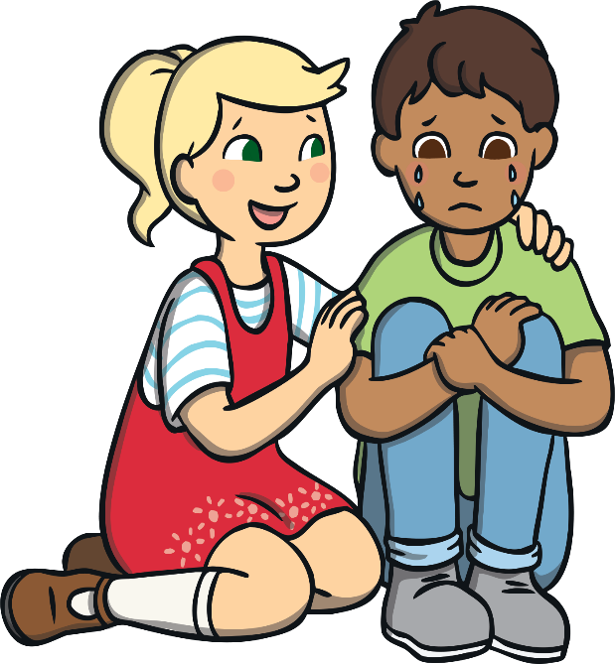
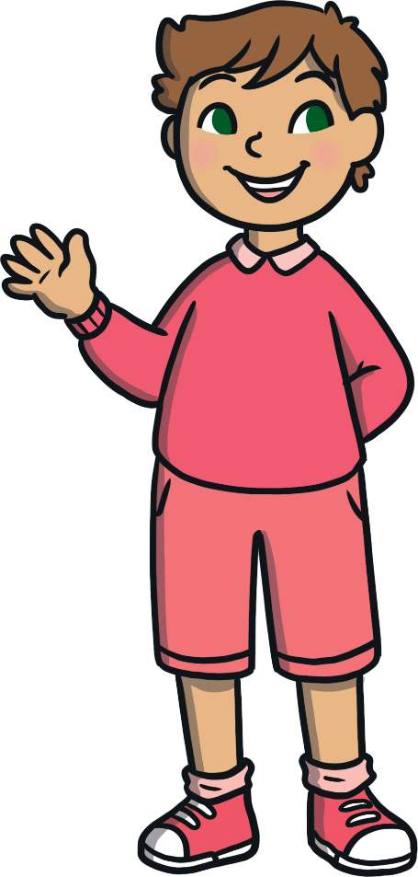
How Could You Show Kindness?
Help somebody up if they
fall over.
Say hello and wave to people.
Give people a hug (if they want you to).

Slide 5
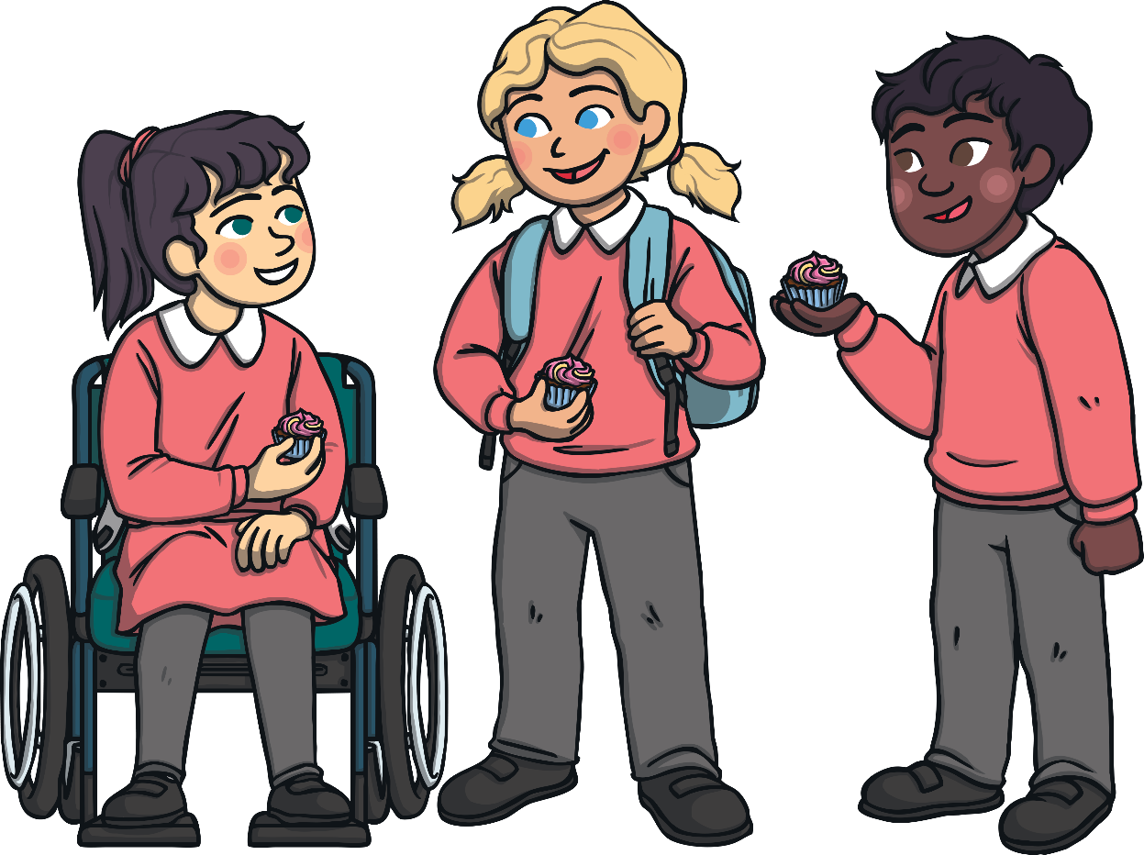
What Can You Do?
Tell a friend how to be kind.

Slide 6
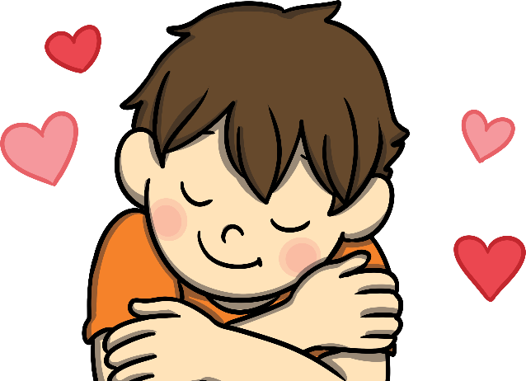

Why Is It Good To Be Kind?
It makes people
feel happy.
It stops people feeling upset.
It helps to make friends.

Slide 7
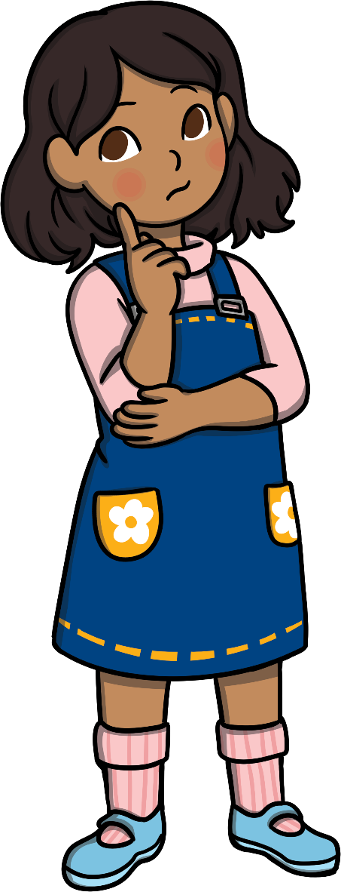
Think About It …
Have you been kind today?
Have you helped somebody?
What else have you done?
H
m
m
.
.
.

Slide 8
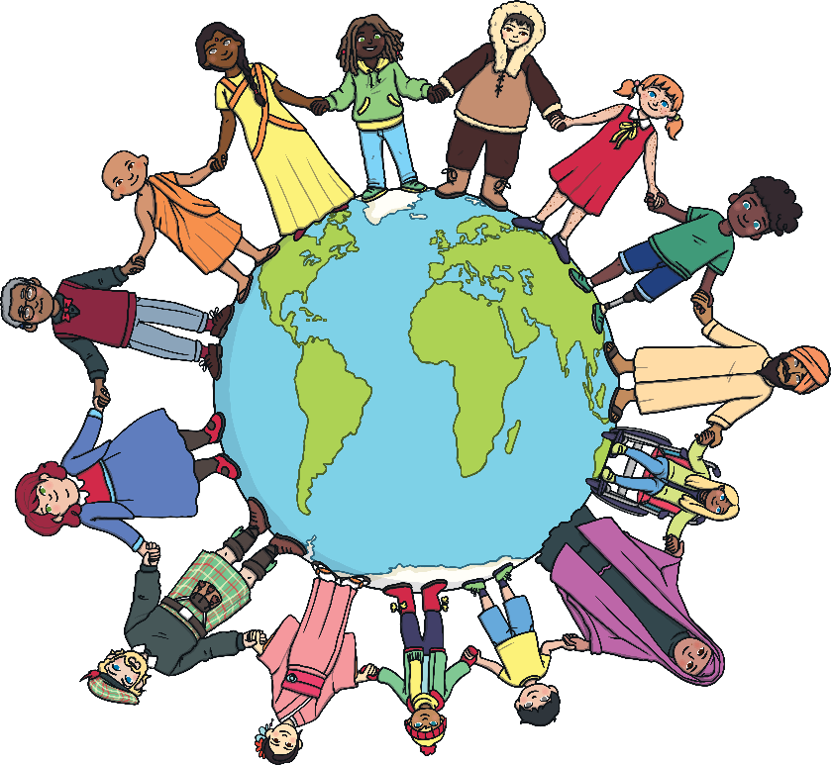
World Kindness Day
Every year the 13th November is World Kindness Day.
It is celebrated all around the world and the day celebrates kindness.
Remember, you do not only have to be kind on World Kindness Day.

Slide 9





What Could You Do On World Kindness Day?
Invite grown-ups in for a drink and a biscuit.
Give out stickers or badges to people who are kind.
Make cards to give to others.
Can you think of any other things you could do?

Slide 10
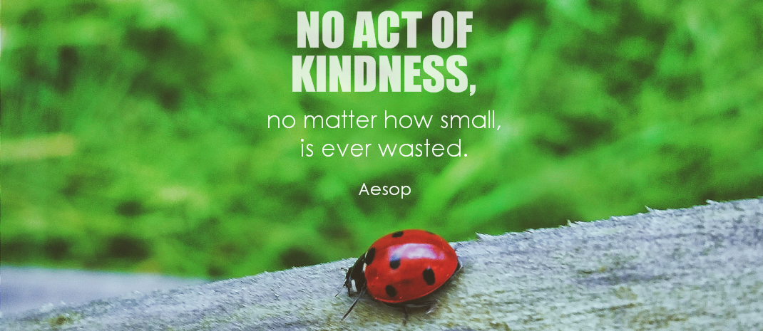
World Kindness Day
Remember:
Always be kind to others.
If you are kind, people will be kind to you.
Photo courtesy of symphony of love (@flickr.com) - granted under creative commons licence – attribution

