Slide 1
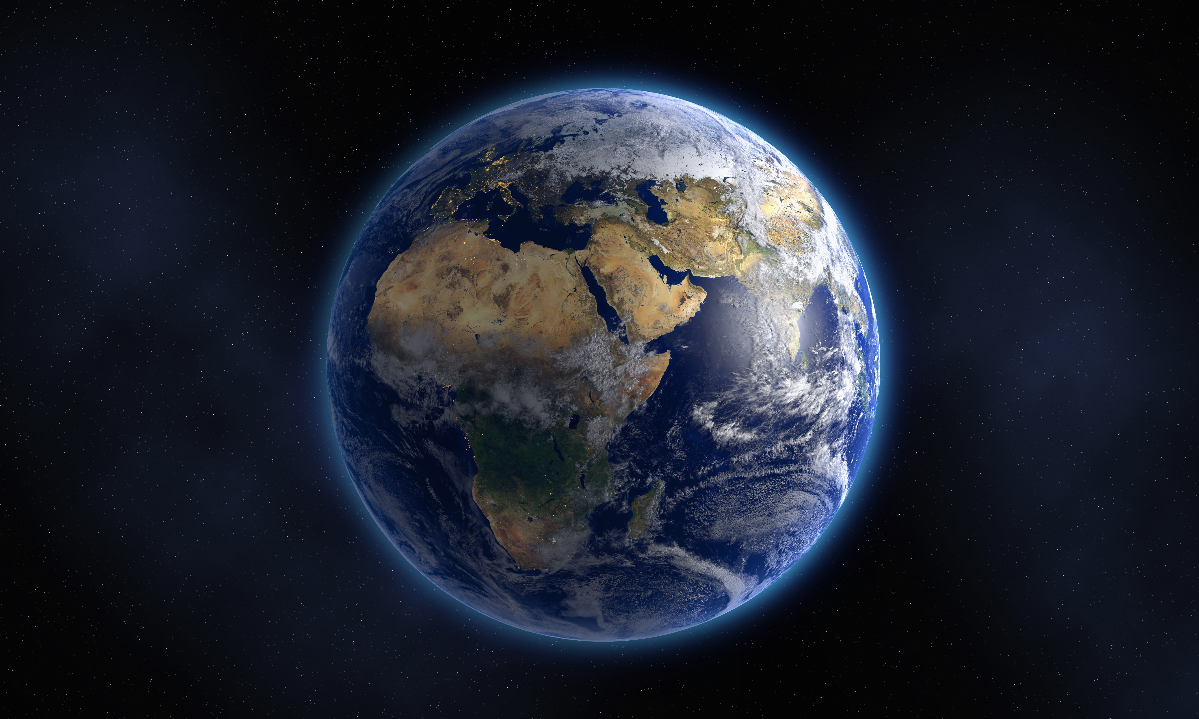
Wild Weather
Biologyy

Slide 2

Lesson 1
L.O: To suggest how to dress appropriately for different weather conditions.

Slide 3


Slide 4


Slide 5


Slide 6


Slide 7


Slide 8


Slide 9
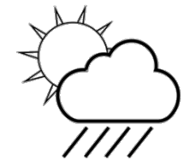

Slide 10
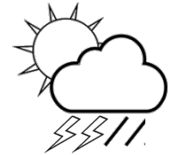

Slide 11
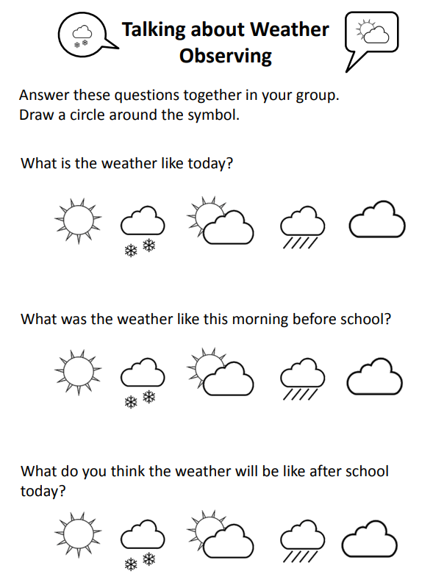

Observing the weather

Slide 12
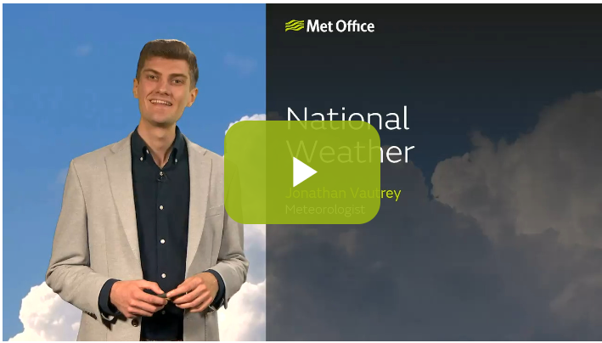
Weather forecast Presentation
Weather forecast video - Met Office

Slide 13
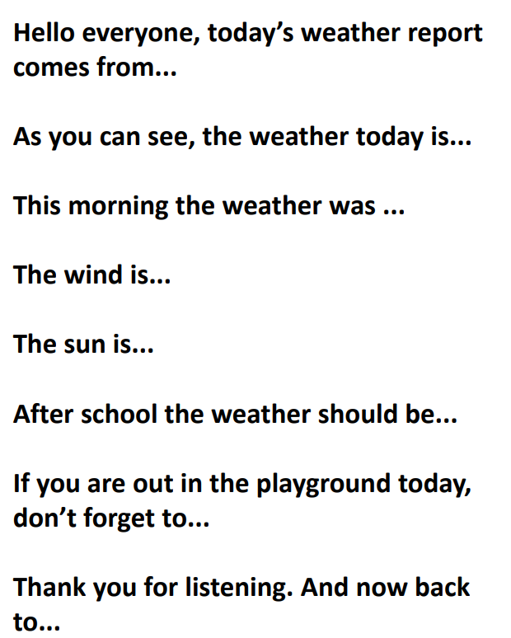
Weather reporting
You are now going to practice being a weather reporter using the symbols to show us on the map what the weather will be like.

Slide 14
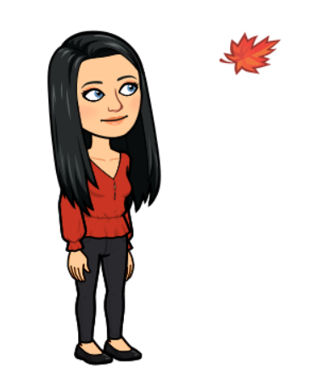
Lesson 2
L.O: To understand how the weather they have observed outside is typical (or not) of the weather for the season.

Slide 15
Observing the weather
Observe weather in the morning and now.
What were you expecting today when you went to watch the weather?
Were you surprised by it?
What season are we in?
What is the weather normally like at this time of year?
What do we expect the weather to be like tomorrow?
How can we tell?

Slide 16
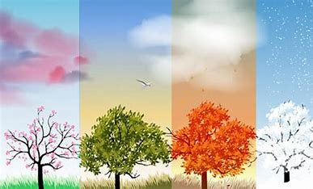
Tell me about the seasons
On the sheets of paper around the class can you draw or write something that you know about that season. It might be a memory you have of that season.

Slide 17
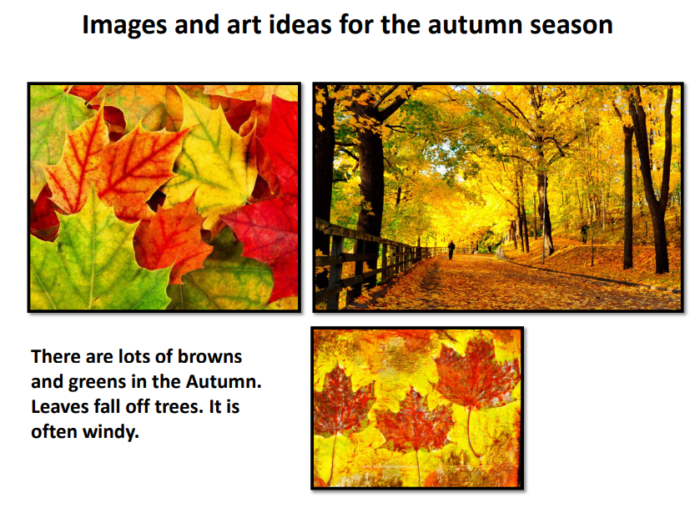
Autumn

Slide 18
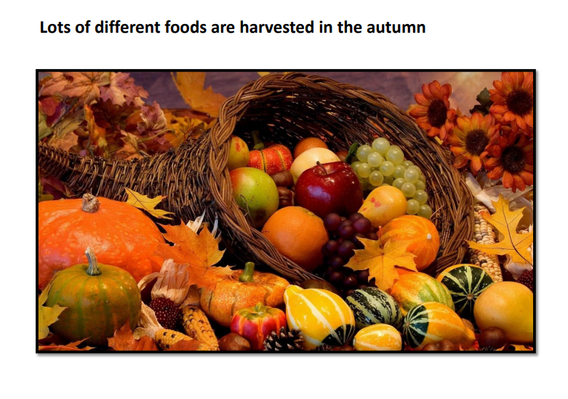

Slide 19
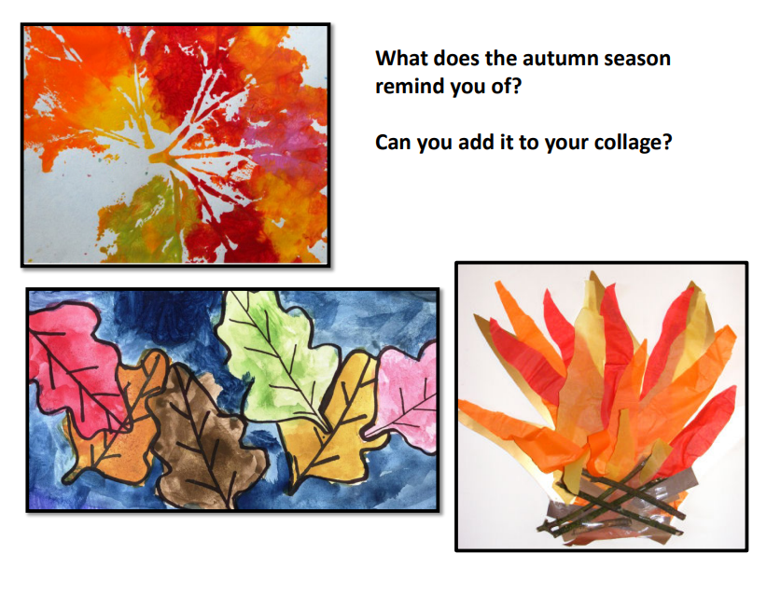
https://www.youtube.com/watch?v=GRxofEmo3HA Play will children make their collages

Slide 20
Lesson 3
L.O: To understand day length changes each day and varies from season to season.

Slide 21
Questions
(Print and take these outside with you)
Can you always see your shadow?
Does your shadow always look like that?
What was your shadow like when you walked to school this morning?
What do you think your shadow will look like this evening?

Slide 22
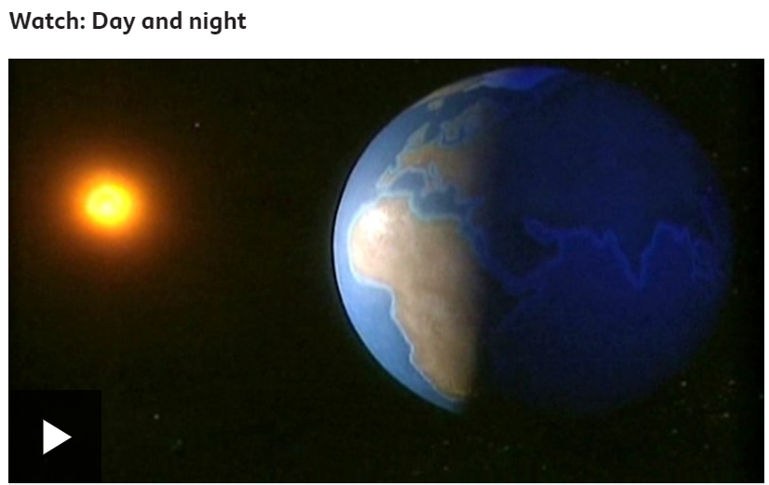
Shadows
Shadows will get longer during the day and will be at their longest at dusk, before the sun sets.
https://www.bbc.co.uk/bitesize/topics/zkbbkqt/articles/zn34r2p

Slide 23
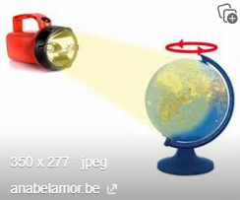
Night and Day
Get a globe and torch to demonstrate how the sun doesn’t move and how the earth moves to make night and day.

Slide 24
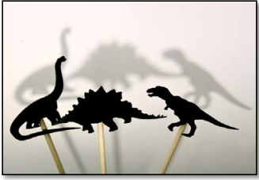
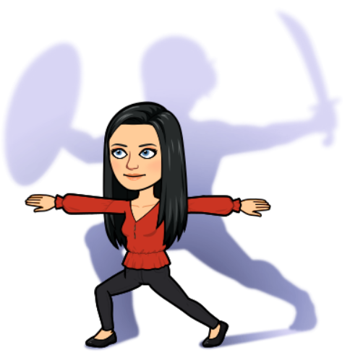
Shadow puppets

Slide 25
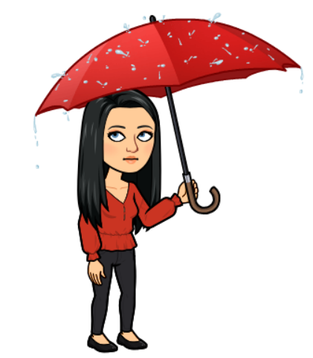
LESSON 4
L.O: To consider what effect rain has on us and our daily lives.

Slide 26
https://www.youtube.com/watch?v=ubNfkpbxXUs
What can you hear?
What does it remind you of?
How does it make you feel?

Slide 27
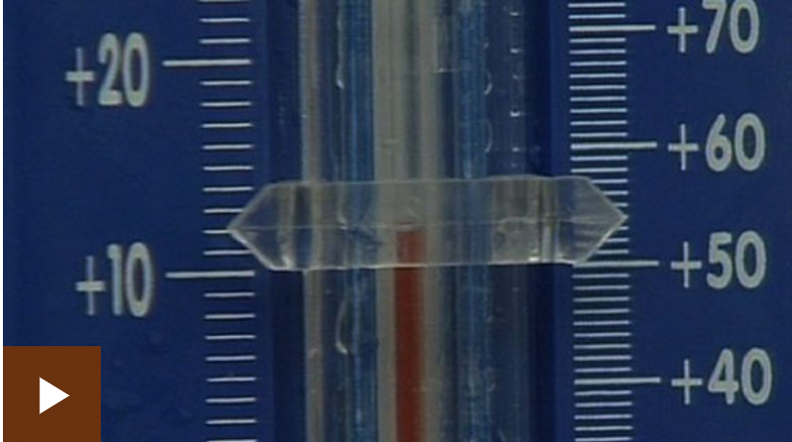
https://www.bbc.co.uk/bitesize/clips/zybq6sg

Slide 28
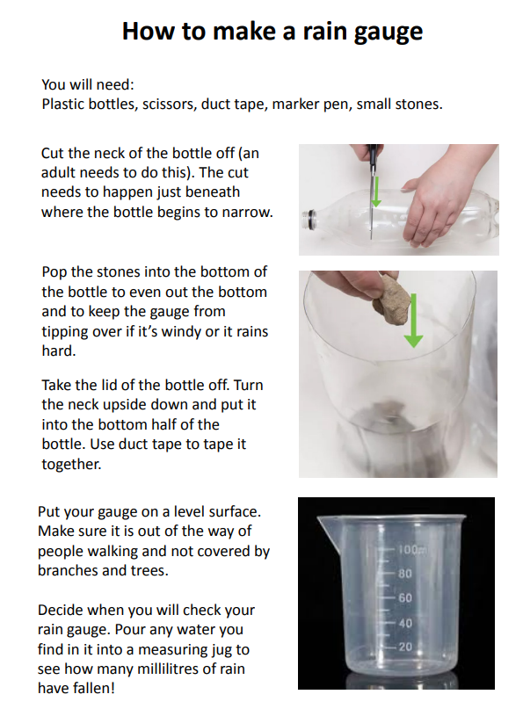
Rain Gauge
We are going to make a weather station over the next few weeks. Today we are focusing on rain and we are going to make a rain gauge.

Slide 29
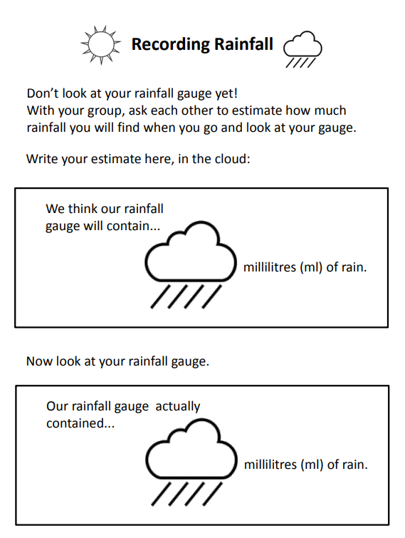
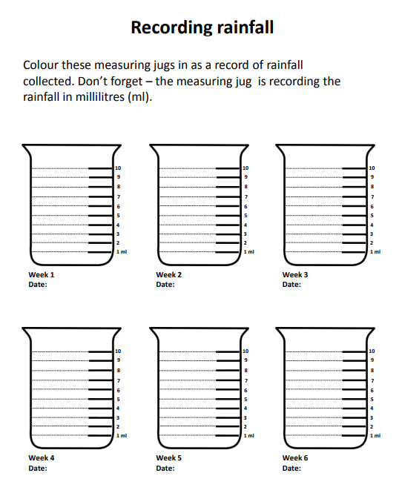
Recording

Slide 30
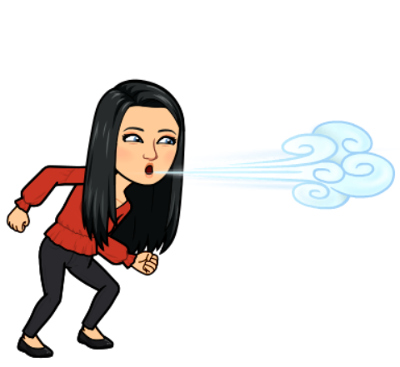
Lesson 5
Weather Stations- Wind Direction

Slide 31
CHECK YOUR RAIN GAUGE!

Slide 32
wind
Was it windy outside at playtime today?
How do you know if it was or wasn't?
How can we tell if the wind is blowing?
We can't see the wind so how do we know?
When is the wind useful?
Why would some people need to know which direction the wind is blowing?

Slide 33
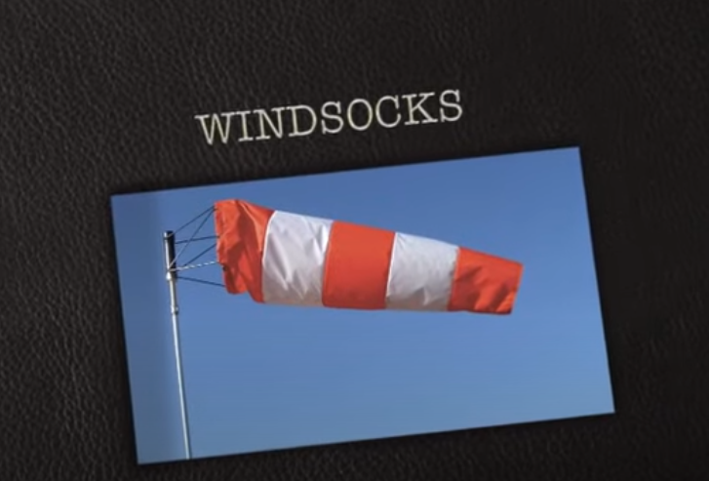
Wind sock
https://www.youtube.com/watch?v=EFBXRkKD2tI

Slide 34
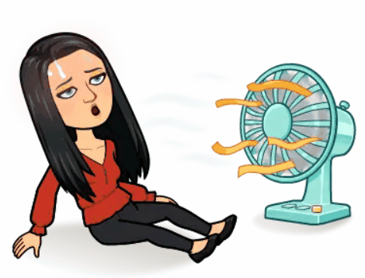
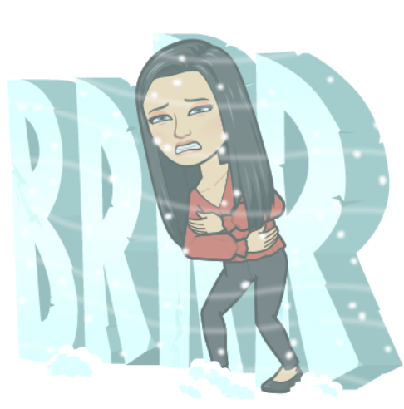
Lesson 6
L.O: To consider warm and cold weather and measure the temperature inside and outside the classroom.

Slide 35
CHECK YOUR RAIN GAUGE!

Slide 36
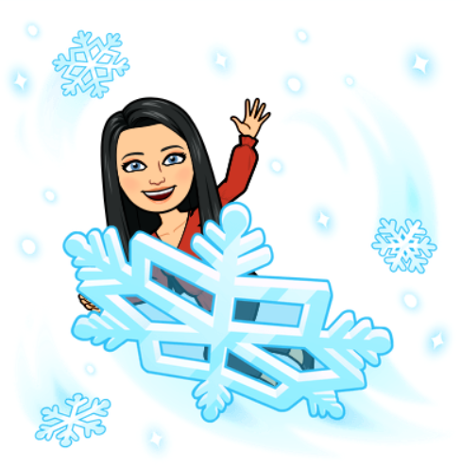
Snow
Can you remember a time when you have seen snow?
Imagine if it snowed today. What would you do?

Slide 37
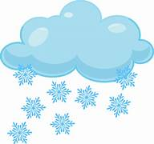
Questions
Why do you think snow falls when it is cold, in the winter? And not in the summer?
Would you rather live in a permanent winter or summer? Or a mixture of both? Why? Why not?

Slide 38
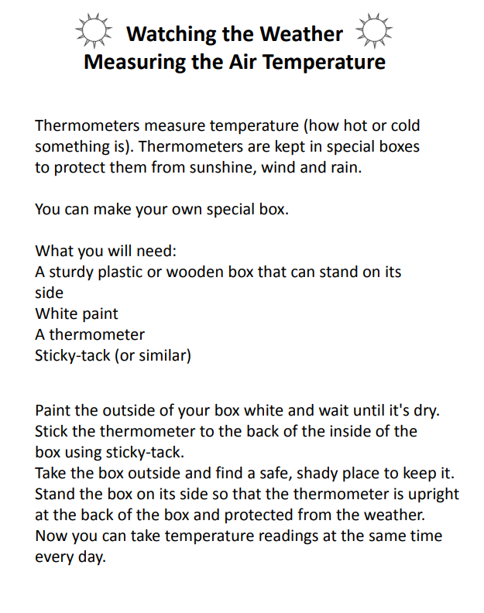
Thermometer box
You are going to make a thermometer box. We will then take the thermometers outside and place them in a safe place.

Slide 39
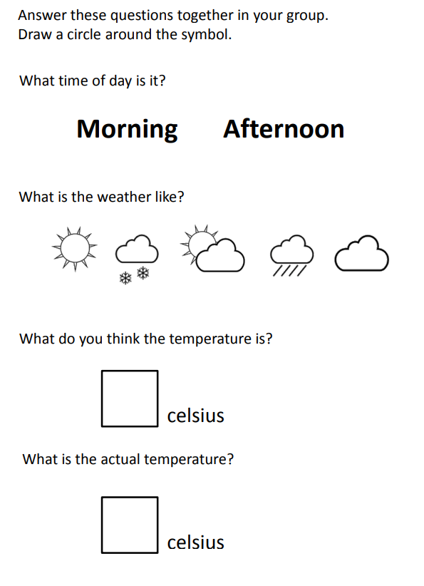
Recording sheet

