Slide 1

Dear Earth
https://www.youtube.com/watch?v=2CvLhSed298
Read bythe author Isabel Otter
(A Writing Root) Dear Earth by Isabel Otter and Clara Anganuzzi

Slide 2
Video Links:
Book Reading:
https://www.youtube.com/watch?v=b2V8Ip3ldsI
Author Reading:
https://www.youtube.com/watch?v=2CvLhSed298

Slide 3
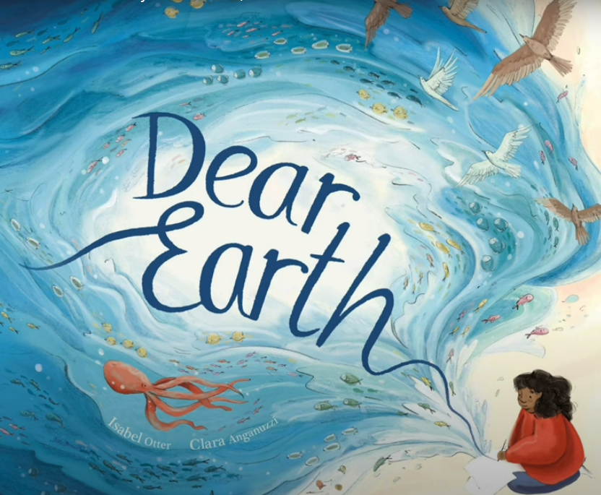
Dear Earth by Isabel Otter and Clara Anganuzzi

Slide 4
Monday 10th June 2024
LO: 1) To discuss future dreams and wishes
I can write in first person
I can use a conjunction to give reasons
I can use the verb would to discuss the future
Ext: I can use a contraction

Slide 5
Tuesday 11th June 2024
LO: 2) To use conjunctions to write a set of instructions
I can use the conjunction if I can use a range of verbs
I can write in second person
Ext: I can use a comma

Slide 6
Wednesday 12th June 2024
LO: 3) To record factual statements about animals I can use a range of adjectives
• I can record factual statements
• I can write in the simple present tense
Ext: I can use an apostrophe to show possession

Slide 7
Thursday 13th June 2024
LO: 4) To create noun phrases to describe
I can use a range of thoughtful adjectives
I can pair adjectives with nouns appropriately
I can use a comma between adjectives
Ext: I can use prepositions

Slide 8

Friday 14th June 2024
LO: 5) To use noun phrases to write a poem about the earth
I can use noun phrases
I can use repetition I can use a range of verbs
Ext: I can use a simile

Slide 9
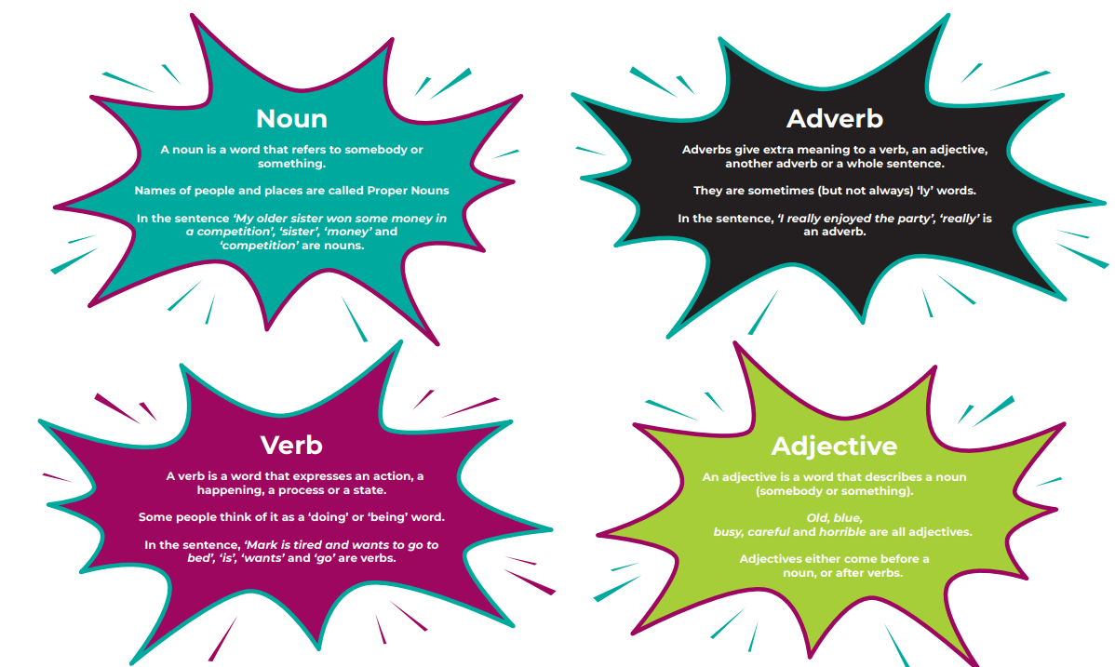
Grammar Splat

Slide 10
Grammar Splat- Noun

Slide 11
Grammar Splat

Slide 12
Grammar Splat

Slide 13
Grammar Splat

Slide 14
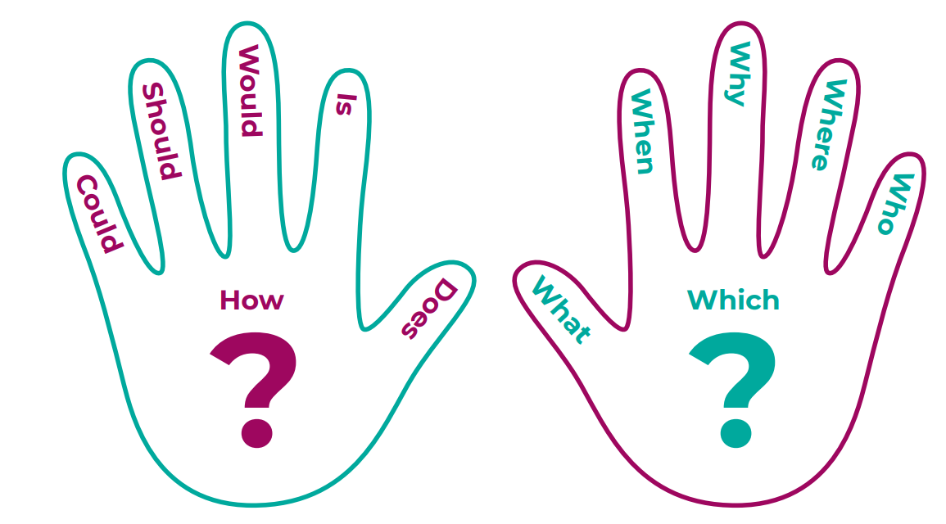
Talk to the hand

Slide 15
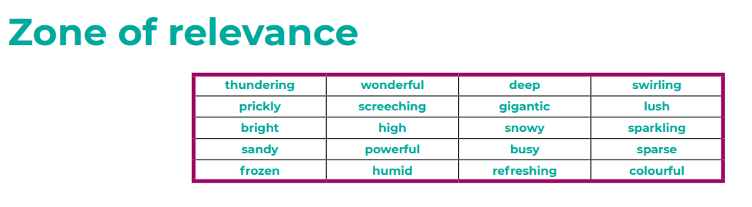
Zone of relevance

Slide 16

Zone of relevance

Slide 17
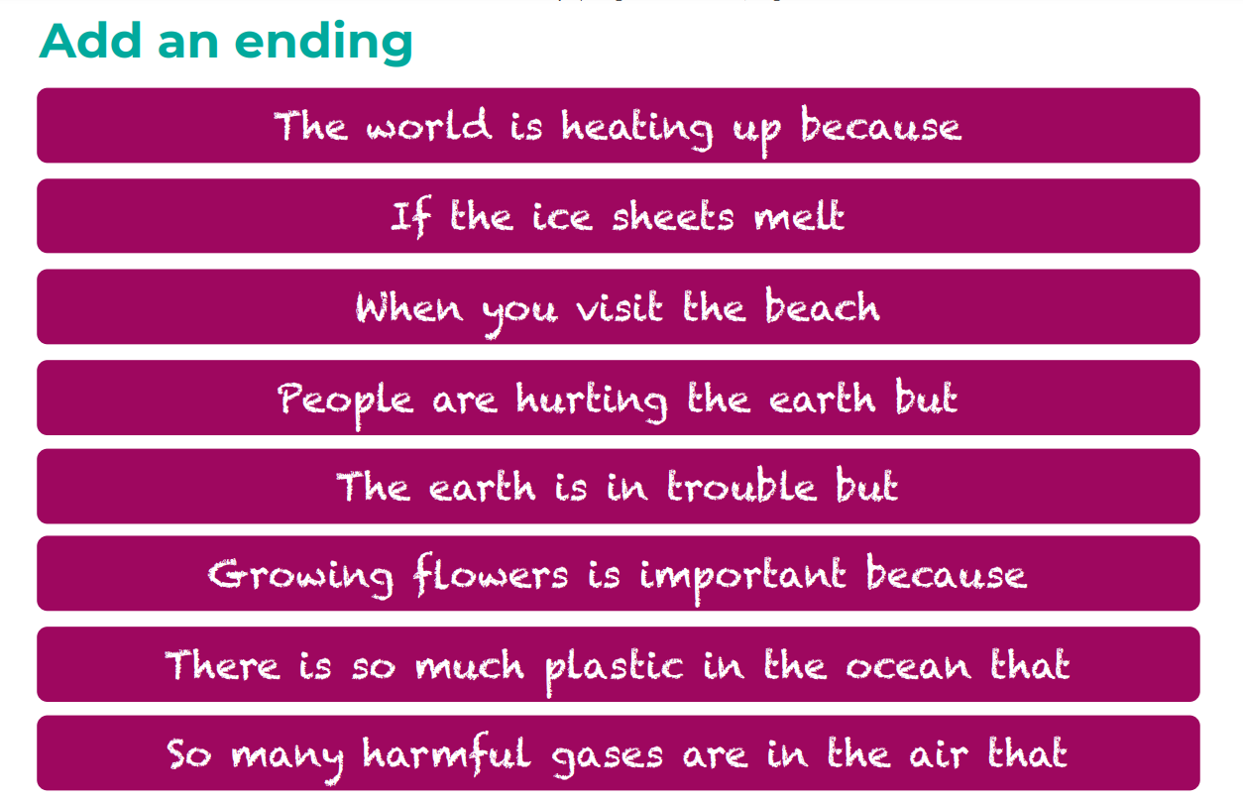
Add an ending

Slide 18
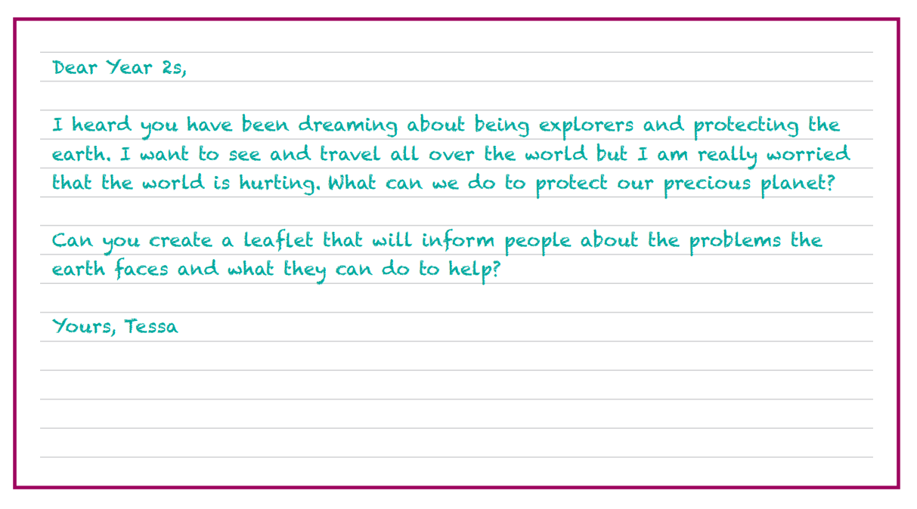
Letter from Tessa

Slide 19
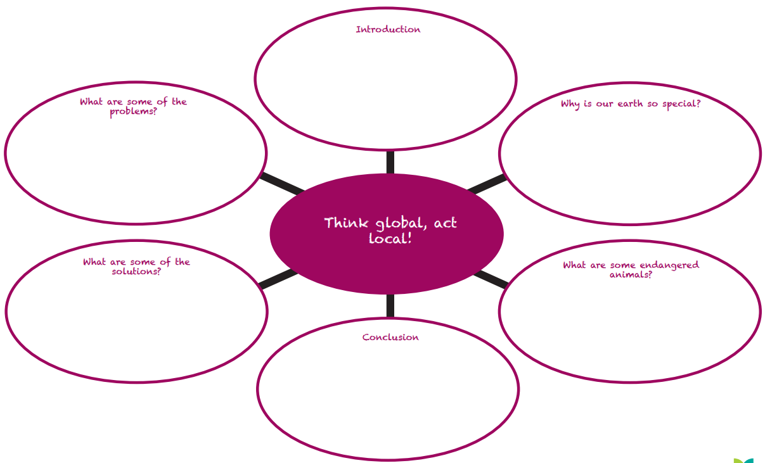
Letter from Tessa

