Slide 1
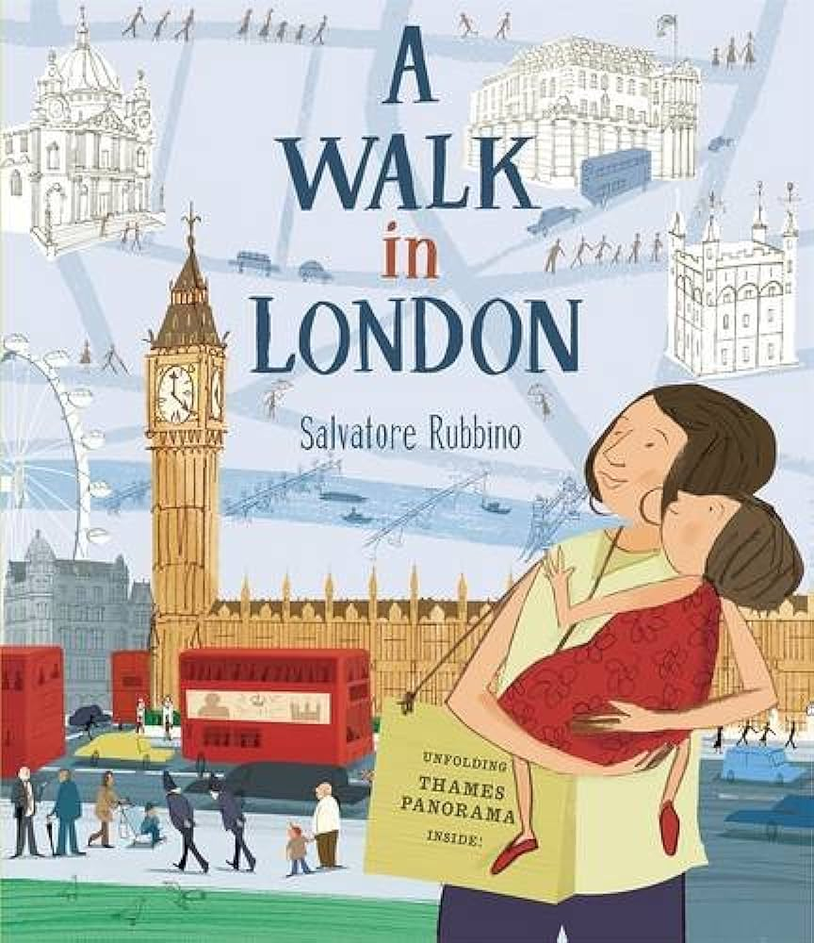
A Walk in London
Salvatore Rubbino

Slide 2
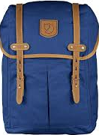

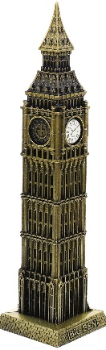
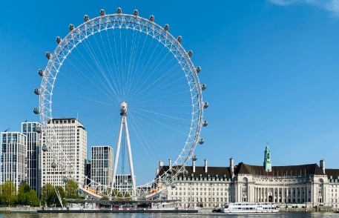
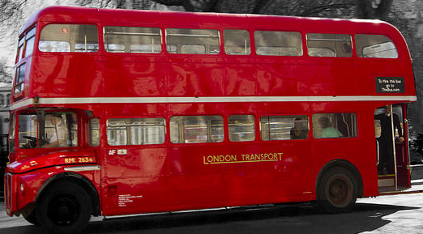
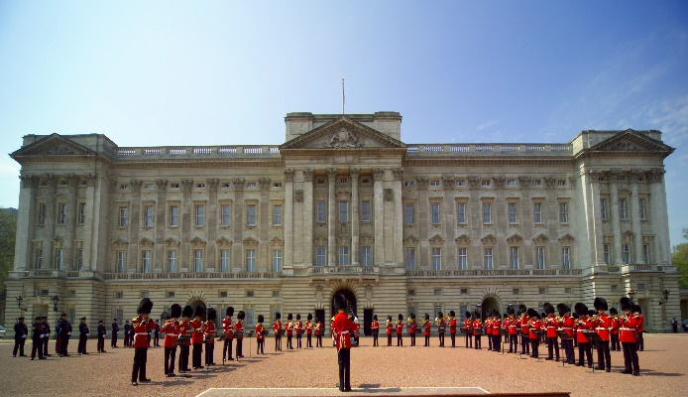
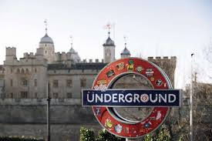
Monday 13th May 2024
L.O: To ask a range of questions.

Slide 3

Where do you think we have been?
Where is London?
What is a walking tour and have you ever been on one?
Where does the King live in London?
If we went on a day trip, what would we need?

Slide 4
Tuesday 14th May 2024
L.O : To use command sentences to give advice
https://360.visitlondon.com/#
A Tour of London

Slide 5
We are going to be planning
Take, Pack, Bring, Make, Fasten, Zip, Collect
From these words, what do you think we could be planning?
A (pretend) trip to London!

Slide 6
Take a phone charger with you, so you can charge your phone.
Pack some sun cream, if it is a sunny day.
Collect train tickets, so that you can get on the train.

Slide 7



Wednesday 15th May 2024
L.O : To use a range of sentence types to create a poster

Slide 8
Thursday 16th May 2024
L.O : To write a setting description
Add link to map
St. Paul’s Cathedral tour
https://www.youtube.com/watch?v=vxH0WyDtQBA

Slide 9
Zone of Relevance
Delicious Soothing Golden
Lively Smooth Shiny
Beautiful Sparkling Sandy
Humungous Idyllic Mysterious
Enchanting Bustling Ancient

Slide 10
Monday 20thMay 2024
L.O : To sequence and caption events in past tense
Inside the Bank of England’s gold vault
https://www.youtube.com/watch?v=yLLcGmvW8WA

Slide 11
, Guide, Saunter, March, Stride, Hike, Trek, Plod, Amble……
What words are these all synonyms for?
Which synonyms are fast and which are slow?
Which are more adventurous than others?

Slide 12
Tuesday 21st May 2024
L.O : To recognise past and present tense
What’s the past tense and what’s the present tense?
go | went
see | saw
is | are
are | were
do | did
keep | kept
taste | tasted
walk | walked
look | looked
laugh | laughed

Slide 13
What is the difference between these sentences?
We went to Trafalgar square and saw amazing things.
You can go to Trafalgar square everyday and see amazing things.

Slide 14
We ventured off the bus and landed next to Big Ben!
Did you know that Big Ben is the name for the bell? It is a very old clock and keeps the time well. You can hear the bell ring every hour. How amazing!
Then we strolled over to St. James’s Park
We took a stroll to Buckingham Palace
Ventured, Explored, Strolled, Wandered, Crossed, Roamed

Slide 15
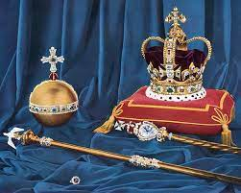
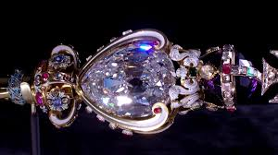


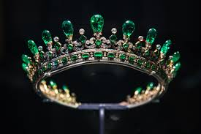

Wednesday 22nd May 2024
L.O : To use past tense to write a postcard/letter

Slide 16
What an amazing time we had! Before we left, I thought about lots of questions. How many rooms are in Buckingham Palace? How many steps are in St Paul’s? We packed our bags and wore out caps.
First, we hiked across Trafalgar Square. Did you know that Trafalgar square has four lion statues in it? Do you know what they are made of?

Slide 17
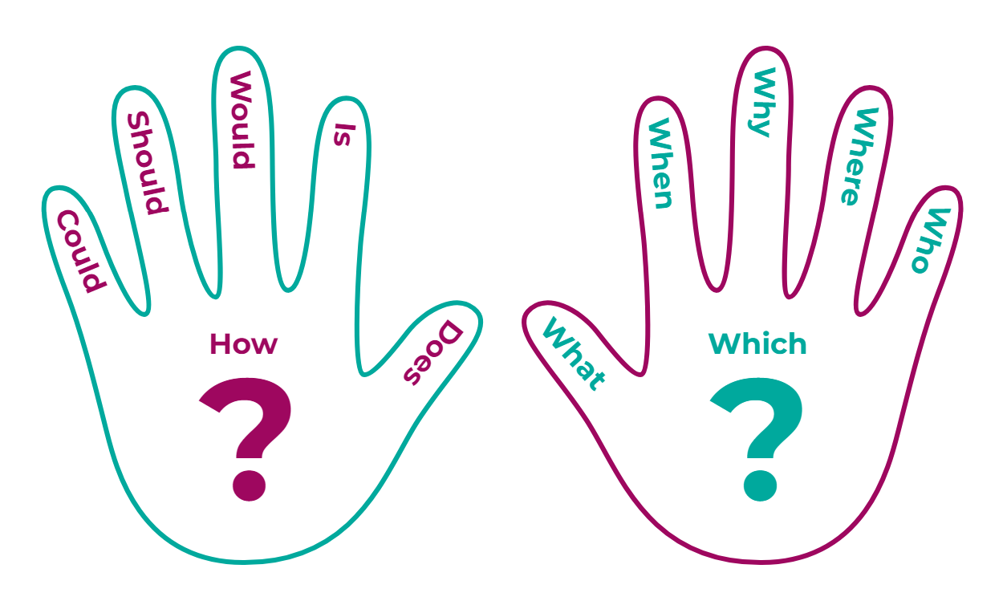
Thursday 23rd May 2024
L.O : To record a range of questions

Slide 18
Where can our walk be?
Where do we start?
Where do you finish?
What places should we visit on our walk?
Are there any facts you know?

Slide 19
w/b 20th May 2024
Learning Objectives:
L.O: To ask a range of questions (Monday)
L.O : To sequence and caption events in past tense (Tuesday)
L.O : To use past tense to write a postcard/letter (Wednesday)
L.O : To record a range of questions (Friday)

Slide 20
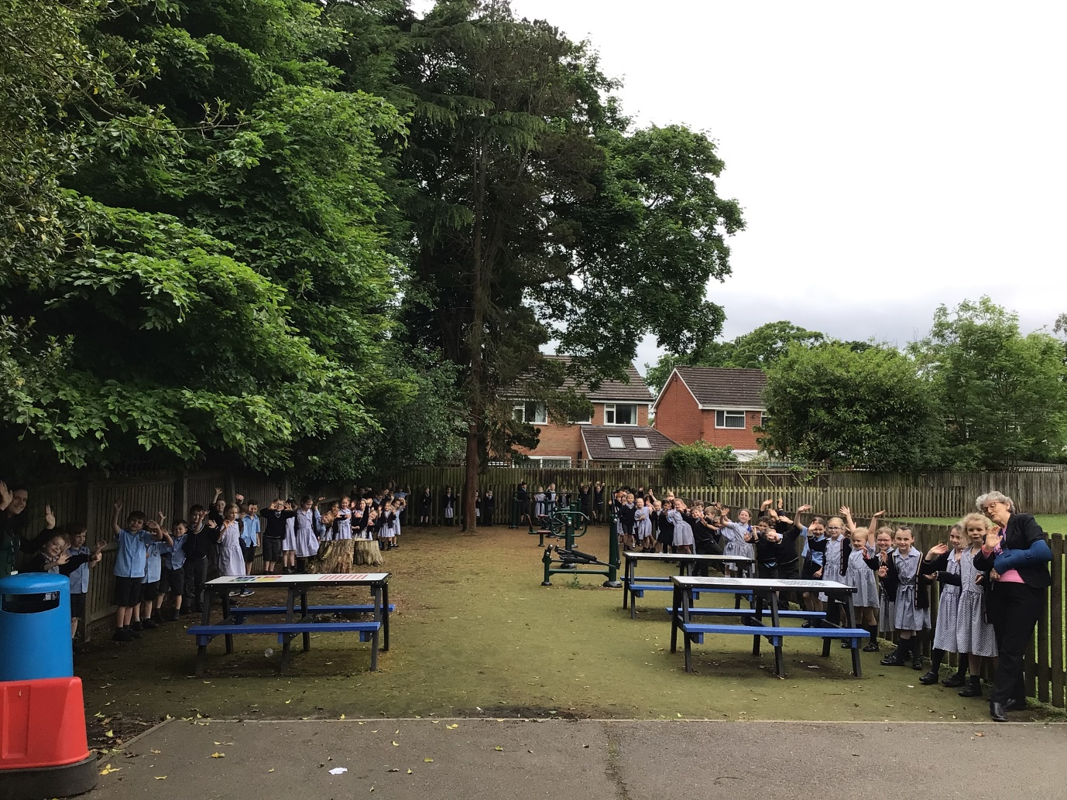
Friday 24th May 2024
L.O : To have a tour around Our Lady of Compassion School, identifying key areas on this journey.

Slide 21
w/b 20th May 2024
Learning Objectives:
L.O: To ask a range of questions (Monday)
L.O : To sequence and caption events in past tense (Tuesday)
L.O : To use past tense to write a postcard/letter (Wednesday)
L.O : To record a range of questions (Friday)

Slide 22
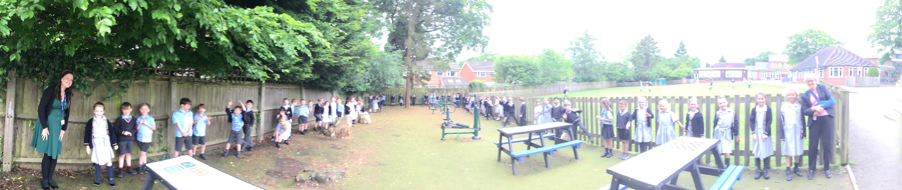
Friday 24th May 2024
L.O : To have a tour around Our Lady of Compassion School, identifying key areas on this journey.

Slide 23
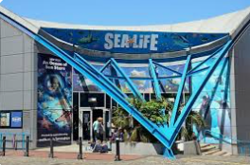
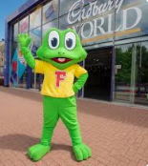
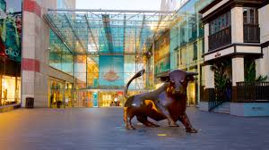
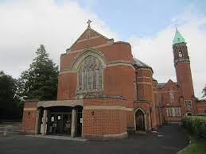
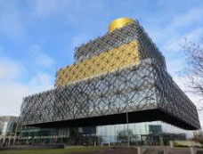

Slide 24
Monday 3rd June 2024
L.O : To write about real events in a diary entry
A Roam in Rotherhithe
Dear Diary,
Yesterday was a marvellous , sunny day!
Before we left, we thought about lots of questions…
First, we ventured to St Mary’s Church. We walked around the graveyard and played on the swings.
After that, we explored the Brunel Museum. We read lots of plaques about the tunnel.

Slide 25
Tuesday 4th June 2024
L.O : To record factual statements
What is one of the oldest buildings?
What is one of the newest buildings?
What is one of the busiest areas?
What is the nicest smelling place?
Where can you buy the sweetest treats?

Slide 26
Wednesday 5th June 2024
L.O : To plan a local walking guide
We will be planning a local walking tour guide like the book ‘A Walk in London’

Slide 27
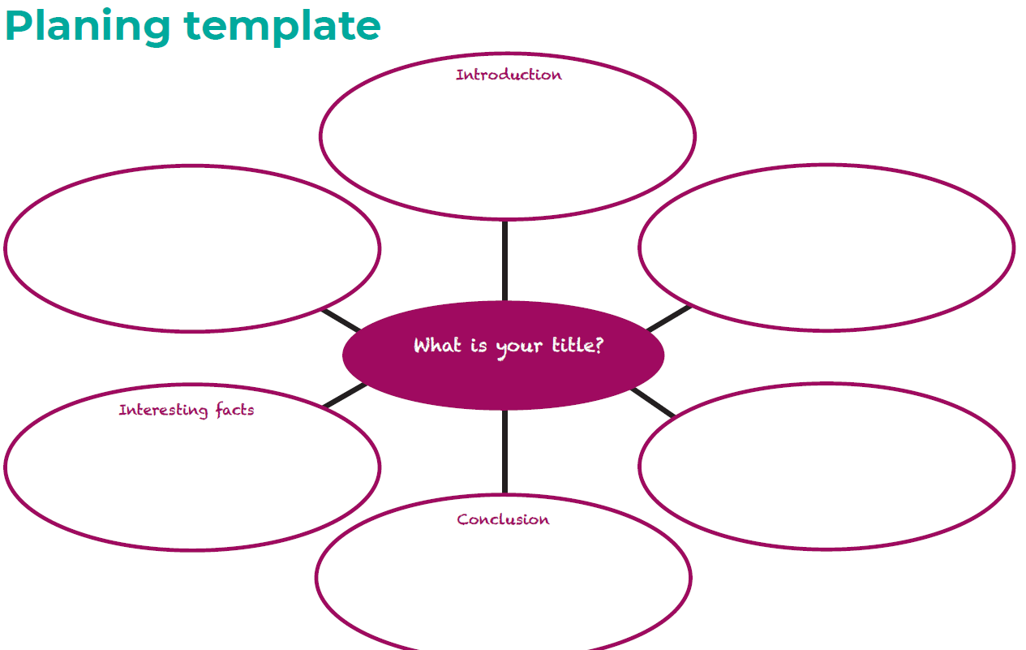

Slide 28
Thursday 6th June 2024
L.O : To use a range of different sentence types to write an introduction
Why is an introduction important?
How can we grab the reader’s attention?

Slide 29
Are you looking for a new place to visit? Are you board of the same old walks? Come and visit beautiful Birmingham/Solihull if you love……………..
Did you know………..

Slide 30
Friday 7th June 2024
L.O : To use the present tense to continue writing a walking tour guide

Slide 31
Monday 10th June 2024
L.O : To use thoughtful adjectives to continue writing a walking tour guide

Slide 32
Monday 10th June 2024
L.O : To use a range of different sentence types to write a conclusion

