Slide 1
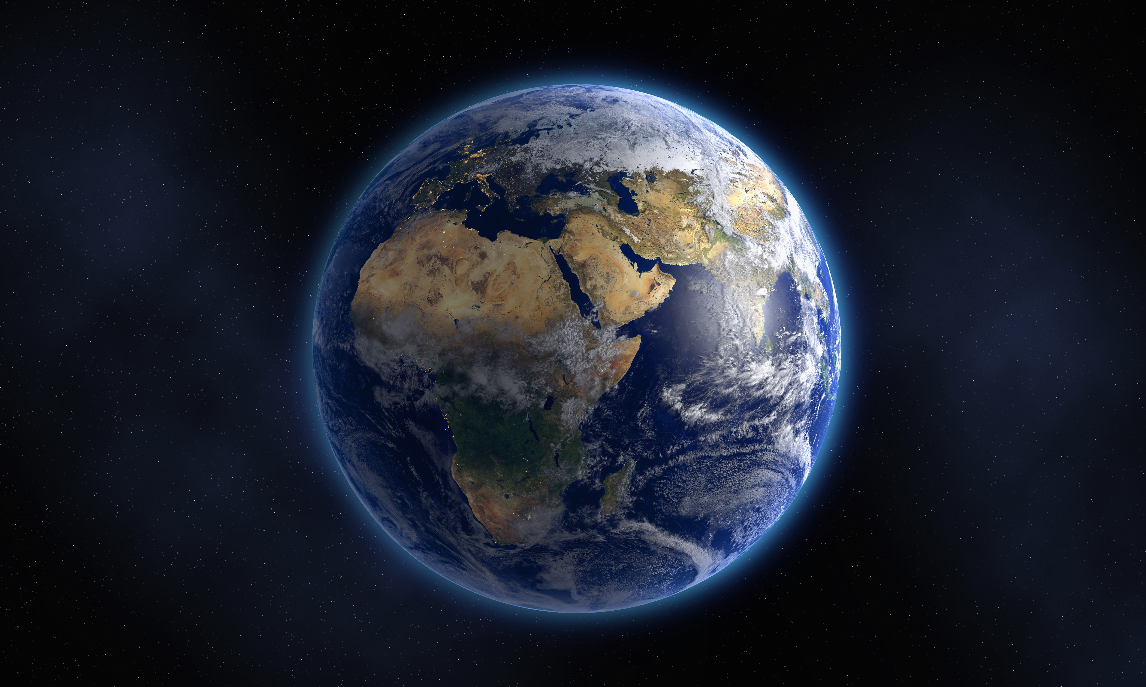
Generous and Grateful

Slide 2
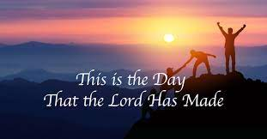
This is the day
https://www.youtube.com/watch?v=YMlQJWMu0gA

Slide 3
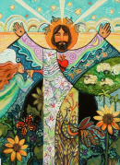
What images of God’s creation do you see in this artwork?

Slide 4
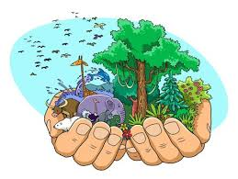
Create your own image of the creation narrative or one of your favorite part of creation.

Slide 5

The Butterfly Song
https://www.youtube.com/watch?v=tUvgOTsPkzc

