Slide 1
Animals, Including Humans
Amazing me – Biology

Slide 2

Lesson 1
L.O: To identify common features and compare similarities and differences.

Slide 3
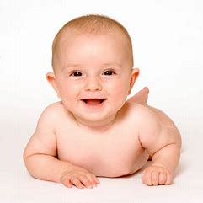
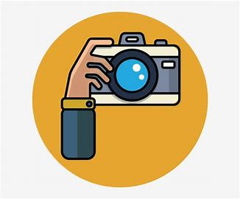
Have a look through our time tunnel. Use the numbers of sheets to guess who you think the baby is?
You will have 20 minutes.

Slide 4
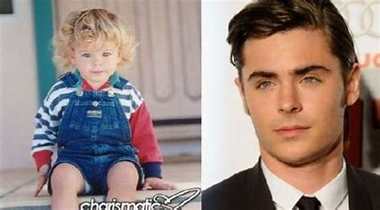
Matching Pairs Game
You need to match the baby photo to the correct adult.
Can you guess which baby photos belongs to which adult?

Slide 5
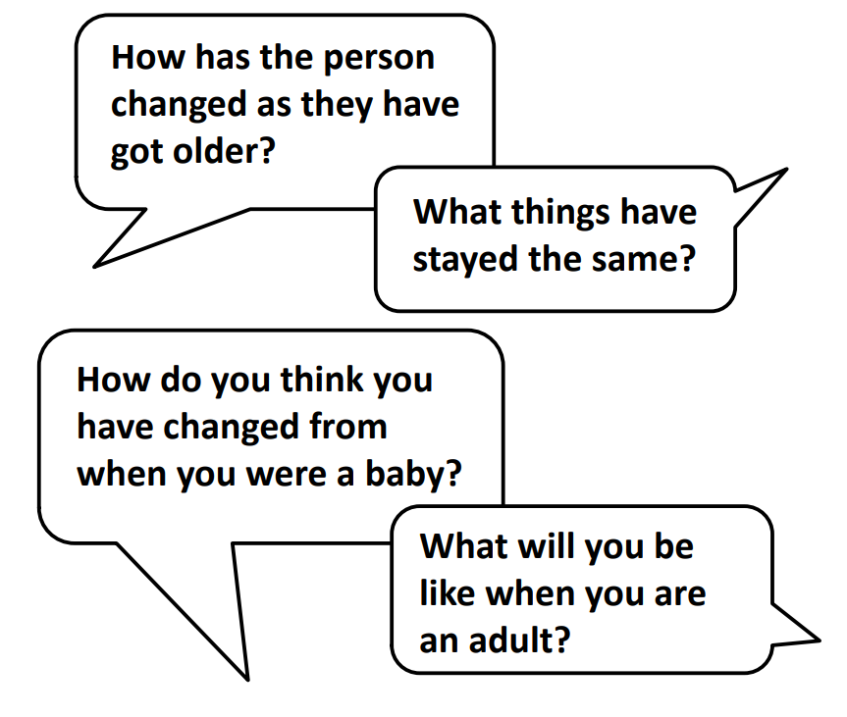
Matching Pairs Game
Think about these questions.

Slide 6
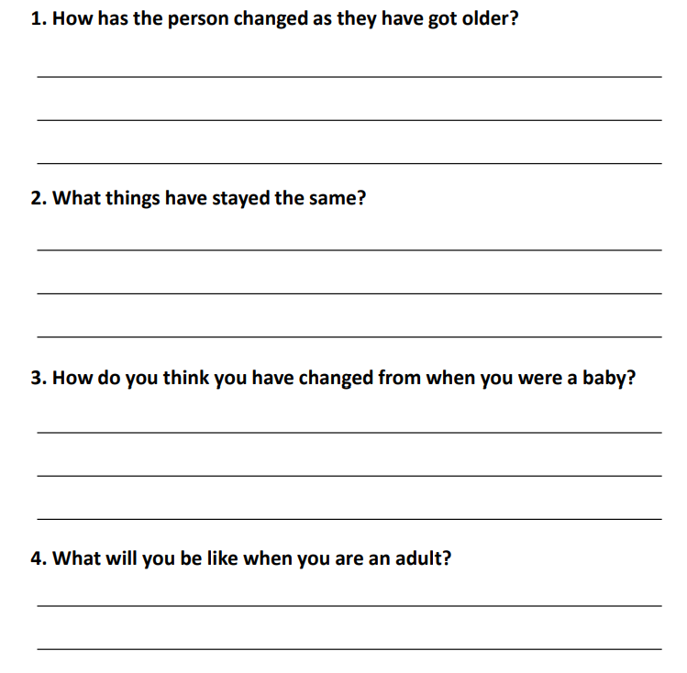

Slide 7
Lesson 2
L.O: To name parts of their bodies and collect information about their bodies by observing, measuring and noticing patterns.

Slide 8
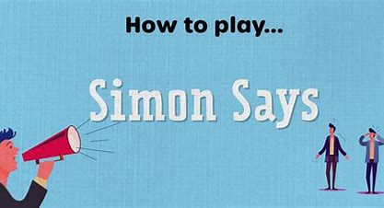
Simon said

Slide 9
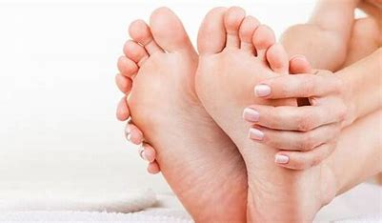
Do people with larger feet need larger gloves?

Slide 10
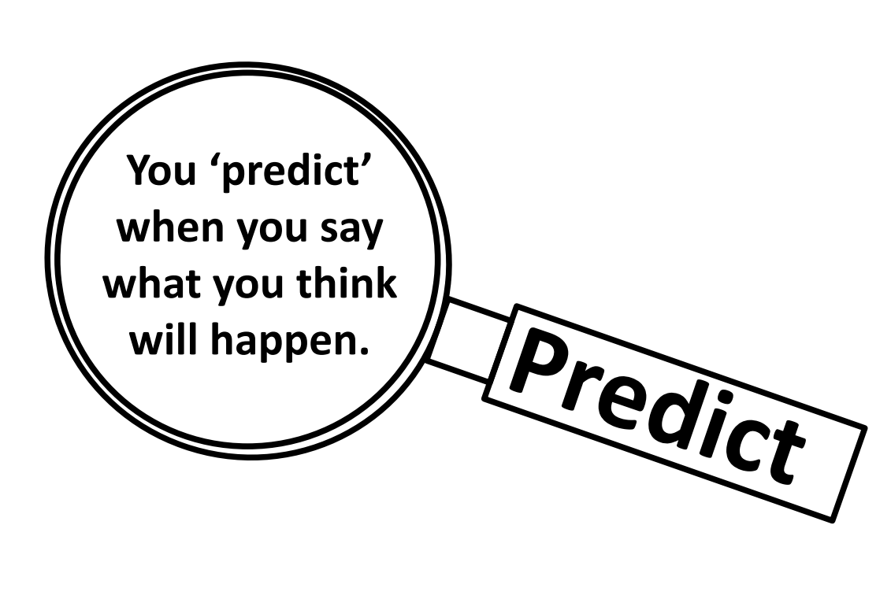


Slide 11
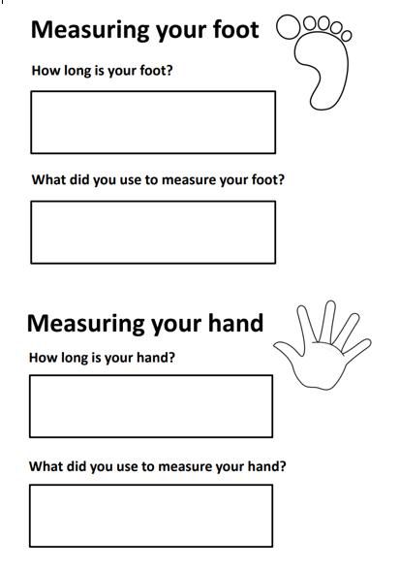
In partners measure your foot and hand.

Slide 12
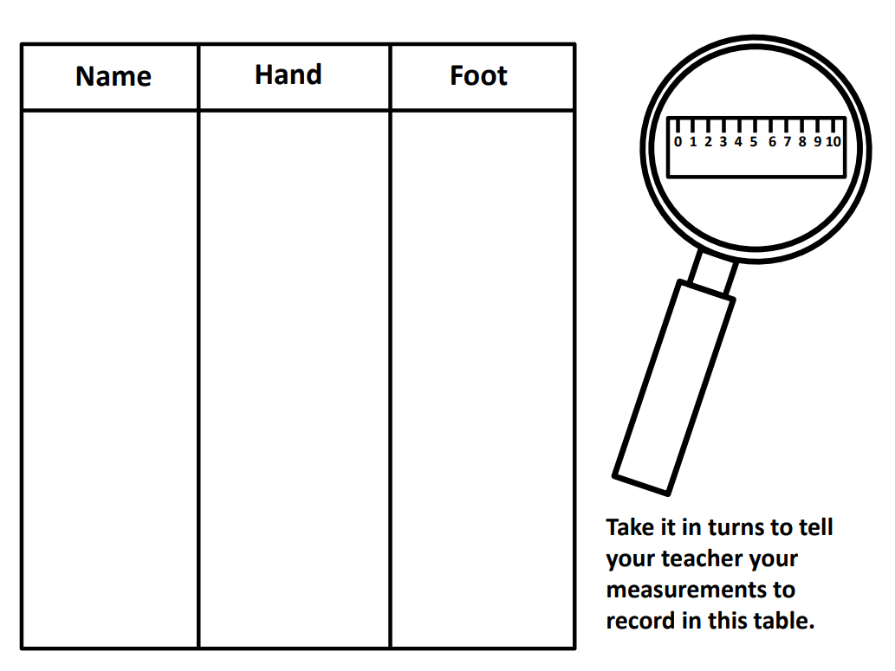
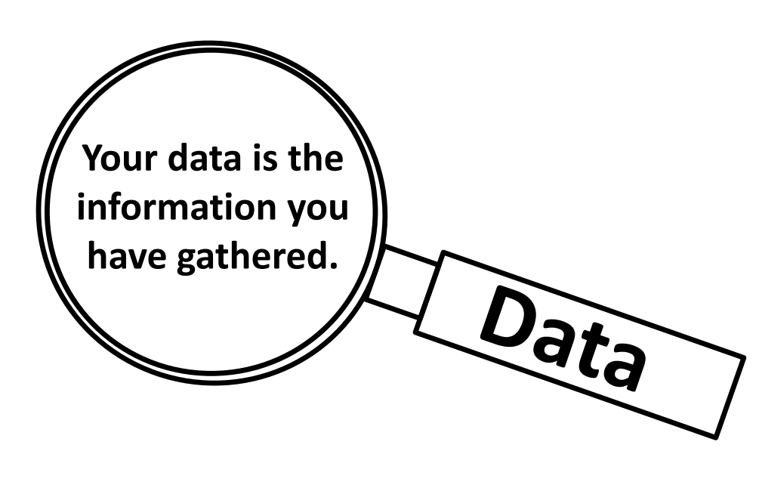

Slide 13
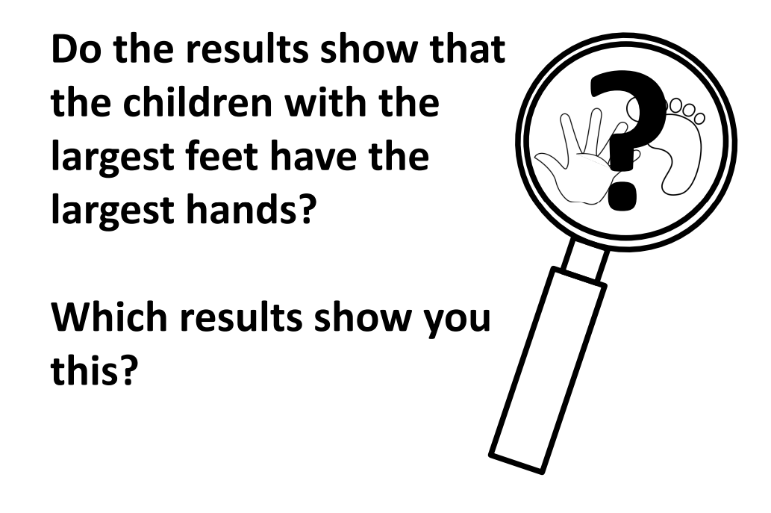

Slide 14

What surprised you the most?

Slide 15
Lesson 3
L.O: To understand that we hear sounds with our ears and that hearing is one of our senses.

Slide 16

https://www.bbc.co.uk/teach/school-radio/eyfs-listening-skills-sound-story/zhq792p
What part of your body are you listening with?

Slide 17
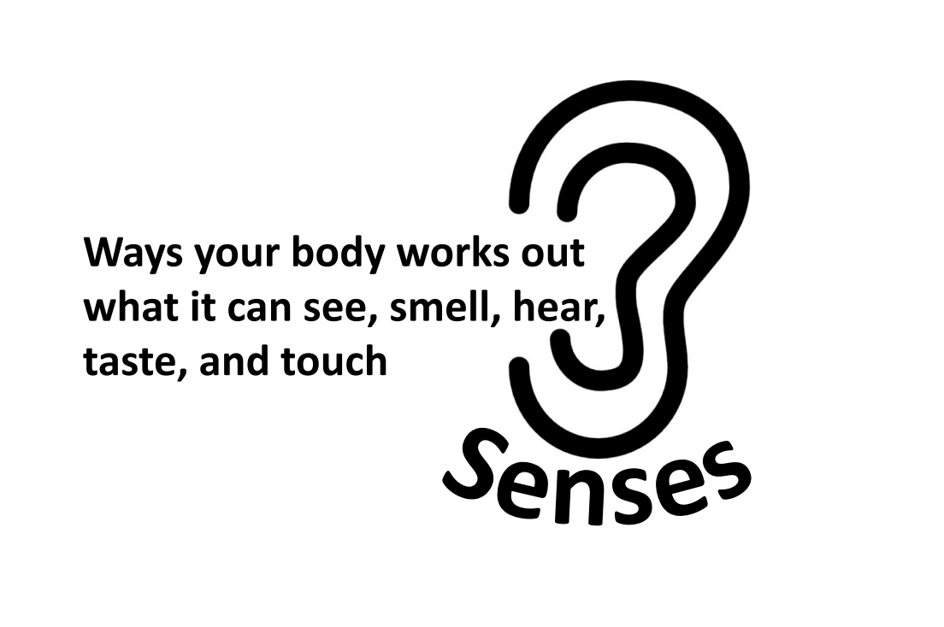

Slide 18
Go to the Playground!
Investigation –Hearing the whistle

Slide 19
What questions did we come up with?
What were our answers.
As a class write these down.

Slide 20
Lesson 4
L.O: To understand that we use our senses to classify things into groups.

Slide 21

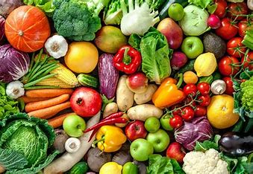
Do you like any of these foods?
Does anyone like green fruits?
Can anyone think of a fruit or veg which is crunchy?
What does the skin feel like?
What does it sound like when you tap it with your fingers?
Does anyone have one with bumpy skin?

Slide 22
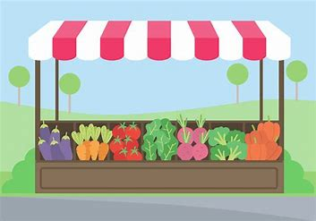
Creating a market stall
You need to create a banner that categories the fruit and veg.
It could be:
‘soft and hard foods’
‘Get your shiny and bumpy food’

Slide 23
Lesson 5
L.O: To understand that we have different ways of exploring the world and that often our sense work together to help us do that.

Slide 24
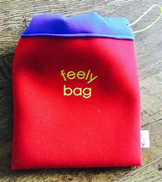
Feely bag

Slide 25
We are going to go outside and explore the world. However, you will only have one sense to use.
E.g if you get sight you will only be able to look at things and not be able to feel anything.

Slide 26

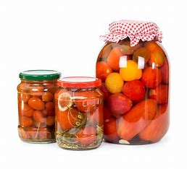
We are now going to explore the sense of smell.

Slide 27
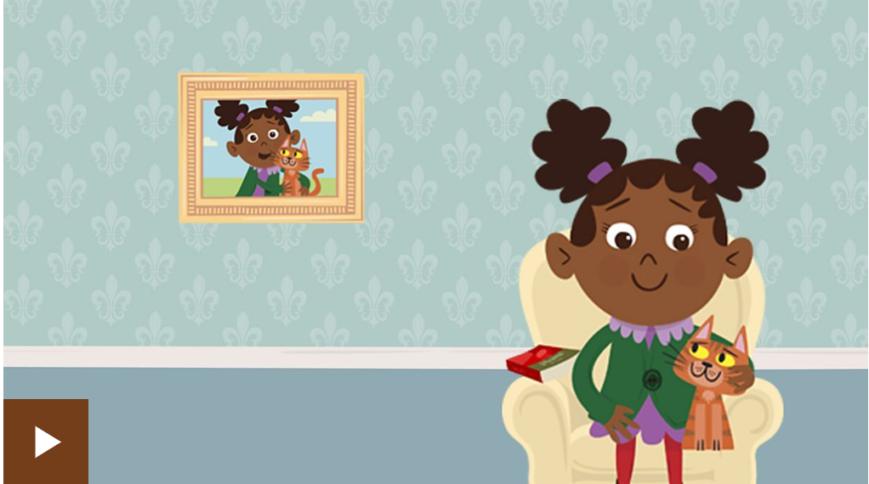
https://www.bbc.co.uk/bitesize/topics/zqbxqfr/articles/zxy987h

Slide 28

Lesson 6
L.O: To design a balanced lunch box on paper to serve as a reminder of how much food each food group is required for a balanced lunch.

Slide 29
Sample different foods

Slide 30
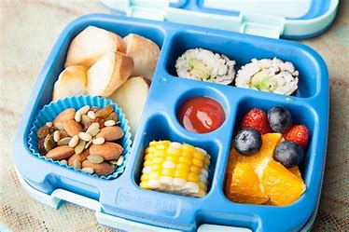
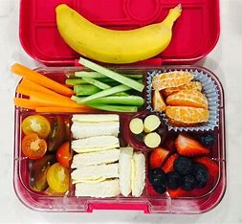
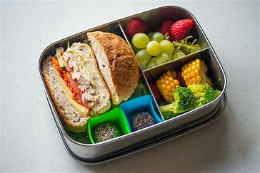
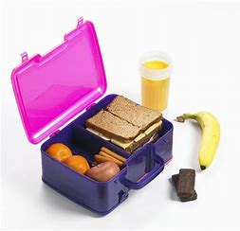
Lunch boxes

Slide 31
