Slide 1
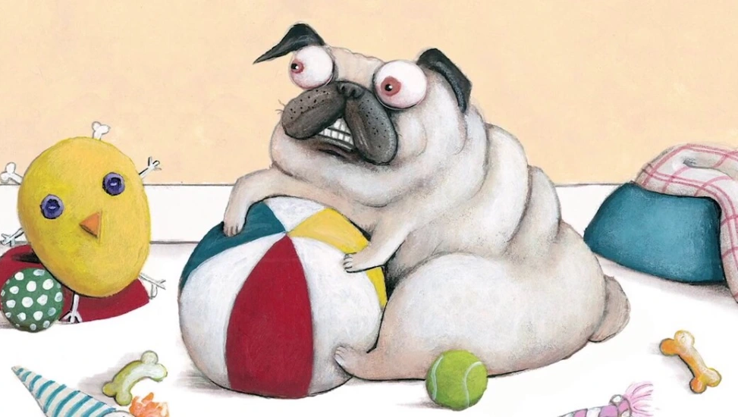
Pig the Pug
BY Aaron Blabey KS1 Spring 2024

Slide 2
LO: 1) To correctly punctuate a question with a question mark.
To predict what might happen on the basis of what has been read so far
To use ‘and’ and question marks (?)
I can guess what might happen in a story

Slide 3
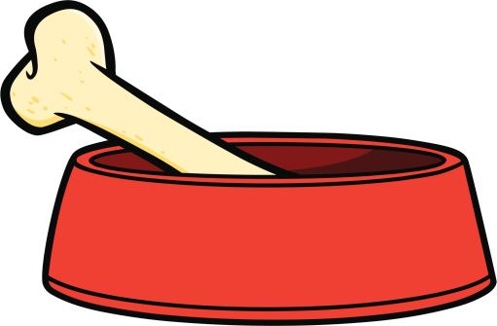
MINE

Slide 4
Questions

Slide 5
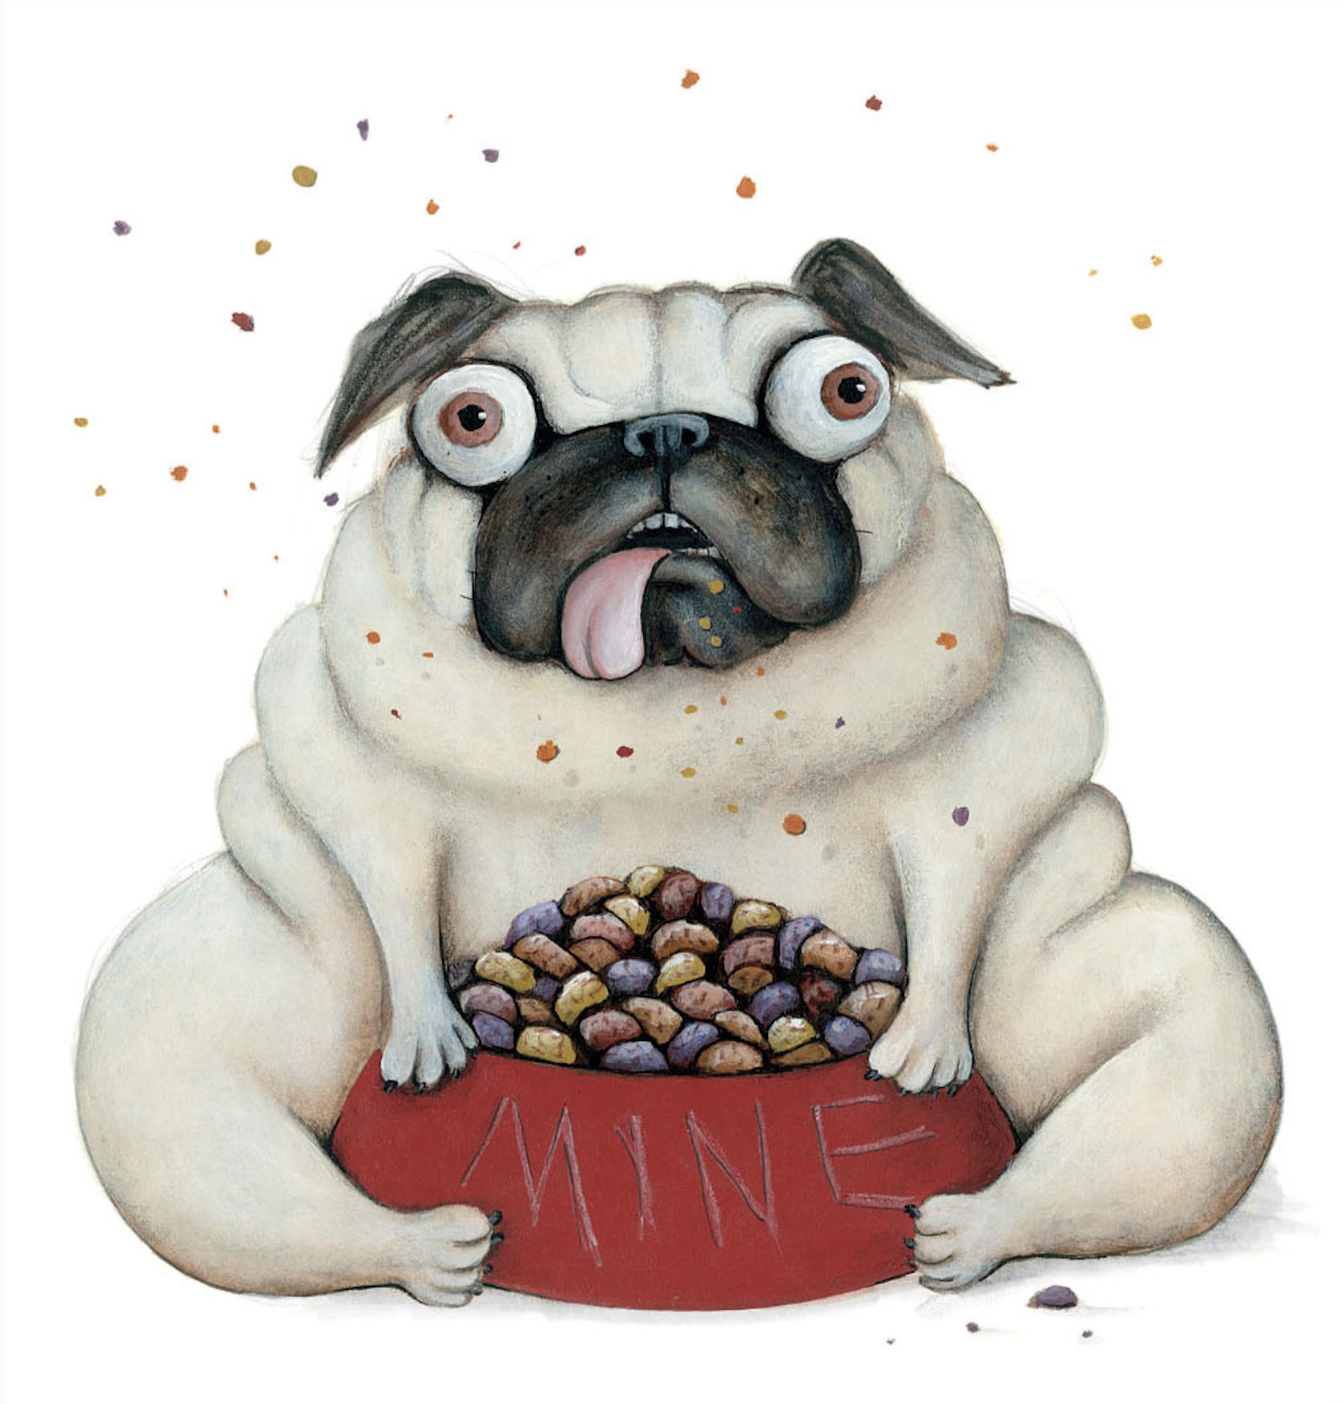
Pig the Pug
I’m Pig and I don’t like to share. All of the toys are MINE!!!

Slide 6
Notes:
Read book.
What might happen next?

Slide 7
Notes:
Role on the wall

Slide 8
Pig is greedy.
Pig is selfish.

Slide 9
Pig is greedy and Pig is selfish.

Slide 10
Examples

Slide 11
What do you think Pig learnt through what happened to him?

Slide 12
LO: 2) To be able to read and write words prefixed with ‘un’.
To infer meaning from the text
I can use ‘but’ in a sentence
I can use the prefix –un

Slide 13
Notes:
Read book
What does Pig do and what does he say?
How might we describe him?

Slide 14
Fair
Nice
Caring
Friendly
Helpful
Selfish
Kind
Selfless
Greedy
Prefixed with ‘un’
Not prefixed with ‘un’

Slide 16
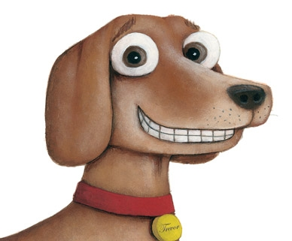

Slide 17
Comparing Pig and Trevor
E.g.,
Pig is greedy but Trevor is kind.

Slide 18
LO: 3) To identify vowel digraphs which have been taught and the sounds which they represent.
To participate in performances
I can read and write vowel digraphs
I can take part in performances

Slide 19
And with that he proceeded to gather his stuff and make a big pile with a huff and a puff.

Slide 20
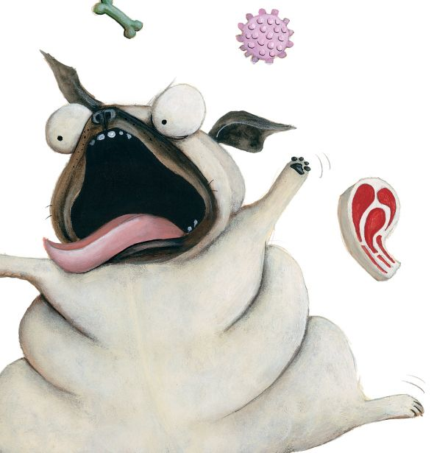
And with that he proceeded to gather his things and
make a big pile with a dring and a tring.

Slide 21
Examples
A

Slide 22
Example Poem
And with that he proceeded to gather his things and make a big pile with a dring and a tring.
And with that he proceeded to gather his toys and make a big pile with a floy and a bloy.
And with that he proceeded to gather his stuff and make a big pile with a rough and a crough.
That greedy pug called Pig.

Slide 23
Class Poem
And with that he proceeded to
and make a
And with that he proceeded to
and make a
And with that he proceeded
and make a
That

Slide 24
Who would like to share?

Slide 25
LO: 4) To listen to and discuss non-fiction at a level beyond which they can read independently.
I can find out facts from information books

Slide 26
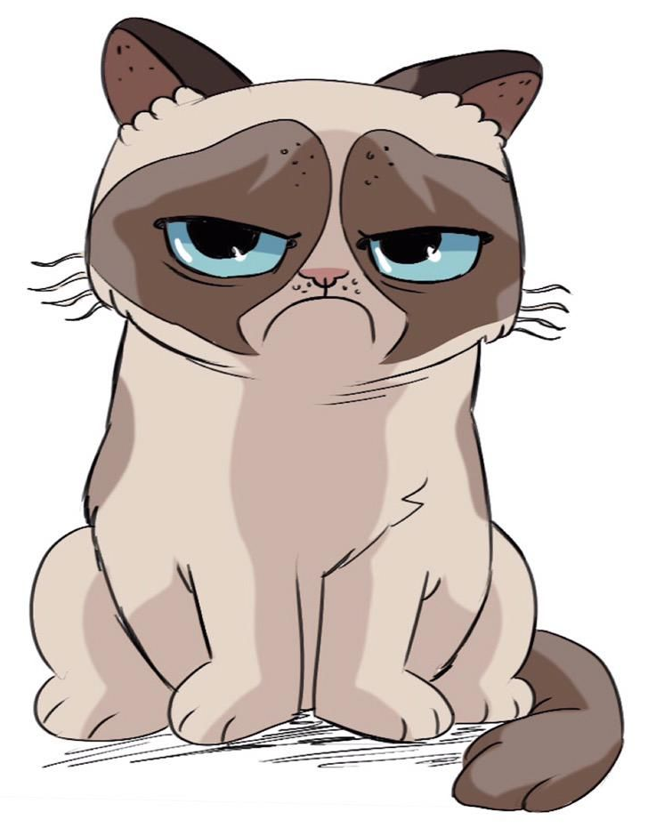
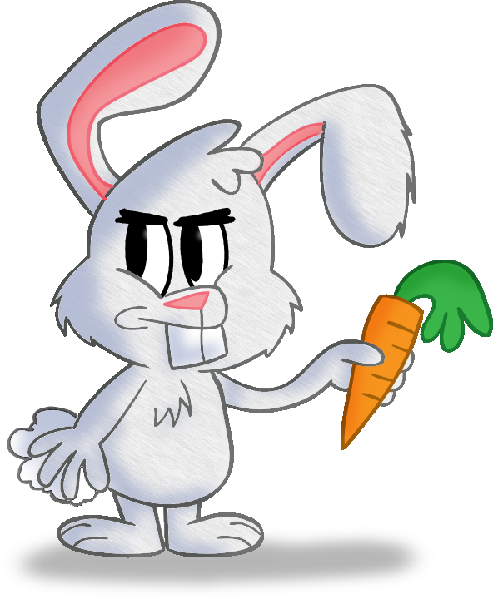
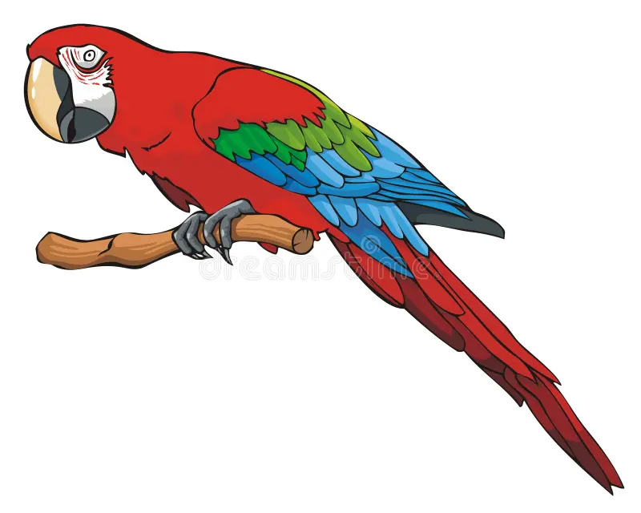
Choose a cat, parrot or rabbit.
Scratch the cat
Peck the parrot
Thump the rabbit

Slide 27
What do they eat?
Do they sleep?
How do they exercise?
What do they play with?

Slide 28
How could your pet have an accident?

Slide 29
LO: 5) To say out loud what they are going to write about.
I can talk about my story ideas

Slide 30
3. One day pig piles all of his things together
2. Pig lives with Trevor
4. Pig falls out of the window
1. Pig is a greedy dog who doesn’t share
5. Now Pig shares with Trevor

Slide 31
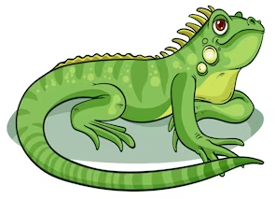
Bully the lizard

Slide 32
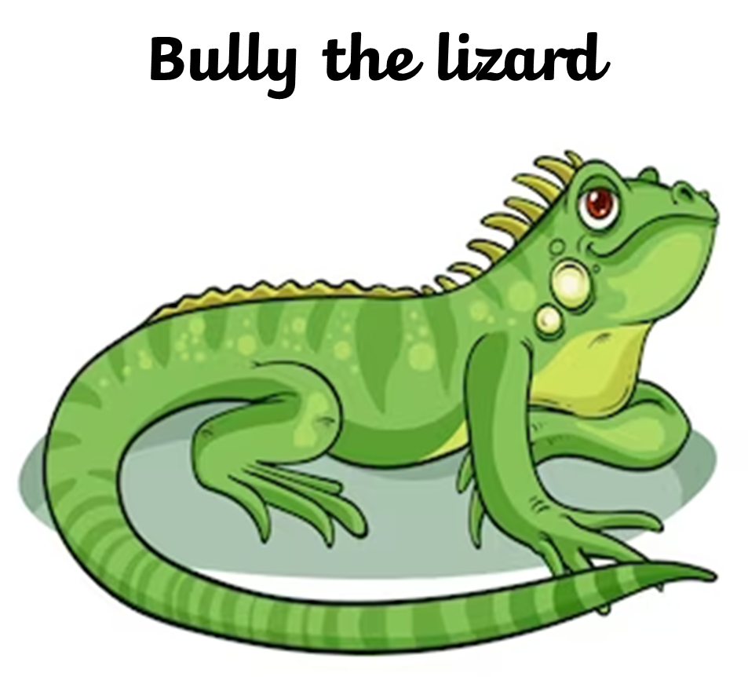
One day…
When suddenly…
Now…
One day Bully
Bully
Bully
Bully
Now Bully

Slide 33
3. Dilemma
2. Build up
4. Resolution
1. Opening
5. Closing

Slide 34
Who would like to share their story?

