Slide 1
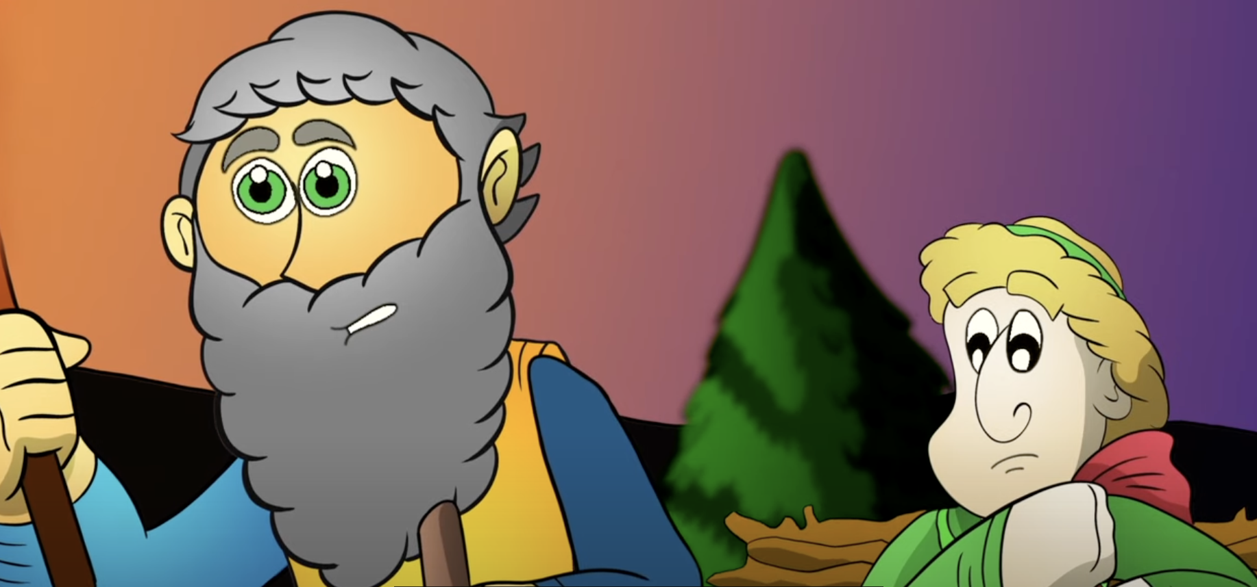
Tuesday 17th September 2024
LO: Create a comic strip explaining the story of Abraham and Isaac.
SC: Listen to the story of Abraham and Isaac.
Identify how Abraham and Isaac may have felt.

Slide 2
The Big Question
’Why do you think God asks His people to do difficult things?’
Key Words:
Abraham
Isaac
God
Difficult

Slide 3
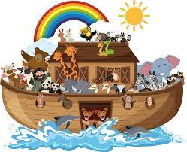
Recall
Thinking back to the story of Noah’s Ark:
What is a promise?
What promise did Noah make to God?

Slide 4
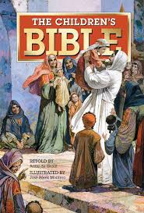
Abraham and Isaac
Let’s be Bible Detectives and find the story of Abraham and Isaac.
Let’s listen to the story of Abraham and Isaac.
https://www.youtube.com/watch?v=8QTk848O-yQ

Slide 5
Abraham and Isaac
Why do you think Abraham was chosen by God?
How do you think Isaac felt when he found out Abraham’s plan?
Did Abraham do what God asked him?
Why did he listen to God even though he loved his son Isaac?

Slide 6
Difficult Decisions
God sometimes calls upon His people to make difficult decisions so:
We can become closer to God
Move away from sin
Experience pain and struggle

Slide 7
Main Activity
Create a comic strip to show the story of Abraham and Isaac.
Year 1:
Who is the story about?
What did God ask Abraham?
Where did Abraham and Isaac go?
How did Isaac feel?
Year 2:
Who is the story about?
What did God ask Abraham?
How did Abraham respond?
Where did Abraham and Isaac go?
What did Isaac have to do?
How did Isaac feel?

Slide 8
The Big Question
’Why do you think God asks His people to do difficult things?’

