Slide 1
Monday 9th September 2024
LO: To know that there are parts to the Bible
I wonder?
What does the word ‘Bible’ actually mean?
Key Words:
Gospel: God’s Word
Bible: Library of many books

Slide 2
The Bible
The Bible is split into two parts:
The Old Testament – first part of the Bible – tells the stories of the people and their relationship with God.
The New Testament – second part of the Bible – written after Jesus lived – tells stories of His miracles and teachings.
This unit of work, we are focusing on the Old Testament.
https://www.youtube.com/watch?v=bKZoWiY5crs

Slide 3
The Gospels
Gospels – The Gospels are the first four books in the New Testament and they are called and written by:
Matthew
Mark
Luke
John.

Slide 4
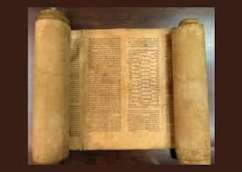
Jewish Scriptures
Scriptures are sacred writings of a religion.
These scriptures were written in Hebrew on scrolls.
These scriptures were then translated into all languages so that we can read it today.
We need to be very careful with scriptures because they are very important and need to be looked after. Just like our Bible!

Slide 5
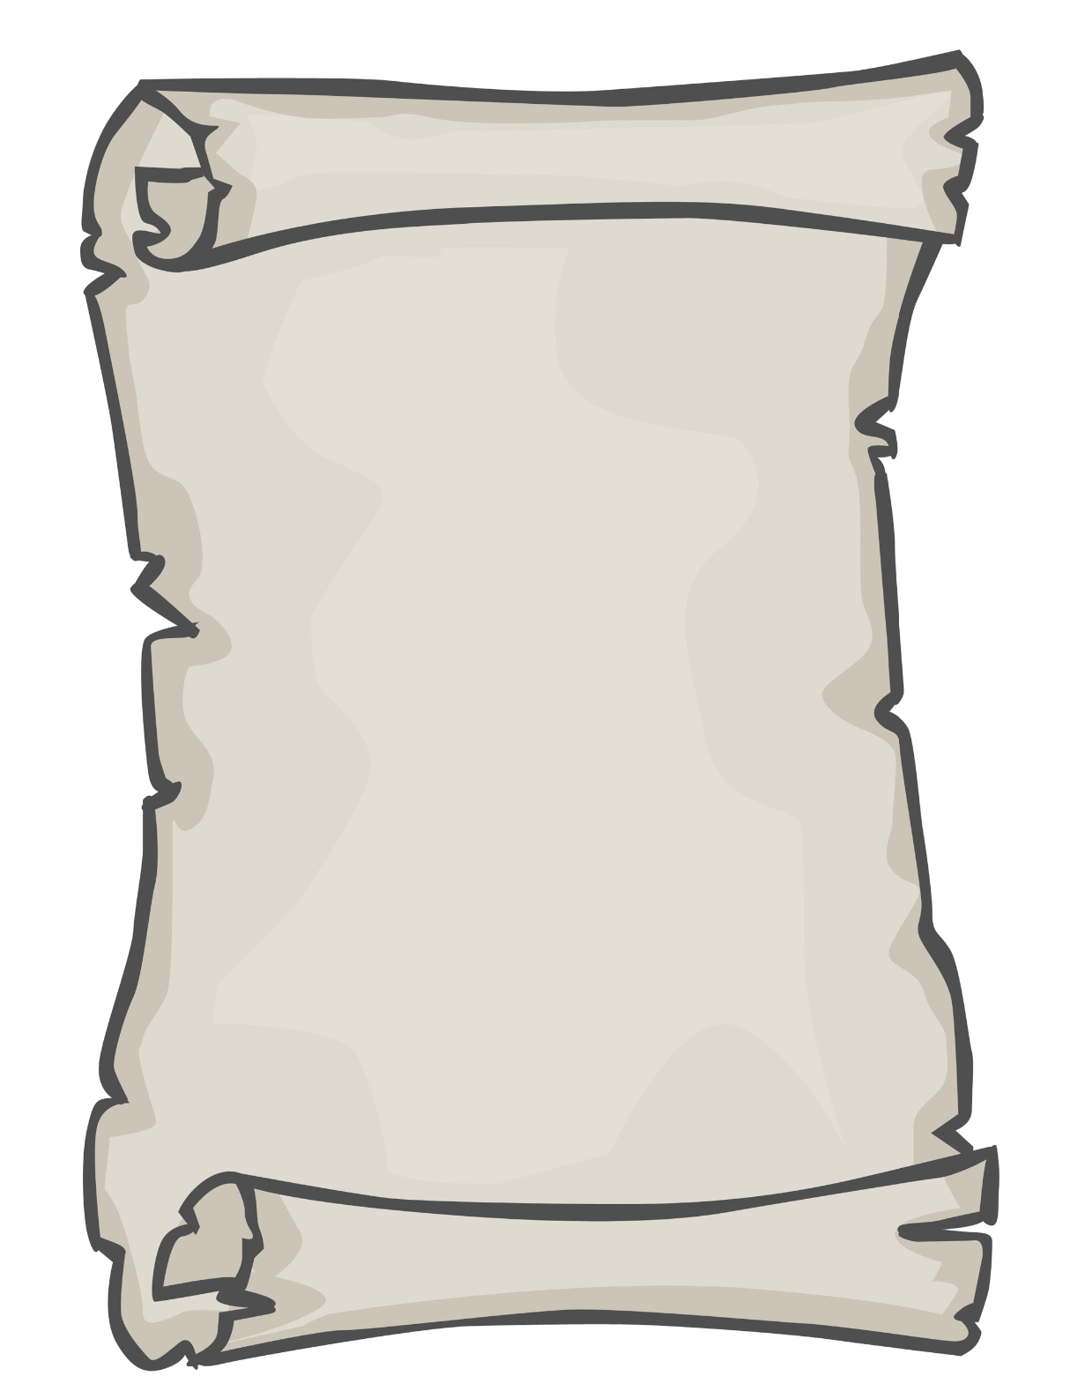

Activity
Today, we are going to make our own scriptures based on stories we know from the Bible.
Think back to FS or Year 1 to different stories you may know.
The Story of Creation
The Birth of Jesus
Easter

Slide 6
Wrap-Up
What is the Bible?
Who are the Gospels?
What are the Scriptures?

