Slide 1
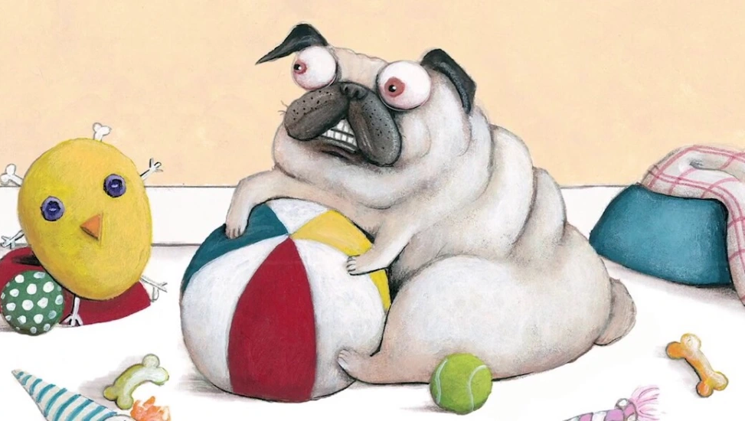
Pig the Pug
BY Aaron Blabey
KS1 Spring 2024

Slide 2

LO: 1) To correctly punctuate a question with a question mark.
To predict what might happen on the basis of what has been read so far
To use ‘and’ and question marks (?)
I can guess what might happen in a story

Slide 3
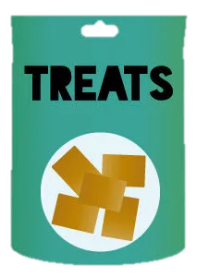

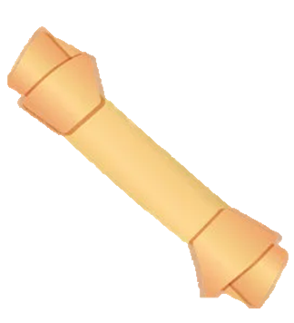

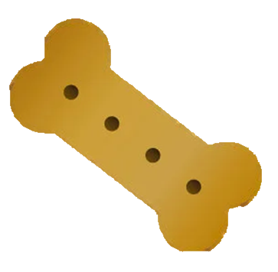
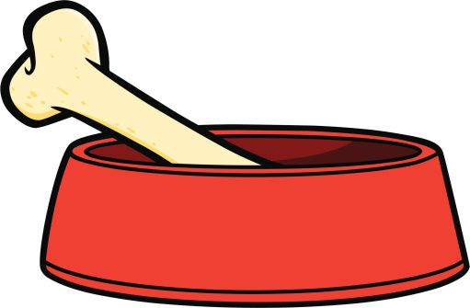

MINE

Slide 4
Questions
Who is Pig the pug?
Is he or she unfriendly?
Why does Pig look grumpy?
How old is Pig the pug?

Slide 5
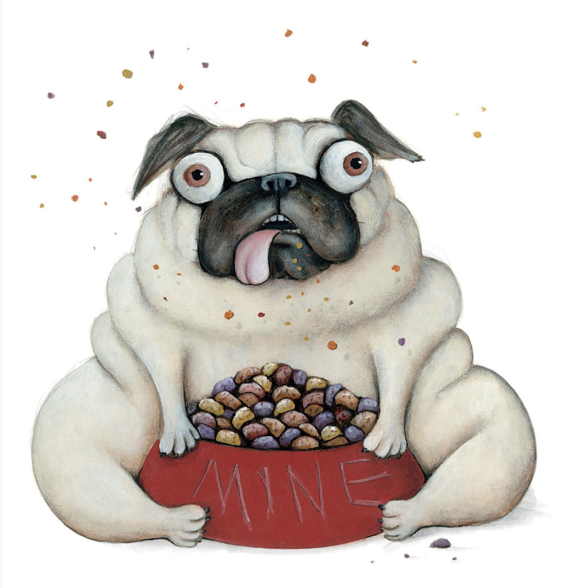
Pig the Pug
I’m Pig and I don’t like to share. All of the toys are MINE!!!

Slide 6

Notes:
Read book.
What might happen next?

Slide 7
Notes:
Role on the wall

Slide 8
Pig is greedy.
Pig is selfish.

Slide 9
Pig is greedy and Pig is selfish.

Slide 10
Examples
Pig is mean and Pig is unfriendly.
Pig is grumpy and he is unkind.
Pig is rude and he is unhappy.

Slide 11
What do you think Pig learnt through what happened to him?

Slide 12
LO: 2) To be able to read and write words prefixed with ‘un’.
To infer meaning from the text
I can use ‘but’ in a sentence
I can use the prefix –un

Slide 13
Notes:
Read book
What does Pig do and what does he say?
How might we describe him?

Slide 14
Fair
Nice
Caring
Friendly
Helpful
Selfish
Kind
Selfless
Greedy
Prefixed with ‘un’
Not prefixed with ‘un’

Slide 16
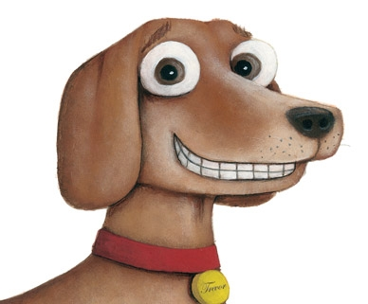

Slide 17
Comparing Pig and Trevor
E.g.,
Pig is greedy but Trevor is kind.
Pig is unfriendly but Trevor is friendly.
Pig is unkind but Trevor is kind.

Slide 18
LO: 3) To identify vowel digraphs which have been taught and the sounds which they represent.
To participate in performances
I can read and write vowel digraphs
I can take part in performances

Slide 19
And with that he proceeded to gather his stuff and make a big pile with a huff and a puff.

Slide 20
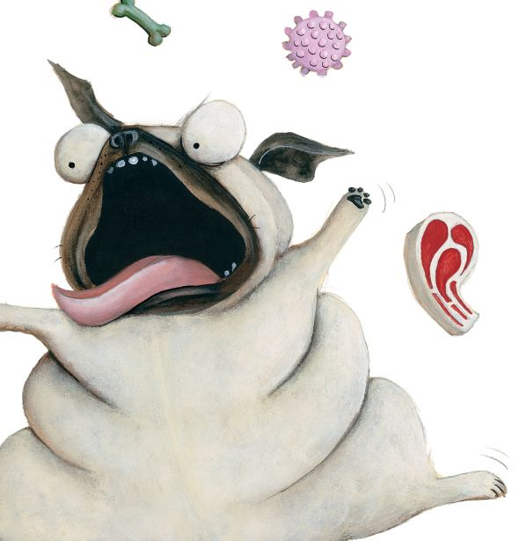
And with that he proceeded to gather his things and
make a big pile with a dring and a tring.

Slide 21
Example Poem
And with that he proceeded to gather his things and make a big pile with a dring and a tring.
And with that he proceeded to gather his toys and make a big pile with a floy and a bloy.
And with that he proceeded to gather his stuff and make a big pile with a rough and a crough.
That greedy pug called Pig.

Slide 22
Class Poem
And with that he proceeded to gather his treats and make a giant pile with a queat and a freat.
And with that he proceeded to gather his belongings and make a tall pile with a jelonging and a selonging.
And with that he proceeded to gather his toys and make an enormous pile with a koy and zoy.
That selfish pug called Pig.

Slide 23
Who would like to share?

Slide 24
LO: 4) To listen to and discuss non-fiction at a level beyond which they can read independently.
I can find out facts from information books

Slide 25
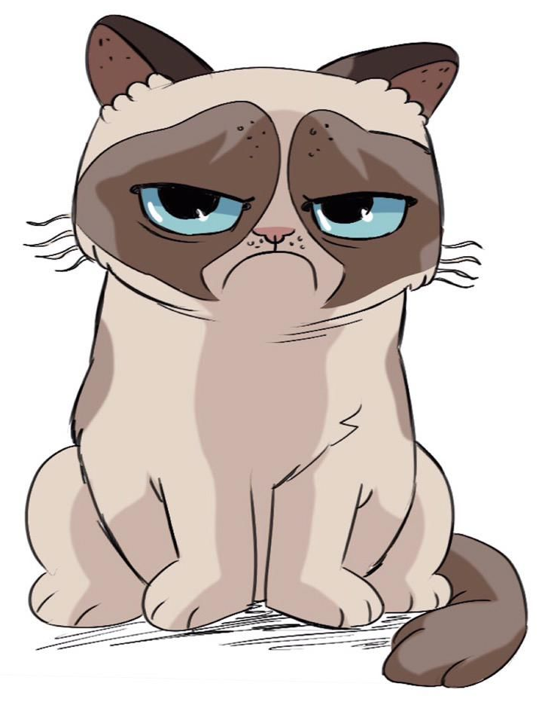
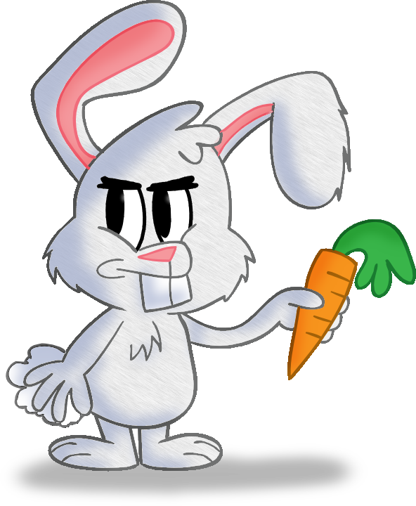
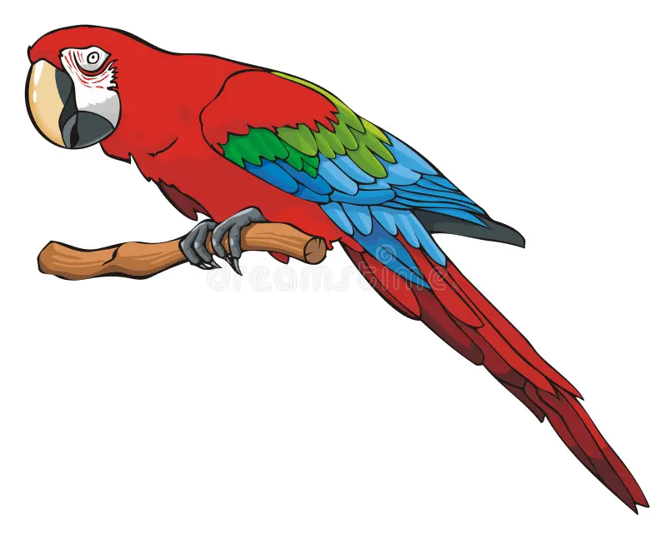
Choose a cat, parrot or rabbit.
Scratch the cat
Peck the parrot
Thump the rabbit

Slide 26
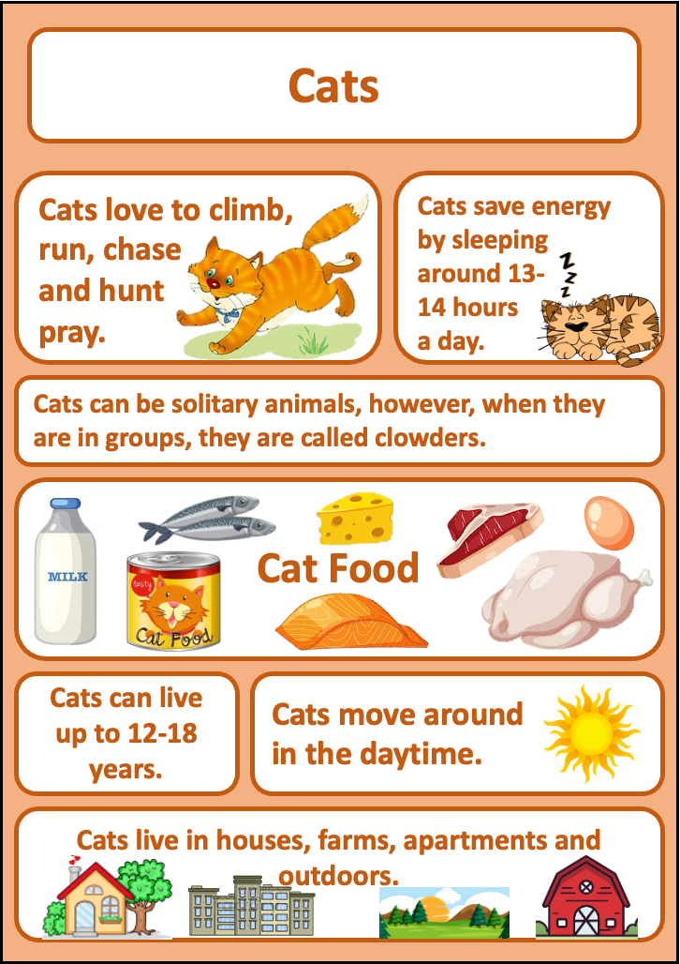
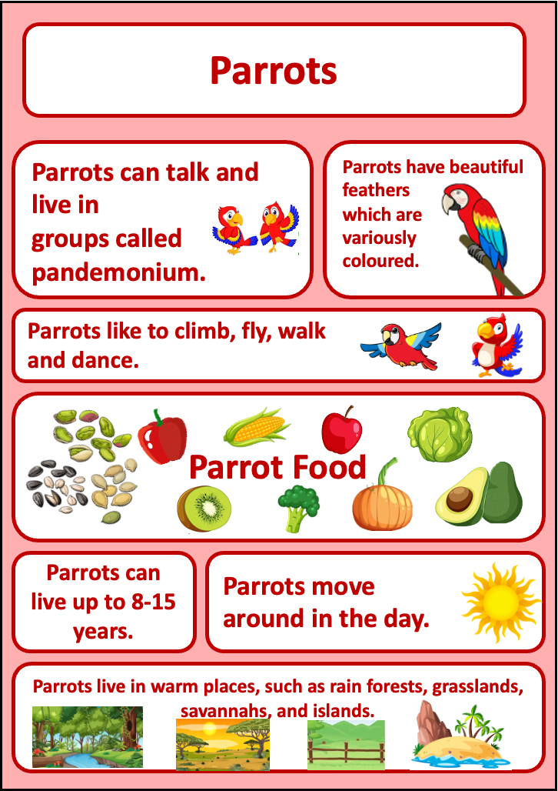
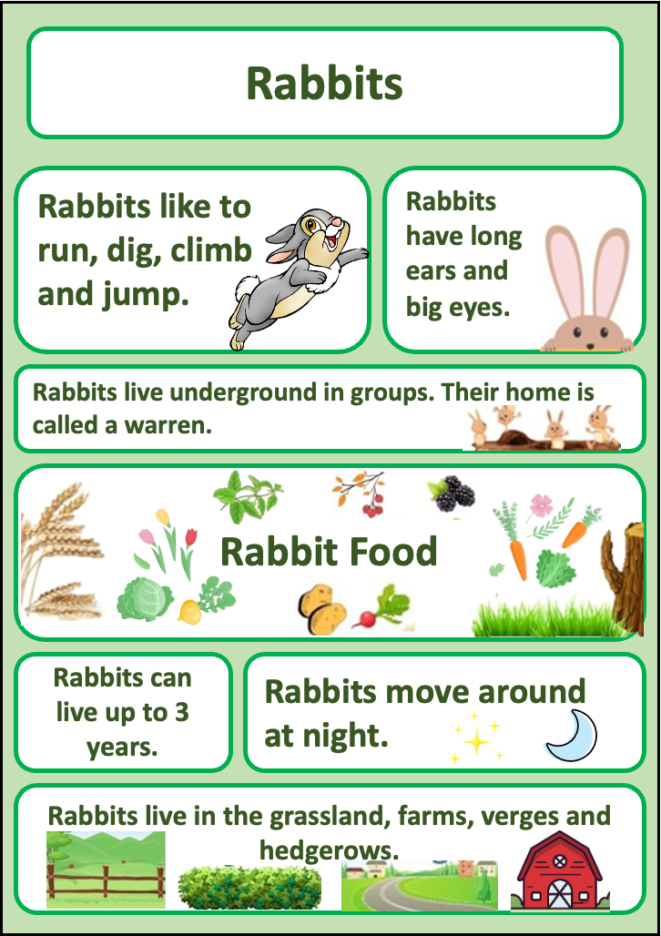

Slide 27
Questions
What do they eat?
When do they sleep?
What do they play with?
How do they exercise?

Slide 28
How could your pet have an accident?

Slide 29
LO: 5) To say out loud what they are going to write about.
I can talk about my story ideas

Slide 30
3. One day pig piles all of his things together
2. Pig lives with Trevor
4. Pig falls out of the window
1. Pig is a greedy dog who doesn’t share
5. Now Pig shares with Trevor

Slide 31
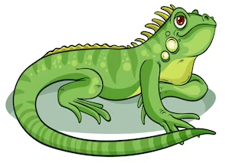
Bully the lizard

Slide 32
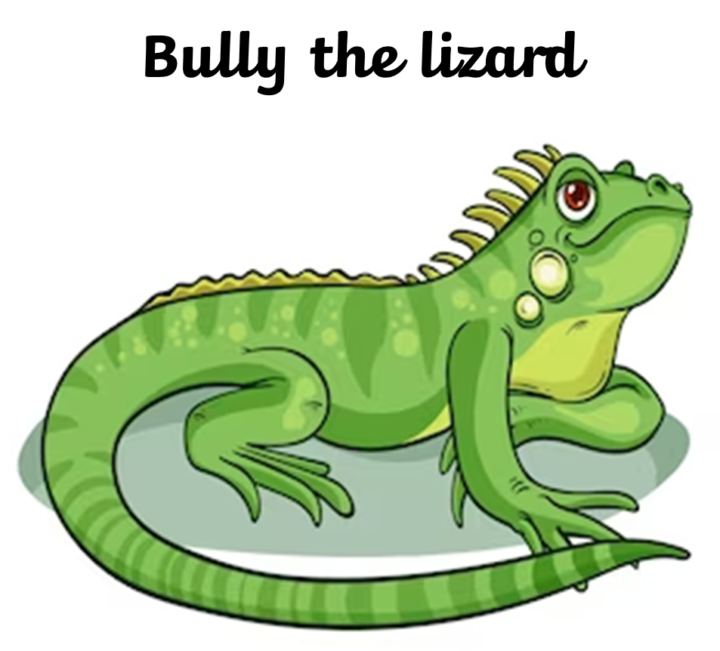
One day…
When suddenly…
Now…
One day Bully
Bully
Bully
Bully
Now Bully

Slide 33
3. Dilemma
2. Build up
4. Resolution
1. Opening
5. Closing

Slide 34
Who would like to share their story?

Slide 35
LO: 6) To sequence sentences to form short narratives
I can say what I’m going to write out loud
I can write a story
I can read and check what I have written

Slide 36
3. Dilemma
2. Build up
4. Resolution
1. Opening
5. Closing

Slide 37
One day…
When suddenly…
Now…
One day Bully
Bully
Bully
Bully
Now Bully

Slide 38
1. Opening
Bully was a lizard and he was unkind.
He lived with a gecko called Sprat.
But Bully did not share and he did not care.

Slide 39
Who would like to share their story?

Slide 40
LO: 7) To sequence sentences to form short narratives
I can say what I’m going to write out loud
I can write a story
I can read and check what I have written

Slide 41
2. Build up
One day, Bully was playing with all of his lizard toys.
Sprat thought it would be nice if they could play together but Bully was having none of it!
He was so very cross!
And with that he proceeded to gather his stuff and make a big pile with a rough and a crough.

Slide 42
Who would like to share their story?

Slide 43
LO: 8) To sequence sentences to form short narratives, using adverbs and adverbials
I can say what I’m going to write out loud
I can write a story
I can use adverbs/ adverbials to help sequence my ideas
I can read and check what I have written

Slide 44
What accident is your pet going to have?

Slide 45
Example Poem
And with that he proceeded to gather his things
and make a big pile with a dring and a tring.
And with that he proceeded to gather his toys
and make a big pile with a floy and a bloy.
And with that he proceeded to gather his stuff
and make a big pile with a rough and a crough.
That greedy pug called Pig.

Slide 46
When suddenly…

Slide 47
Example
When suddenly, Scratch the parrot wobbled and wibbled before falling into his water bowl! Plop!

Slide 48
3. Dilemma
When suddenly, Bully the lizard lunged and flailed before flying through the air and landing on his bottom! Ouch!

Slide 49
4. Resolution
Now Bully is kind.
Now he shares his toys with Sprat.

Slide 50
5. Closing
Will Bully be kind forever?

Slide 51
Who would like to share their story?

Slide 52
LO: 9) To use expanded noun phrases for description and specification
I can use noun phrases

Slide 53
Dear Children,
I wasn’t very kind when I lived with Trevor, was I?
But my fall taught me a
I’ve also been asked to write some more guides: How to be a cat, How to be a parrot and How to be a rabbit but I don’t know much about these
lesson and now I like to
share and play nicely. In fact, I have become such a kind and helpful dog that I was asked to write a guide on ‘How to be a Dog’.
pets.
Can you be kind and help me write these books please?
Kind wishes,
Pig xx

Slide 54
Example
Dear Pig,
Thank you for your friendly letter. I am so glad you are selfless and kind now. That’s brilliant news that you have been asked to write ‘How to be a Dog’. I would love to help by writing a guide called ‘How to be a lizard’. Do send our love to dear Trevor.
Best wishes,
Bully, the lovely lizard.

Slide 55
Who would like to share their letter?

Slide 56
LO: 10) To say out loud what they are going to write about
I can roleplay my ideas

Slide 57

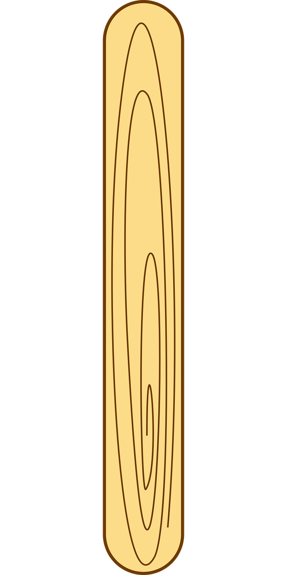
Take a lolly stick and the picture of your chosen animal to make a puppet of your animal.

Slide 58
What do they eat?
Do they sleep?
How do they exercise?
What do they play with?

Slide 59
Example
In the morning, I wake up and climb out of my den.
Then, I have a drink from my water bowl.
After that, I am feeling so hungry, that I eat my bowl full of mealworms.

Slide 61
Who would like to share their letter?

Slide 62
LO: 11) To be able to plan for a piece of non- fiction writing
I can draw a picture-plan

Slide 63
‘How to be a lizard’ guide

Slide 64
What do they eat?

Slide 65
How do they play and entertain their owner?

Slide 66
How and where do they sleep?

Slide 67
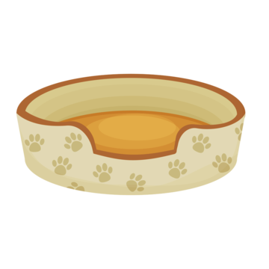
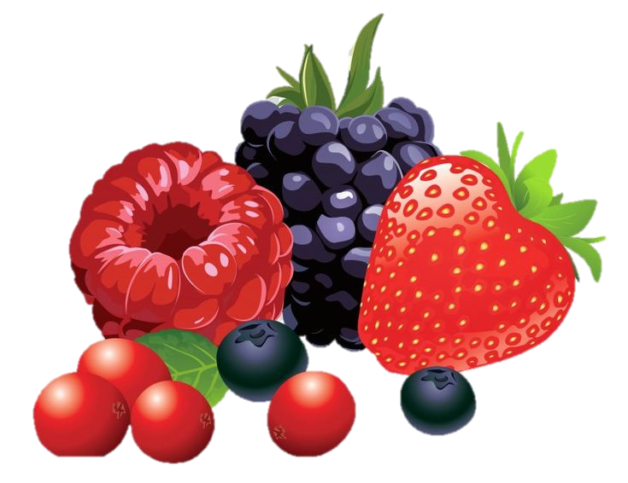
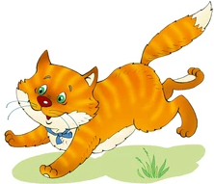
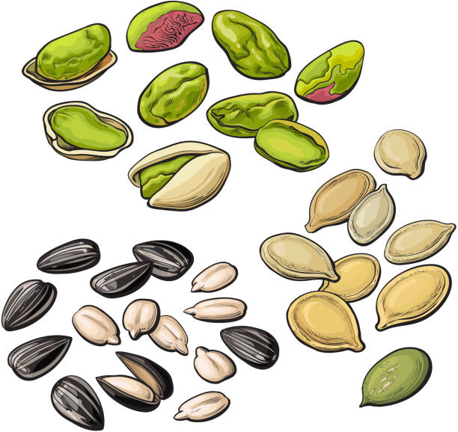
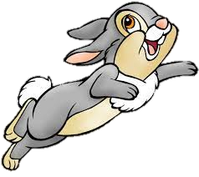

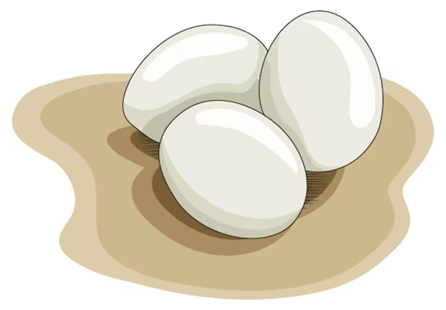
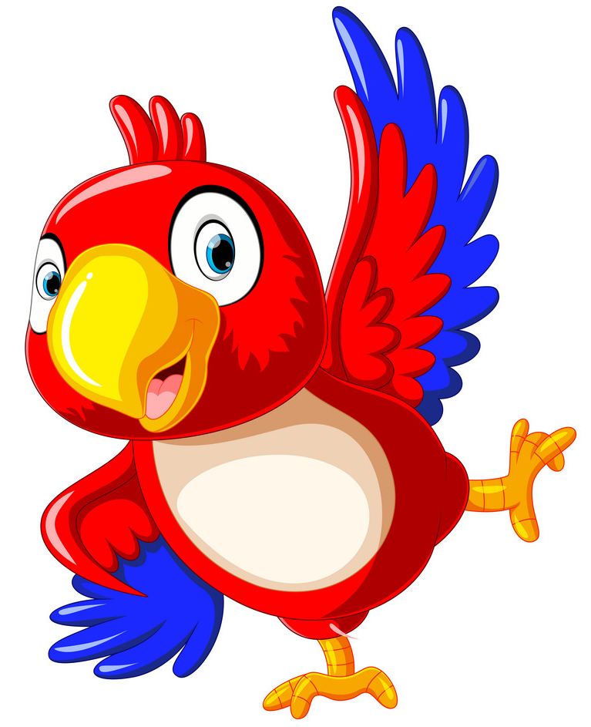
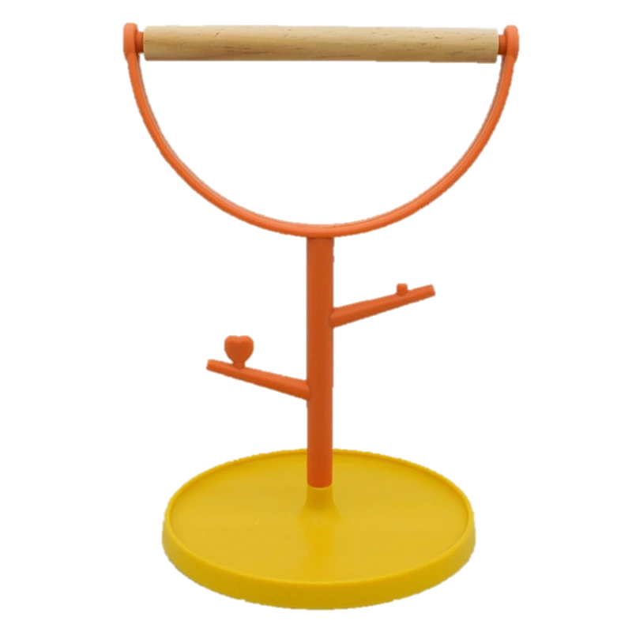
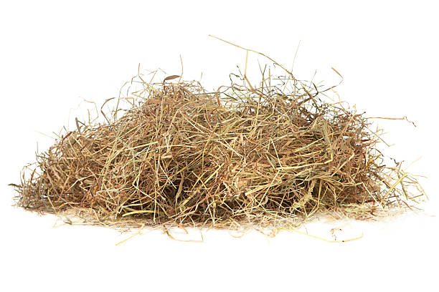
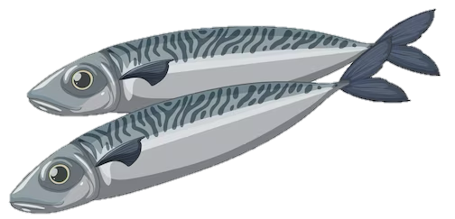
What to eat
Playing and entertainment
Where to sleep

Slide 68
LO: 12) To use expanded noun phrases for description and specification
I can describe a noun in a sentence

Slide 69



Slide 70
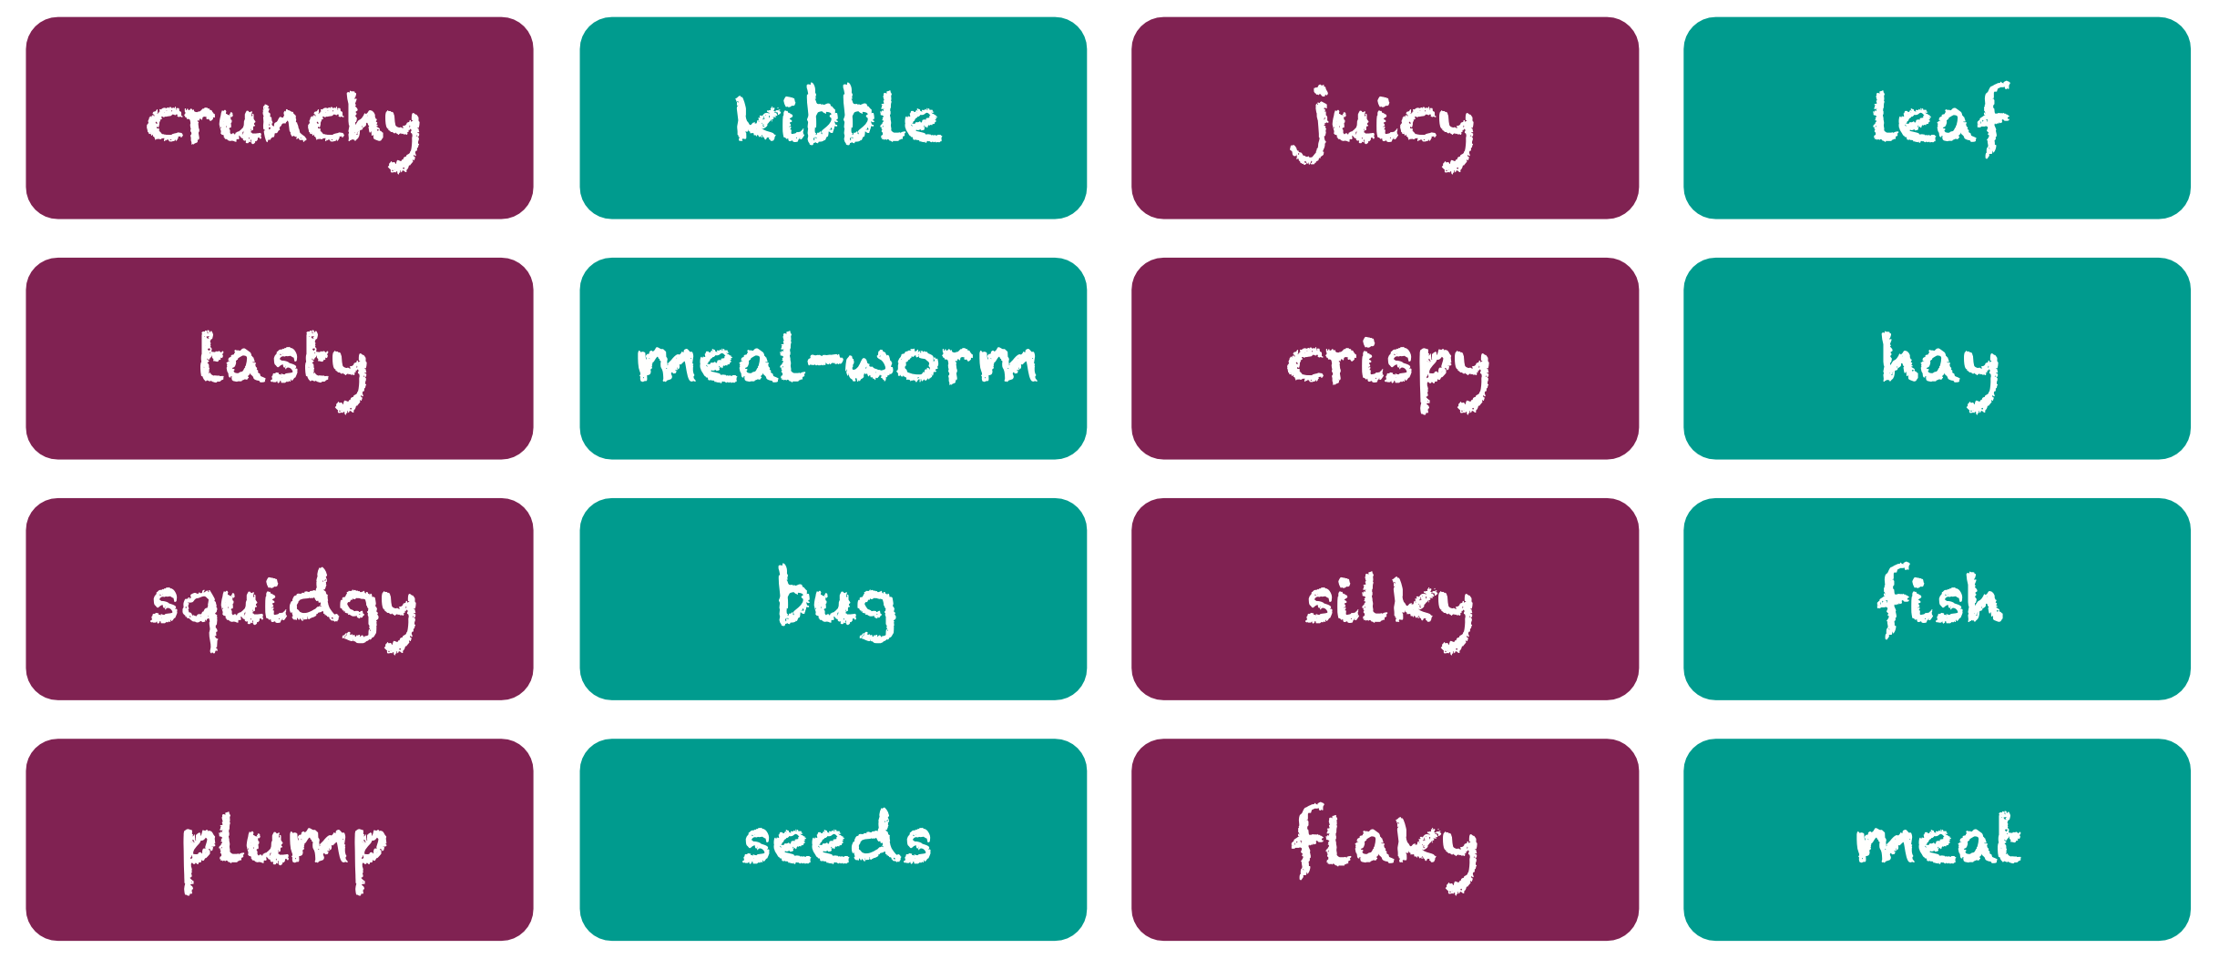

Slide 71
What to eat…
Good pets always eat tasty food.
In the morning, I like to eat one juicy leaf.
Then for a little snack in the afternoon, I will eat a squishy meal-worm or two.
It is always a good idea to learn how to make your eyes as big as possible so that your human feels sorry for you and feeds you extra.

Slide 72
What to eat…
Good pets always eat

Slide 73
LO: 13) To be able to read and spell words with the suffix -ing
I can read and spell ‘ing’ words
I can imagine what it is like to be an animal

Slide 74
Music
Musical statues

Slide 75
flying
munching
chirping
jumping
crunching
leaping

Slide 76
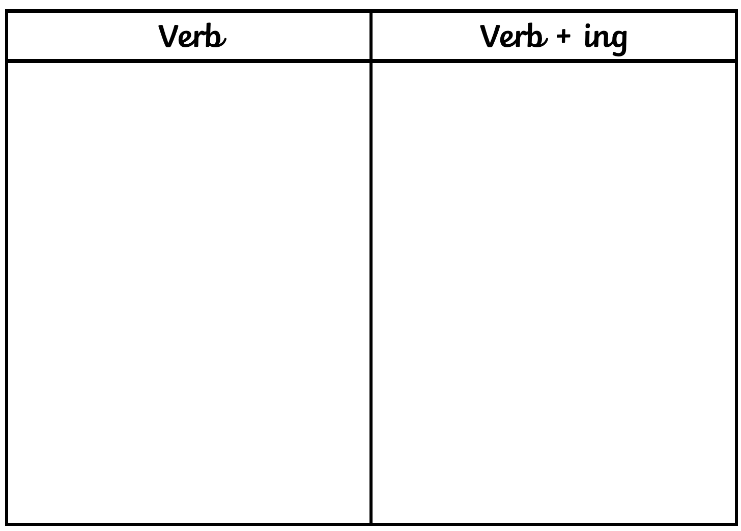
flying
munching
chirping
jumping
crunching
leaping

Slide 77
Playing and entertainment
You must keep your human happy by performing tricks and taking exercise.
I like hanging upside down on my log and leaping off into the bark.

Slide 78
Playing and entertainment
You must keep your human happy by…

Slide 79
LO: 14) To be able to use prepositions accurately
I can use positional language
I can read and write could and should

Slide 80
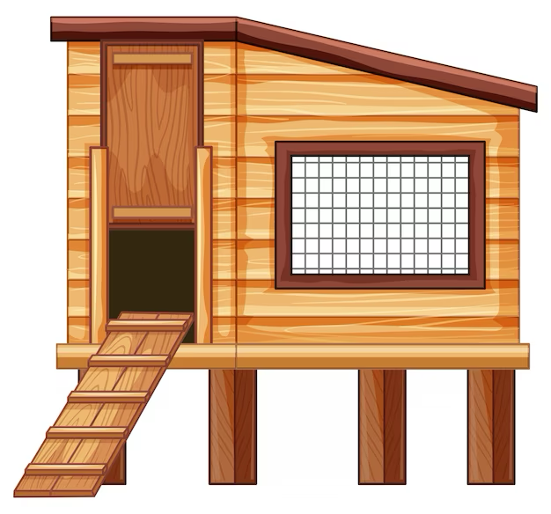
I like to sit…
I like to snuggle…
I like to rest…
I like to sleep…

Slide 81
Where to sleep
In the afternoon, I like to sit on my perch and sleep.
This really annoys my human as they bought me a nesting box that I never use.
You could sleep where your human would like you to, but under a bed, beside the fire and in between a wardrobe and a wall are great places too.

Slide 82
Where to sleep
In the afternoon, I like to

Slide 83
LO: 15) To be able to discuss what they have written with the teacher or other pupils
I can talk about what I have written with my friends

Slide 84
Introduction
Hello! Bully the lovely lizard here.
This is a guide to being the best pet you can be.
I’ll tell you how to eat well, find the best place to sleep and keep your human happy.

Slide 85
Introduction
Hello! Bully the lovely lizard here.
This is a guide to
I’ll tell you how to

