Slide 2
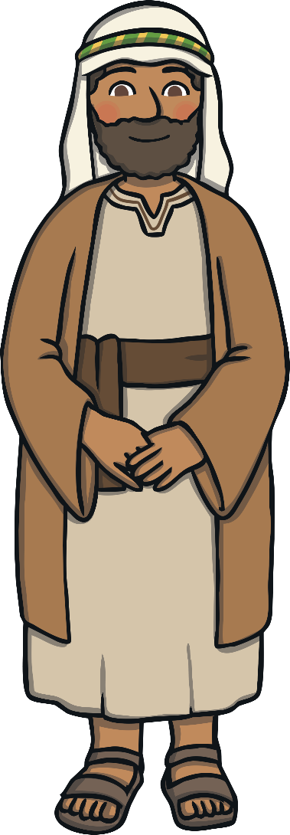
What is Advent?
Advent is the start of the Christian year.
It is a time for Christians to prepare for the celebration of the birth of Jesus.
It is also a time for Christians to look forward to a time when Jesus will come again.
The word ‘Advent’ comes from a very old word ‘Adventus’ which means the arrival of something or someone important.

Slide 3
When is Advent?
Advent is the four weeks before Christmas.
It starts on the nearest Sunday to November 30th.
Advent lasts until midnight on Christmas Eve.
Advent is a time for Christians to enjoy time with their families and friends.
It began in Germany over 250 years ago.

Slide 4
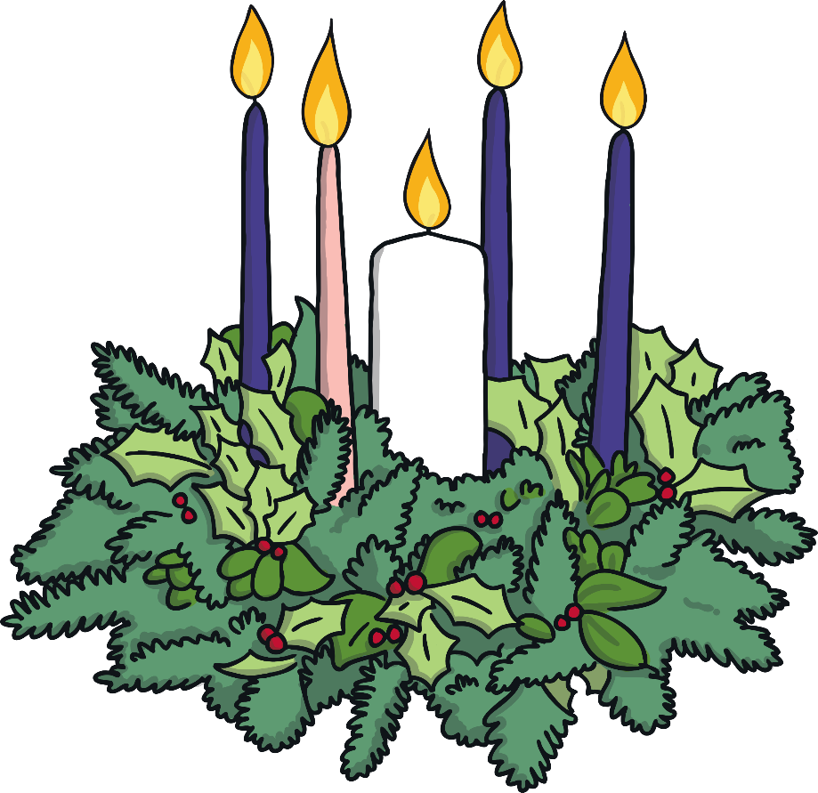
How is Advent Celebrated?
Churches display an Advent crown or Advent wreath during Advent.
There are four candles standing in the circle. In the centre there is a fifth candle.
During advent, in some churches there are no flowers
The Advent wreath is a circle of evergreen branches.

Slide 5
How is Advent Celebrated?
The circle of evergreen branches is a reminder that God does not change.
The candles remind Christians of the light of God.
A new candle is lit each Sunday during Advent until all four candles are burning. Each candle has a different meaning:
Hope
Peace
Joy
Love
The final candle is lit on Christmas day to celebrate the birth of Jesus.

Slide 6
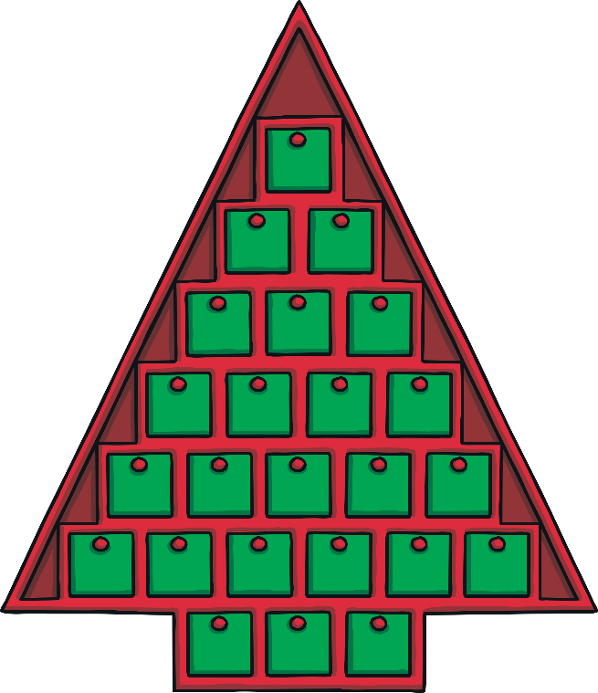
Advent Calendars
Advent calendars start on the 1st of December and countdown to Christmas Eve.
Each day a door is opened and shows a Christmas picture.
Some Advent calendars have a chocolate treat hidden behind each door!

