Slide 1
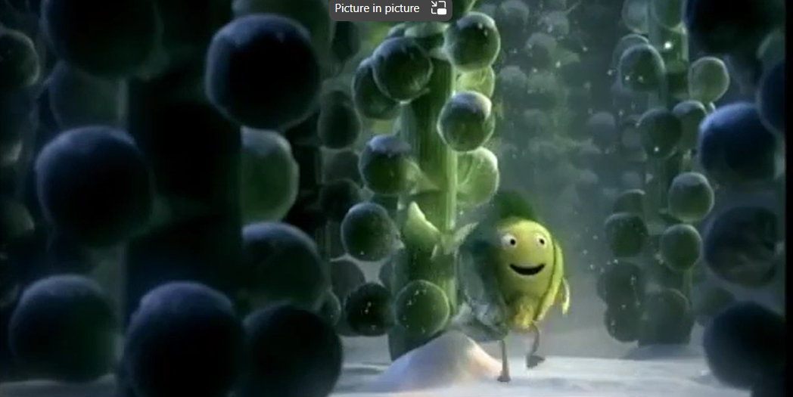
SPROUT BOY
Sproutboy - THE LITERACY SHED

Slide 2
Sprout Boy
'There once was a sprout with love to give.'
​ He is looking for friends to spend Christmas with.
Sadly, no one seems to like sprouts.

Slide 3
Learning opportunities: Sprout Boy
Collect words that rhyme with 'sprout.'
Use the collected words to create rhyming couplets.
Retell the story in the 3rd person detailing his journey and adding vivid description of each setting.
Introduce new characters who do not like sprouts - favourite book characters, members of school staff, the dinner ladies etc.
Follow the given rhyming pattern:

Slide 4
"A baker he met whilst out and about said, "I love Christmas pudding and would go without, but nobody ever liked a sprout."

Slide 5
KS! Writing Activities…
Retell the narrative in the 1st person detailing how the sprout feels in each section of the film.
Punctuate the speech, add replies from 'Sprout' and punctuate the dialogue accurately.
Write an opposites version of the tale - 'Everyone loves a sprout.'
Change the character - carrot, Yorkshire pudding, roast potatoes - Children can choose whether everyone loves or hates these new characters.
Adaptive Learning…
Word List
Opening Sentence
Storyboard using pictures as stimuli

Slide 6
Lesson Objectives…Sprout Boy
Monday27th November 2023 LO: To predict what will happen next in Sprout Boy. | Tuesday 28th November 2023 LO: To use adjectives to describe a character’s appearance. | Wednesday 29th November 2023 (Comprehension Focus) LO: To be able to write some open questions about Sprout Boy. | Thursday 30th November 2023 LO: To be able to write expanded noun phrases to describe a character | Friday 1st December 2023 LO: Retell the story (in the 3rd person) detailing his journey and adding vivid description of each setting

Slide 7
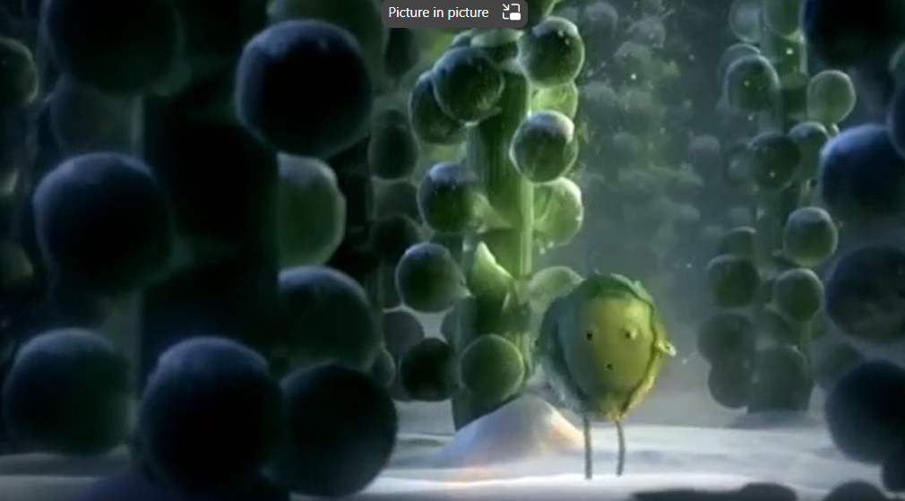
Sprout Boy

Slide 8
How does Sprout Boy feel now?

Slide 10
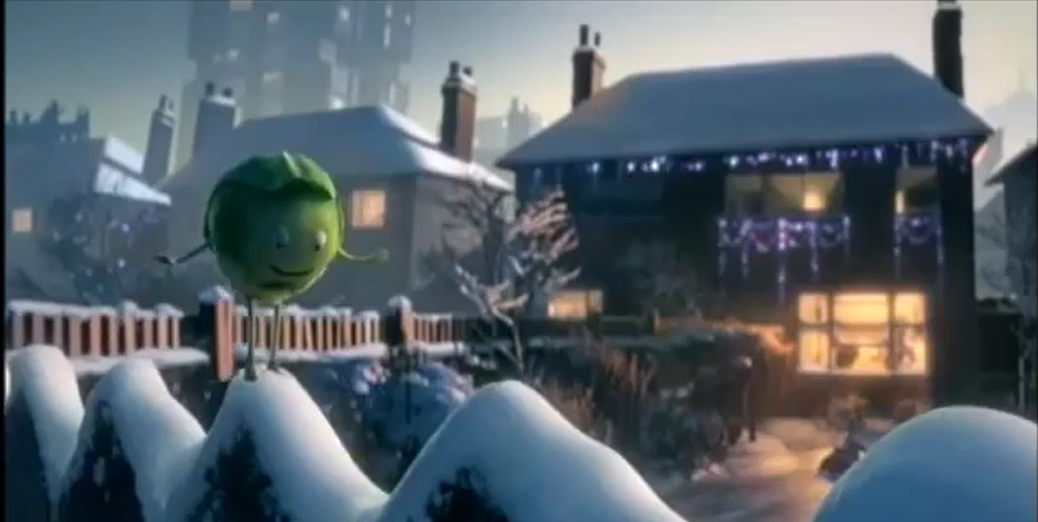
Sprout Boy’s Adventure… What sort of journey is he going on?

Slide 11
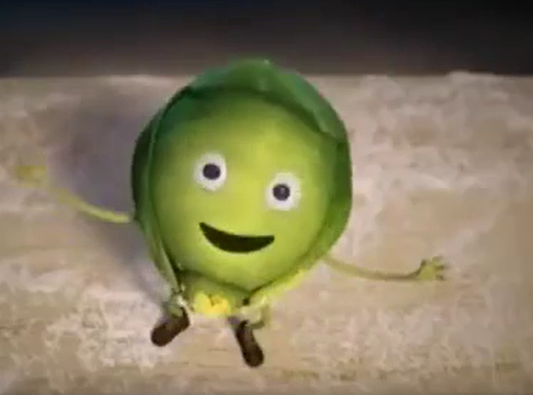
The conversation…
A baker he met whilst out and about said,
"I love Christmas pudding and would go without,
but nobody ever liked a sprout."

Slide 12
How does the Sprout Boy feel now?

Slide 13
At the Toy Stall…

Slide 14
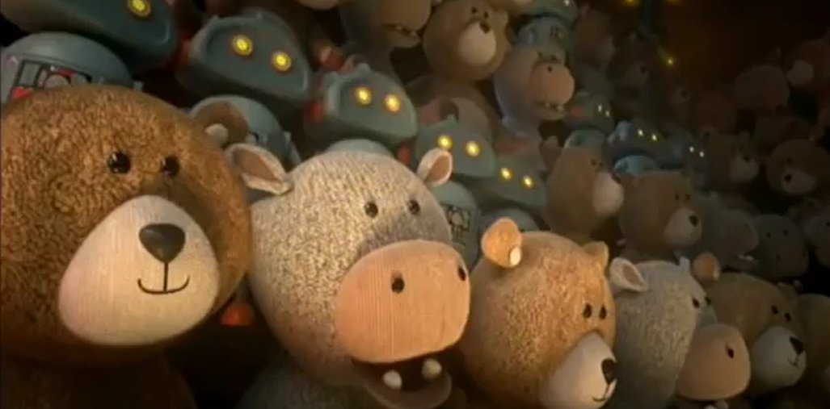
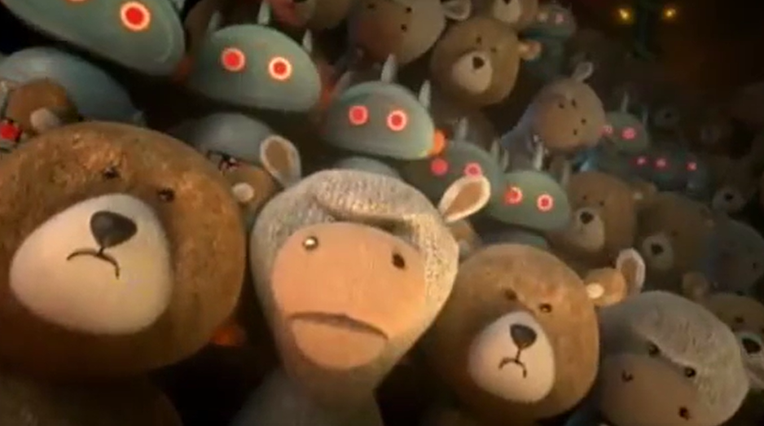
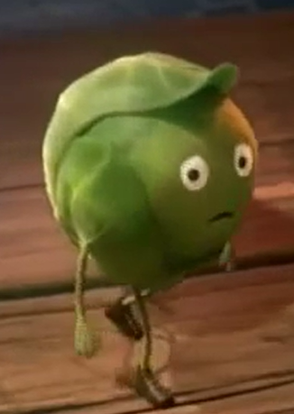
What changes occur here and why?
What do they think about sprouts?

Slide 15
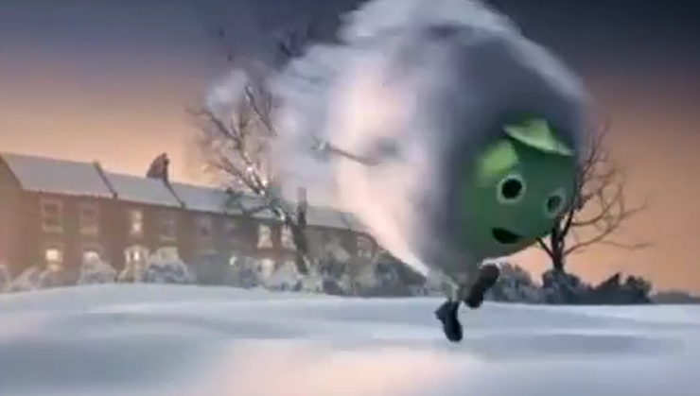
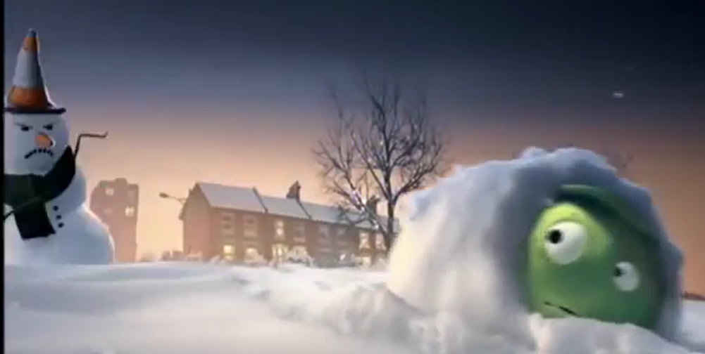
Snowball Fight!

Slide 16
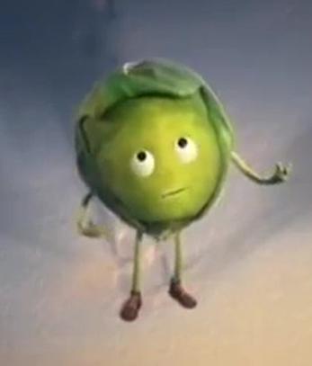
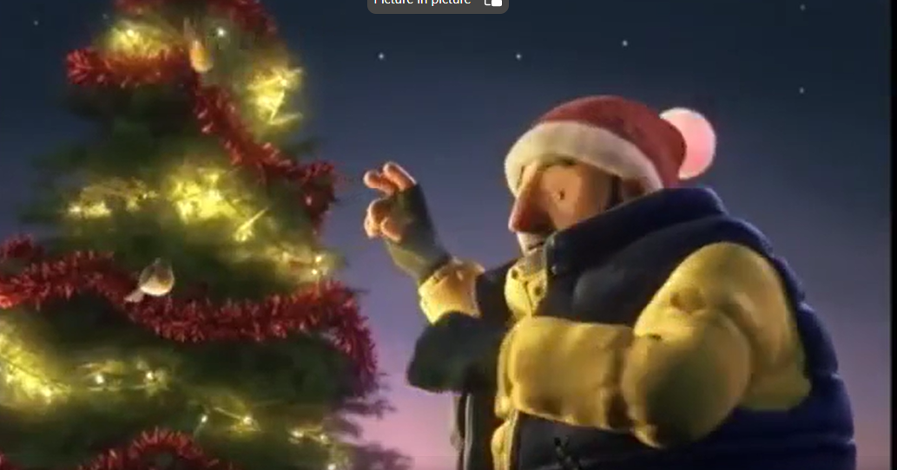
The Woodcutter…

Slide 17
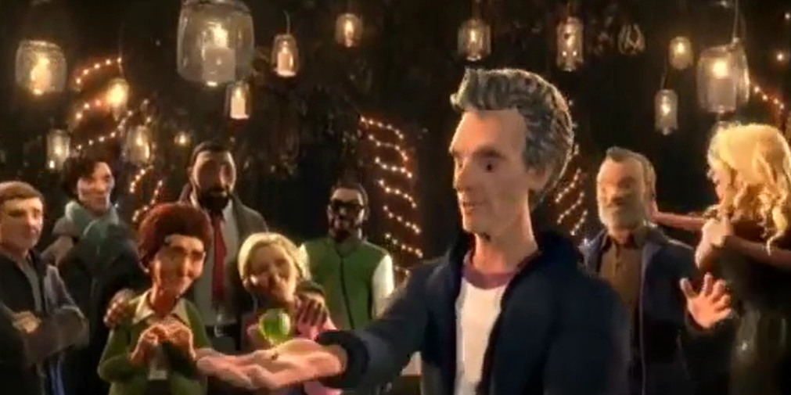
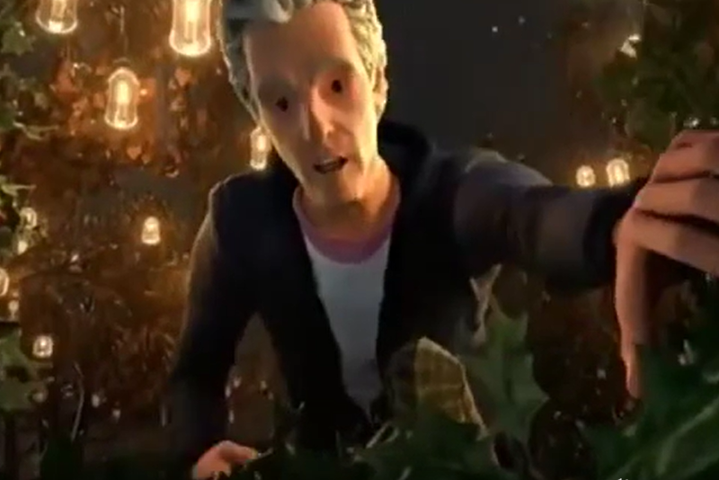
Come join us!

Slide 18
The fun is about to begin…

Slide 19
This Christmas, everyone loved a sprout!

Slide 20
For Christmas Together…

Slide 21
BBC Trailer…

