Slide 1
LO: To use words and phrases to describe God.

Slide 2
Think of all the words/phrases that we use to describe God.
Can you think of one beginning with each letter of the alphabet?
E.g. All loving,
Beloved
Compassionate
Divine
Everlasting
Task: Write the word ‘God’ in the centre of a page with a small image. Write some of the words/phrases around the image that describe God.

Slide 3
LO: To know the story of the creation of human beings in the Book of Genesis.

Slide 4
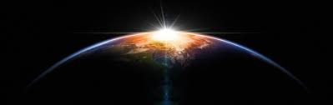
Recap some of the some of the words and phrases you thought of to describe God.
One important image of God for Christians is that of the Creator. Did you think of that word?
What does it mean to create something?
Read the story of the creation of human beings from the Book of Genesis 1:27-30.
Which words in the text describe the actions of God?

Slide 5
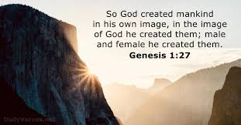
Task: Write an account about the creation of human beings.

Slide 6
LO: To understand what being created in the image and likeness of God means.

Slide 7
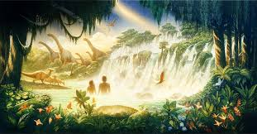
What does “image and likeness” mean?
Why do you think God created human beings?
What does the creation story tell you about the way God thinks about human beings?

Slide 8
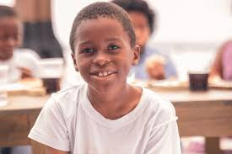
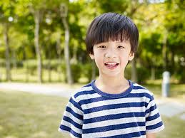
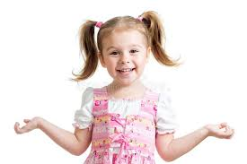
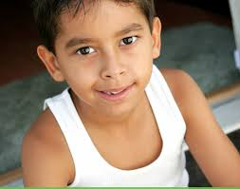
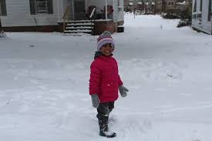
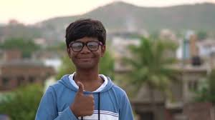
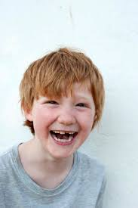
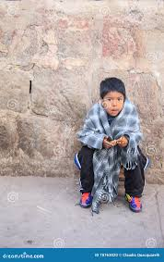
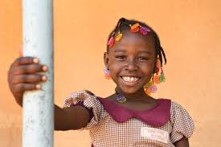
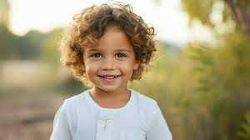
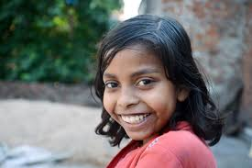
God made us all. God has created every person to be a little different. We all have different abilities, and different gifts. Even though we are all are different from others, we are all special.
God’s plan for the creation of human beings was that they would be different, every single one of them. No two human beings are exactly alike. Isn’t that a wonderful thing?

Slide 9
If human beings are created in the image and likeness of God, what effect should that have on the way human beings treat one another?
God created human beings to be like God – to show the attributes and characteristics of God. How can we think and act more like God?
It is so important that we always show respect, care and consideration for other people and for ourselves.
Can you think of any stories and events that show people respecting or failing to show respect for other people?

Slide 10
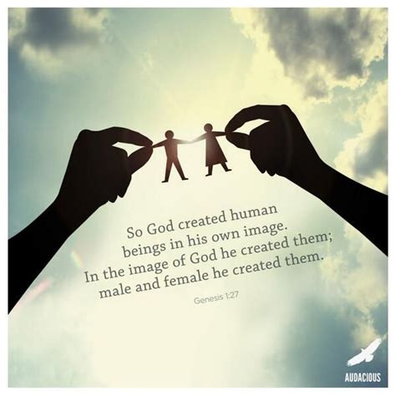
Task: Write about /draw how we can live in the image of God.
Let us pray together:
Dear God, You created each of us in your own image. You created each of us in Your image, to be like You and to have a special place in the world. Because we are like God, we can love and we can choose what is right. The way we act and treat others should be like you did, God. Help us to be like you.
AMEN

