Slide 1
Weather and Field work

Slide 2
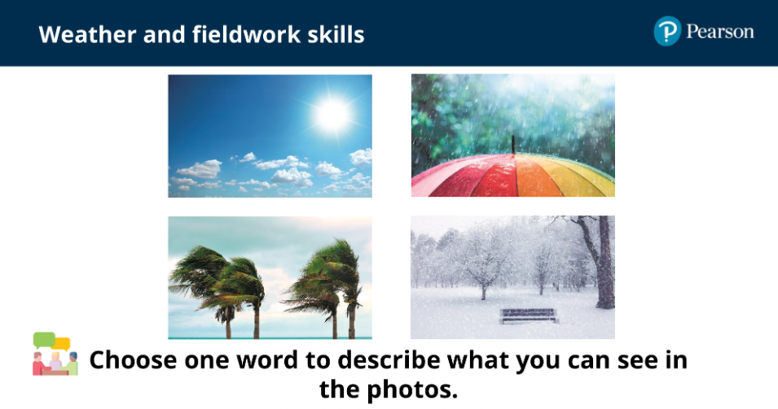
Lesson 1 – What is weather?

Slide 3
‘weather’ - describes what it is like outside today.
EXAMPLE: It is sunny. It is windy
‘climate’ - is what the weather is usually like.
EXAMPLE: It is usually sunny in the summer.

Slide 4

Can you name the seasons?

Slide 5
Autumn
Winter
In the hoops put a picture for which season you think it belongs to.
Spring
Summer

Slide 6
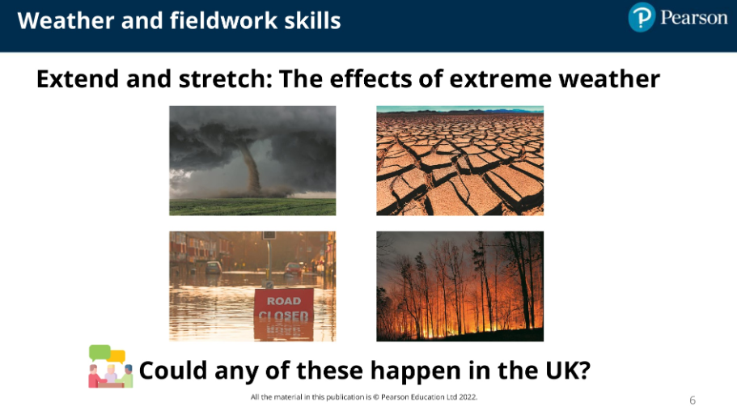

Slide 7
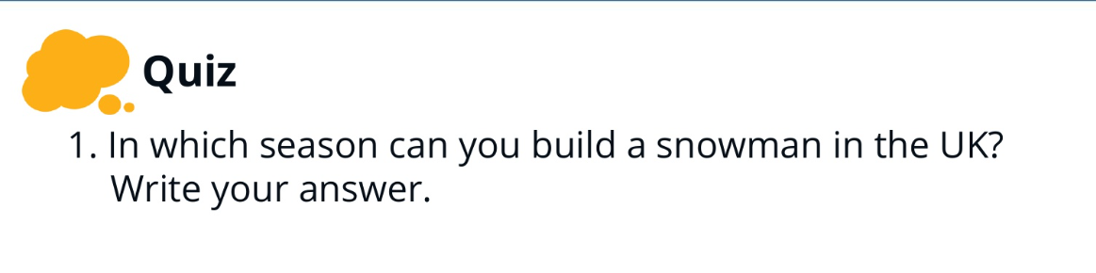
Lesson 2- How do we make decisions

Slide 8
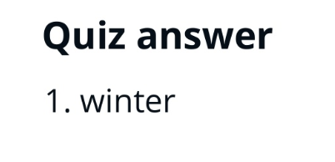

Slide 9
What decisions do you have to make?
EXAMPLES:
What to wear
What to eat

Slide 10
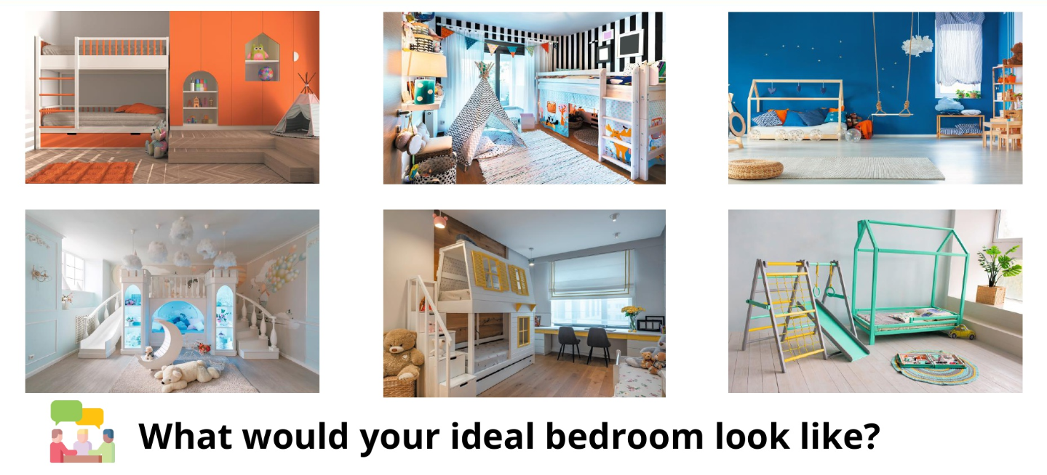

Slide 11
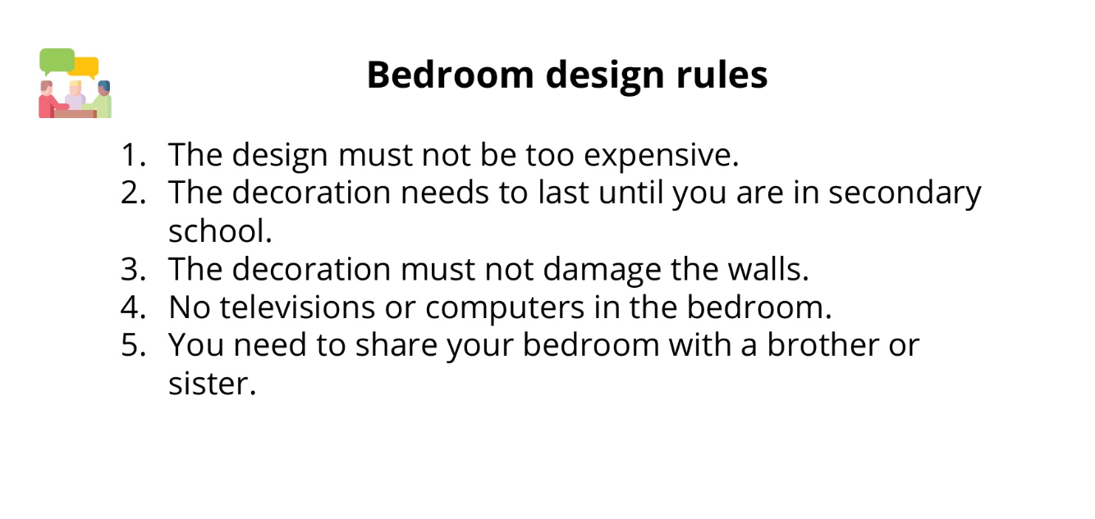
We need to choose three of these rules for our ‘criteria’.

Slide 12
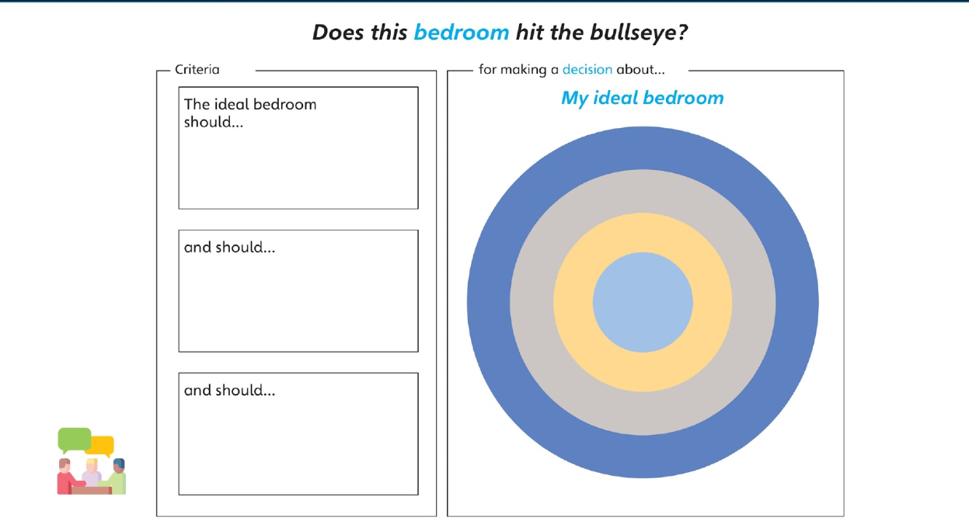
Year 1 to do together

Slide 13
You are going to use this decision-making process to come up with a plan to help the school council with a new project.
(NEED TO COME WITH A PROJECT)

Slide 14
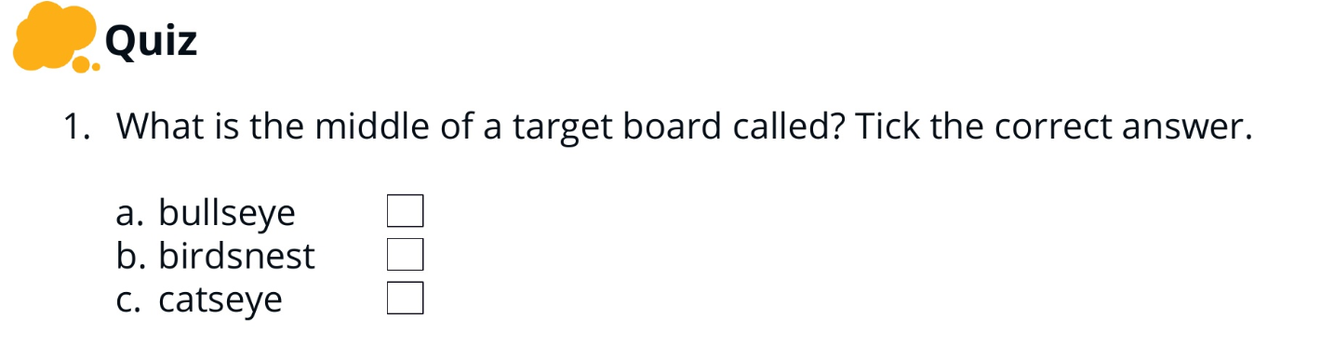
Lesson 3- What do we need to find out

Slide 15
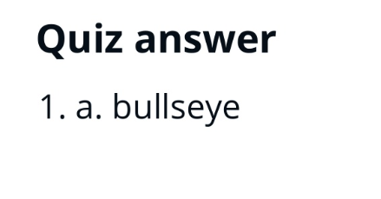

Slide 16
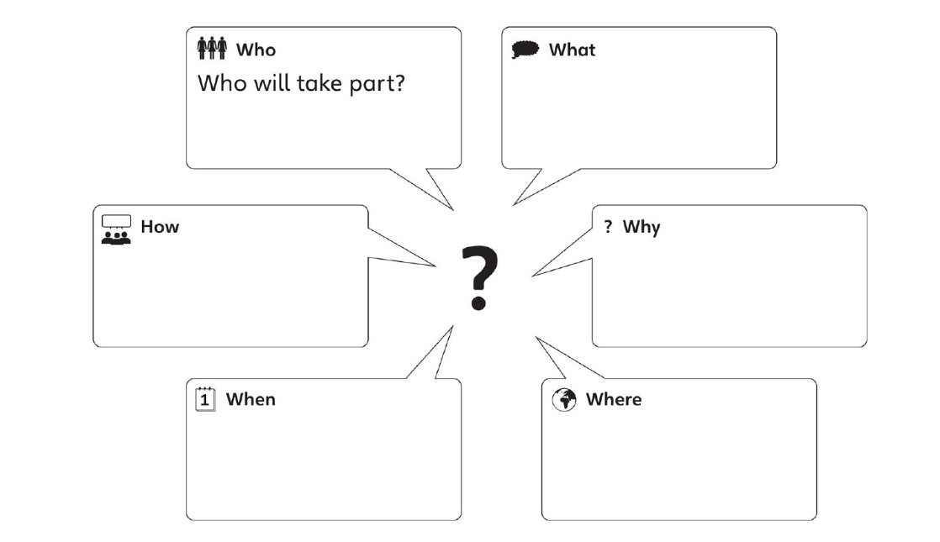
What questions do we need to ask before we start our project?

Slide 17
Need to find out information about our project.
Can link to a computer lesson.

Slide 18
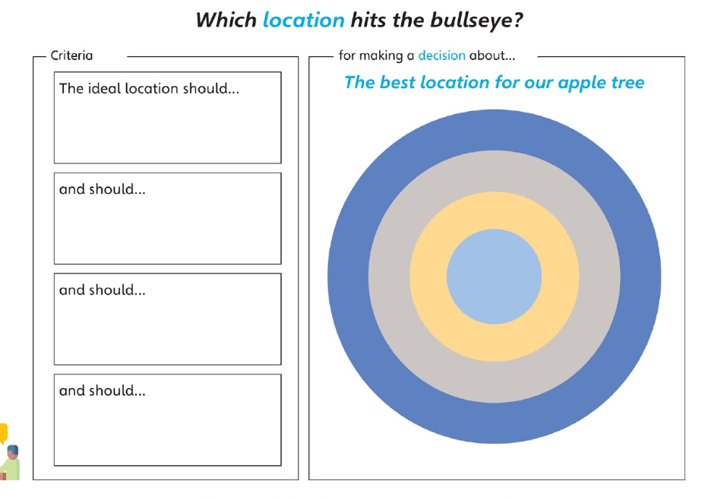

Slide 19
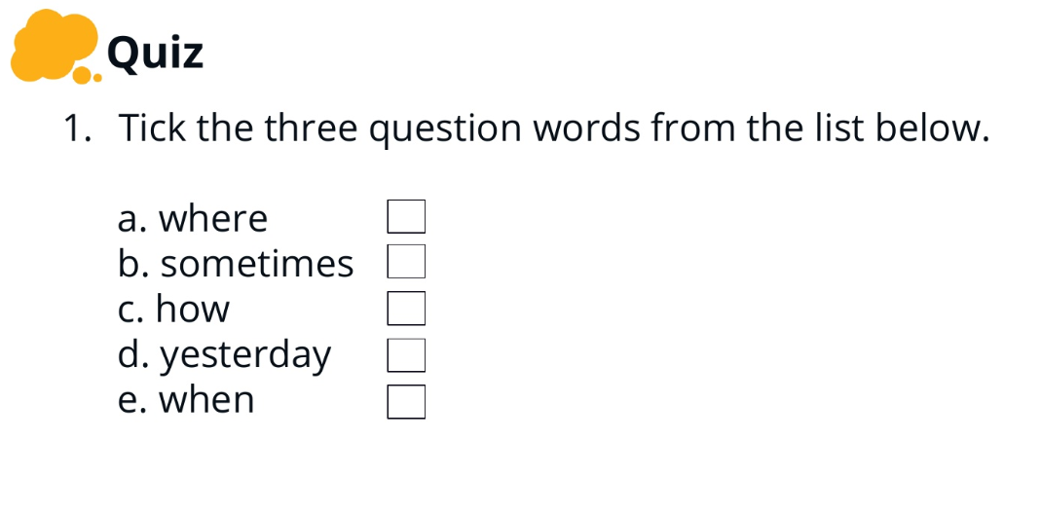
Lesson 4 – How can we use criteria to help us decide?

Slide 20
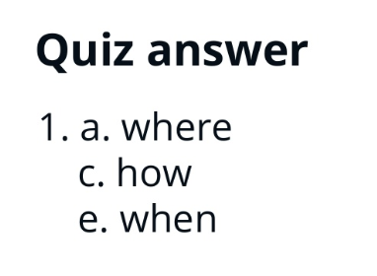

Slide 21
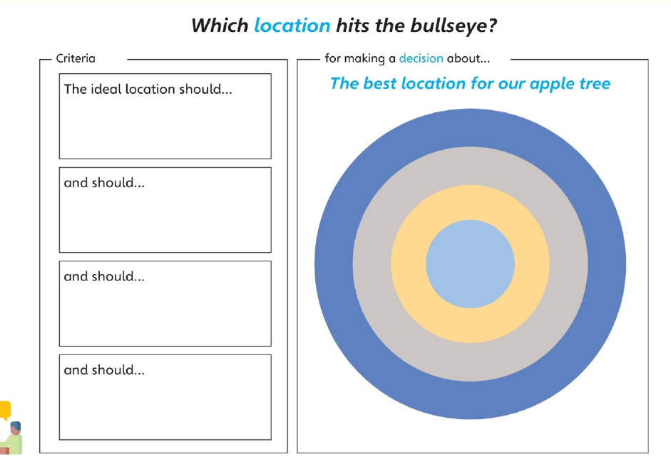

Slide 22
Using picture of school plan label the different areas of the school.
Choose three different areas to carry out our project label them on the plan.

Slide 23
Why have you chosen these areas?
What information will we need to collect to decide which location is most suitable?
e.g. for criteria involving water, they could measure rainfall, or for temperature, they could use a thermometer.

Slide 24
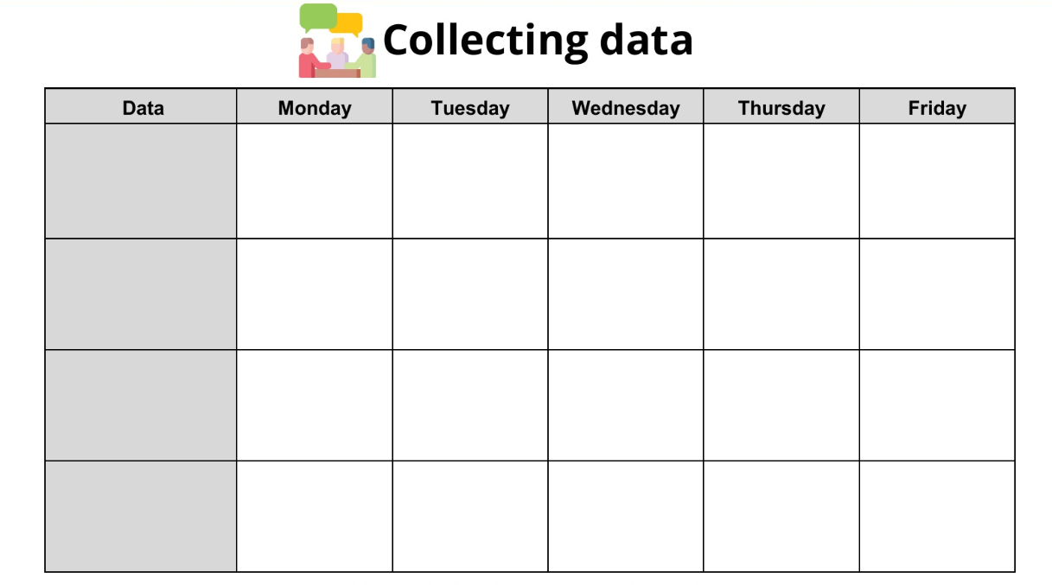

Slide 25
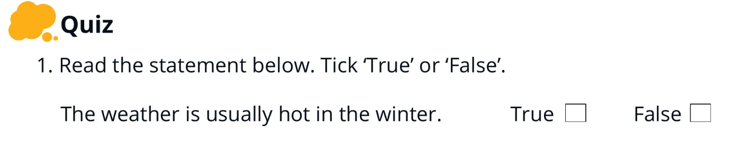
Lesson 5 – How can data help us decide?

Slide 26
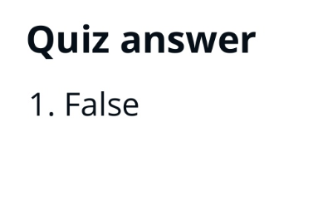

Slide 27
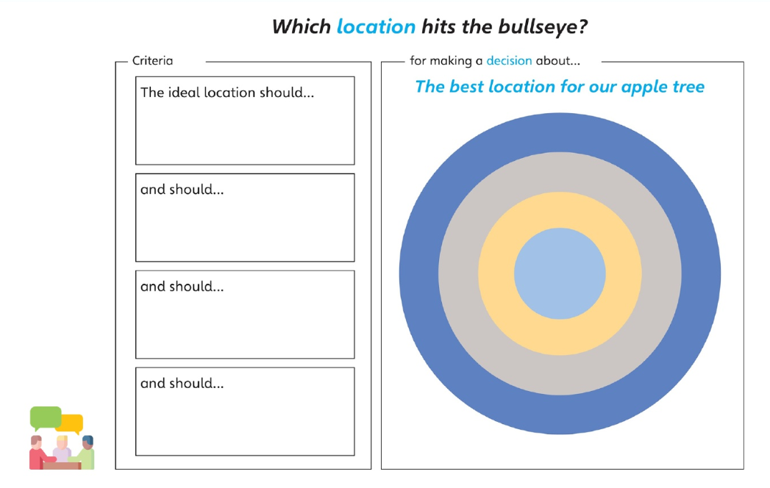

Slide 28
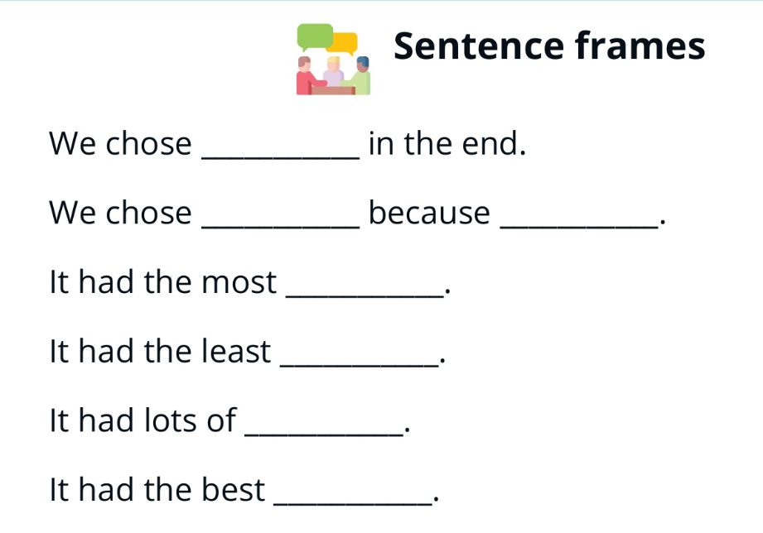

Slide 29
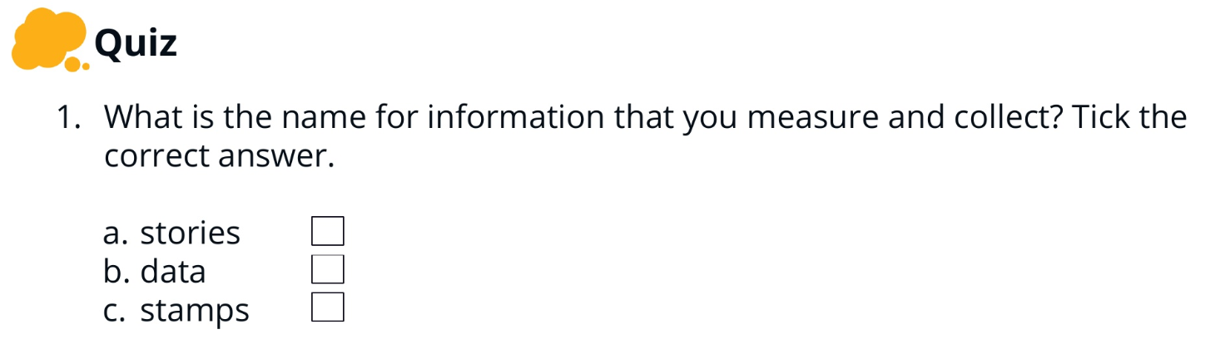
Lesson 6- How can you present your decision

Slide 30
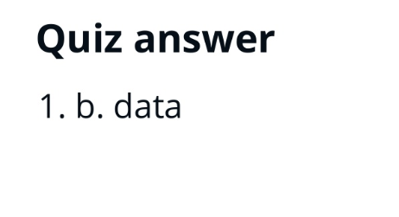

Slide 31
What are our next steps from the data we have collected?
Put in sticky note picture.

Slide 32
Presentation
  What we needed to decide
  The research we did
  The criteria we chose
  The data we needed to collect
  How we collected the data
  What the data showed
  What our final decision was
  What our plan of action is.

Slide 33
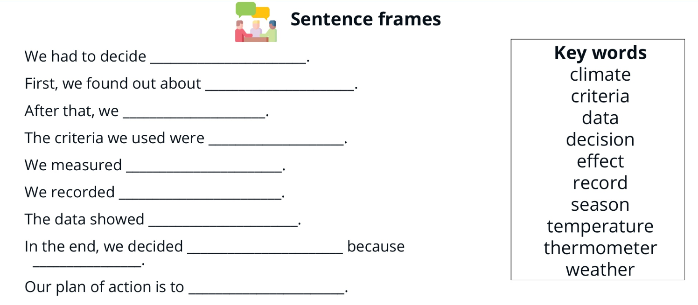

Slide 34
Deliver presentation to the class.

