Slide 1
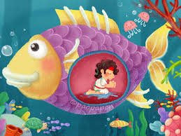
Monday 23rd September 2024
LO: Retell the story of Jonah and the fish
SC: Listen to the story of Jonah and the fish.
Summarise the story of Jonah and the fish.
Explore why it is sometimes difficult to say ‘yes’.

Slide 2
The Big Question
’Why was it hard for Jonah to say yes to God?’
Key Words:
God
Jonah
Difficult

Slide 3
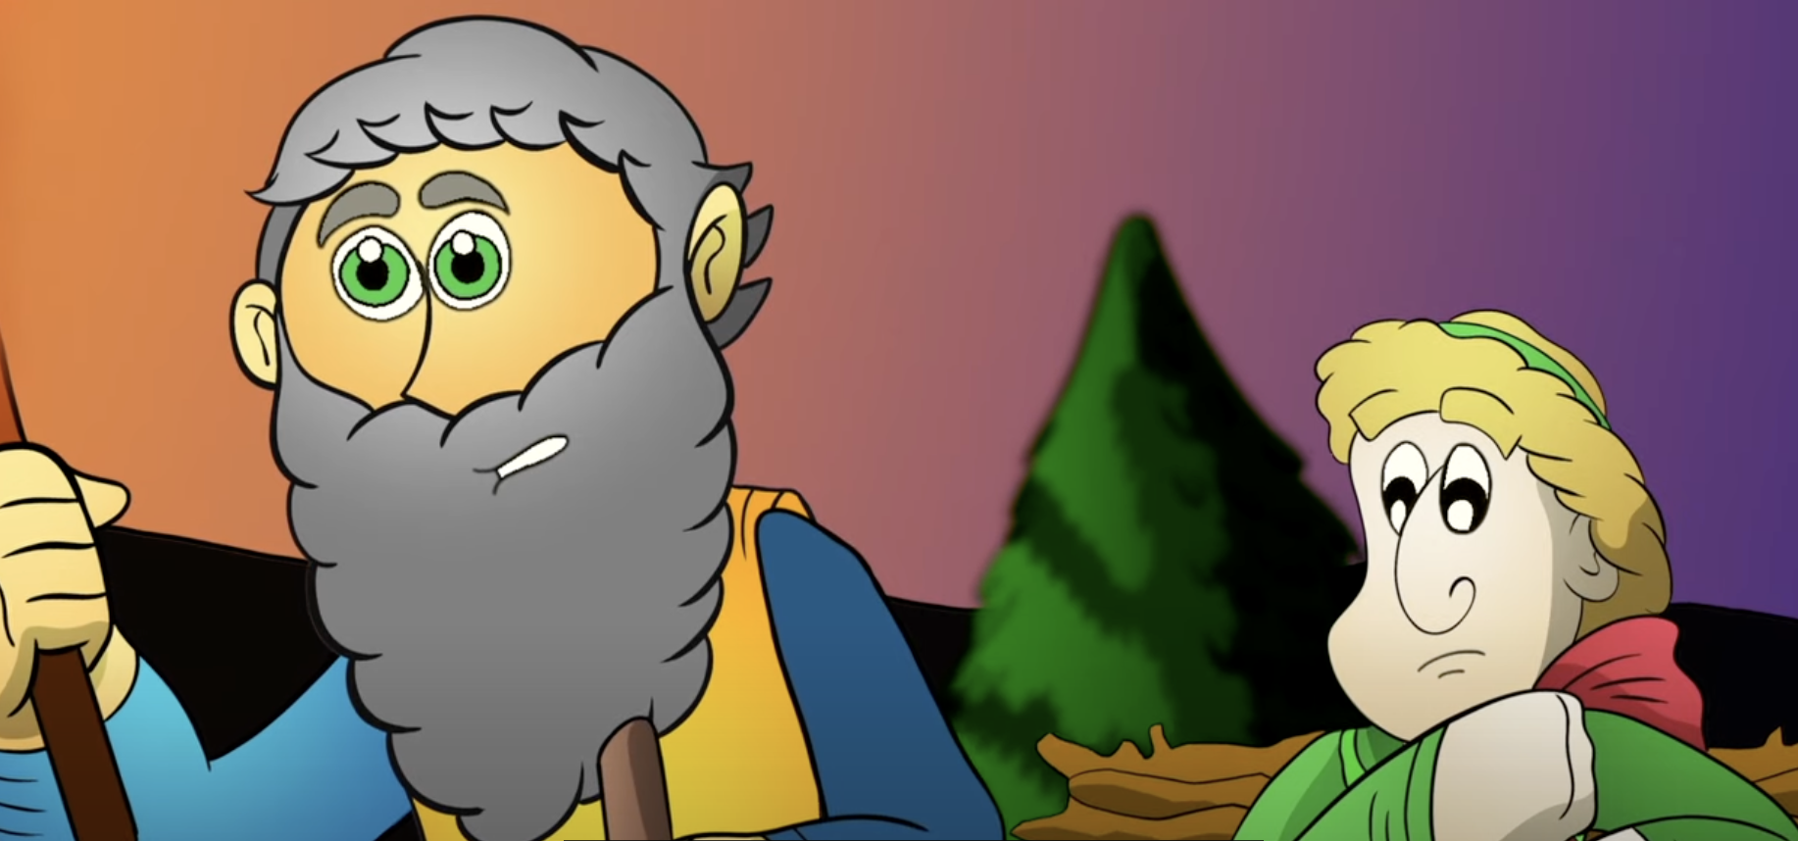
Recall
Thinking back to the story of Abraham and Isaac:
What difficult decision did Abraham make?
How was Isaac feeling after he found out about his father’s plan?

Slide 4
Jonah and the Fish
Let’s listen to the story of Jonah and the Fish.
https://www.youtube.com/watch?v=WOSadLyqshg

Slide 5
Jonah and the Fish
Why do you think Jonah was chosen by God?
Did Jonah do what God asked him?
What happened when Jonah did not listen to God?

Slide 6
Difficult Decisions
Sometimes it is hard to say yes to something because:
You feel nervous
You don’t want to
You don’t feel confident enough to say yes

Slide 7
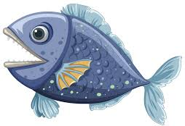
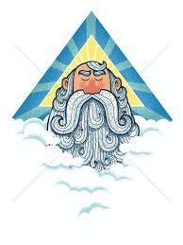
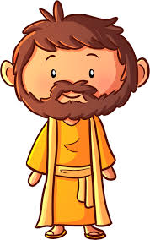
Main Activity
Retell the story of Jonah and the fish using puppets.
You will work in groups and be Jonah, the fish, God, wind, waves and the people.

Slide 8
Main Activity
Think about how Jonah was feeling when he was swallowed by the big fish.
Year 1: What was Jonah thinking?
Year 2: What was Jonah thinking and what did he say?

Slide 9
The Big Question
’Why was it hard for Jonah to say yes to God?’

