Slide 1
Cinderella
An Art Deco Fairy Tale
By David Roberts and Lynn Roberts-Maloney
KS1 Spring 2024

Slide 2
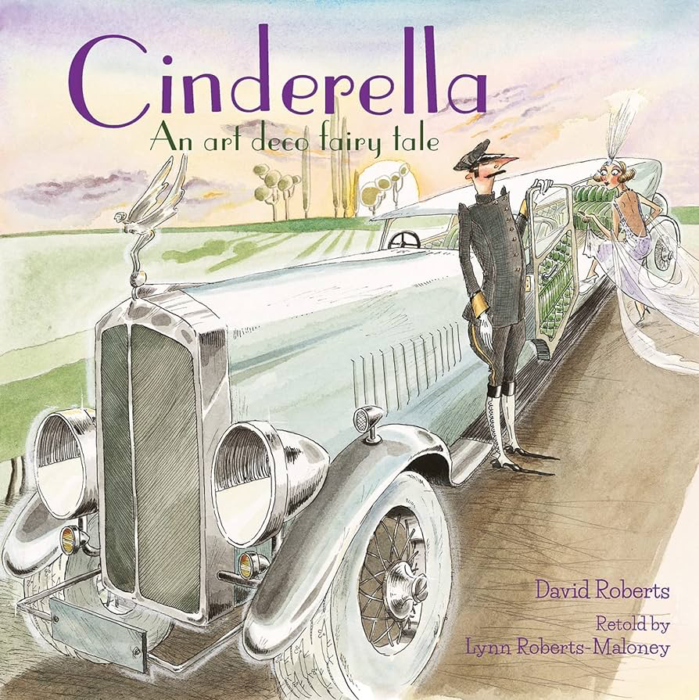
LO: 1) Identify and explain the sequence of events in texts (1c)
Five sentence fairy tales

Slide 3
Summarising Cinderella

Slide 4
Cinderella’ s mum has died and her father remarries.
An unkind stepmother and 3 mean sisters move in.
An unkind stepmother and 3 mean sisters move in.
At the ball, she meets the Prince and they fall in love but Cinderella has to hurry away and loses her glass slipper.
The prince finds the slipper and uses it to find Cinderella.

Slide 5
Together
Cinderella

Slide 6
Can you spot any similarities between the different versions of Cinderella?

Slide 7
Examples
In some versions of Cinderella, the main character is a girl but in others the Cinderella character is a boy.
Some versions of Cinderella have three stepsisters however, in others, there could be more or less.

Slide 8
Together
In

Slide 9
LO: 2) Predict what might happen on the basis of what has been read so far (1e)
Point and predict

Slide 10
Point and predict
The car looks fancy so I think the characters are wealthy.

Slide 11
Predictions
I think that this must be... because...

Slide 12
LO: 3) Draw on knowledge of vocabulary to understand texts (1a)
What’s in a word?

Slide 13
Recognised
Frock
Dim
Smugly
Endearment

Slide 14
1) Which word do you think is closest in meaning to frock?
sock
dress
skirt

Slide 15
2) What do you think cinders means?

Slide 16
3) Why does Greta become Cinderella?

Slide 17
4) Look at the word, endearment as in friendly endearment. Do you think this is a pleasant thing or not? Explain your answer.

Slide 18
LO: 4) Make inferences from the text (1d)
Familiar faces in fairy tales

Slide 19
Ball
Announcement
Eligible
Finery

Slide 20
Retrieve and infer
I see the cat running away so I think it is frightened, and this could be because the cat knows what the new household members are going to be like.

Slide 21
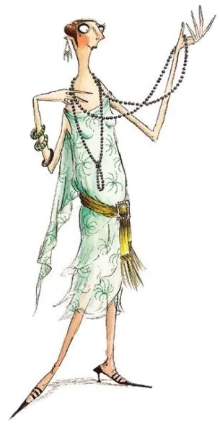
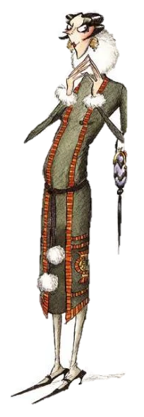
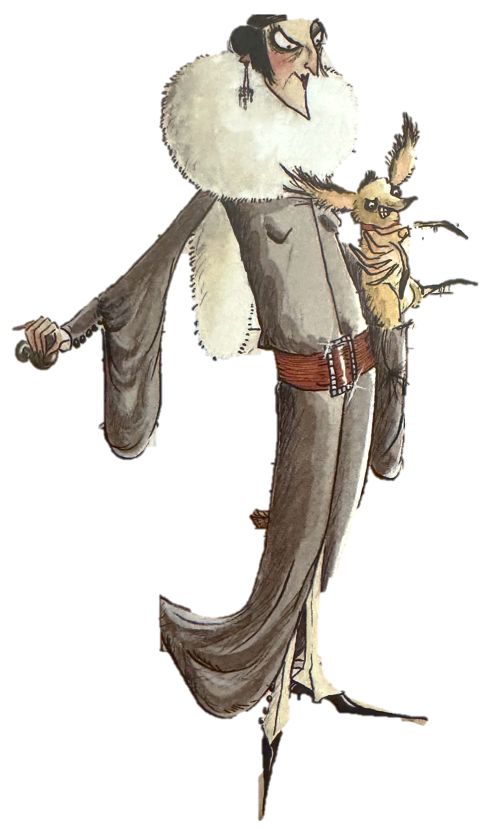
Ermintrude
Elvira
Stepmother

Slide 22
Ermintrude
Elvira
Stepmother

Slide 23
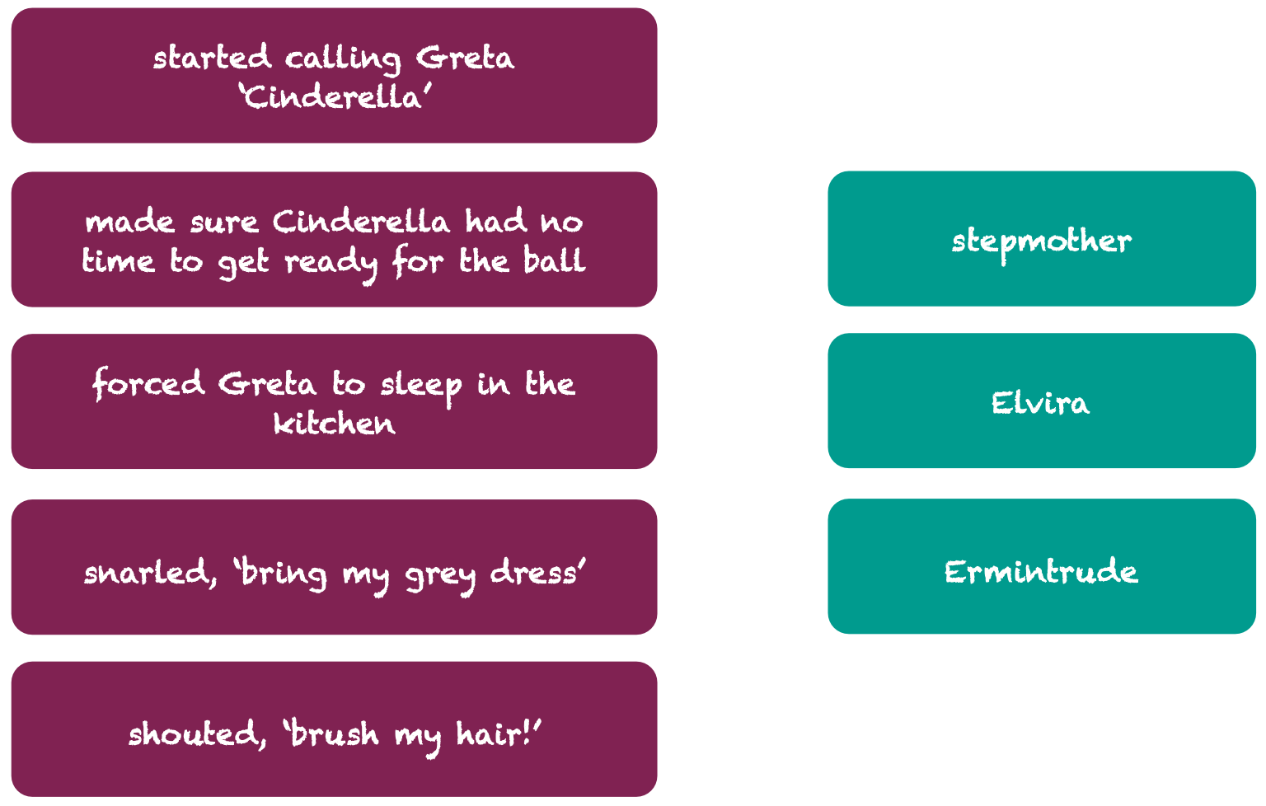

Slide 24
Sentences

