Slide 1
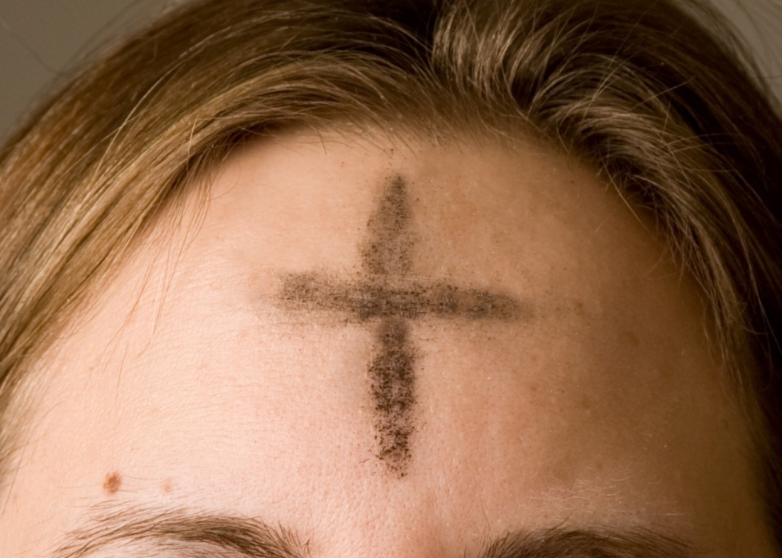
All about
Ash Wednesday

Slide 2
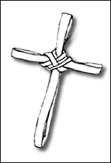
Ash Wednesday is the first day of Lent. It occurs forty days before Easter not counting Sundays.

Slide 3
Ash Wednesday is the beginning of Lent. It is a day of penitence to say sorry for the things you have done wrong.

Slide 4
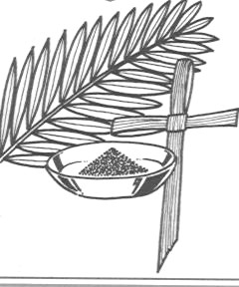
The priest burns last years palm crosses.
The ashes are then used to make a sign of the cross on the forehead.

Slide 5
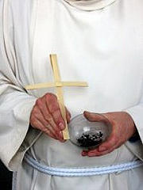
The palm cross
And the ash

Slide 6
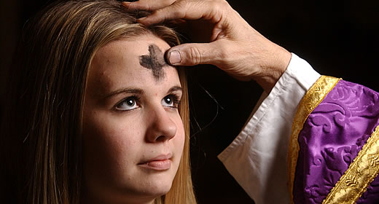
The priest puts a cross on your forehead and says
“remember you are dust and unto dust you shall return”

Slide 7
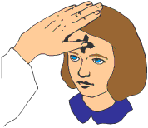
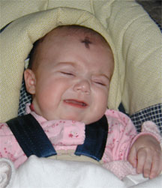

Slide 8
The marking of our forehead with a cross made of ashes reminds us that:
We must be sad for the things we have done wrong and say sorry
We must change ourselves and try to be good
God made the first human being by breathing life into dust

