Slide 1
Tuesday 10th September 2024
LO: Recall the story of Noah
What is the Old Testament?
Key Words:
Gospel: God’s Word

Slide 2
Introduction to Noah’s Ark
Predict:
What do you think Noah’s Ark means?
Who do you think Noah is?
What is an Ark?
Let’s watch this together:
https://www.youtube.com/watch?v=QAsfOcGjgoM

Slide 3
Introduction to Noah’s Ark
What did we think of this story?
Why did God send a flood?
Who was saved?

Slide 4
Role Play
In groups, you will now role-play as:
Noah
God
The People
and animals.
You will retell the story of Noah’s Ark.

Slide 5
Song
Let’s sing this song
https://www.youtube.com/watch?v=iYpftlQO5HQ
Add some actions that represent the animals

Slide 6
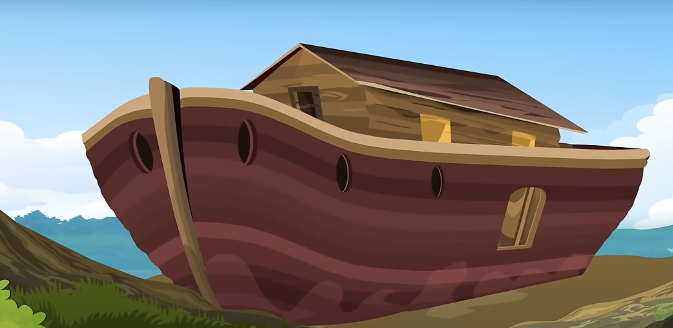
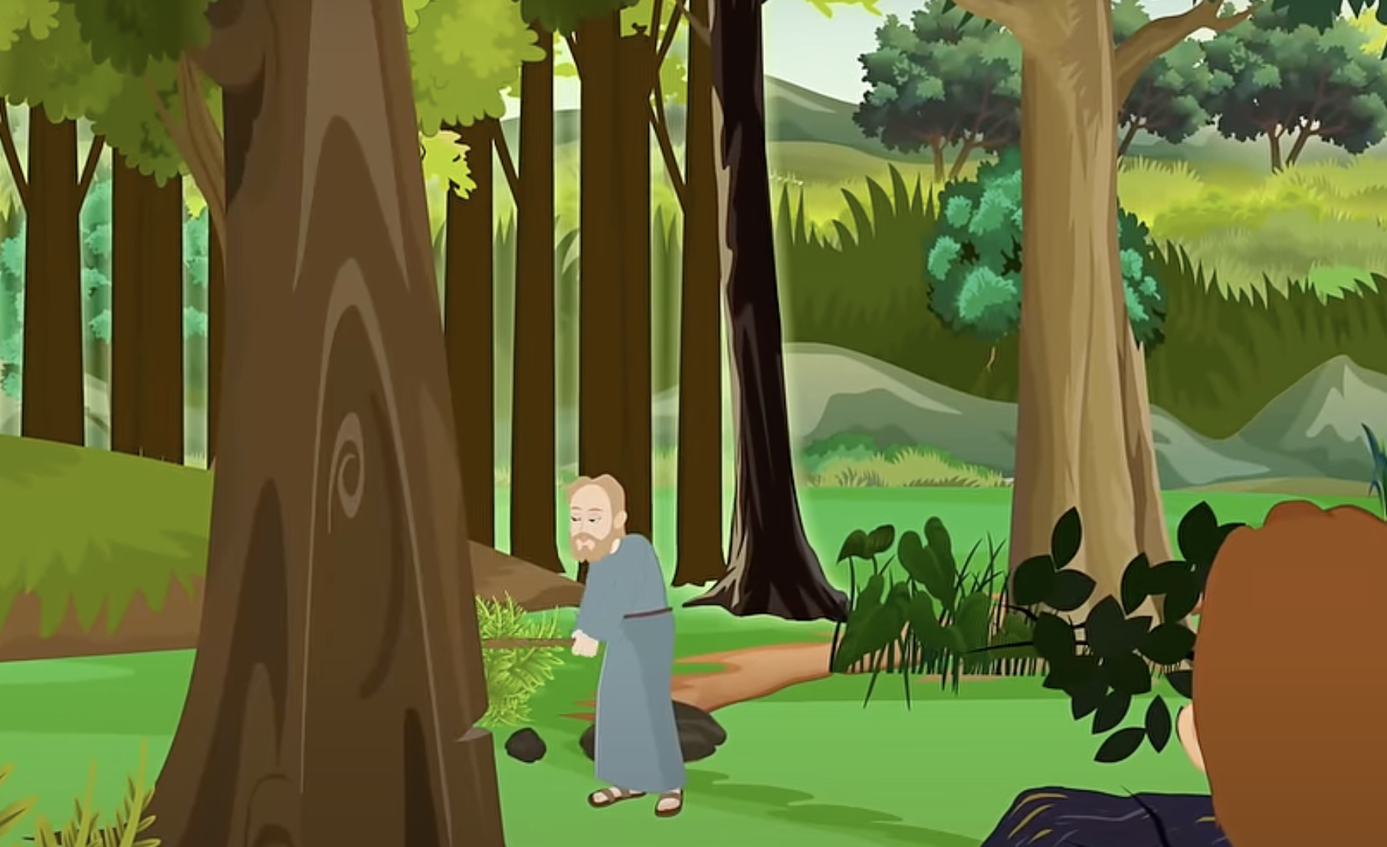
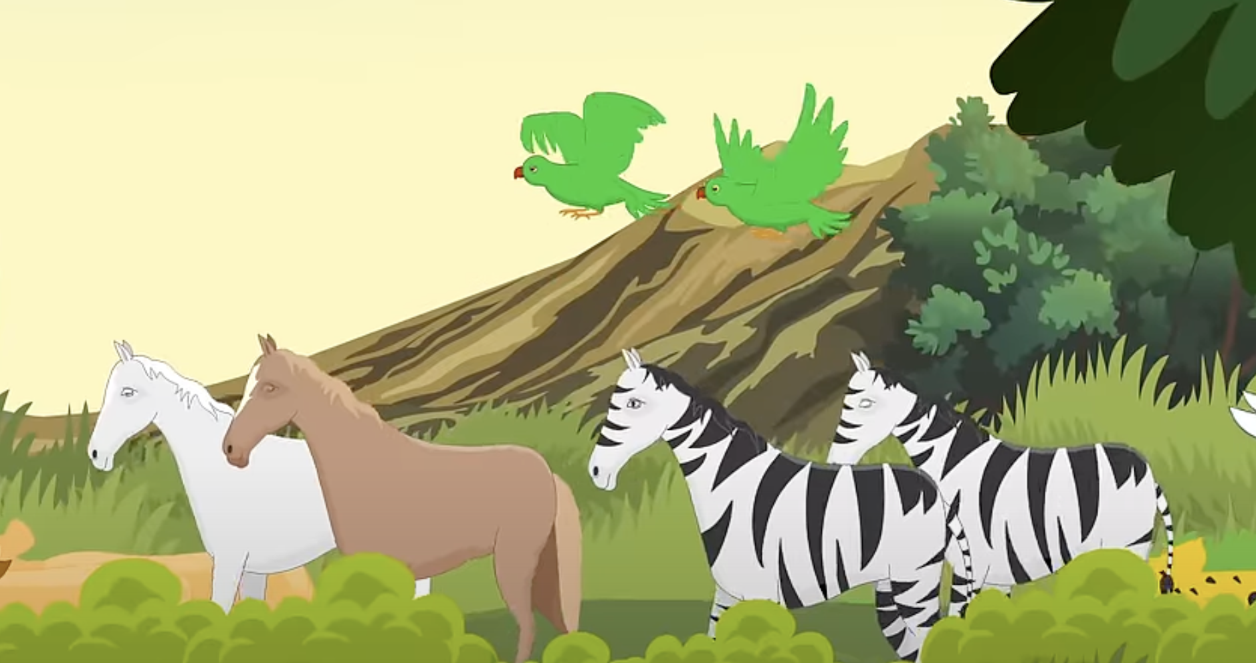
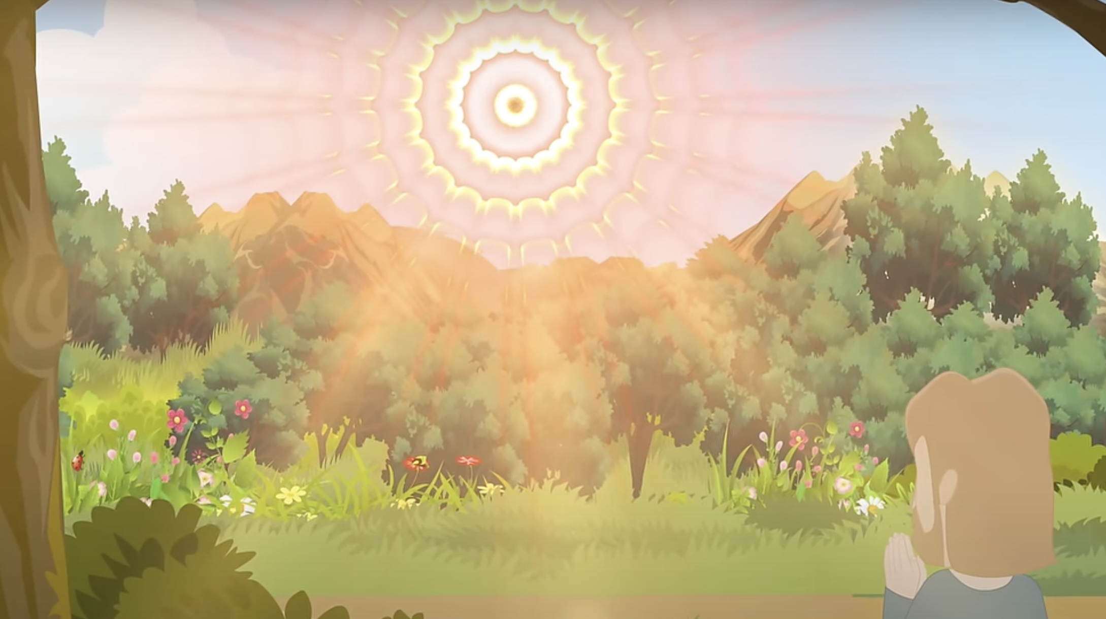
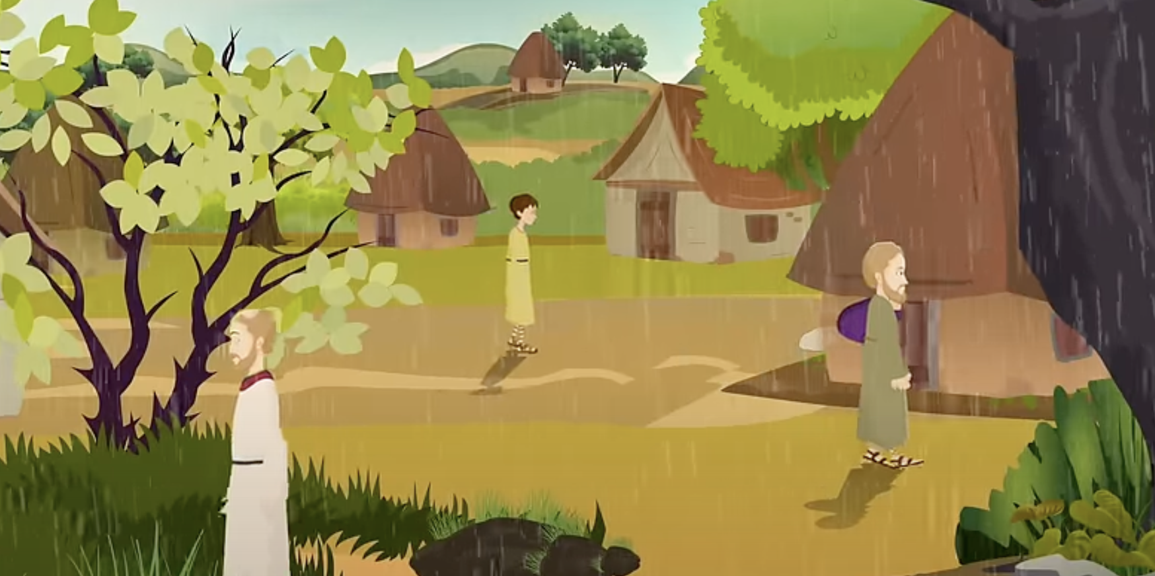
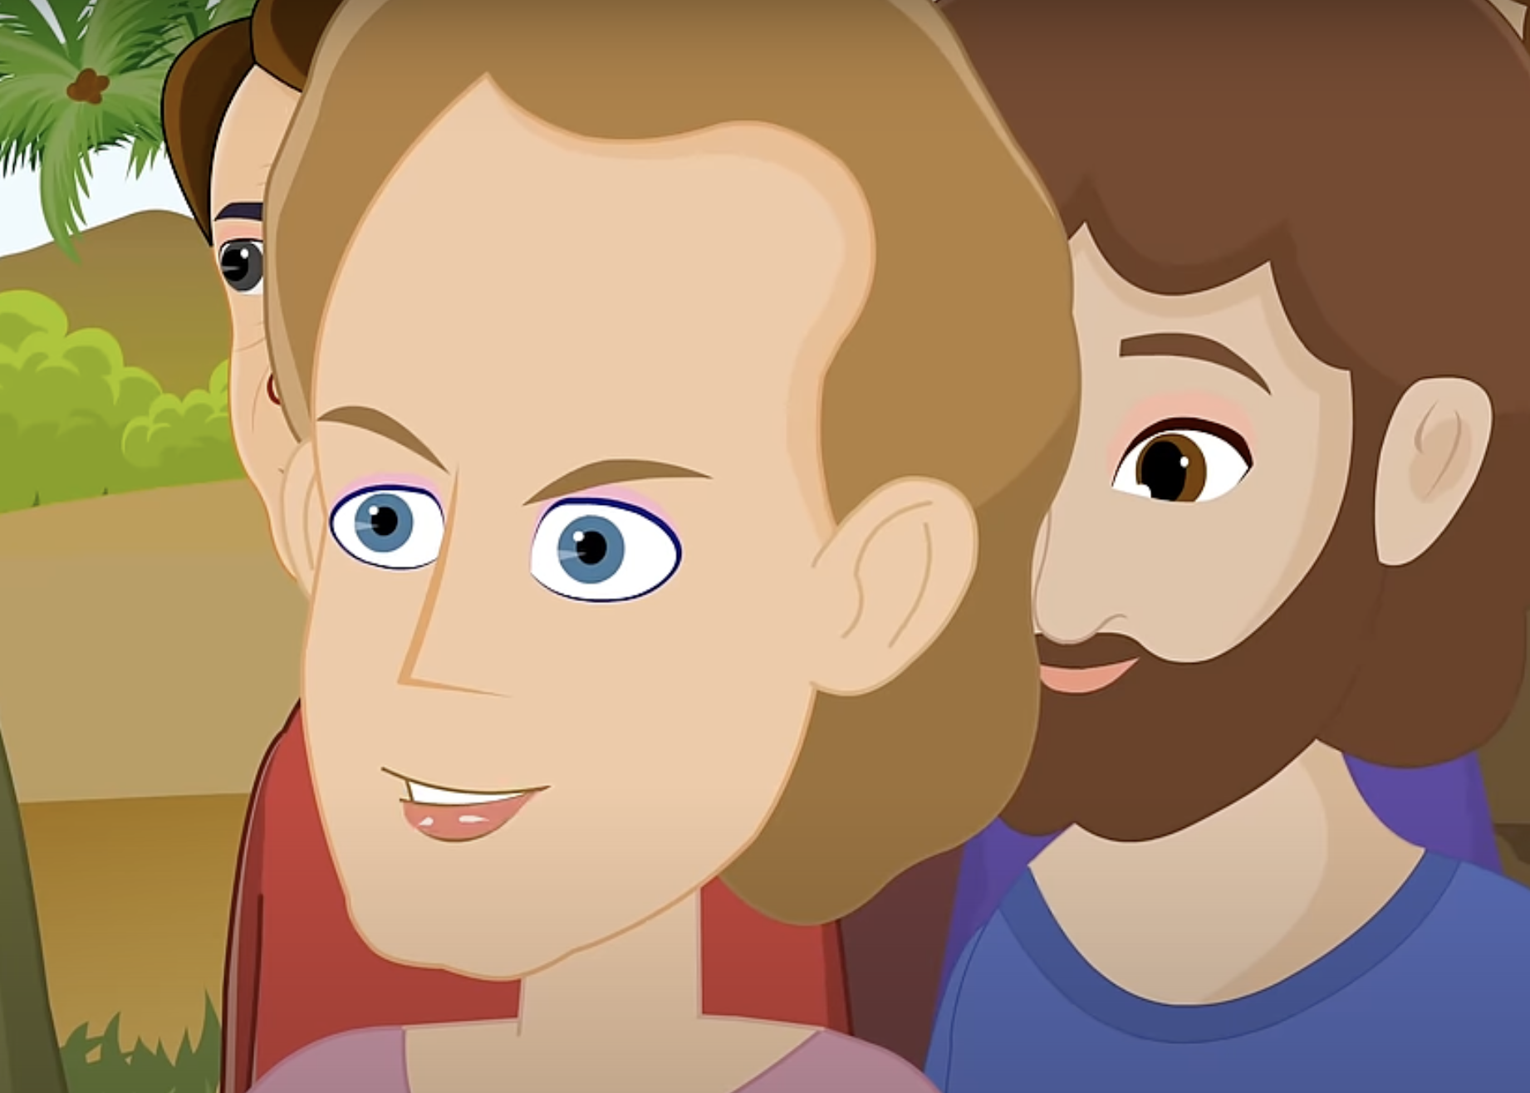
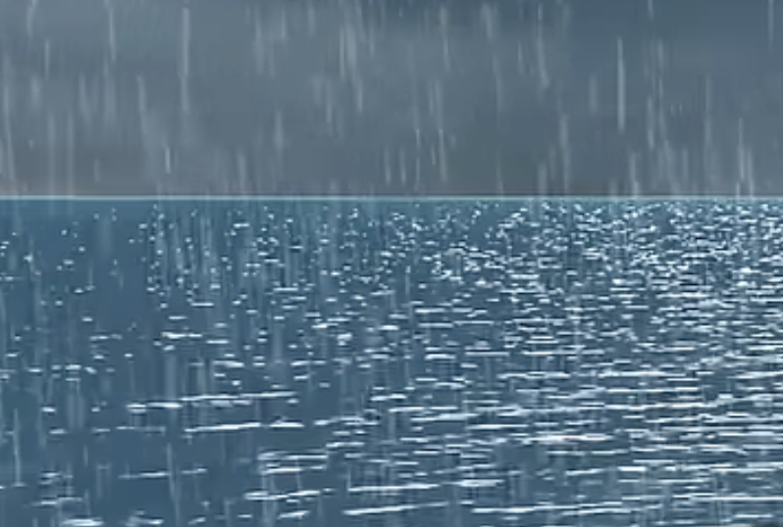
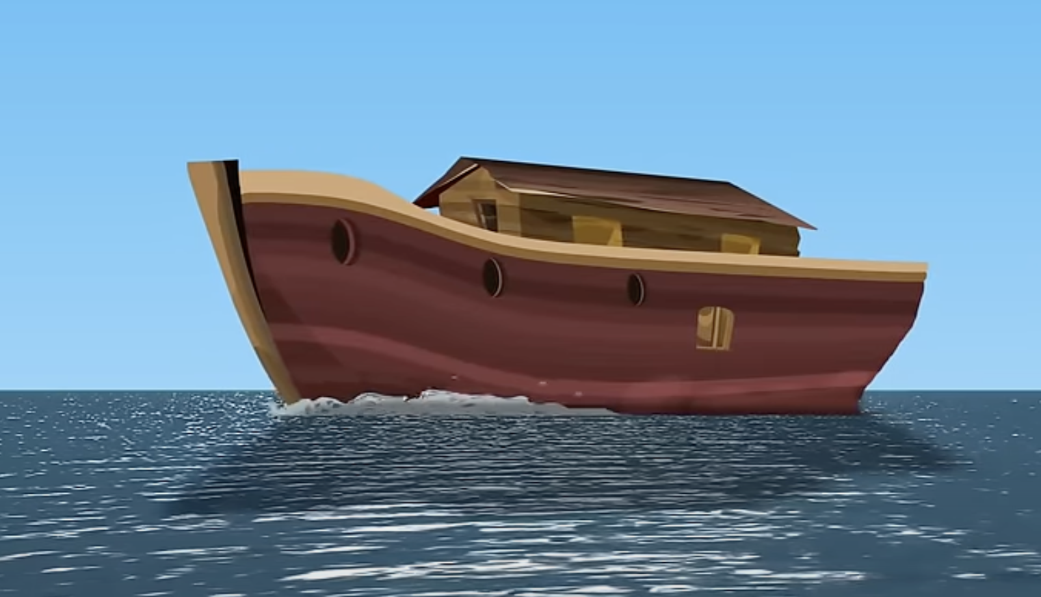
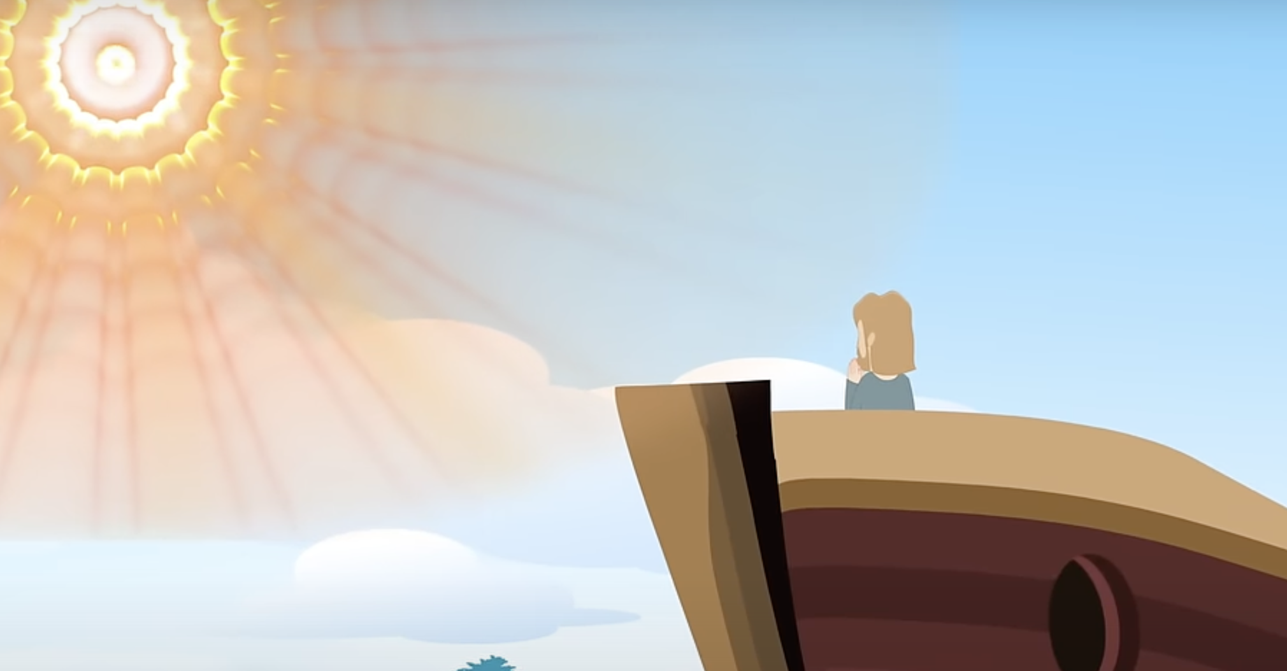
Wrap-Up
Can we put these images in order for the story of Noah’s Ark?

