Slide 1
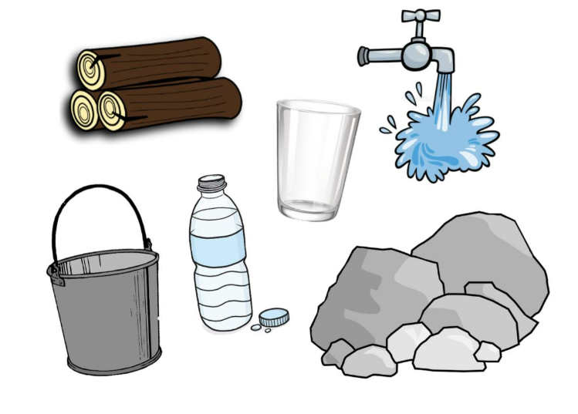
Brilliant Builders!
Chemistry

Slide 2

LO: 1) To discuss, identify and label various materials.

Slide 3
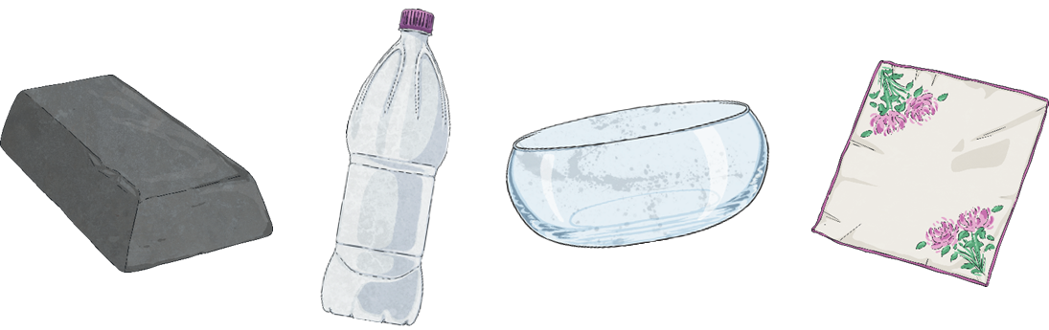
Materials
We use wood, metal, plastic, glass and fabric to make most everyday objects.
Different materials have different properties.
Materials can be natural or humanly-constructed.

Slide 4
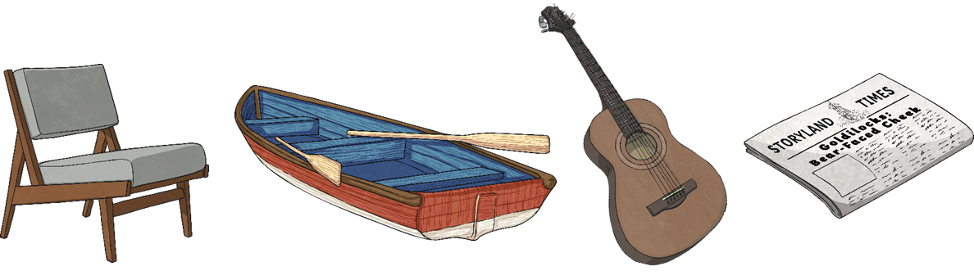
Wood
Wood is a natural material. It comes from trees.
A few things made from wood are:
Furniture
Boats
Instruments
Paper
Wood is used as it can be carved in to any shape, is strong and has a very nice appearance.

Slide 5
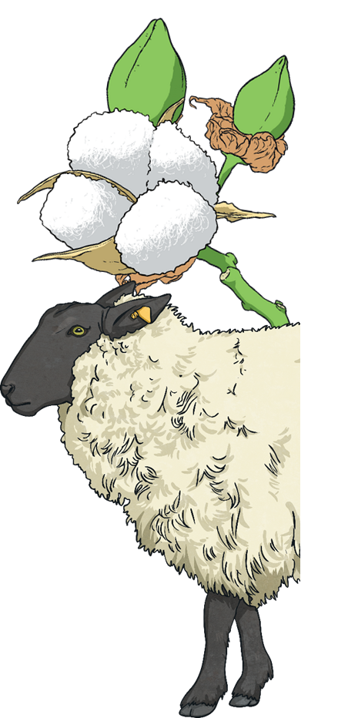
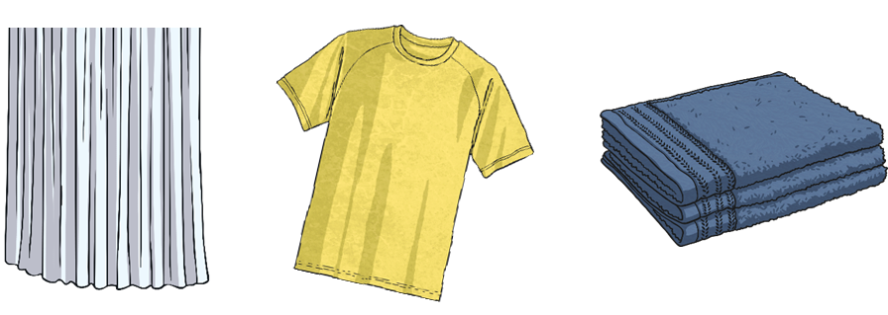
Fabric
Fabric comes from plants and animals.
A few things made from fabric are:
Curtain
Clothes
Towels
Fabric is used as it is very light, warm, soft and quite easy to produce and sew.

Slide 6
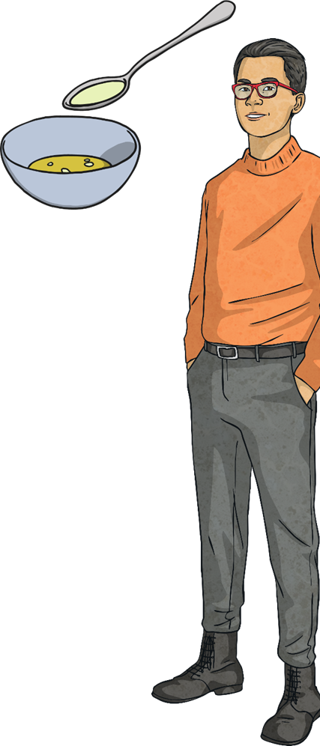
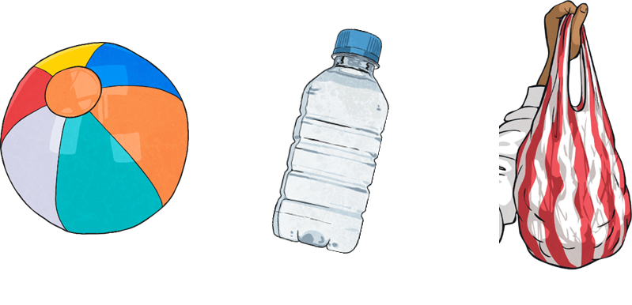
Plastic
Plastics are humanly-constructed, mostly from oil.
A few things made from plastic are:
Balls
Bottles
Carrier bags
Plastic is used as it can be made to be flexible, hard, rough or smooth. It is also very cheap to produce and easily washable.

Slide 7
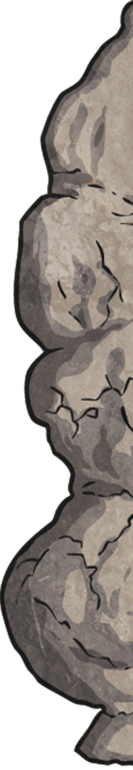
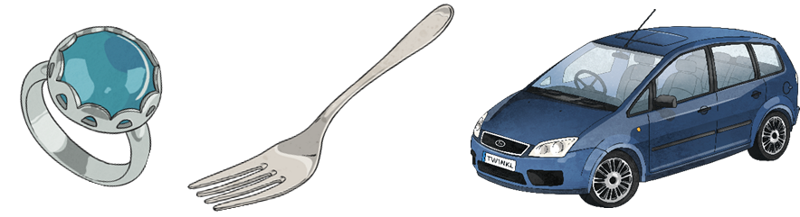
Metal
Metals are made from rocks. The rocks are dug up and taken to a factory where they are heated and processed into metal.
A few things made from metal are:
Jewellery
Cutlery
Cars
Metal is used as it is strong, hard, smooth and easily washable.

Slide 8
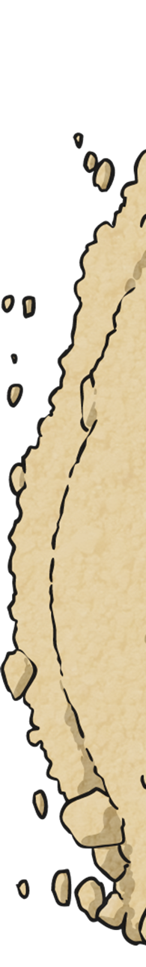
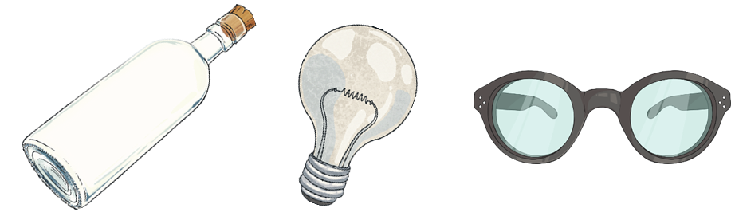
Glass
Glass is made from very fine sand. It is heated until it melts.
A few things made from glass are:
Bottles
Lightbulbs
Glasses
Glass is used as it is strong, hard, smooth, easily washable and transparent.

Slide 9
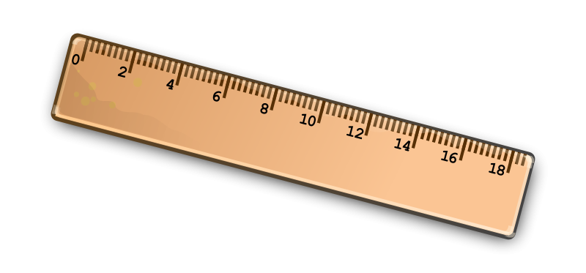
Object
Properties
Wood
Hard
Opaque

Slide 10
LO: 2) To identify different objects and the materials they are made from, investigating their properties.

Slide 11
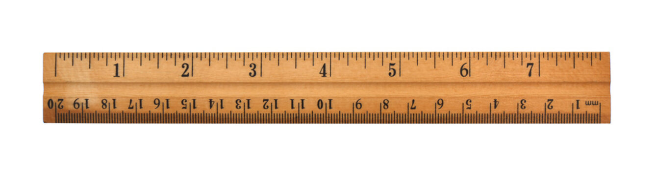
What material is it made of?
Where does the material come from?
It is cut into blocks of wood, then cut to size, polished and marked to make a ruler.
Notes:
Natural or man-made?
Talk about objects around the room

Slide 12
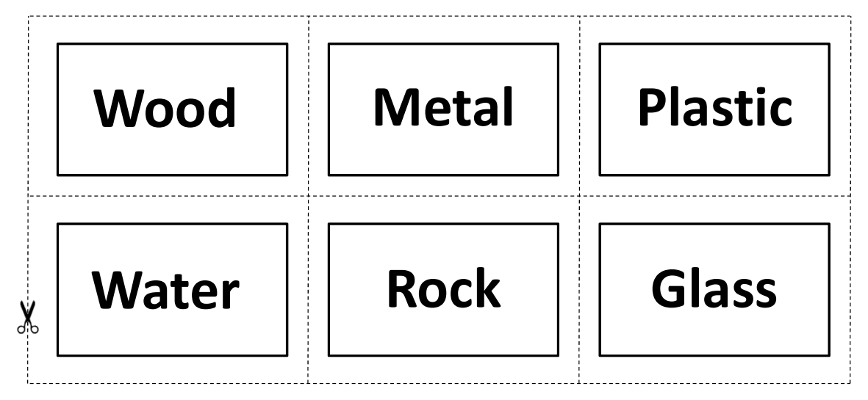
In pairs…
Notes:
Ask the children to get into pairs and take a set of Material Snap cards to their tables.
Explain that they need to mix the cards up and place them face down on the table in two piles.
Say that each person in the pair then turns a card over at the same time and reads aloud what is written on the card.
Then they need to go and find an object matching that material.
When they have got their objects, they must think of words to describe the objects and their similarities and differences, before replacing the objects and turning another pair of cards over.

Slide 13
Describe the properties of the materials…
Sharp
Rough
Smooth
Hard
Weak
Soft
Flexible (Bendy)
Opaque
(Not see-through)
Transparent
(See-through)
Flat
Bumpy
Strong
Blunt
Notes:
Examples of describing the properties of the objects

Slide 14
Choose an object which is made from a material you want to think more about.
We are going to write a song about your chosen material!
Notes:
Main activity

Slide 15
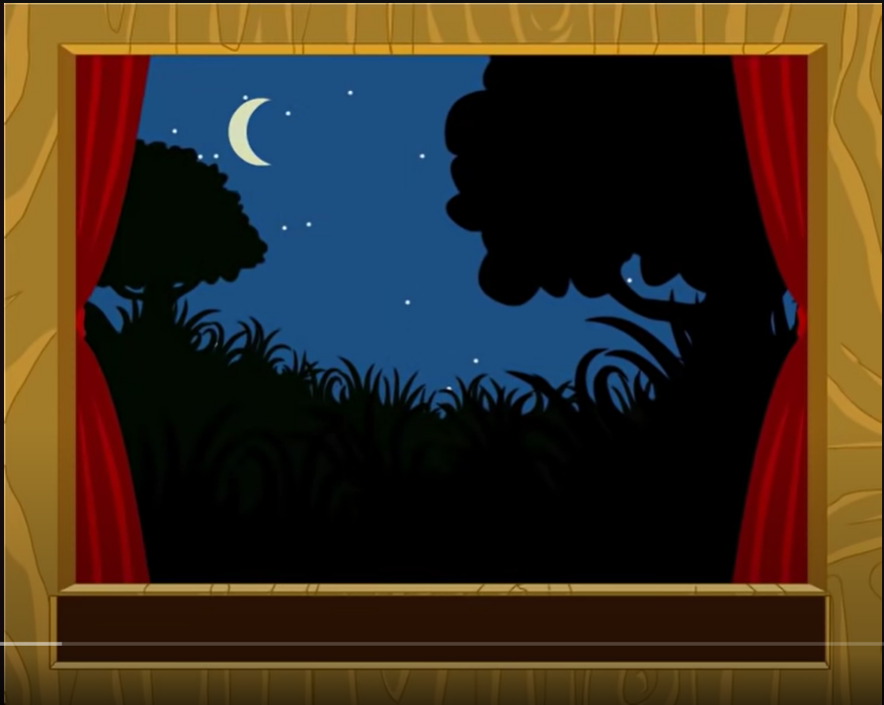
Notes:
Link to song on the picture.
Sing the rhythm of the song as a class.

Slide 16
Example Song
Wooden table,
Wooden table,
Flat and smooth,
Flat and smooth,
Strong, opaque and hard,
Strong, opaque and hard,
Not flexible!
Not flexible!
Notes:
Sing as class to model activity

Slide 17
Who would like to share their song?
Notes:
Share work at the end

Slide 18
LO: 3)

