Slide 1
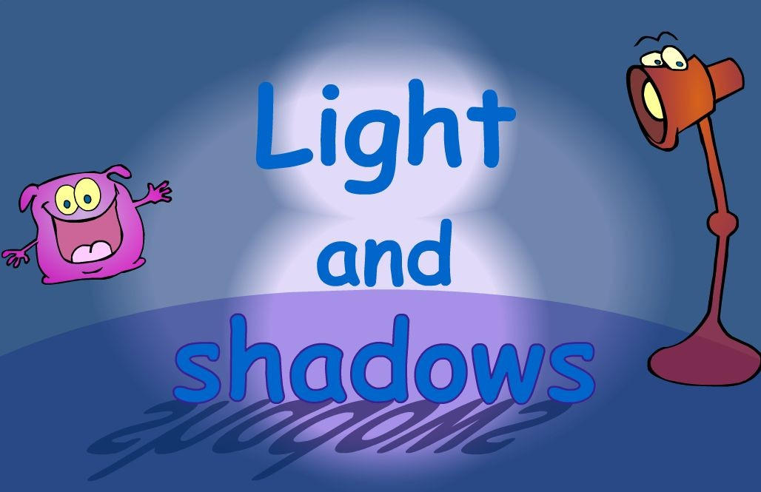
LO: To recognise that you need light in order to see things and that dark is the absence of light

Slide 2
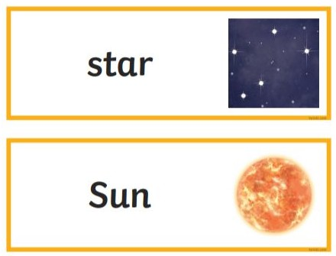
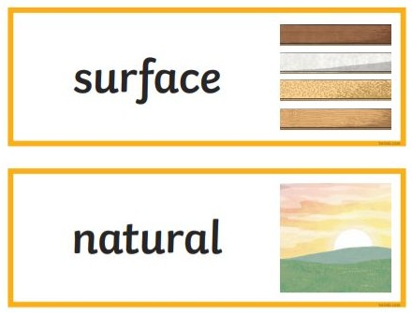
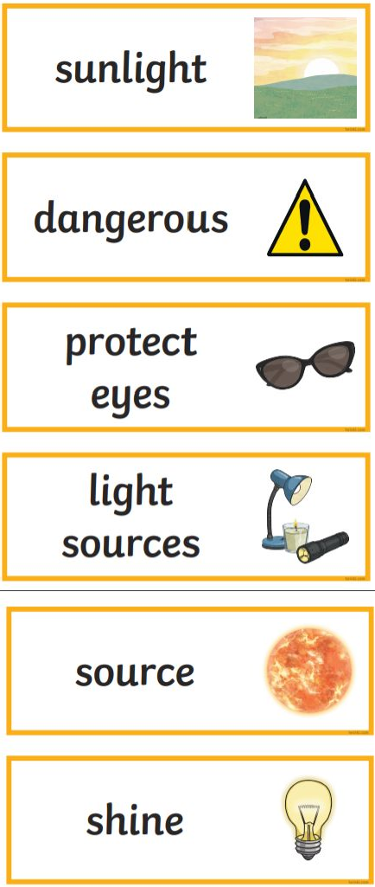
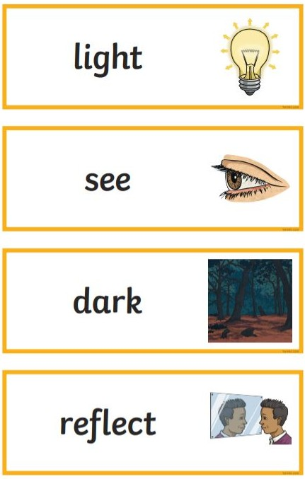
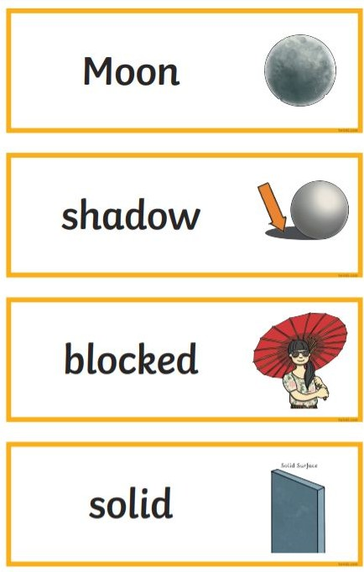
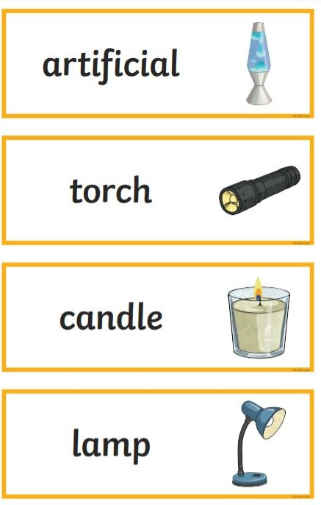
Vocabulary

Slide 3
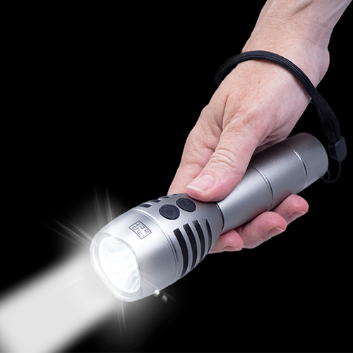
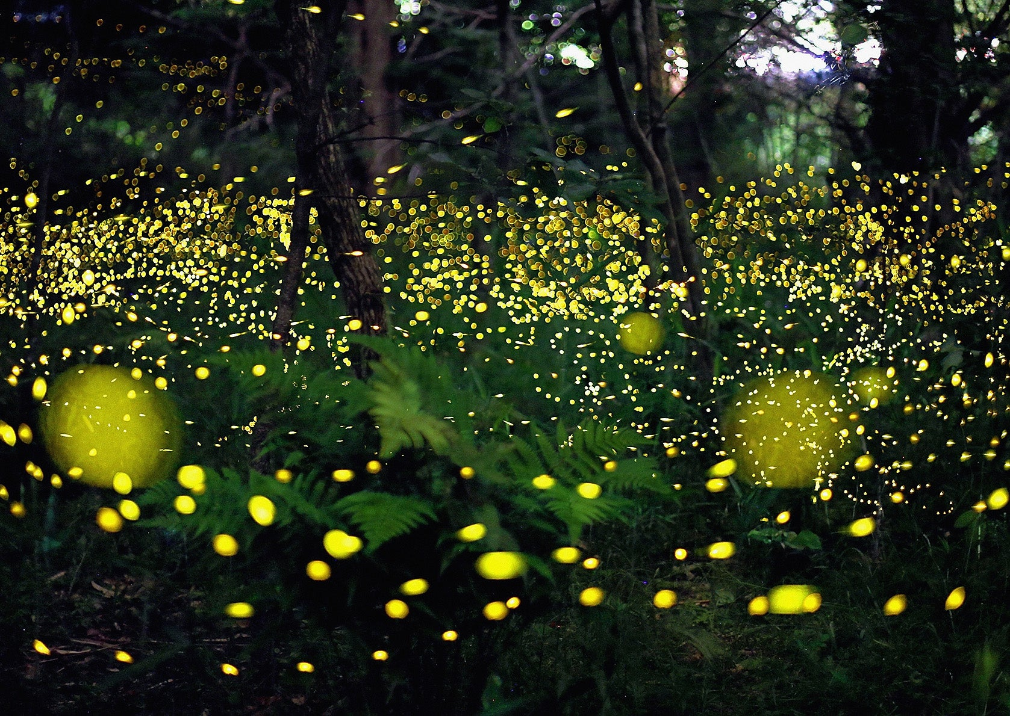
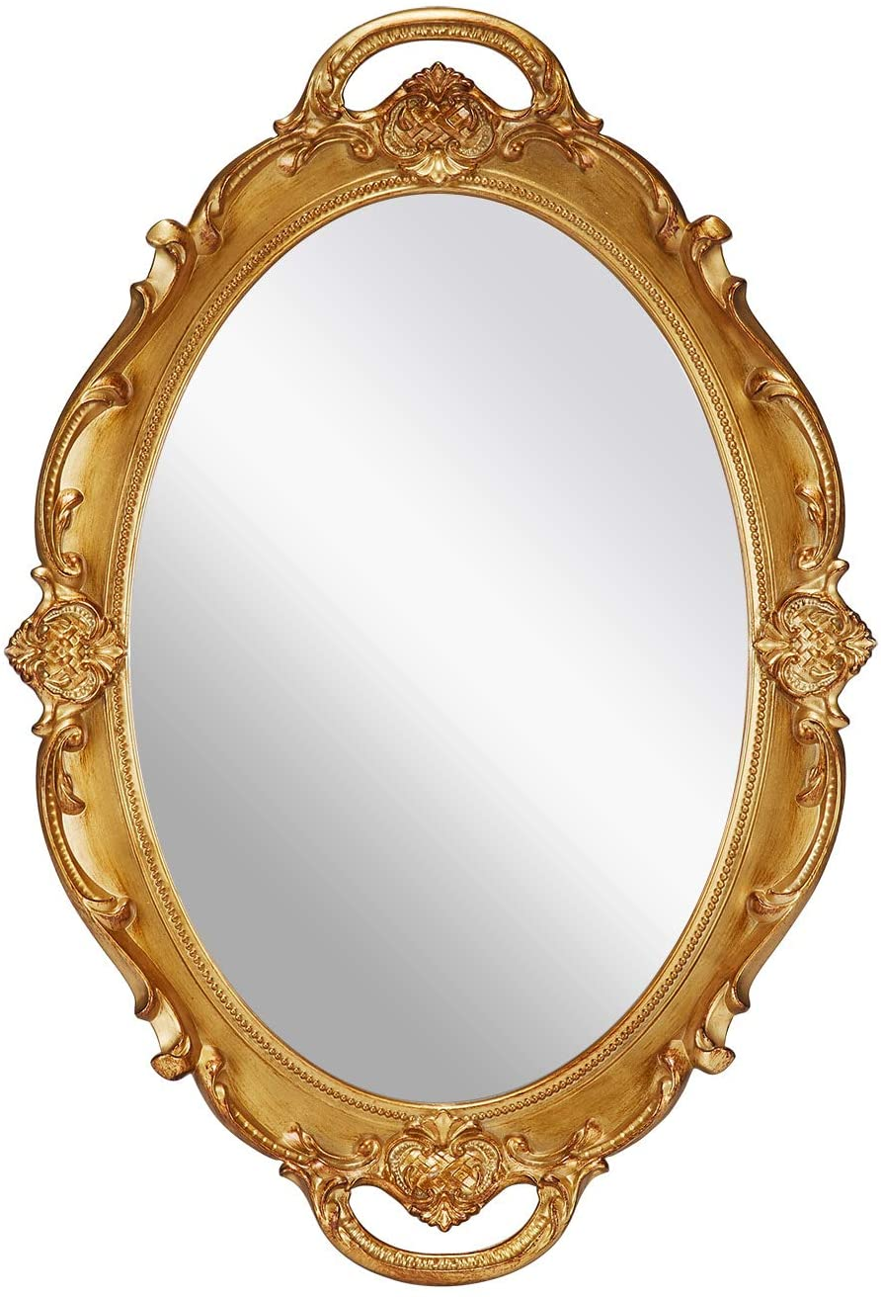
What is the odd one out? Why?
Notes:
The mirror could be the odd one out because it is a reflector of light and not a light source like the glow worms and the torch.

Slide 4




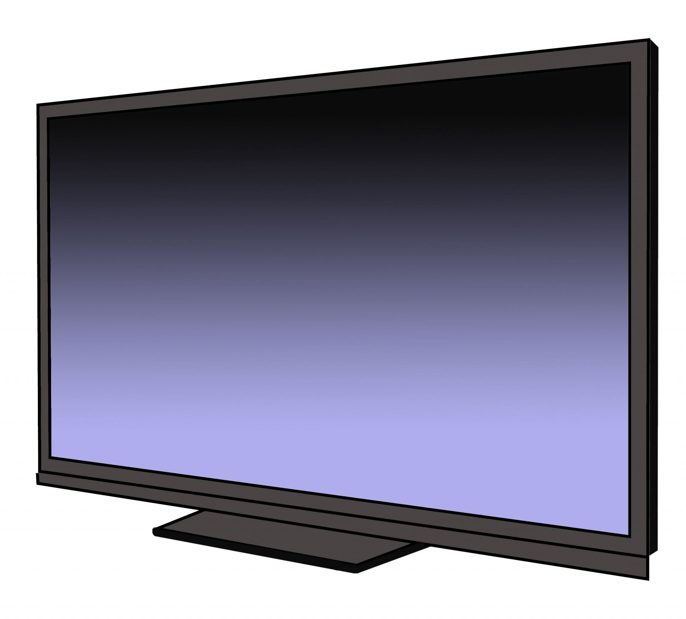

What do we need to be able to see?
What do all of these things have in common?
Notes:
Emphasise that they are all examples of light sources.
e.g. light bulb, projector light and computer screen

Slide 5
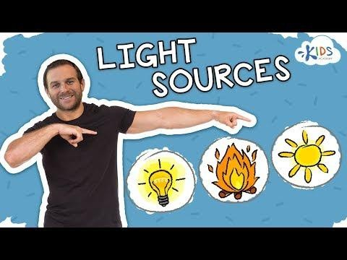
They are all sources of light!
This means that each one of these things makes light.
Stem sentence: We need light to see. Darkness is the absence of light.
Notes:
https://www.youtube.com/watch?v=d65mdTJaJTI&t=10

Slide 6


Light is a wave of energy that allows us to see. Light comes from different sources.
We can see something when light bounces off it and into our eyes.
If there is no light, it will be dark and we won’t be able to see.
Stem sentence: We need light to see. Darkness is the absence of light.

Slide 7
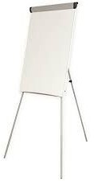
Natural and artificial light sources Natural light sources produce light by themselves without any human involvement.
Let’s list as many different natural and artificial light sources as we can!
Artificial light is made by humans.
Stem sentence: We need to see. Darkness is the absence of light.

Slide 8
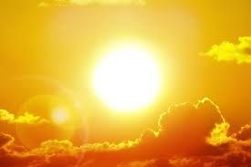
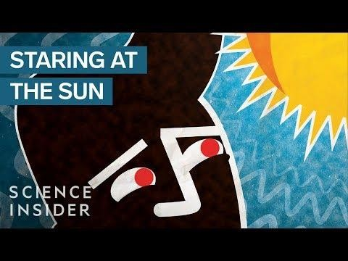
The sun
The main source of natural light is the sun. The sun uses its own resources to create light, and is constantly burning its own body of gas which gives off a huge amount of energy. This energy travels down to earth at an amazing speed in the form of light and this is what enables us to see things.
Stem sentence: We need to see. Darkness is the absence of .

Slide 9
Sort the pictures on your table. Decide if they are a light source or not a light source.

Slide 10
Sort the pictures on your table. Decide if they are a light source or not a light source.

Slide 11


Mini Investigation
Close your eyes. Can you see anything?
Keeping your eyes closed, move your hands around in front of your face. What do you notice?
Keeping your eyes closed, cover them completely with your hands. Now open your eyes. What do you notice?
Stem sentence: We need to see. is the absence of light.

Slide 12
Task 1: Create and complete a table of light sources and non light sources.
Light source | Not a light source
2. Label the natural and artificial light sources.
Challenge 1: Write a clear definition of what light is.
Challenge 2: Explain why the moon is not a light source.
Moon is not a light source because …

