Slide 1
Journey
By Aaron Becker

Slide 2
What can you see?

Slide 3
Noun Phrases
A red door
A magical forest
Hanging lanterns
A winding river
Tall trees
A glowing pathway
Twinkling lights
A hidden doorway
A peaceful clearing
Mysterious woods

Slide 4
Now put them into sentences
I can see twinkling lights between the trees.
A winding river flows through the forest.
Tall trees cover the sunlight.

Slide 5
Now experiment with changing the phrase order:
I can see paper lanterns between the trees.
Between the trees, I can see paper lanterns.

Slide 6
Lesson 2: 09.09.24
LO: To make predictions about a text.

Slide 7
Dear Reader, This is a story of long ago, when I was just a girl. One summer, as the days stretched out endlessly, I made a discovery which was to change my life for…

Slide 8
What do the children think might have been in the rest of the letter?
Who might have left the letter here?

Slide 9
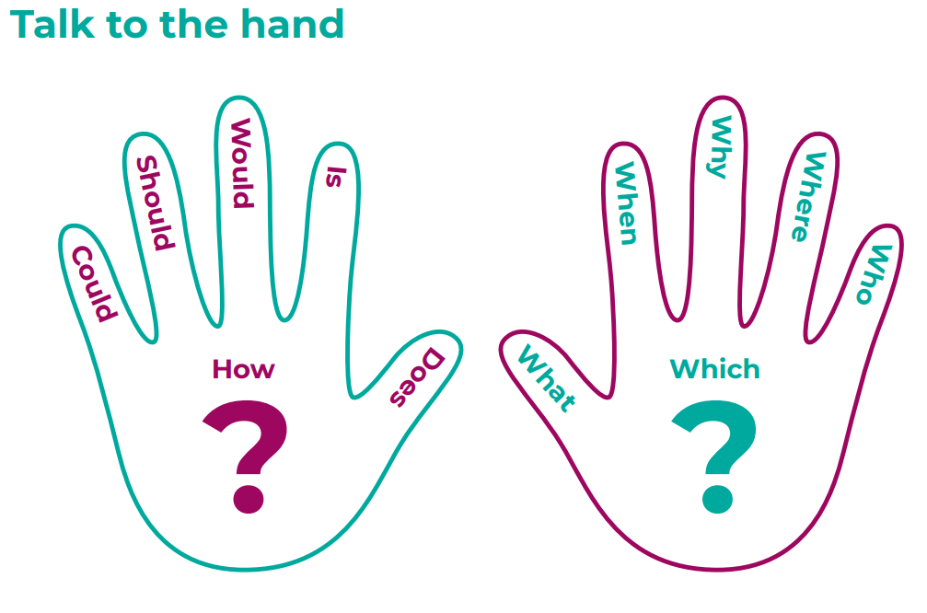

Slide 10
Now using conjunctions, prepositions and adverbs to express time, place and cause e.g.
As the letter ends with …
it could be that …
Notes:
Model these with the class.
The book needs to be fully read/recapped today.

Slide 11
Lesson 3: 10.09.24
LO: To use speech accurately.

Slide 12
Your task is to role-play in groups of four and use your knowledge of contracted verbs to capture what is said in bubbles of speech from the scene with the aqueduct.
Use the speech bubble paper to write out your speech bubbles then pop them and write them as full punctuated sentences.

Slide 13
Pop the bubbles
https://www.bbc.co.uk/bitesize/articles/ztcp97h#ztfk239 – inverted commas
https://www.bbc.co.uk/bitesize/articles/zhqh92p#zw8wkty – punctuating speech
Your task now is to pop your speech bubbles and put what is in the speech bubbles into sentences with the speech punctuated correctly.

Slide 14
Lesson 4: 11.09.24
LO: To plan writing.

Slide 15
Over the coming days the you will be writing a sequel to journey and today will be an opportunity to plan for it.
The things you need to think about for your sequel:
The colour of crayon each character might find.
How and where they will travel (likely to be using the bike, at least initially!)
Will they be time-travelling?
What problems/ threats they might encounter along the way (again, this could be linked to topic).
Children can choose names for their characters but for the purposes of this planning sequence, we have named them Lila and Ethan.

Slide 16
Lesson 1 - they find a magic crayon that leads them to another world/time. Use lots of description in this piece.
Lesson 2 – they introduce another character that they will share dialogue with.
Lesson 3 - children will conclude their stories using noun phrases and descriptive sentences from the first lesson.

Slide 17
Lesson 5,6&7: 13.09.24/14.09.24/15.09.24
LO: To write an effective narrative.

Slide 18
What do we need to include in our writing today?

Slide 19
We rode off on our tandem bike, both of us happy to have found friendship. As the sun began to set, the sky turned orange and pink, and we stopped by a small stream. The stream looked familiar, but I couldn’t remember why. Just then, a green bird flew down and dropped a green crayon from its beak. I bent down to pick it up, and felt a spark of excitement again. If my red crayon had taken me on an adventure, and Ethan's purple crayon had done the same for him, where would the green crayon take us both?

Slide 20
Lesson 2

Slide 21
As we flew higher into the sky, the air grew darker, and a spooky mist began to swirl around us. "Do you think something bad is going to happen?" Ethan asked, shivering and looking around nervously. But before he could say anything else, a deep, powerful voice suddenly spoke out of nowhere...

