Slide 1
ages 7-9
Barefoot meets micro:bit
Wildlife Animations - Lesson 1

Slide 2
Learning objectives
I can explain what the micro:bit’s components do
I can sequence code within the micro:bit MakeCode editor
I can design and code images using the micro:bit’s LEDs

Slide 3
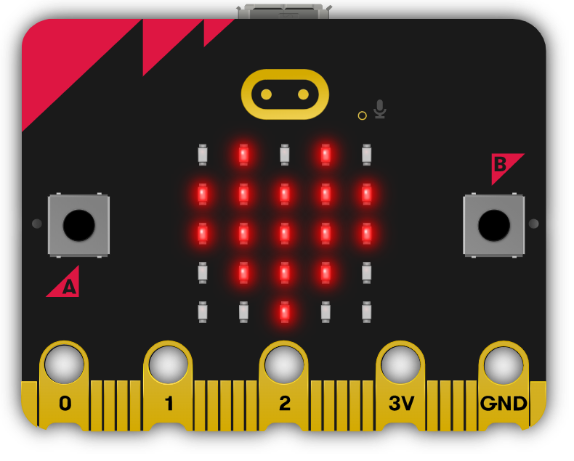
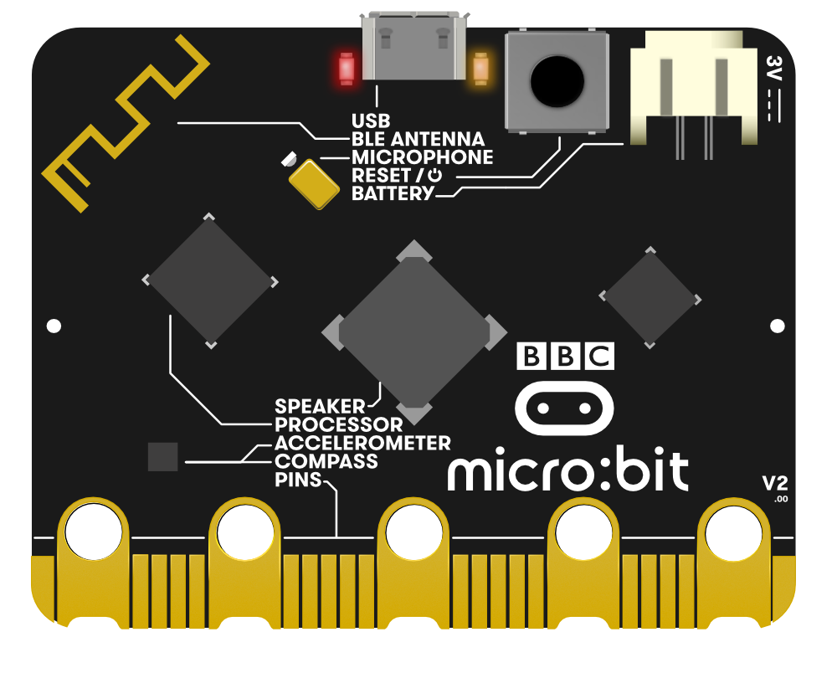
micro:bit
The micro:bit is a special computer we can program.
Can you find these parts?
LEDs
USB connector
Are the LEDs inputs or outputs?
What other parts can you find?
What might these other parts do?
Notes:
Image © Micro:bit Educational Foundation

Slide 4
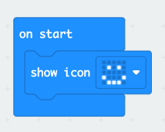
Our first program
What do you think this program for the micro:bit does?

Slide 5
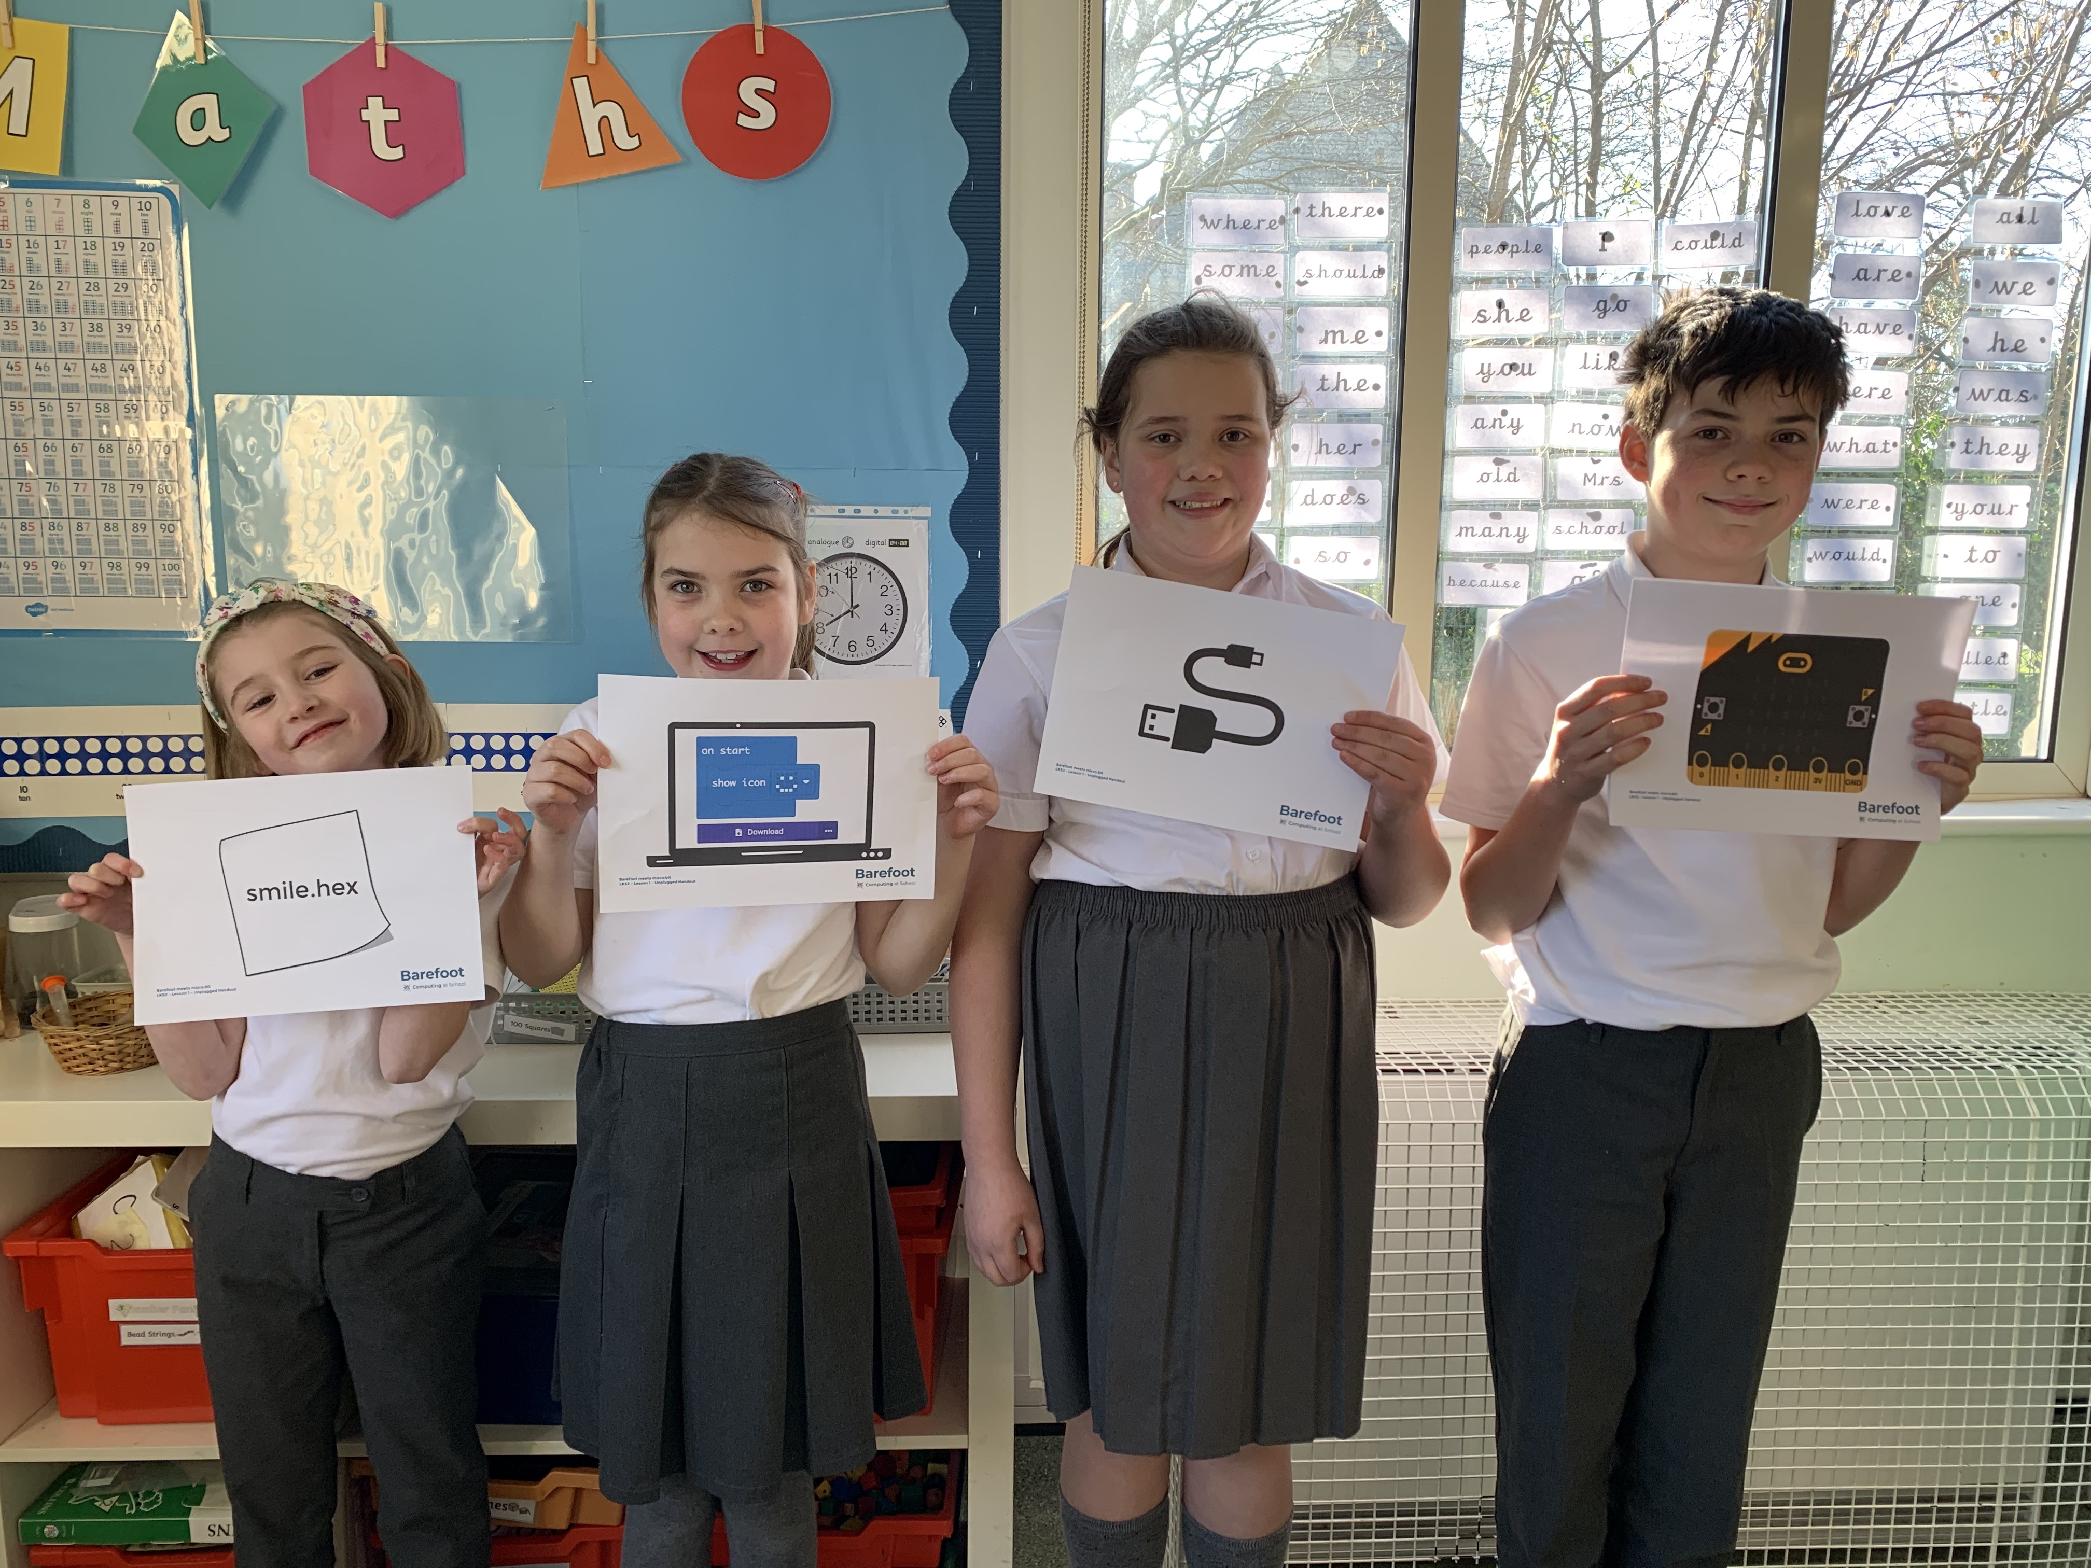
Transferring a program
Starting position for images

Slide 6
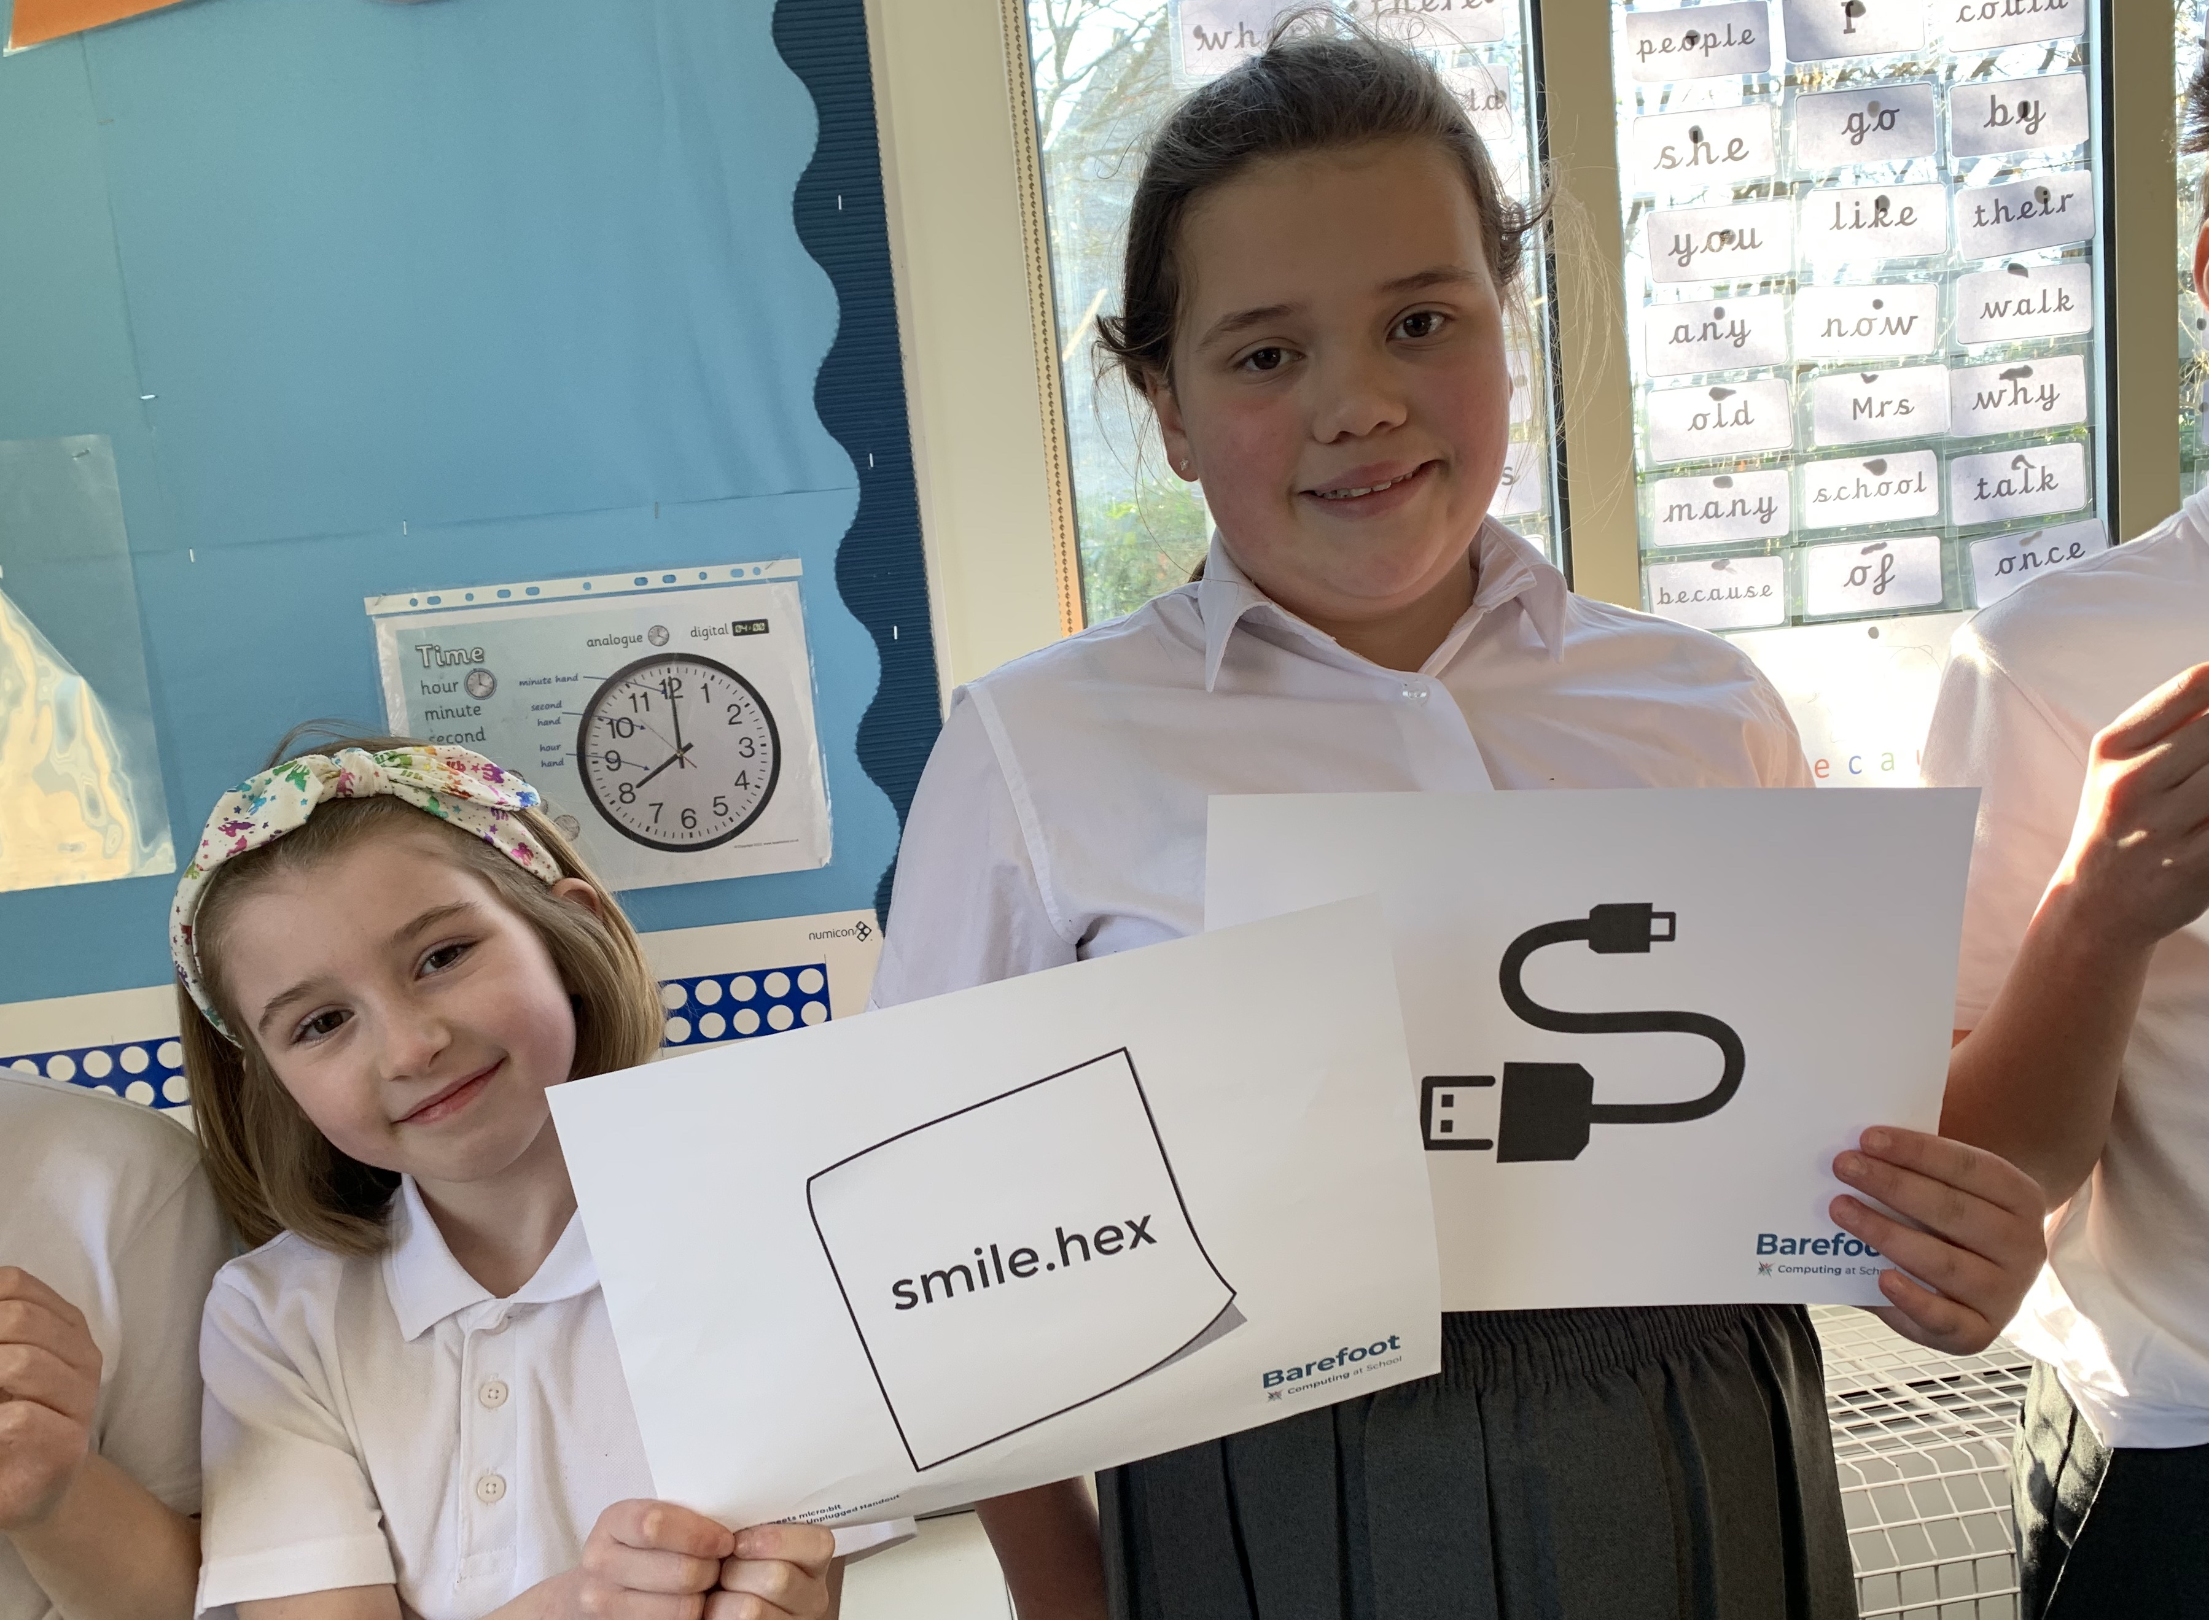
Transferring a program
File being transferred using USB cable

Slide 7
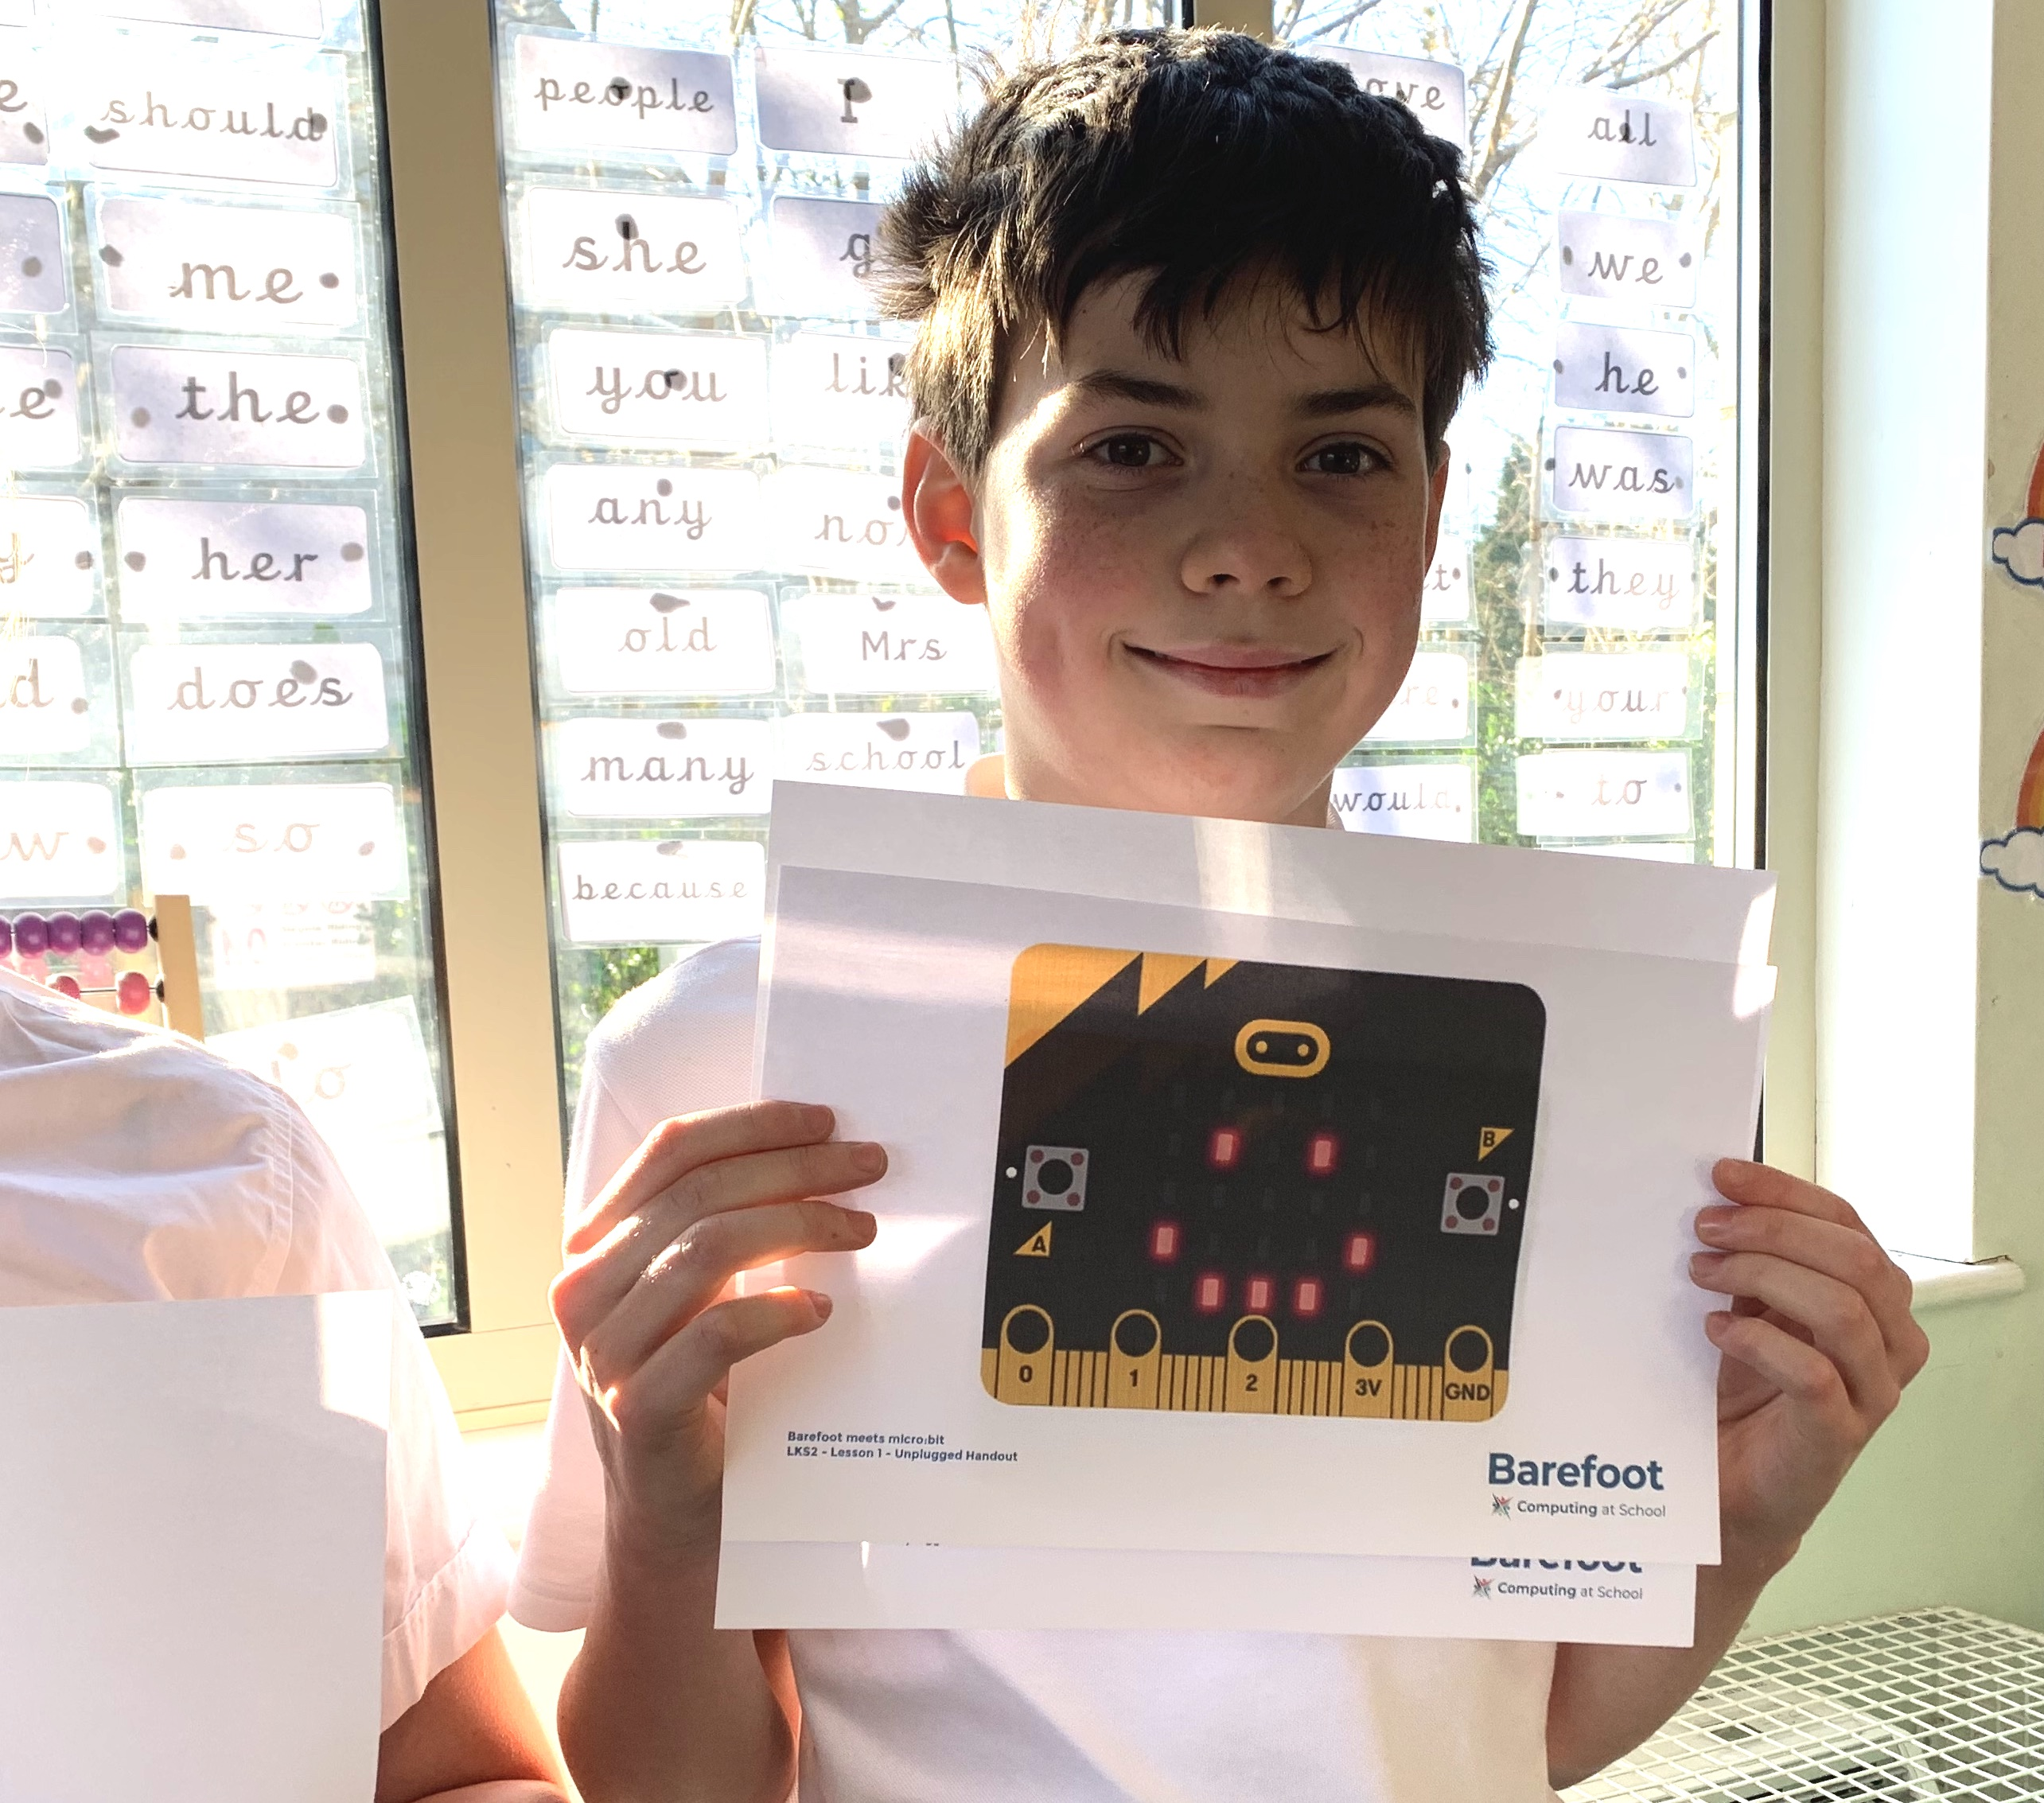
Transferring a program
micro:bit image displaying smiley face

Slide 8
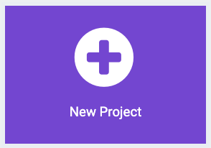
Creating a program
MakeCode programming environment - makecode.microbit.org
Create a new project
Give the project a name

Slide 9
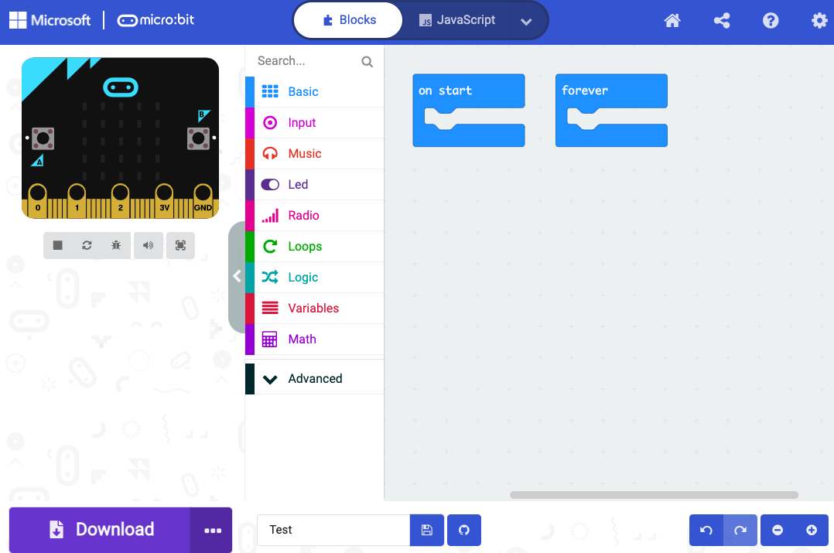
Creating a program
A
B
C

Slide 10
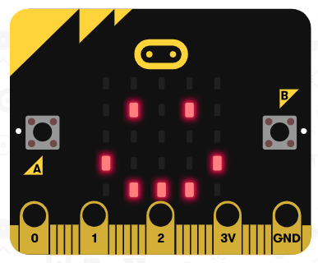
Creating a program
Let’s create the program we saw at the start of the lesson

Slide 11
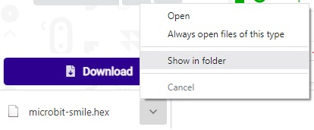
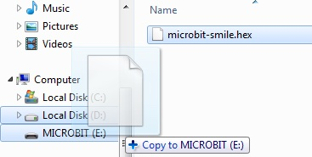
Transferring a program
Download the program, then select ‘Show in folder’
Drag the file from the ‘Downloads’ folder onto the micro:bit

Slide 12
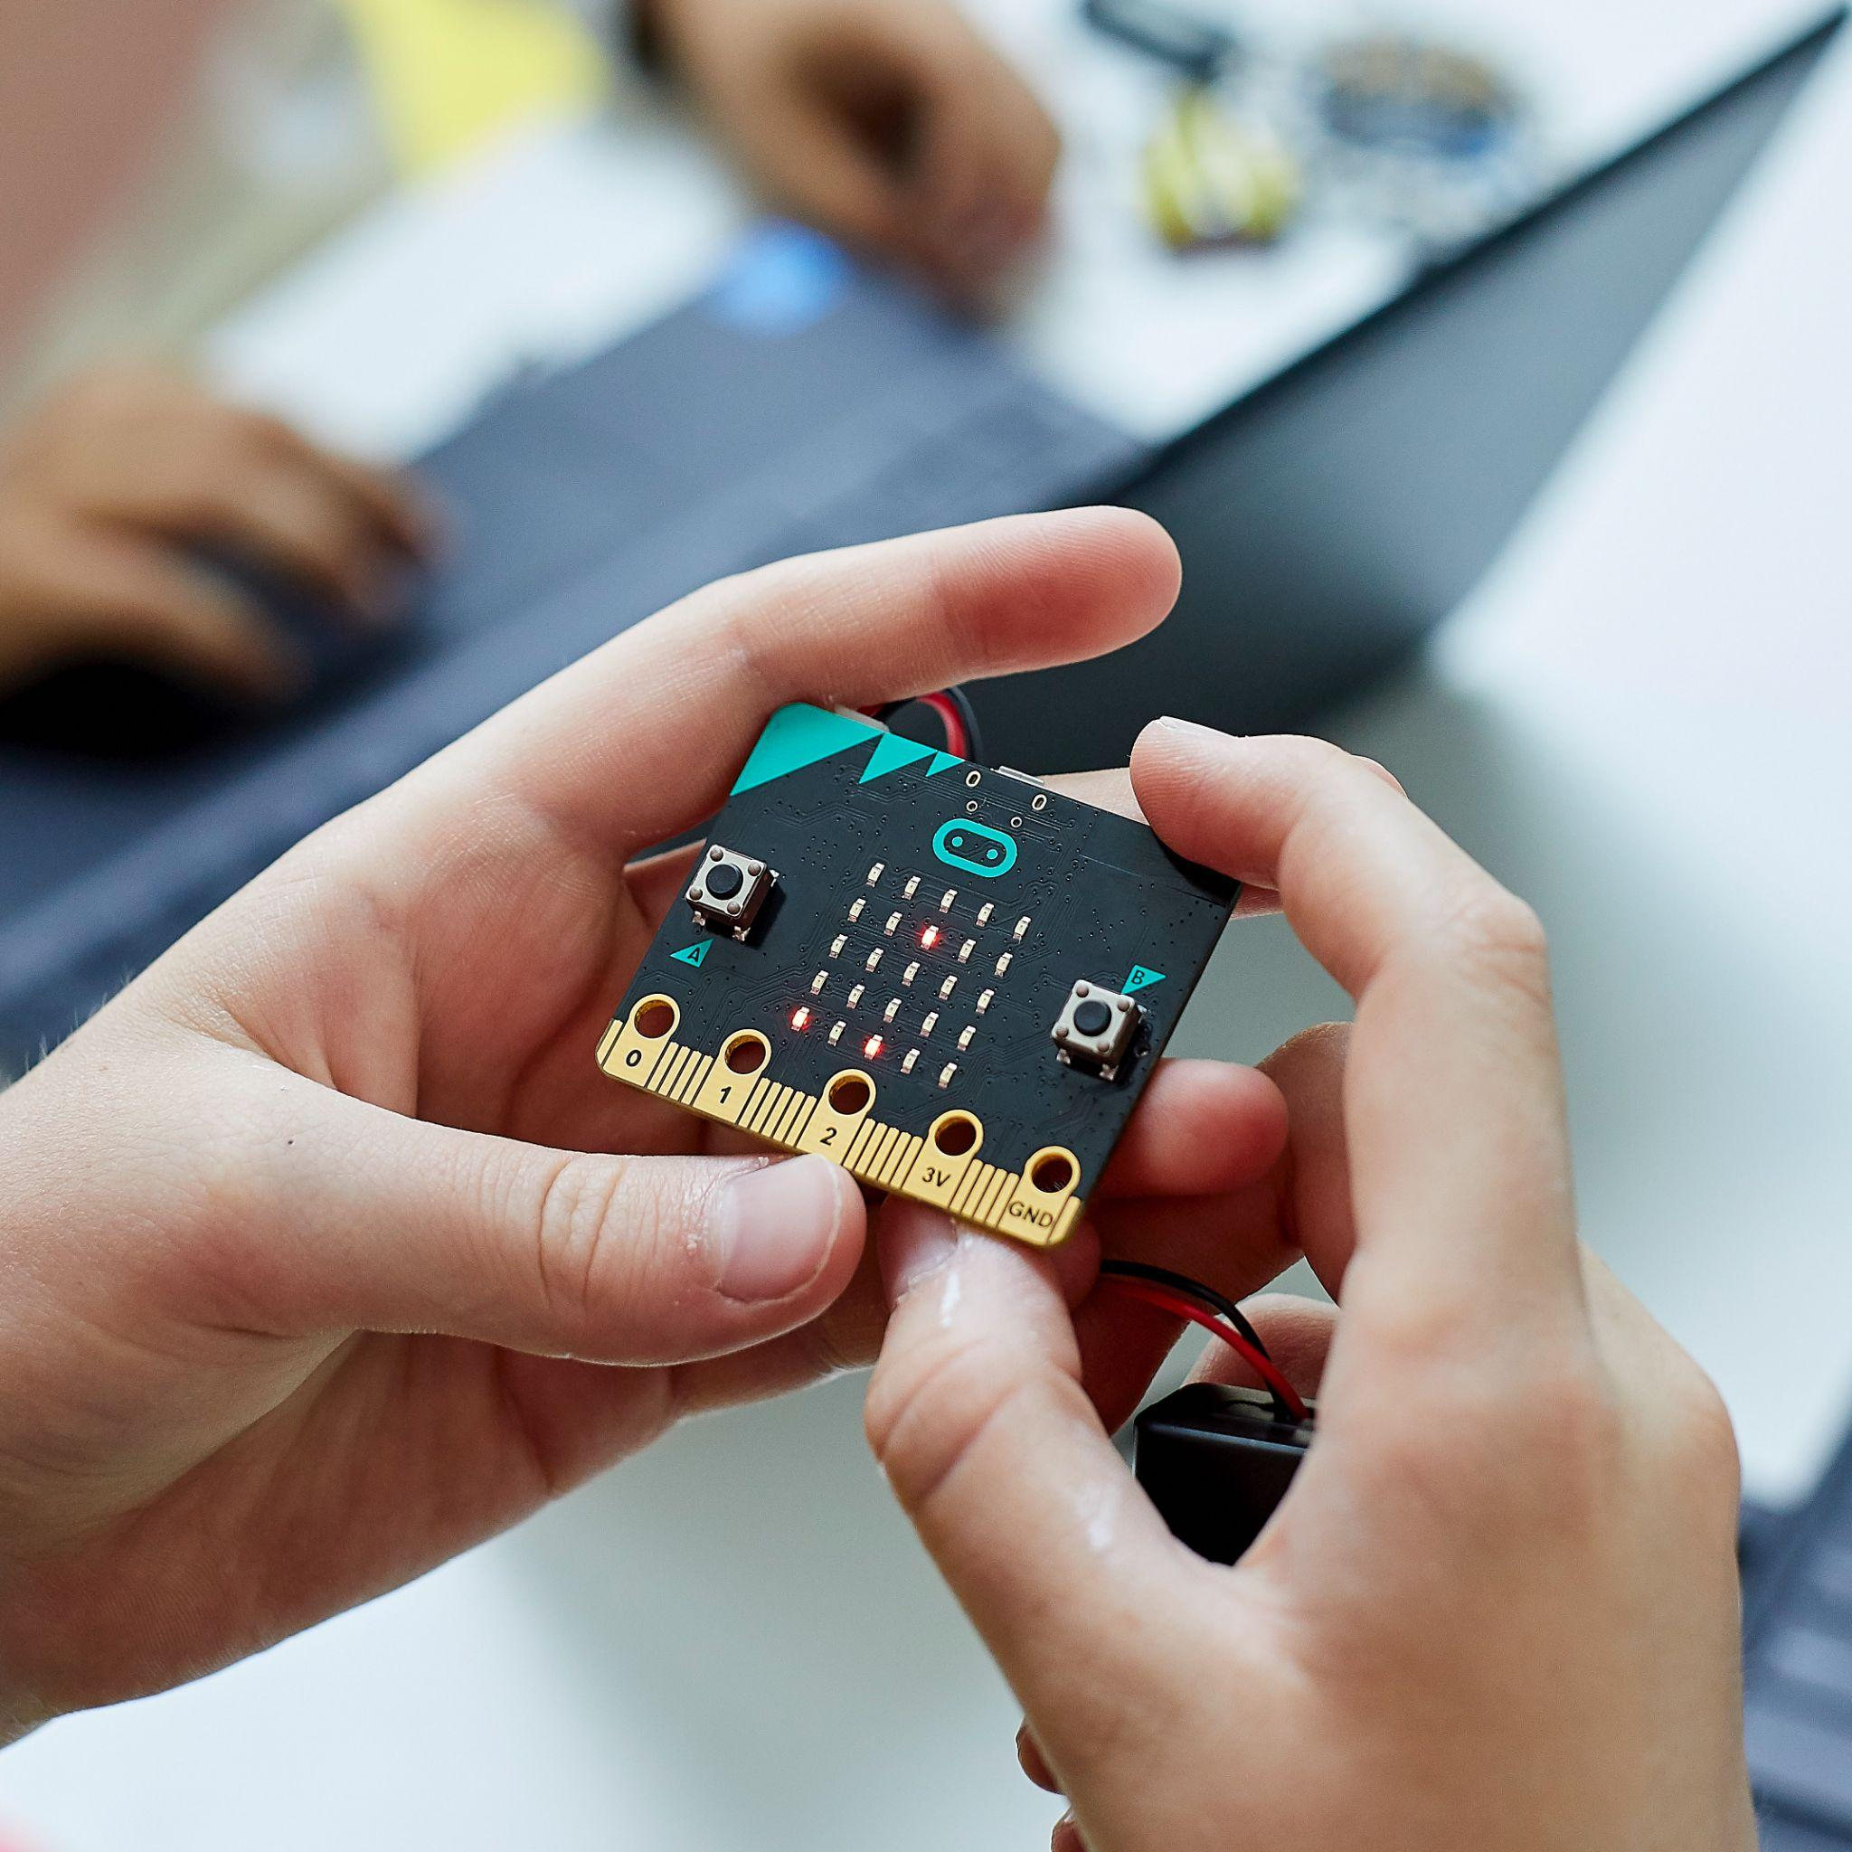
Keeping safe
Hold the micro:bit carefully by the edges
Avoid touching the components
Keep liquids away from the micro:bit
Notes:
Image © Micro:bit Educational Foundation

Slide 13
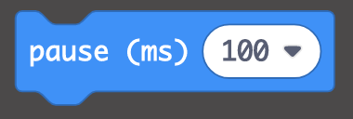
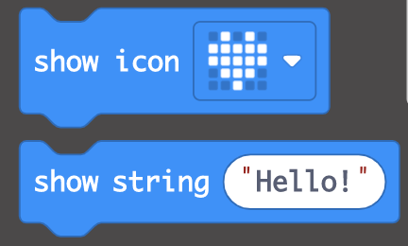
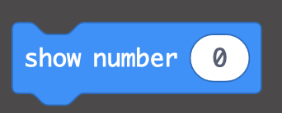
Your turn!
MakeCode programming environment - makecode.microbit.org
Once you have made your first program, can you experiment with these use ‘Basic’ blocks to:
  Display a different image?
  Display two images, with a pause in between?
  Display a number?
  Display some text?
  Combine images, numbers and text in a sequence?
A
B
C

Slide 14
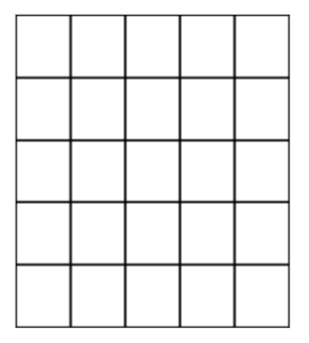

Creating our own images
Each LED can be programmed individually, so we can create our own images

Slide 15

Creating our own images
What plant or nature images could we make using the LEDs?

Slide 16
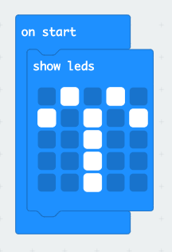
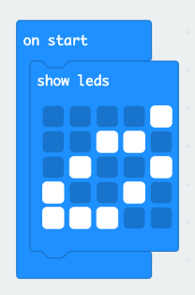
Creating our own images
The ‘show leds’ block lets us program individual LEDs

Slide 17
Your turn!
Once you made your program containing your own image, can you experiment with these ‘Basic’ blocks to:
  Display a different image?
  Display two of your own images, with a pause in between?
  Add the name of your image after is has been displayed?
  Combine a number of images and text in a sequence?

Slide 18
Plenary
Share your program with someone near you
Explain to them which blocks you have used in your program and why

