Slide 1
Session 6: Writing game instructions and publishing the game
To write a set of instructions for your game and publish it online

Slide 2
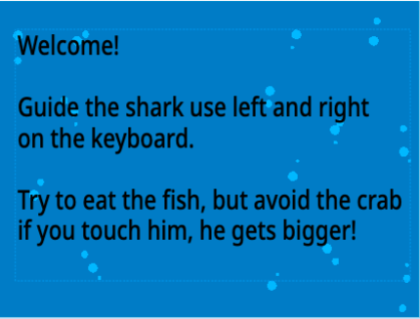
Let’s learn
In this session, you will create a splash screen and a set of instructions for your game.
Notes:
It is important that these screens are clear and don’t contain any errors. Can you spot the errors on this splash screen?

Slide 3
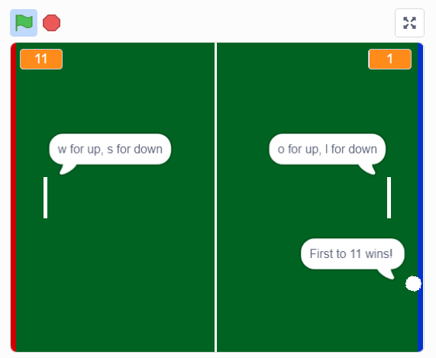
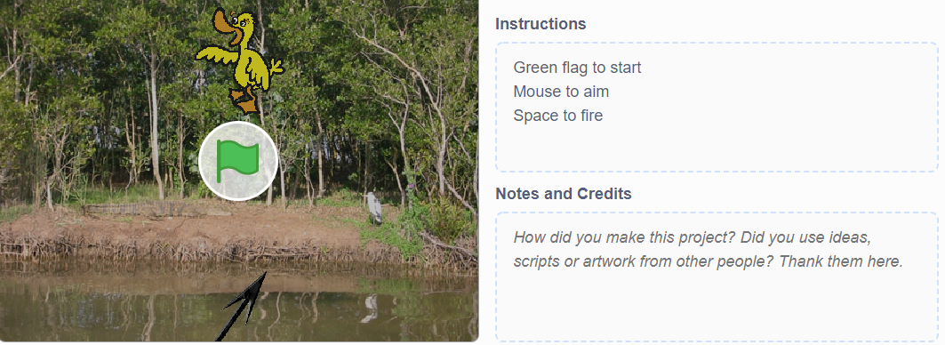
Let’s do
Think about any instructions or other information you need to include with your game.
How might these be best presented?
Look at these examples from other Scratch games.

Slide 4
Let’s learn
You could include a splash screen at the beginning of the game and a set of instructions, either as text or a recorded narration.
Tip!
Giving too much information might spoil the experience of playing the game.

Slide 5
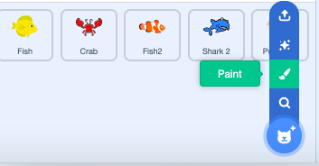
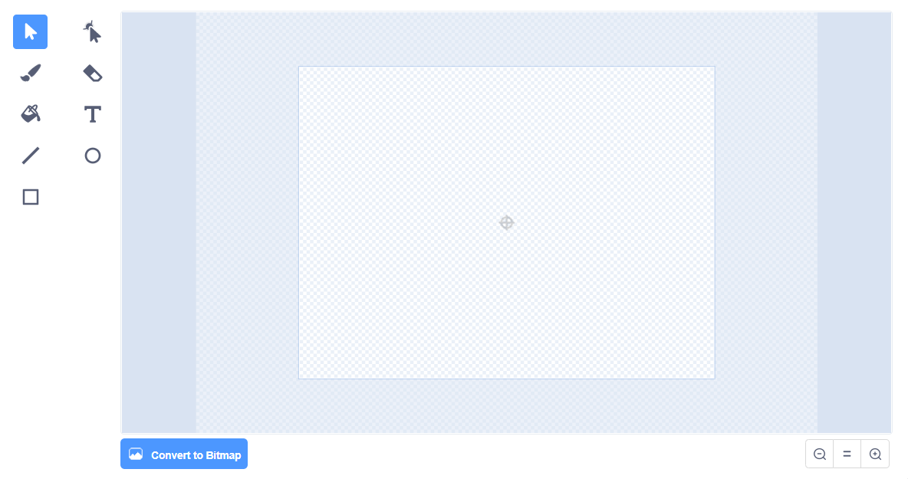

1
Let’s do
As an example, to create a splash screen for the Fish Game:
Click on the new sprite icon and choose ‘Paint’ to create a new sprite. This will take you to the sprite editor.
Select ‘Convert to Bitmap’.
Paint a splash screen using the sprite editor.
2
3

Slide 6

1
Let’s do
Complete the splash screen by adding the instructions for the game:
Click the text icon.
Add some instructions for your game. Remember, don’t add too much information.
2

Slide 7
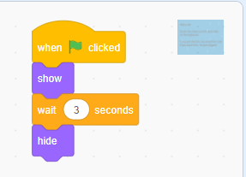
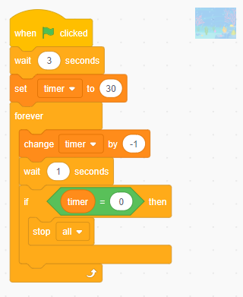
Let’s do
Code a set of instructions for the splash screen to appear at the beginning and then disappear:
  Add a when green flag clicked block.
  Add a show block.
  Add a wait 1 seconds block and change it to 3 seconds.
  Then make the splash screen hide for the rest of the game by adding a hide block.
Go back to your timer code (on the backdrop) and add a wait 1 seconds before the timer starts, setting it to 3 seconds. Otherwise the player will lose ten seconds at the start of the game.
1
a
b
c
d
2

Slide 8
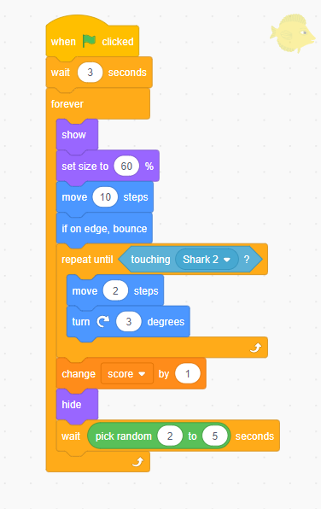
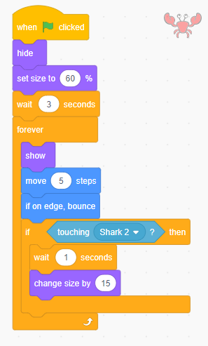
Let’s learn
You will also need to adjust when your sprites appear. The shark could appear on the splash screen, but we want to hide the others, so the scoring doesn’t start before the splash screen disappears.
Let’s do
On the fish sprite code add a wait 1 seconds block and change it to 3 seconds. We need to do this for the three fish sprites.
On the crab sprite code:
  add a wait 3 seconds block.
  we also need to code the sprite to hide during the splash screen and appear after three seconds, so add hide and show blocks.
1
2
b
a
b

Slide 9
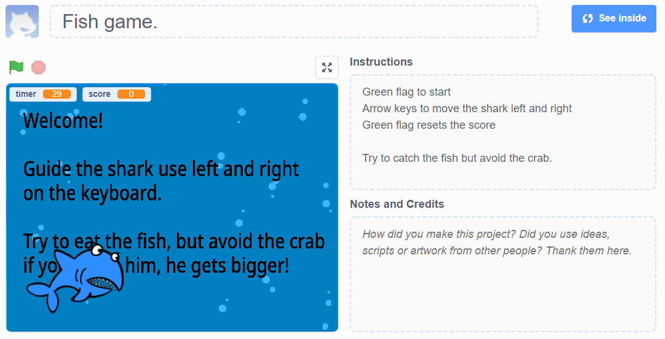
Let’s learn
Scratch games can be remixed by other programmers. This means that programmers make their own version of the game by changing the code, sprites, backdrop, sound effects, etc.
Add further comments to your script to explain how it works. This means that other programmers can remix it more easily. Remember to use logical reasoning here.
Let’s do
Add some instruction in the instructions box.
You can share your project by clicking share.
1
2
Do you know what logical reasoning is?
Click on this box to see the definition.
Logical reasoning: a systematic approach to solving problems or deducing information using a set of universally applicable and totally reliable rules

Slide 10

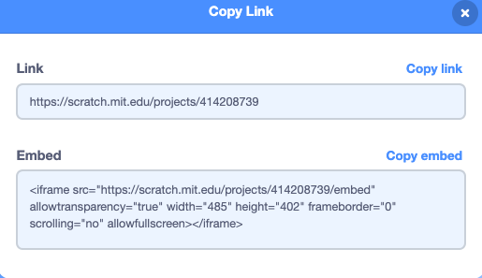
1
Let’s do
You could share your game through a link or embed your game in the school learning platform or class blog.
Do this by:
Clicking ‘Copy Link’.
Choosing to copy the link to share with others, or copy embed if you are embedding it into a website or blog.
2

Slide 11
Let’s review
Review your work during this project in pairs and draw together ideas as a class.
Have you enjoyed the project?
How have your programming skills improved?
What might you still need to work on?
How would you improve about your game if you could?
How might you challenge yourself when you next program?
Do you find Scratch easy to use?
How does Scratch compare to other coding software that you have used at school or elsewhere?

Slide 12
Quiz time!
Do you know the answers to these questions?
There are ten questions in total – click to see the answers in bold.
Question 1
Match the word to its definition:
background | an error or mistake in a program
algorithm | a sequence of precise instructions to achieve an objective
bug | scenery and other unchanging elements in a game
debug | instructions that can be understood by a computer
sprite | correct mistakes in a program
code | a graphical character that can be given its own sequence of instructions
background | scenery and other unchanging elements in a game
algorithm | a sequence of precise instructions to achieve an objective
bug | an error or mistake in a program
debug | correct mistakes in a program
sprite | a graphical character that can be given its own sequence of instructions
code | instructions that can be understood by a computer

Slide 13
Question 2
Which of the following statements is true?
a) Games must have characters
b) Games must have a score
c) Games must have rules
d) Games must use the keyboard
Question 3
What are vector graphics?
a) Images where each dot has a colour code
b) Images made of lines and curves
c) Images that point in a certain direction
d) Images with lots of similar versions
Question 2
Which of the following statements is true?
a) Games must have characters
b) Games must have a score
c) Games must have rules
d) Games must use the keyboard
Question 3
What are vector graphics?
a) Images where each dot has a colour code
b) Images made of lines and curves
c) Images that point in a certain direction
d) Images with lots of similar versions
Question 4
Why would you create multiple costumes for the same sprite?
a) To save memory
b) To speed the game up
c) To allow movement to be animated
d) To try out lots of different ideas
Question 4
Why would you create multiple costumes for the same sprite?
a) To save memory
b) To speed the game up
c) To allow movement to be animated
d) To try out lots of different ideas
Question 5
How do you access the music blocks in Scratch?
a) By using the extension tool to add music blocks
b) By using the Sounds palette
c) By using the sounds library
d) By using the recording tool
Question 5
How do you access the music blocks in Scratch?
a) By using the extension tool to add music blocks
b) By using the Sounds palette
c) By using the sounds library
d) By using the recording tool

Slide 14
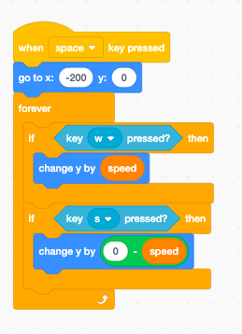
Question 6
What does this program do?
a) Moves a sprite left and right according to which keys are pressed
b) Moves a sprite up and down according to which keys are pressed
c) Moves a sprite up or down randomly
d) Moves a sprite up and down if the W and S keys aren’t pressed
Question 6
What does this program do?
a) Moves a sprite left and right according to which keys are pressed
b) Moves a sprite up and down according to which keys are pressed
c) Moves a sprite up or down randomly
d) Moves a sprite up and down if the W and S keys aren’t pressed

Slide 15
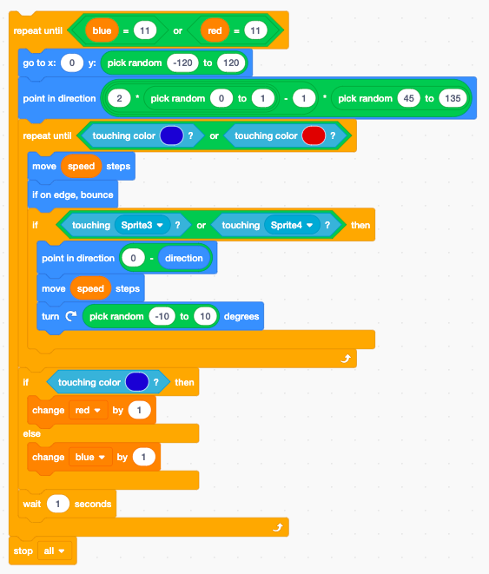
Question 7
Look at this Scratch program. When will the game end?
a) After one second
b) When the sprite touches a blue or red colour
c) As soon as the sprite touches Sprite3 or Sprite4
d) When one player scores 11 points
Question 7
Look at this Scratch program. When will the game end?
a) After one second
b) When the sprite touches a blue or red colour
c) As soon as the sprite touches Sprite3 or Sprite4
d) When one player scores 11 points

Slide 16
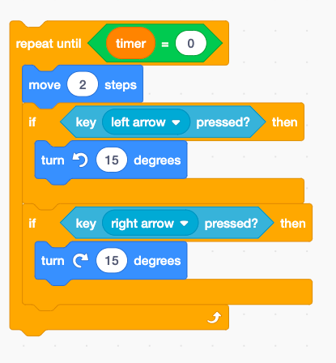
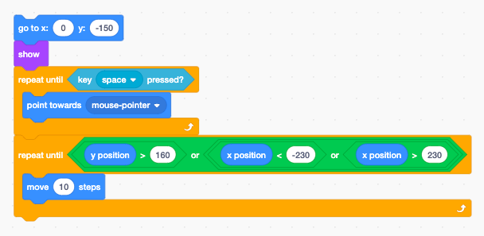
Question 8
How would you change this program to make the sprite move more quickly?
a) Increase the turn numbers
b) Increase the number of steps forward
c) Use a forever loop
d) Add another if block to only move forward if the up arrow is pressed
Question 8
How would you change this program to make the sprite move more quickly?
a) Increase the turn numbers
b) Increase the number of steps forward
c) Use a forever loop
d) Add another if block to only move forward if the up arrow is pressed
Question 9
What does this Scratch program do?
a) Steers a racing car using the space key
b) Fires something towards where the mouse pointer is
c) Make a ball bounce
d) Moves in a random direction until it hits the edge
Question 9
What does this Scratch program do?
a) Steers a racing car using the space key
b) Fires something towards where the mouse pointer is
c) Make a ball bounce
d) Moves in a random direction until it hits the edge

Slide 17
Question 10
When will this game end?
a) After two seconds
b) After 30 seconds
c) When the score is bigger than the high score
d) When the score is zero
Question 10
When will this game end?
a) After two seconds
b) After 30 seconds
c) When the score is bigger than the high score
d) When the score is zero

