Slide 1
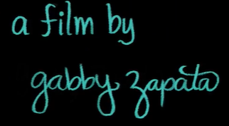
Bubbles by Gabby Zapota

Slide 2
Bubbles
A Literacy Shed Film by Gabby Zapota
https://www.literacyshed.com/bubbles.html

Slide 3
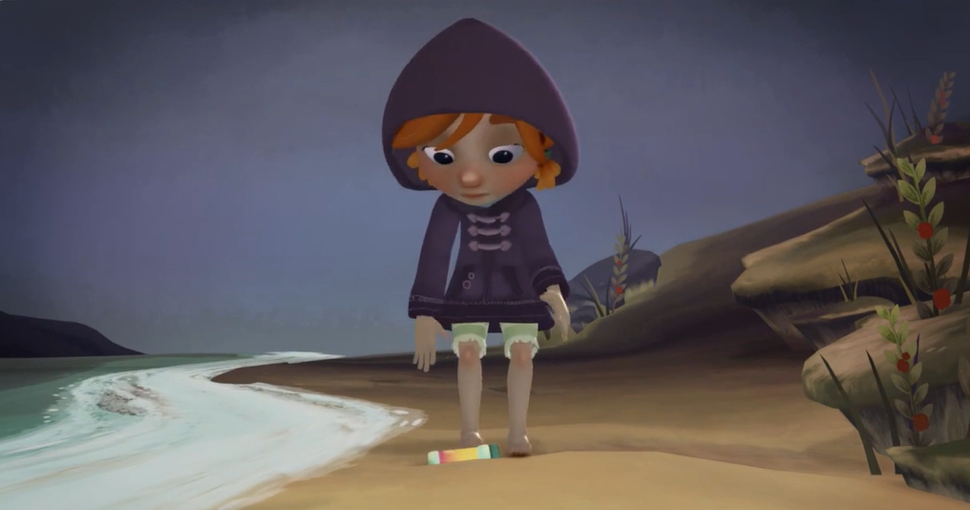
Monday 29th April 2024 LO: To make sensible predictions about this image?
Who is she?
What is she doing?
Where is she going?
How does she feel?
What will she discover?
What is the object lying on the sand?
Why is she there?
How would you feel if you discovered an object on the beach? (0-12 seconds)

Slide 4
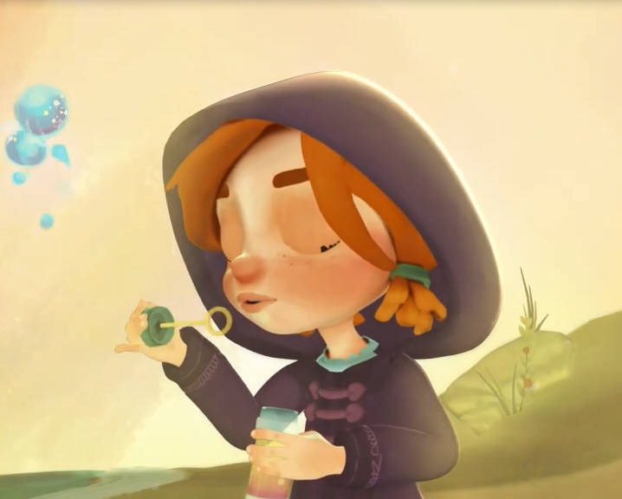
Tuesday 30th April 2024 LO: To demarcate most sentences in their writing with capital letters and full stops (Y2). Beginning to use full stops to end sentences (Y1).
What happens when she blows the very first bubble? (20seconds- stop)
How will her mood change?
Talk partners
Discuss what could happen...
Are they magical bubbles?
How will her mood change?
If you had found these bubbles
Where would you like to go and why?

Slide 5
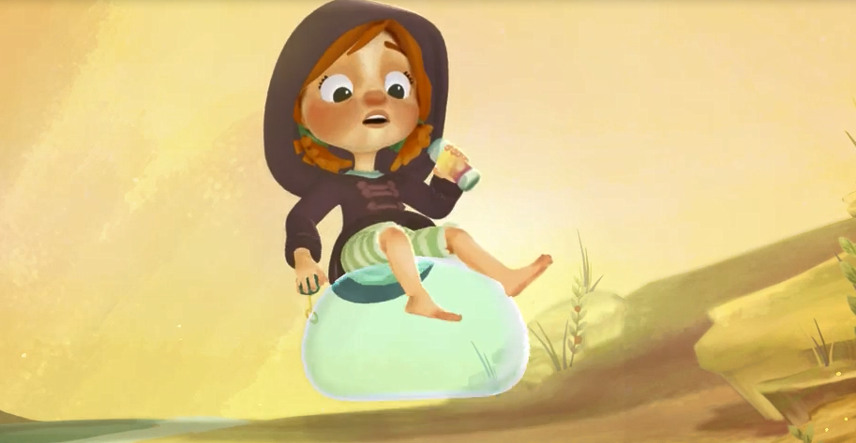
Wednesday 1st May 2024 LO: To go on a magical adventure…

Slide 6
Wednesday 1st May 2024 LO: To sequence Gabby’s magical adventure…
Describe Gabby’s exciting journey, sequencing where the bubble takes her (using time adverbials)…
First,
Next,
After that,
Soon,
Meanwhile,
Suddenly,
Then,
Finally

Slide 7
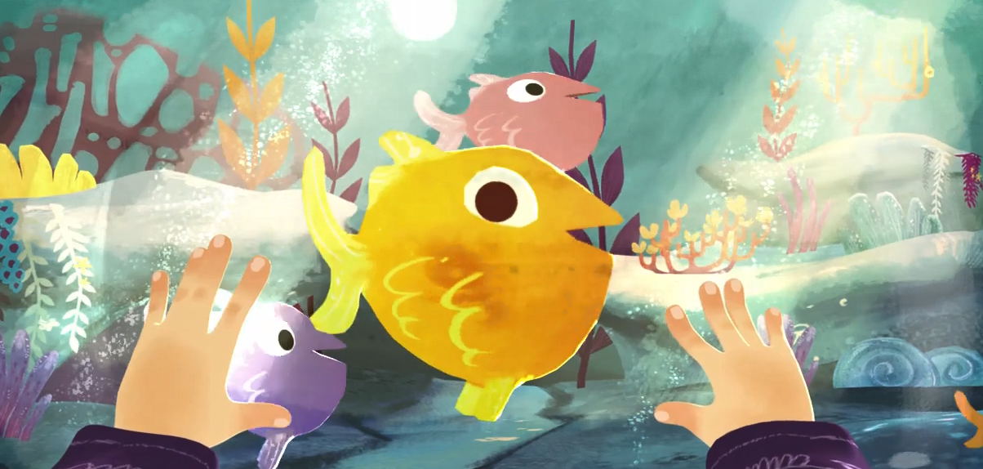
Bubble Adventure…
?

Slide 8
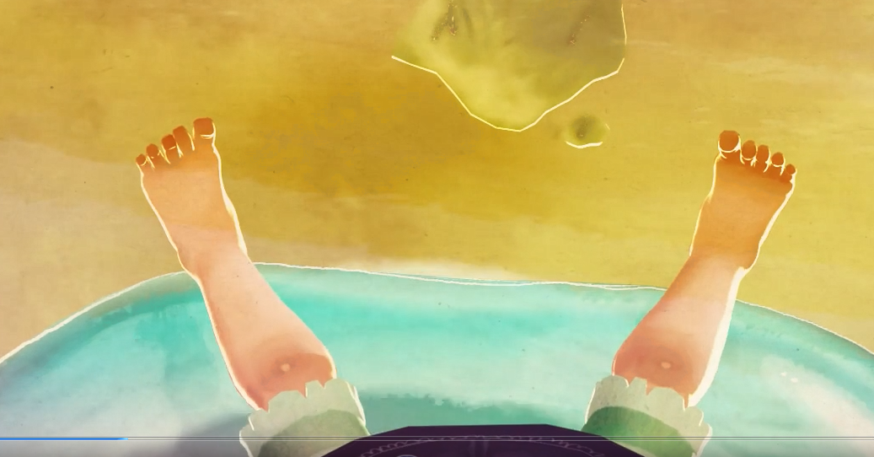
Floating up into the sky above! Look way down below…

Slide 9
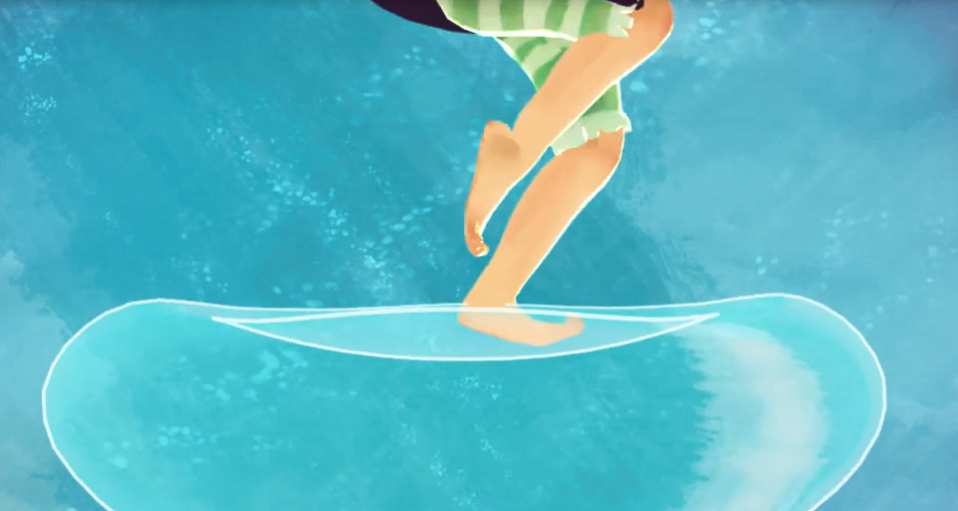
Bouce! Bounce! Bouce!
First bullet point here
Second bullet point here
Third bullet point here
Class | Group 1 | Group 2
Class 1 | 82 | 95
Class 2 | 76 | 88
Class 3 | 84 | 90

Slide 10
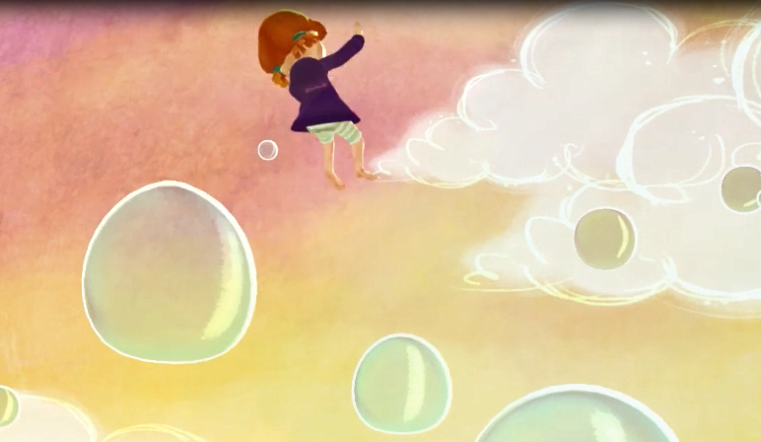
Jumping, floating and spinning through the air!

Slide 11
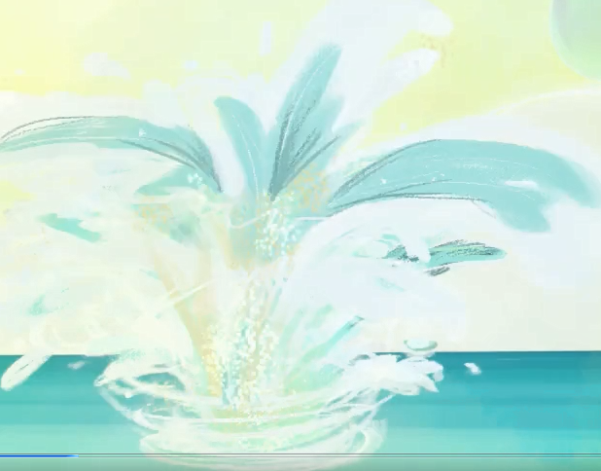
Descending down, down, down and SPLASH!

Slide 12
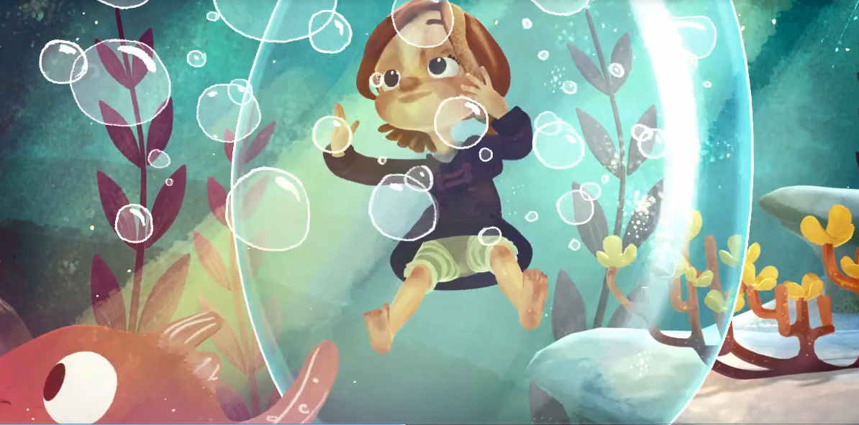
Deep, down under the sea!

Slide 13
Thursday 2nd May 2024 LO: Using your senses describe what you see under the sea…

Slide 14
Describe the setting below…. What can Gabby see, hear, taste, smell and touch?

Slide 15
Friday 3rd May 2024 LO: Using your senses describe what you see under the sea…

Slide 16
Friday 3rd May 2024 LO: If you could wish upon a star like Gabby, what would you wish for? Use some subordination (eg when / if / that / because) to join clauses.

Slide 17
Wish upon a star…

Slide 18
Year 1 Writing Targets- Reports
Write sentences in order to create short narratives and non-fiction texts.
Use some features of different text types (although these may not be consistent).
Re-read their writing to check that it makes sense and make suggested changes.
Use adjectives to describe.
Use simple sentence structures.
Use the joining word (conjunction) ‘and’ to link ideas and sentences.
Capital letters for names, places, the days of the week and the personal pronoun ‘I’.
Beginning to use finger spaces.
Beginning to use full stops to end sentences.
Beginning to use question marks.
Beginning to use exclamation marks.
Spell most words containing previously taught phonemes and GPCs accurately.
Spell most Y1 common exception words and days of the week accurately.
Use -s and -es to form regular plurals correctly.
Use the prefix ‘un’.
Add the suffixes –ing, -ed, -er and –est to root words (with no change to the root word).
Write lower case and capital letters in the correct direction, starting and finishing in the right place.
Write lower case and capital letters in the correct direction, starting and finishing in the right place with a good level of consistency.

Slide 19
Year 2 Writing Targets- Reports
Write simple, coherent narratives about personal experiences and those of others (real or fictional).
Write about real events, recording these simply and clearly.
Demarcate most sentences in their writing with capital letters and full stops.
Use question marks correctly when required.
Use present tense mostly correctly and consistently.
Use past tense mostly correctly and consistently.
Use co-ordination (eg or / and / but) to join clauses.
Use some subordination (eg when / if / that / because) to join clauses.
Segment spoken words into phonemes and represent these by graphemes, spelling many of these
words correctly and making phonically-plausible attempts at others.
Spell many common exception words.
Form capital letters and digits of the correct size, orientation and relationship to one another and to lower-case letters.
Use spacing between words that reflects the size of the letters

