Slide 1
LO: To understand what being created in the image and likeness of God means.

Slide 2
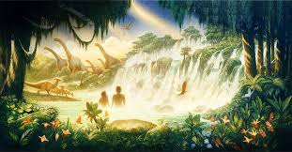
What does “image and likeness” mean?
Why do you think God created human beings?
What does the creation story tell you about the way God thinks about human beings?

Slide 3
If human beings are created in the image and likeness of God, what effect should that have on the way human beings treat one another?
God created human beings to be like God – to show the attributes and characteristics of God. How can we think and act more like God?
It is so important that we always show respect, care and consideration for other people and for ourselves.
Can you think of any stories and events that show people respecting or failing to show respect for other people?

Slide 4
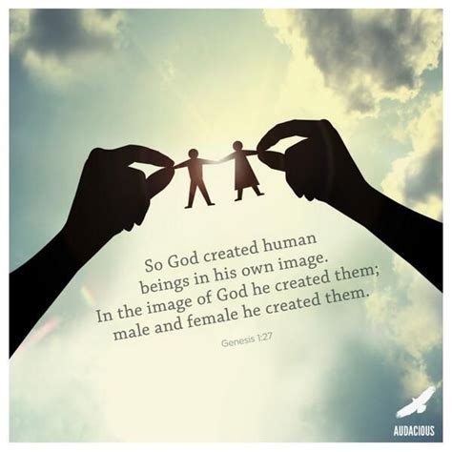
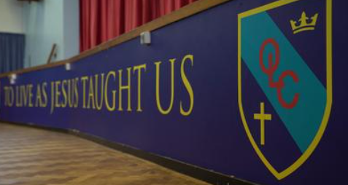
Task: Write about /draw how we can live in the image of God.
Let us pray together:
Dear God, You created each of us in your own image. You created each of us in Your image, to be like You and to have a special place in the world. Because we are like God, we can love and we can choose what is right. The way we act and treat others should be like you did, God. Help us to be like you.
AMEN

Slide 5
LO: To understand that we should see diversity as a source of blessing.

Slide 6
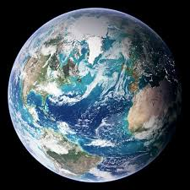
God created an entire human race.
Is everybody the same?
What differences do people have across the world?

Slide 7
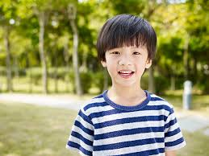
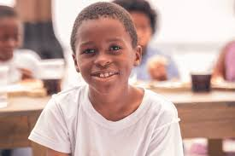
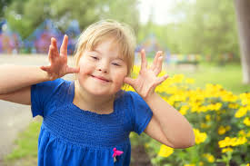
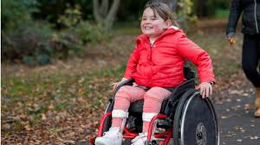
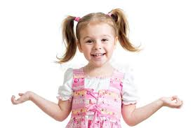
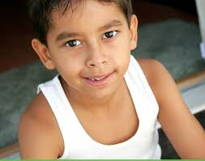
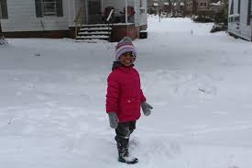
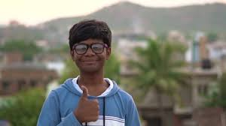
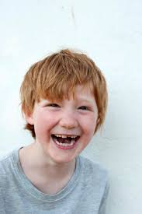
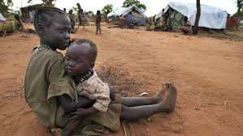
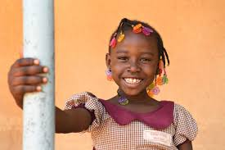
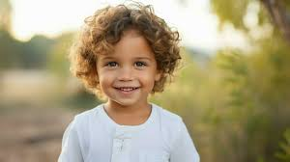
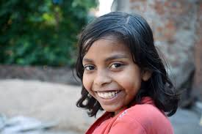
God made us all. God has created every person to be a little different. We all have different abilities, and different gifts. Even though we are all are different from others, we are all special. God’s plan for the creation of human beings was that they would be different, every single one of them. No two human beings are exactly alike. Isn’t that a wonderful thing?

Slide 8
Task: Create a mind map to highlight as many differences in the Human Race as possible.
Remember that we should respect other people’s beliefs and values even if they are different from our own.
Warm countries
Cold countries
People live in different countries
Countries with a lot or countries with few people
Human Race Differences

Slide 9
LO: To know the first five books of the Old Testament.

