Slide 1

Families and Celebrations unit B: Baptism
https://www.youtube.com/watch?v=rmnX-fMJVTU

Slide 2
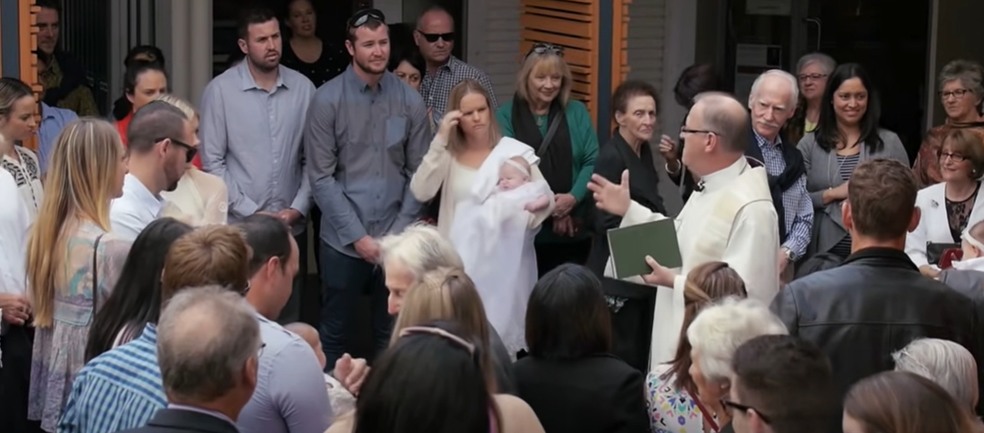
Our Families gather together…

Slide 3
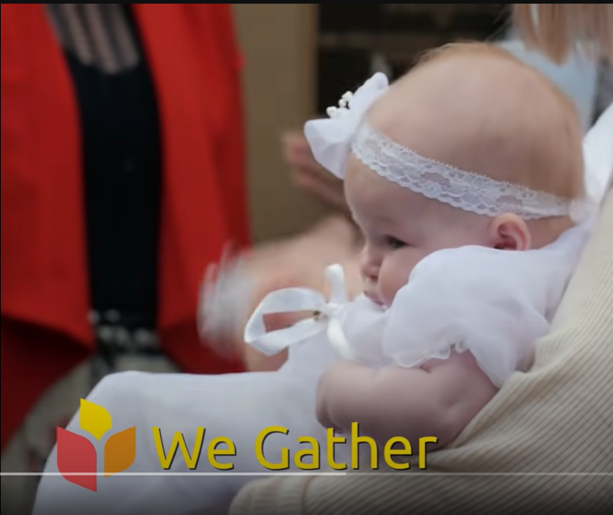
We gather at the entrance to the church…

Slide 4
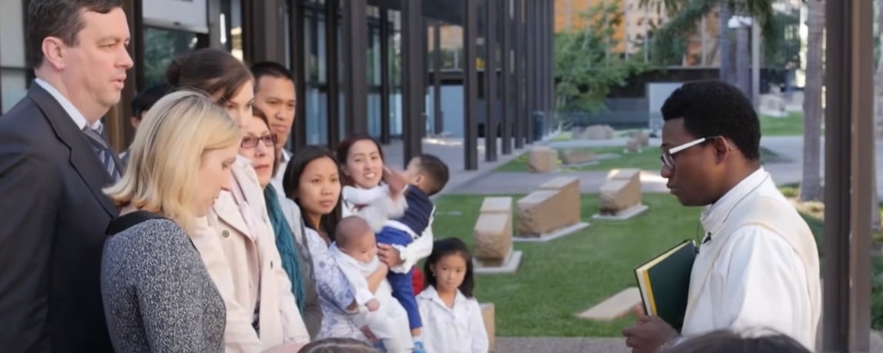
Parents and godparents Gather

Slide 5
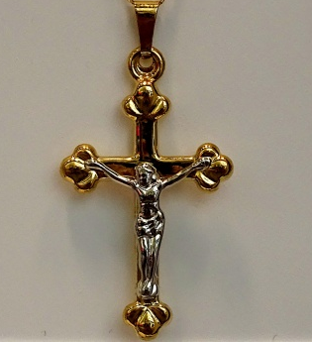
The sign of the cross:
In the Name of the Father, and of the Son,
and of the Holy Spirit
Amen

Slide 6
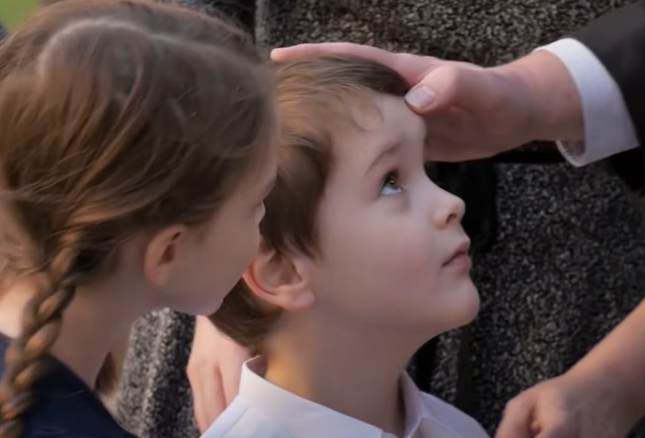
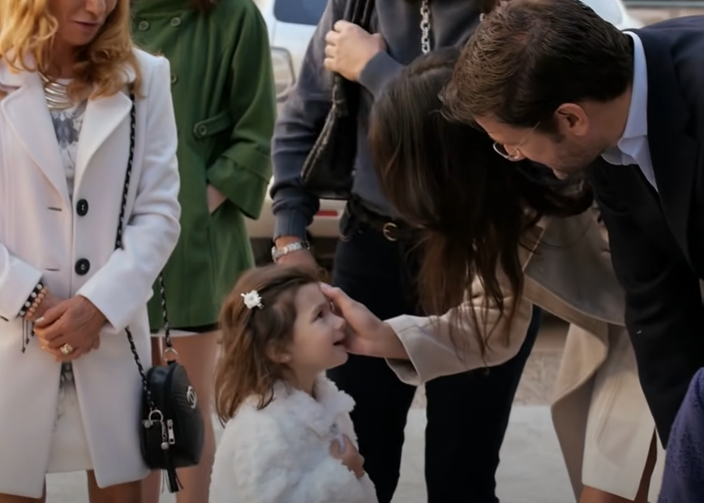
Sign of the cross

Slide 7
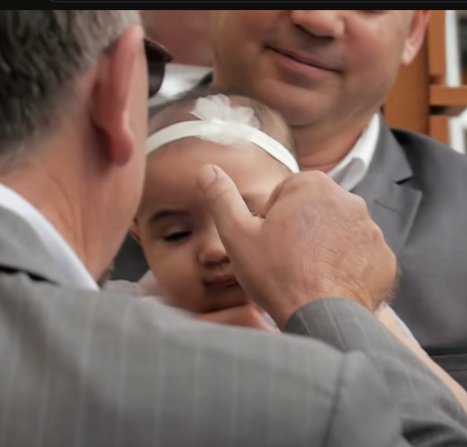
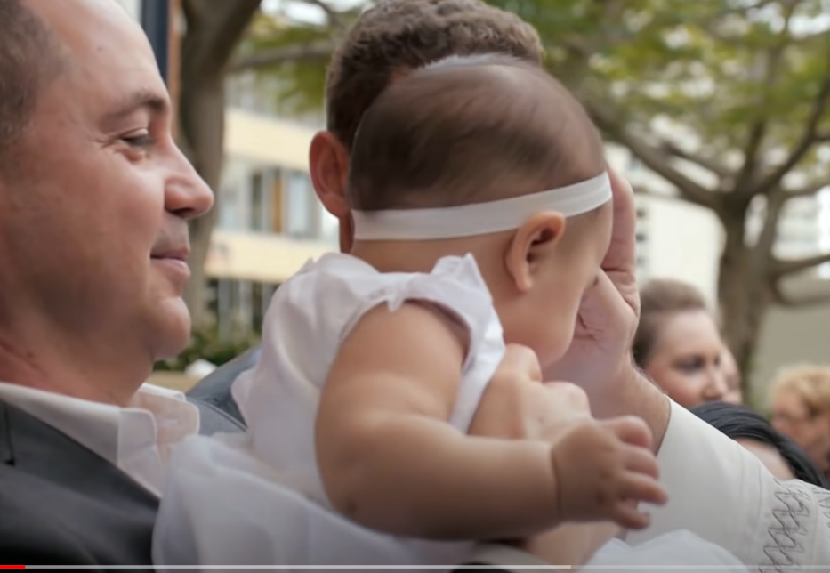
Sign of the cross

Slide 8
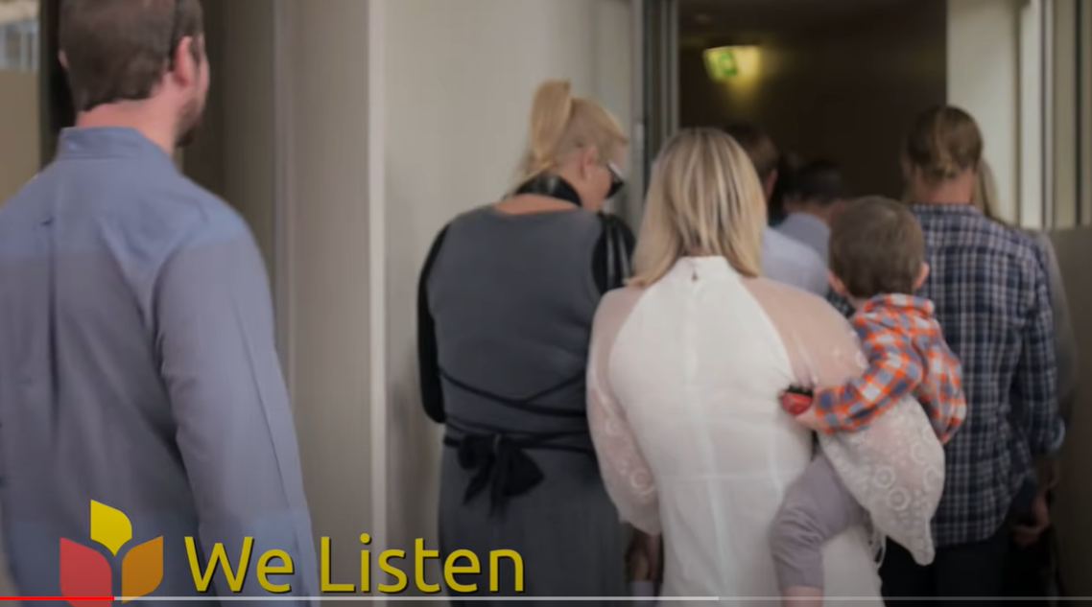

Slide 9
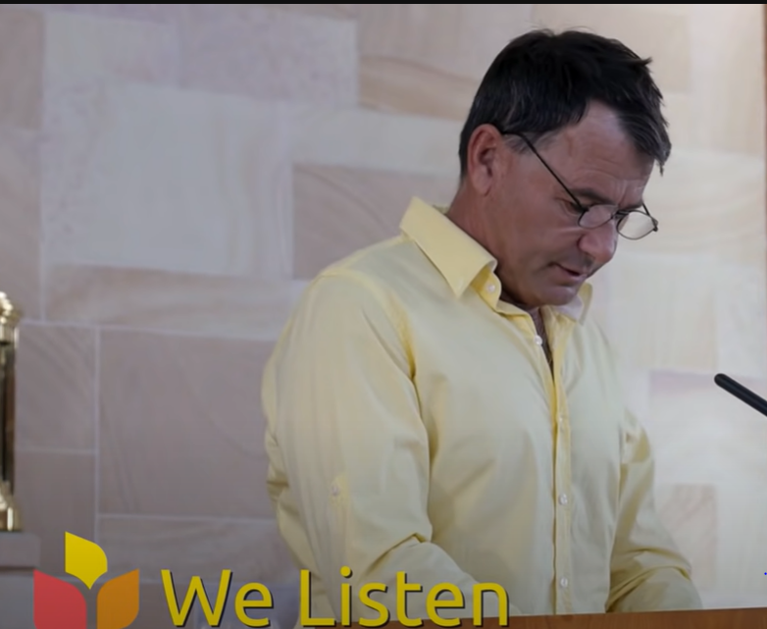
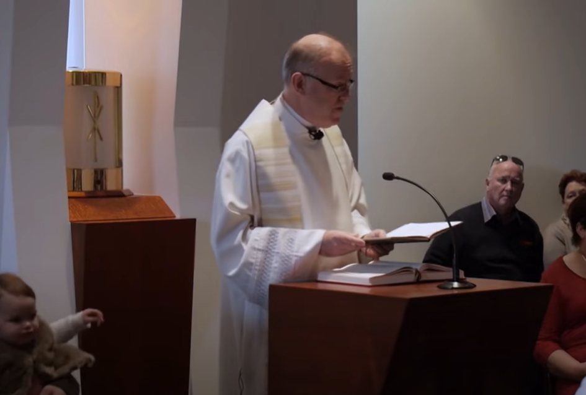
We listen to the readings and the Gospel…

Slide 10
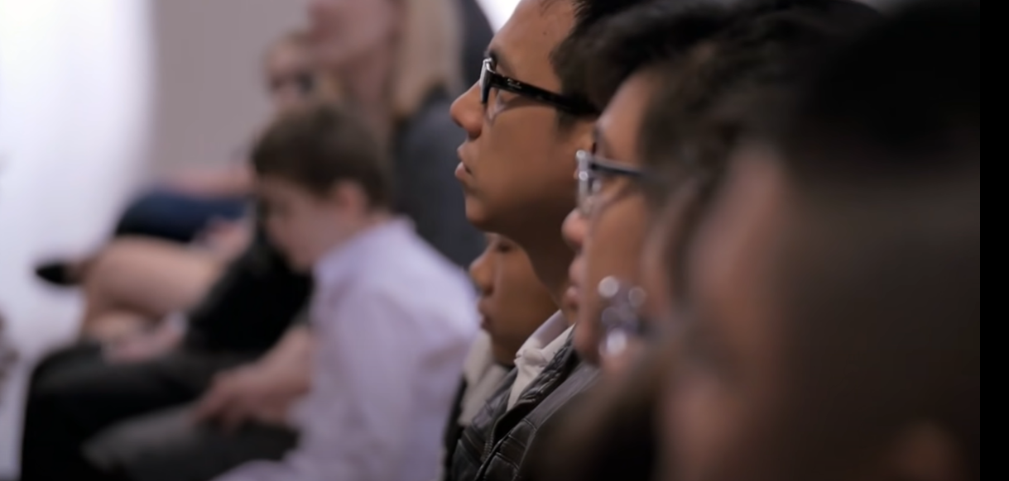
Listening to the Gospel…

Slide 11
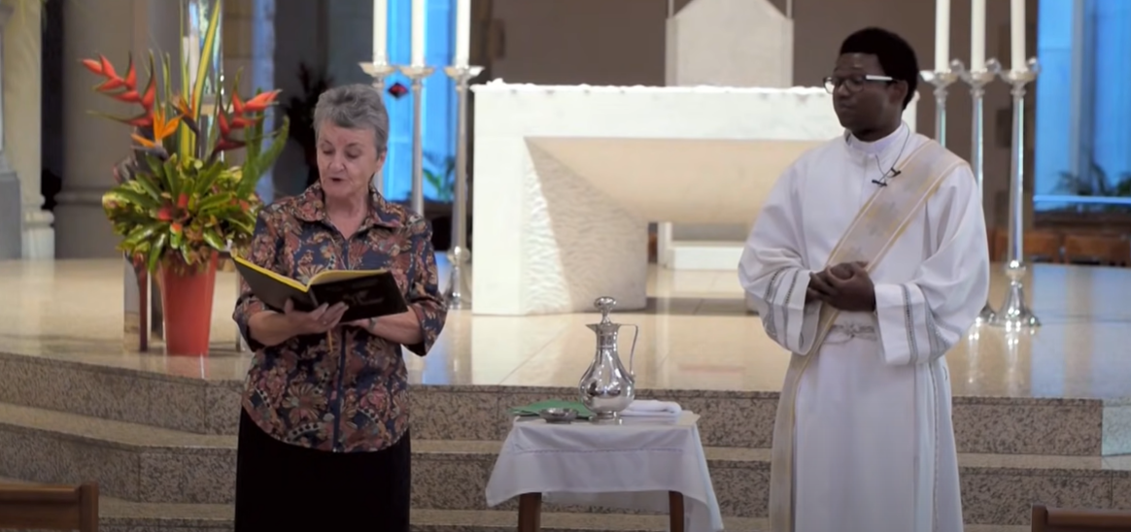
Prayers of the faithful…

Slide 12
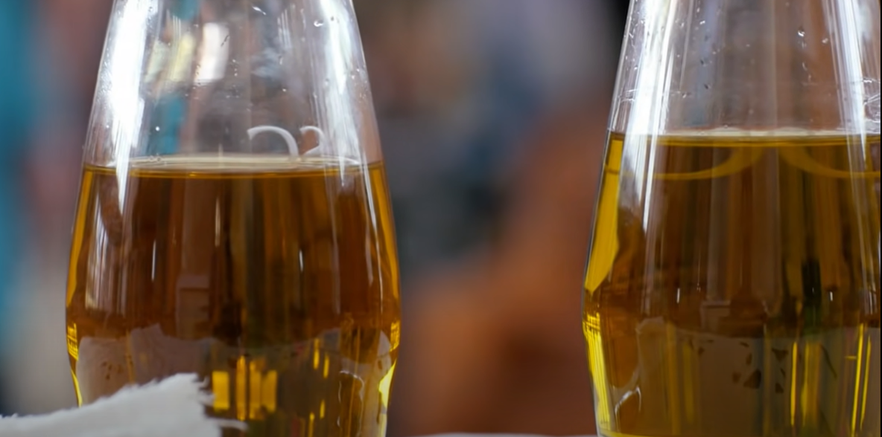
Blessing of the Oil of catechumen

Slide 13
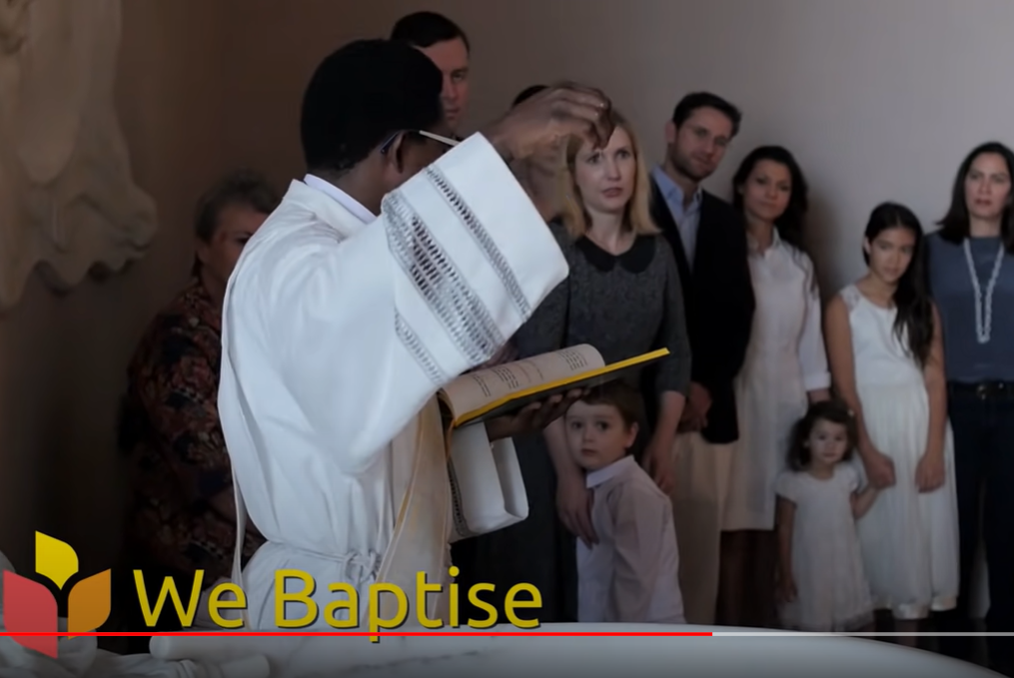
Blessing of the Holy water

Slide 14
Baptismal promises

Slide 15
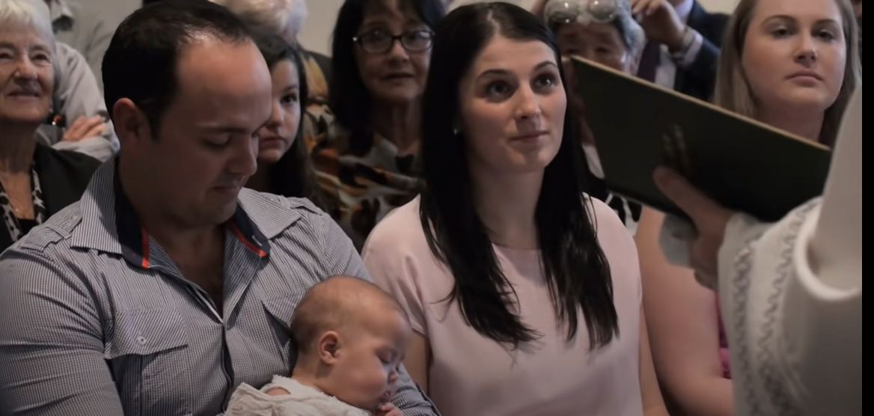
Parents and Godparents are asked if it is there will that the child will be baptised.

Slide 16
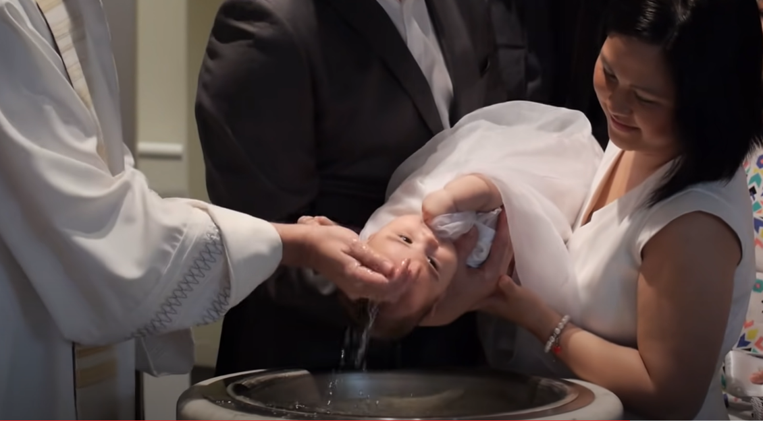
The celebrant pours holy water over the child’s head saying…

Slide 17
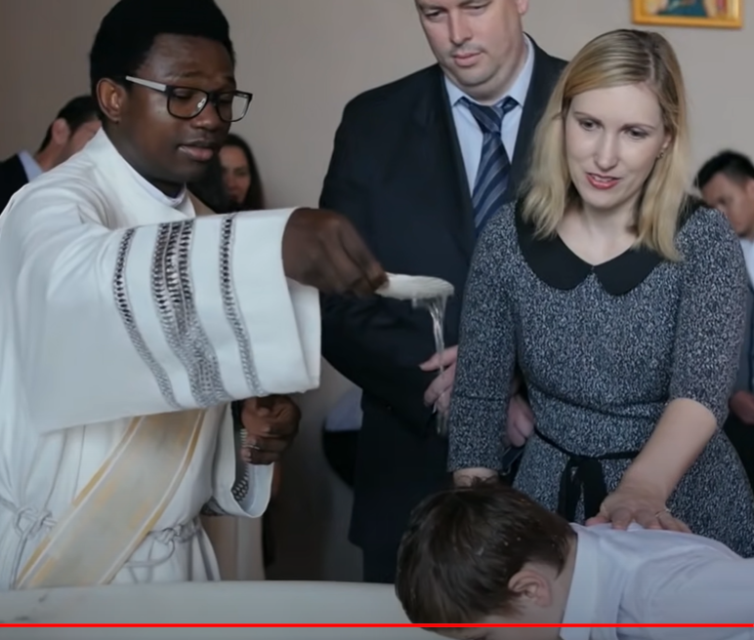
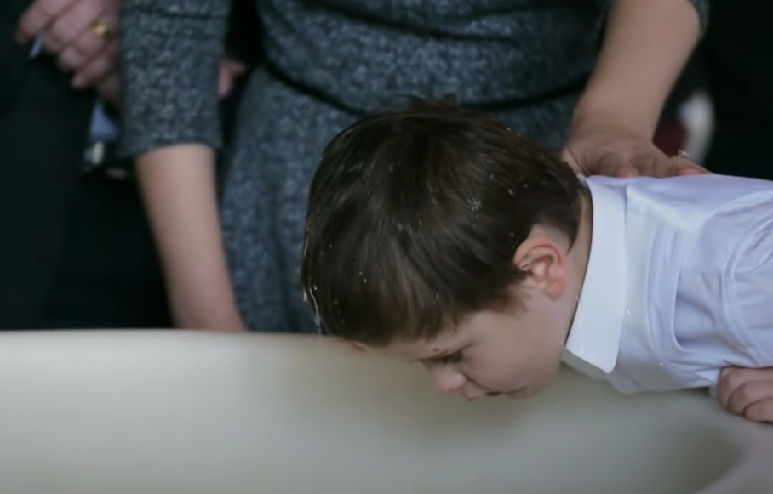
Water is poured Three times…
Name_______________,
I baptise you in the name of the father,
And of the son,
And of the Holy spirit
AMEN

Slide 18
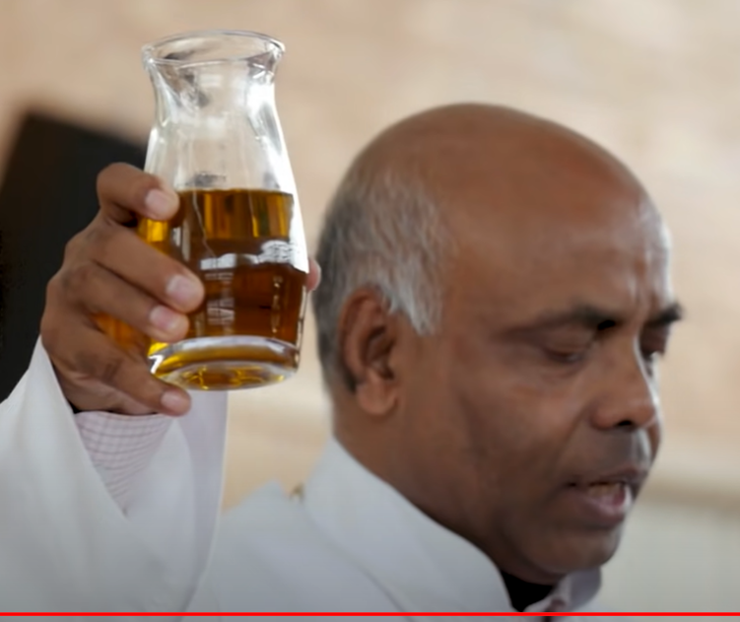
Oil of chrism- annointing

Slide 19
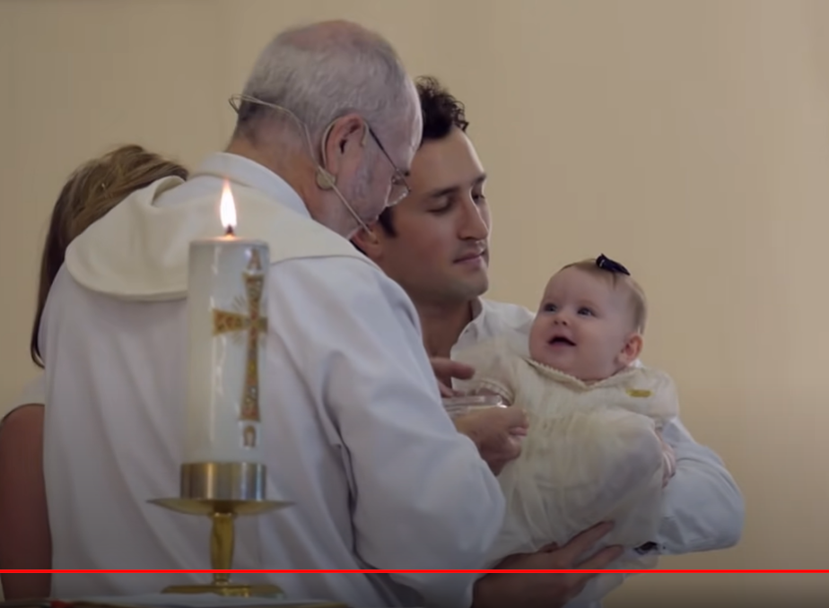
Dressed in white…

Slide 20
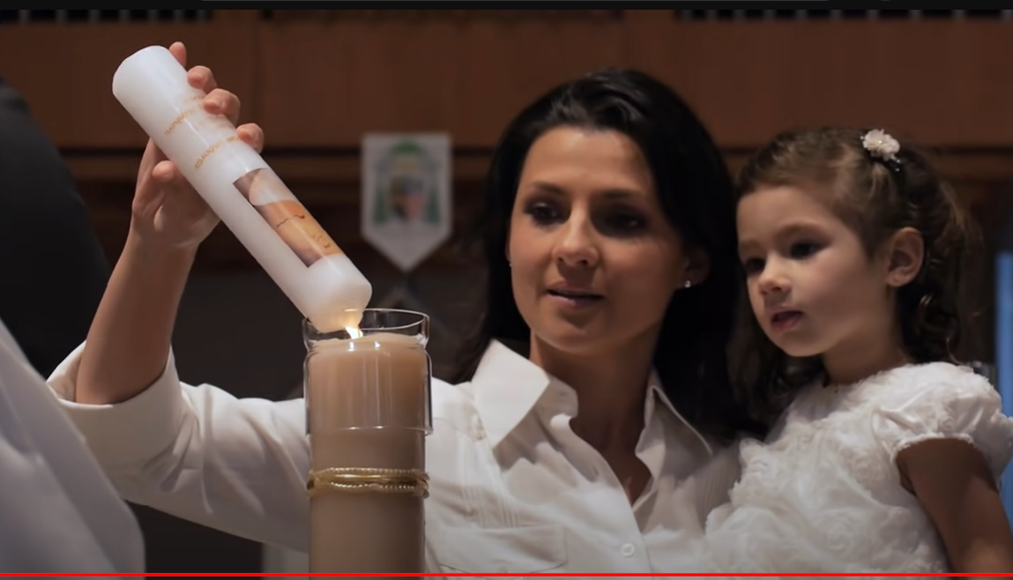
The baptismal candle is lit from the
Paschal- Easter candle…the light of christ

Slide 21
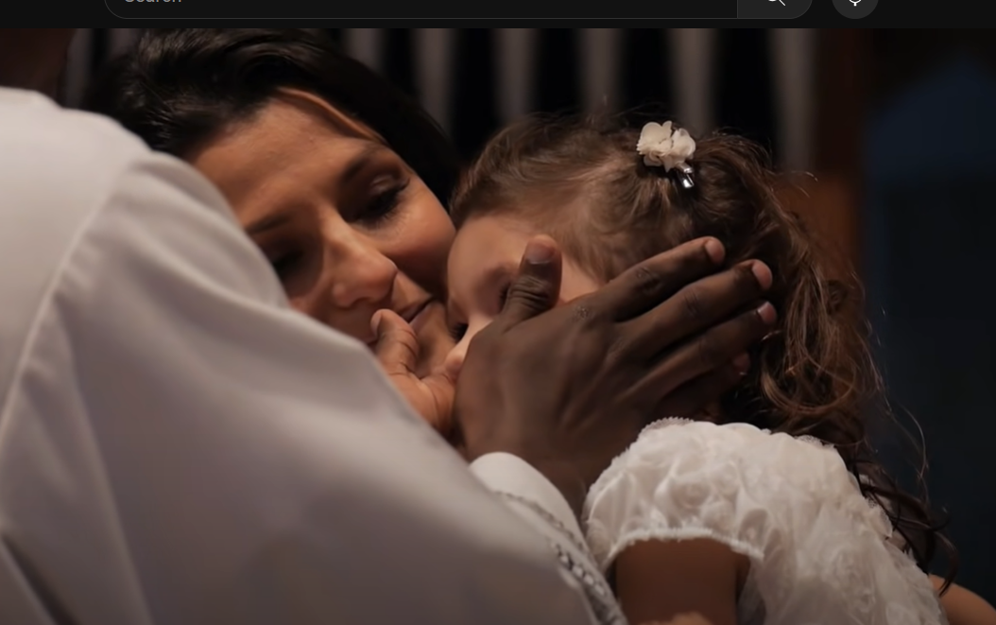
Blessing of the ears…

Slide 22
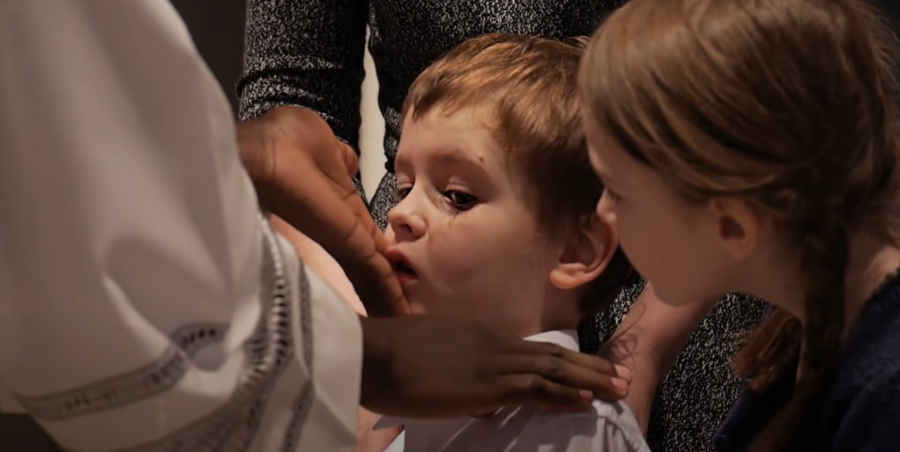
Blessing of the lips…

Slide 23
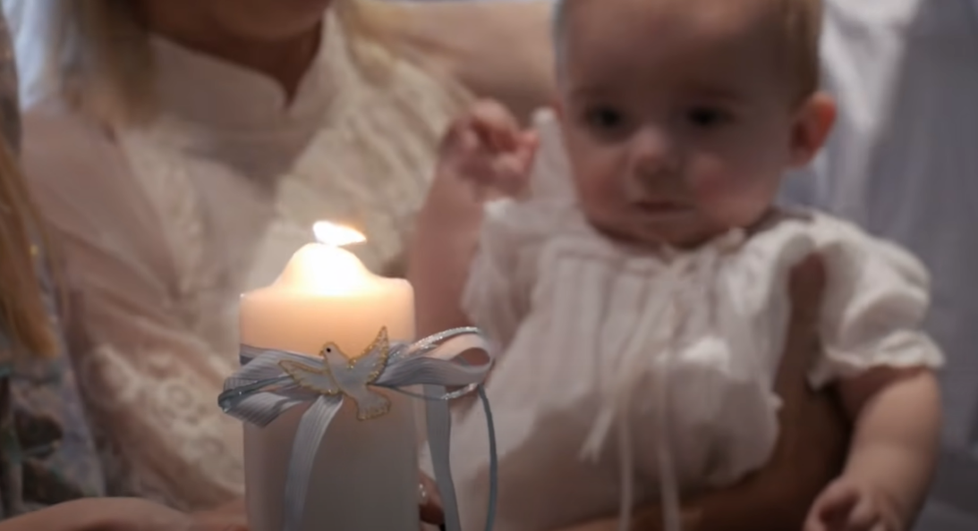
Pray the lords prayer…

Slide 24
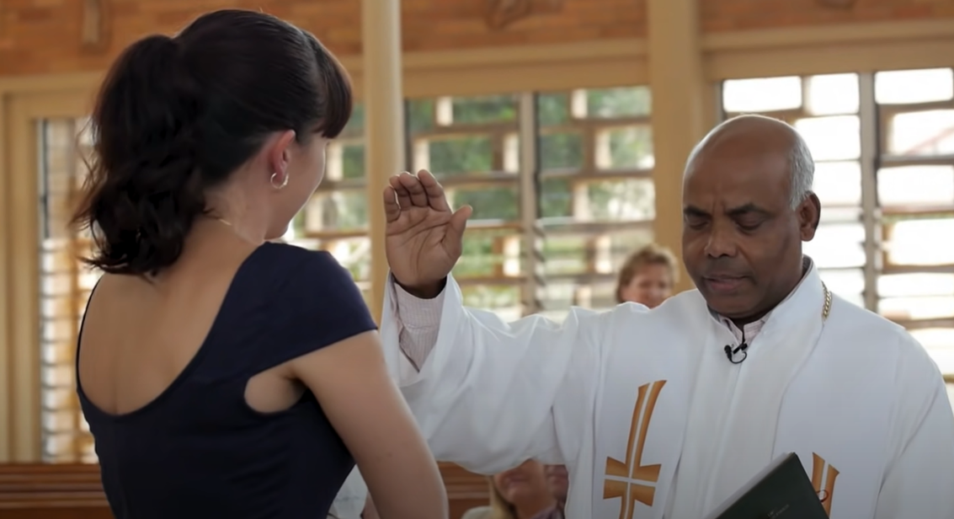
Blessing for the parents…and all who have gathered to welcome the baptised child into god’s family.

