Slide 1

Dear Earth
https://www.youtube.com/watch?v=2CvLhSed298
Read bythe author Isabel Otter
(A Writing Root) Dear Earth by Isabel Otter and Clara Anganuzzi

Slide 2
Video Links:
Book Reading:
https://www.youtube.com/watch?v=b2V8Ip3ldsI
Author Reading:
https://www.youtube.com/watch?v=2CvLhSed298
Clear Words /Text: Mrs Dodds
https://www.youtube.com/watch?v=eb9lSwKieMA

Slide 3
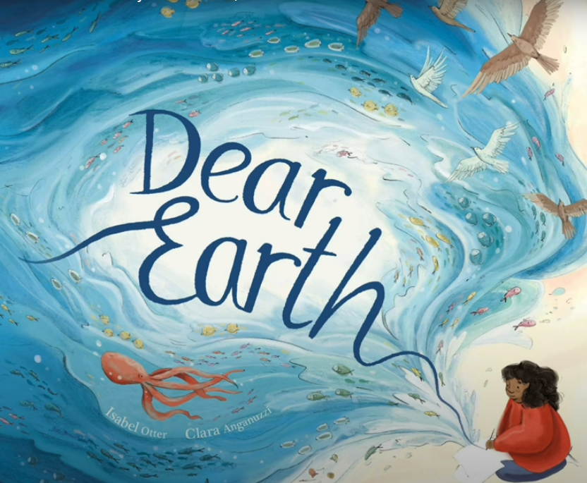
Dear Earth by Isabel Otter and Clara Anganuzzi

Slide 4
Monday 10th June 2024
LO: 1) To discuss future dreams and wishes
I can write in first person
I can use a conjunction to give reasons
I can use the verb would to discuss the future
Ext: I can use a contraction

Slide 5
Tuesday 11th June 2024
LO: 2) To use conjunctions to write a set of instructions
I can use the conjunction if I can use a range of verbs
I can write in second person
Ext: I can use a comma

Slide 6
Wednesday 12th June 2024
LO: 3) To record factual statements about animals I can use a range of adjectives
• I can record factual statements
• I can write in the simple present tense
Ext: I can use an apostrophe to show possession

Slide 7
Thursday 13th June 2024
LO: 4) To create noun phrases to describe
I can use a range of thoughtful adjectives
I can pair adjectives with nouns appropriately
I can use a comma between adjectives
Ext: I can use prepositions

Slide 8

Friday 14th June 2024
LO: 5) To use noun phrases to write a poem about the earth
I can use noun phrases
I can use repetition I can use a range of verbs
Ext: I can use a simile

Slide 9
Getting the Word Out about Earth Day
List ideas here

Slide 10
Earth Day Resources
List resources here

