Slide 1

Tuesday 24th September 2024
LO: Write a story review about what the story of Jonah means to you.
SC: Listen to the story of Jonah and the fish.
Recap the story of Jonah.
Write a review about what this story means to you.

Slide 2
Recall
Thinking back to the story of Jonah and the Fish:
What did God ask Jonah to do?
Did Jonah say yes to God?
What happened to Jonah?

Slide 3
Jonah and the Fish
Let’s listen to the story of Jonah and the Fish.
https://www.youtube.com/watch?v=WOSadLyqshg

Slide 4
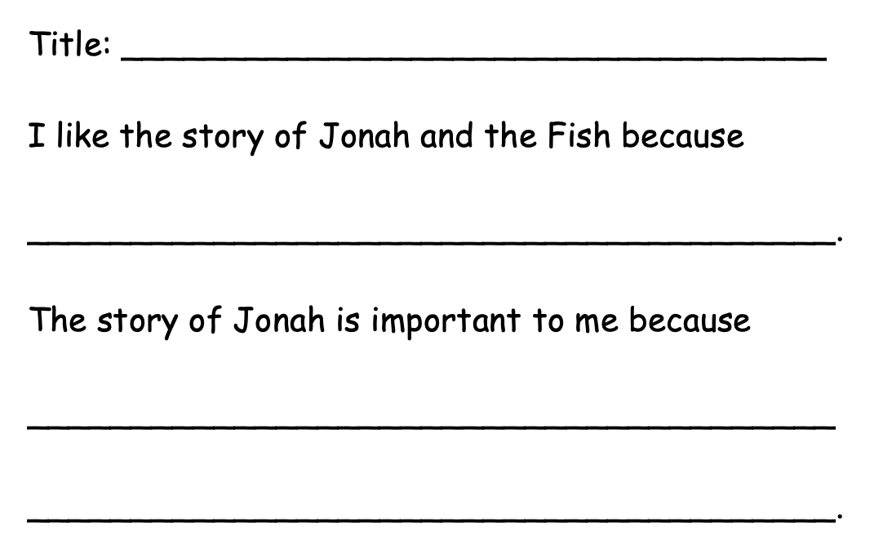
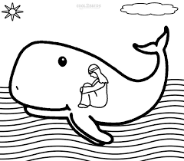
Main Activity
Write a story review about Jonah and what it means to you.

Slide 5
Wrapping Up
What is the message of this story?

