Slide 1
Cinderella
An Art Deco Fairy Tale
By David Roberts and Lynn Roberts-Maloney
KS1 Spring 2024

Slide 2
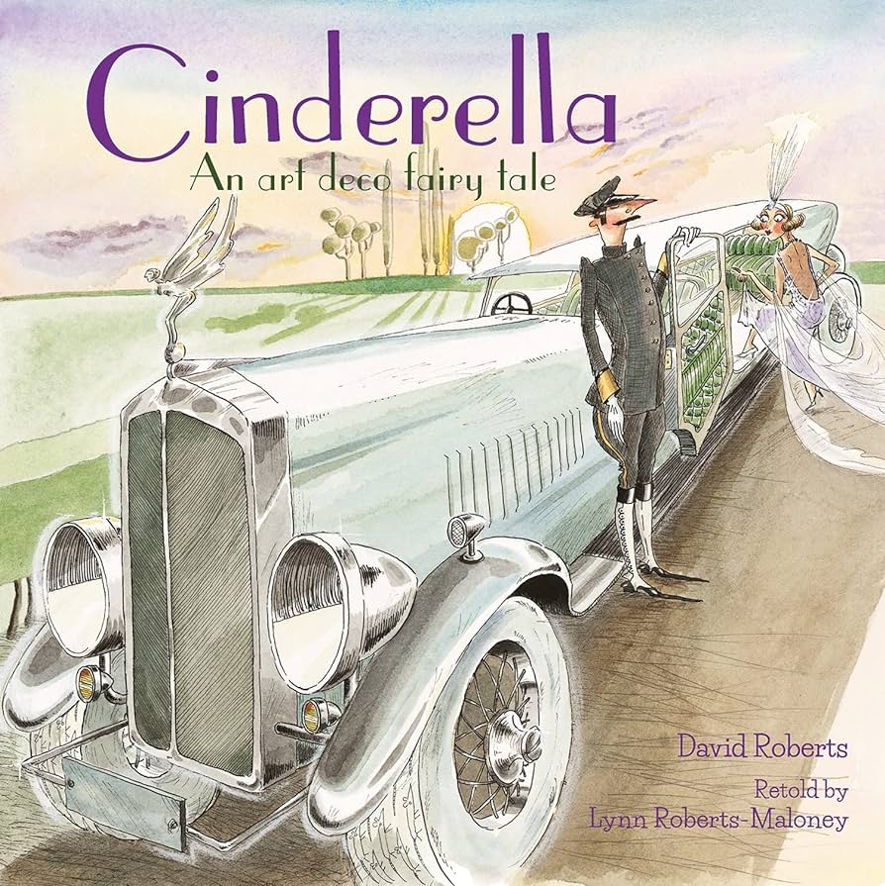
LO: 1) Identify and explain the sequence of events in texts (1c)
Five sentence fairy tales

Slide 3
Summarising Cinderella

Slide 4
Cinderella’ s mum has died and her father remarries.
An unkind stepmother and 3 mean sisters move in.
An unkind stepmother and 3 mean sisters move in.
At the ball, she meets the Prince and they fall in love but Cinderella has to hurry away and loses her glass slipper.
The prince finds the slipper and uses it to find Cinderella.

Slide 5
Together
Cinderella

Slide 6
Can you spot any similarities between the different versions of Cinderella?

Slide 7
Examples
In some versions of Cinderella, the main character is a girl but in others the Cinderella character is a boy.
Some versions of Cinderella have three stepsisters however, in others, there could be more or less.

Slide 8
Together
In

Slide 9
LO: 2) Predict what might happen on the basis of what has been read so far (1e)
Point and predict

Slide 10
Point and predict
The car looks fancy so I think the characters are wealthy.

Slide 11
Predictions
I think that this must be... because...

Slide 12
LO: 3) Draw on knowledge of vocabulary to understand texts (1a)
What’s in a word?

Slide 13
Recognised
Frock
Dim
Smugly
Endearment

Slide 14
1) Which word do you think is closest in meaning to frock?
sock
dress
skirt

Slide 15
2) What do you think cinders means?

Slide 16
3) Why does Greta become Cinderella?

Slide 17
4) Look at the word, endearment as in friendly endearment. Do you think this is a pleasant thing or not? Explain your answer.

Slide 18
LO: 4) Make inferences from the text (1d)
Familiar faces in fairy tales

Slide 19
Ball
Announcement
Eligible
Finery

Slide 20
Retrieve and infer
I see the cat running away so I think it is frightened, and this could be because the cat knows what the new household members are going to be like.

Slide 21
Ermintrude
Elvira
Stepmother

Slide 22
Ermintrude
Elvira
Stepmother

Slide 24
Sentences

Slide 25
LO: 5) Identify and explain key aspects of fiction and non-fiction texts, such as characters, events, titles and information

Slide 26
gown
stout
fetch
chauffeur

Slide 27
Collect nouns that are an important part of the story.

Slide 28
1. Name two of the objects that the kindly woman asked Cinderella to collect.

Slide 29
2. What was Cinderella’s mode of transport to the ball in this version of the story?

Slide 30
3. What was the warning that the kindly lady gave to Cinderella before she left for the ball?

Slide 31
4. What was Cinderella wearing to the ball?

Slide 32
LO: 6) Draw on knowledge of vocabulary to understand text

Slide 33
hopeless
anxious
dainty
vowed
delicate
haste

Slide 35
LO: 7) Identify and explain key aspects of fiction and non-fiction texts, such as characters, events, titles and information

Slide 36
How would you summarise these few pages using a pair of words?
bride found
found her
it fits

Slide 38
LO: 8) Make inferences from the text to predict what might happen on the basis of what has been read so far

Slide 39
1. Which word is closest in meaning to allowed?
invited
permitted
forbade

Slide 40
2. Two slightly surprising things happen at the end of this version of Cinderella. Name one and explain why this is surprising.

Slide 41
3. Why has the author chosen to put the word almost in italics?

Slide 42
4. What do you think would happen next if a sequel of this Cinderella version were to be written?

Slide 43
LO: 9) Make inferences from the text

Slide 44
The father’s actions
Cinderella’s father disappeared for two weeks then came back already married.
He called her Cinderella instead of Greta as he thought it was an affectionate nickname for his daughter.

Slide 45
kindly, a bit forgetful, scatty, sees the best in people, foolish, jolly, polite.
mean, quick-witted, unkind, rude.
Picture of father to be added

Slide 46
LO: 10) Identify and explain the sequence of events in texts

Slide 47
Main themes

Slide 49
Main themes
1. I think kindness is a theme in Cinderella because…
2. I think love is a theme in Cinderella because…
3. I think friendship is a theme in Cinderella because…

