Slide 2
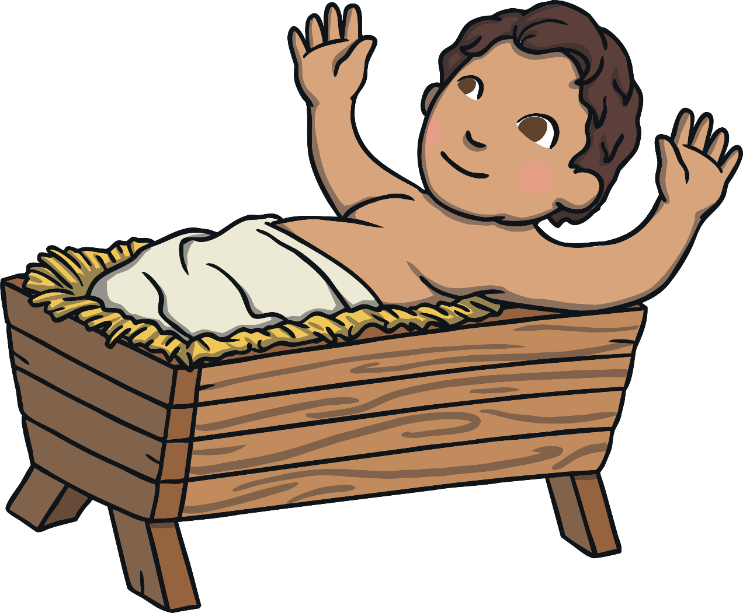
What is Epiphany?
Epiphany is a Christian festival.
It takes place just after Christmas.
It celebrates when the Three Kings arrived to see baby Jesus.

Slide 3

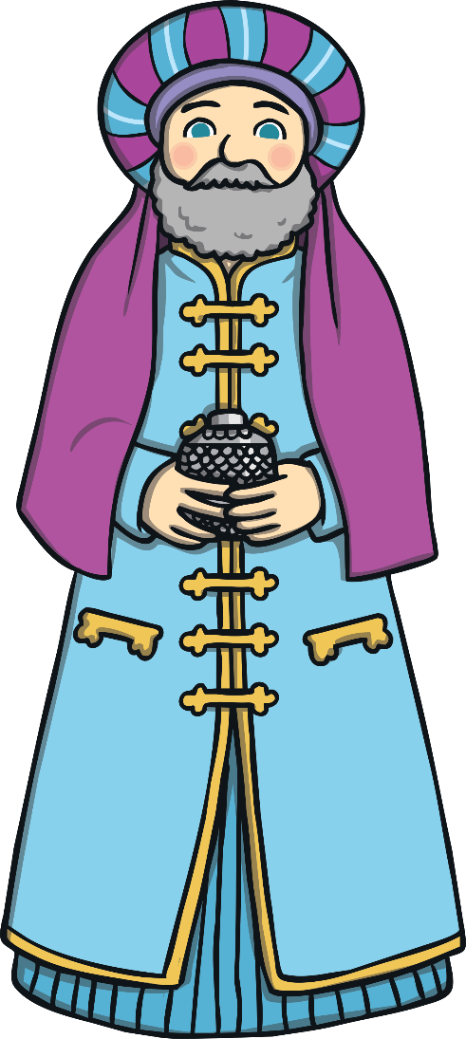
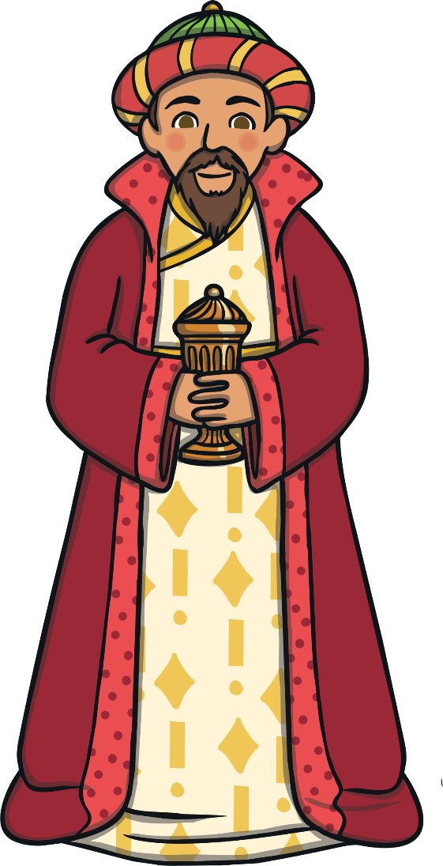
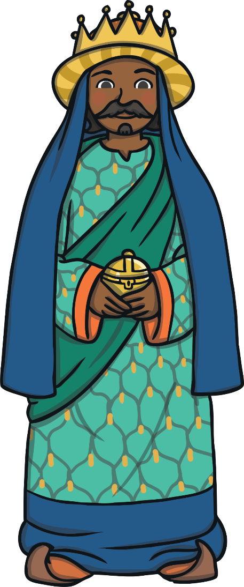
The Three Kings
The Three Kings are sometimes known as the ‘Wise Men’.
They travelled a long way to visit baby Jesus in the stable in Bethlehem.
Epiphany is sometimes called ‘Three Kings Day’ or the ‘Feast of Epiphany’.

Slide 4




The Star
The Three Kings knew that the bright star meant that a new king had been born.
They followed the bright star in the sky.
They travelled across the desert.
They brought presents for baby Jesus.

Slide 5
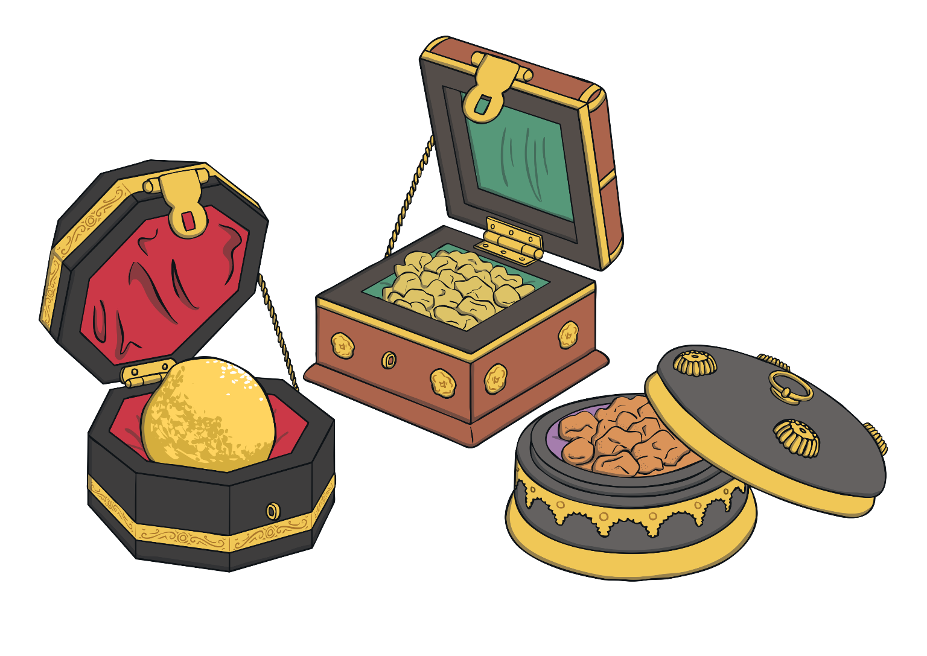
Presents from The Three Kings
The Three Kings brought presents to give to baby Jesus.
The Three Kings gave baby Jesus gifts of gold, frankincense and myrrh.

Slide 6
How is Epiphany Celebrated?
The Feast of Epiphany is celebrated in churches, usually on the 6th January.
Epiphany is sometimes celebrated with parades and fireworks.
Sometimes, children wear paper
crowns and they may receive gifts.
Some people like to celebrate
Epiphany by making King
Bread or King Cake which
resembles a crown and often
has small dolls inside to
represent baby Jesus.

Slide 7




Epiphany
What can you remember about Epiphany?
Can you remember another name for this festival?
How is Epiphany celebrated?

