Slide 1
Session 3: Creating a prototype of the game
To create a prototype of your game in Scratch

Slide 2
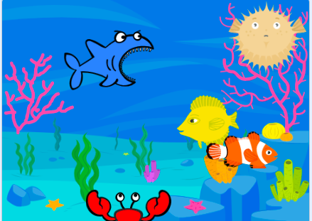
Let’s learn
In this session, you will look at how to create a game in Scratch and develop a prototype of your own game, using the assets that you have collected and created.

Slide 3
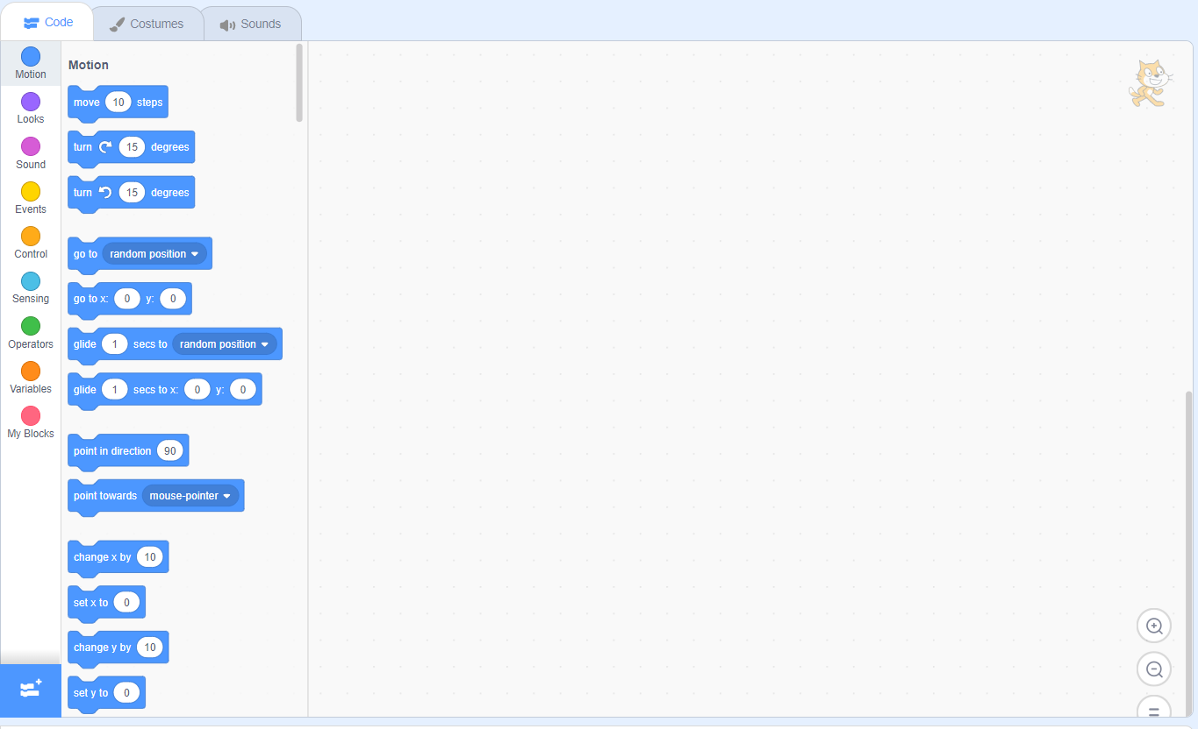
Let’s review
Do you remember how the Scratch script editor works?
Can you demonstrate it to the class?

Slide 4
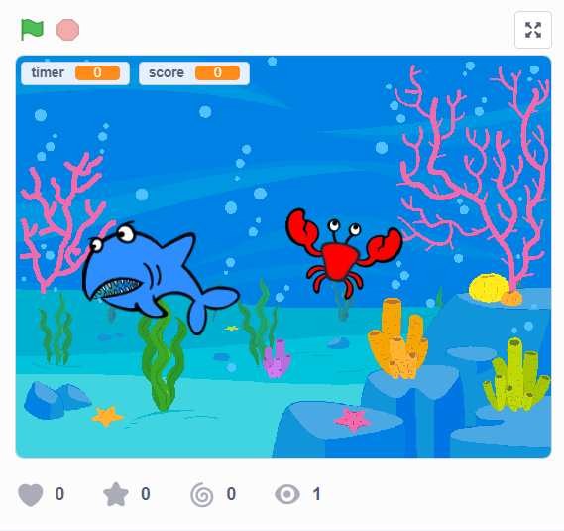
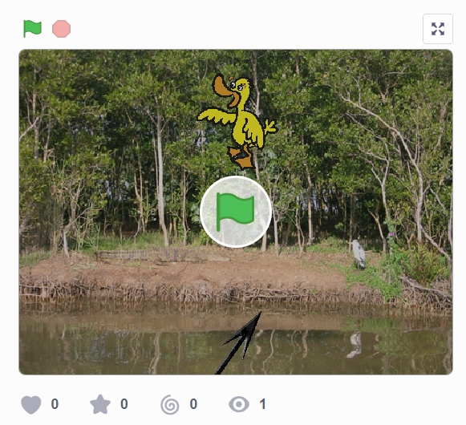
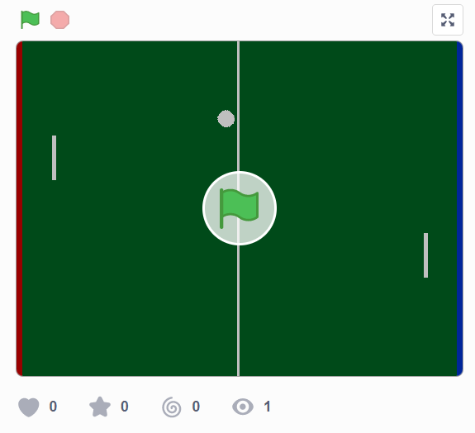
Let’s learn
Here are some examples of simple games that have been programmed in Scratch. We will investigate the Fish Game in more detail in this session.
Fish Game
Duck Shoot
Click on the images to view the games in Scratch!
Tennis

Slide 5
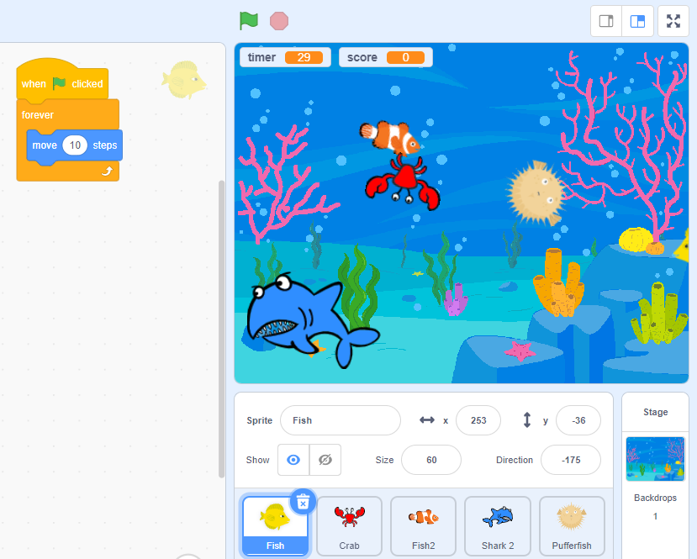
Let’s learn
The Scratch script editor works by controlling each sprite; there is a script for each one to follow.
Let’s do
We are going to make one fish move:
Drag in a when green flag clicked block.
Drag in a move 10 steps block.
Add a forever loop. This means the fish will keep swimming until the game ends.
a
c
b

Slide 6
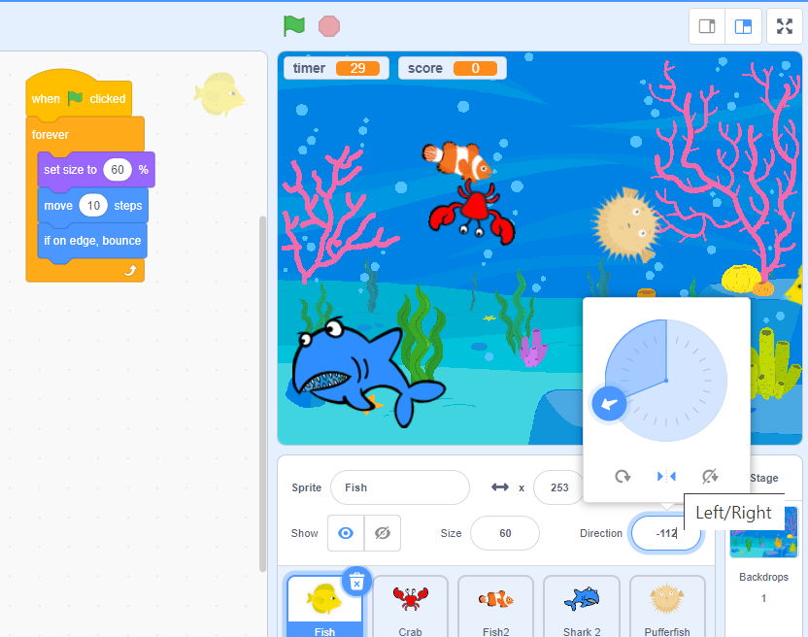
e
Now add an if on edge, bounce block so the sprite changes direction when it hits the edge.
Click the green flag – your sprite should move.
If the sprite moves upside down, click the direction icon under the stage and click the central arrows to set it moving only left or right.
You might think the fish is too big – you can reduce its size by adding a set size to block and choosing a percentage of the size, such as 60%.
g
d
f

Slide 7
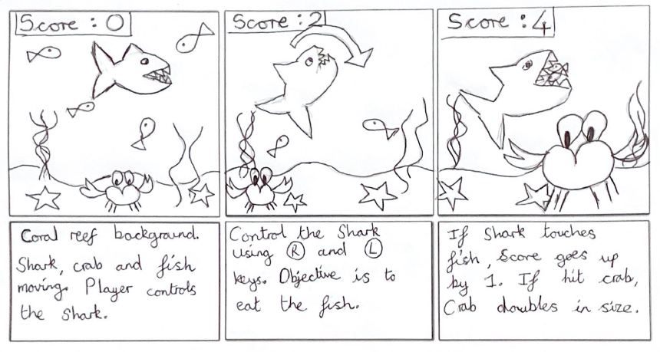
Let’s do
Create your game by breaking it down into smaller component parts and solving each part.
Always keep the overall game in mind when you do this.
Use your outline algorithms on the storyboards or flowcharts you created to help you.

Slide 8

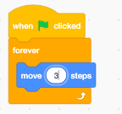
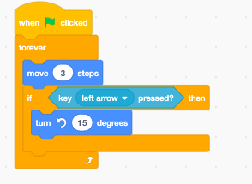
Let’s learn
Think about how you will control the movement of the player’s sprite using the keyboard or the mouse. You could use point towards mouse-pointer? or key pressed? blocks from the Sensing palette. In the Fish Game, we want to control the shark with the arrow keys.
Let’s do
Select the shark sprite.
Add a when green flag clicked block, a forever block and a move 10 steps block. Change this to 3 steps to make the shark move slower.
Program the shark to turn left when the left key is pressed:
  Add in an if/then block.
  Insert a key pressed? and set to ‘left arrow’.
  Add a turn anti-clockwise 15 degrees block.
1
2
3
b
a
c

Slide 9
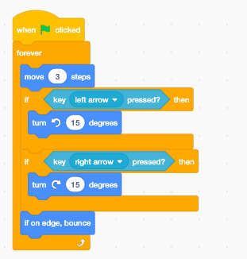
Now let’s program the shark to turn right when the right arrow is pressed:
  Add another if/then block.
  Insert a key pressed? and set to right arrow.
  Add a turn clockwise 15 degrees motion block.
  At the bottom of the script add an if on edge, bounce block, so the shark doesn’t swim off the edge of the screen.
a
b
c
d

Slide 10
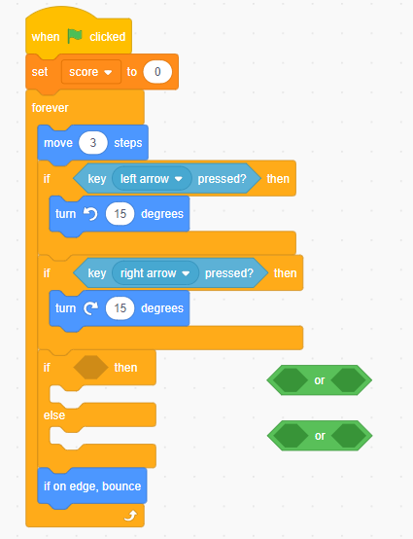
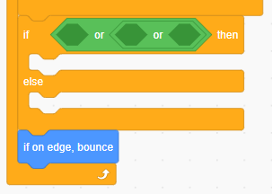
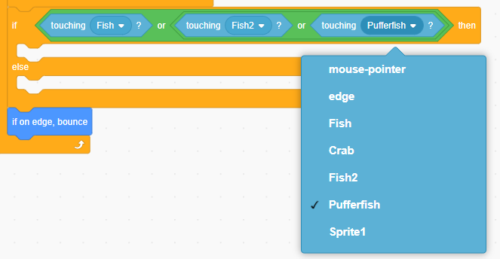
Let’s learn
Think about how the player’s sprite interacts with other elements in the game. This is likely to involve if/then/else blocks, Sensing palette blocks, such as touching?, or Events palette blocks such as broadcast and when I receive.
Let’s do
You can program the shark to look like it is eating the fish when it touches them, by opening its mouth.
Add an if/then/else block.
Insert two green or blocks (Operators) in this block.
Insert three touching? blocks and set them to touching each fish.
1
2
3

Slide 11
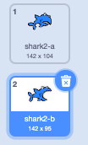
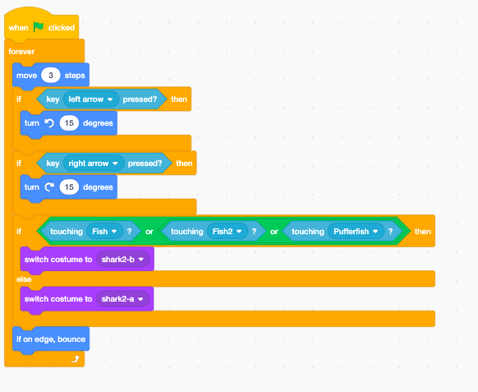
Let’s learn
Click the ‘Costumes’ tab. You will notice the shark has two costumes: mouth closed (shark2-a) and mouth open (shark2-b).
When the shark touches the fish you can change the costume to mouth open. If the shark is not touching the fish it will keep its mouth closed.
Let’s do
Add two switch costume to blocks (Looks) to the if/then/else block – one after if and one after else.
Add one switch costume to the if section and the other to the else section.
Set the first switch costume to block to change the costume to shark2-b if it touches the fish, and the second to shark2-a else it doesn’t.
a
b
a
b

Slide 12
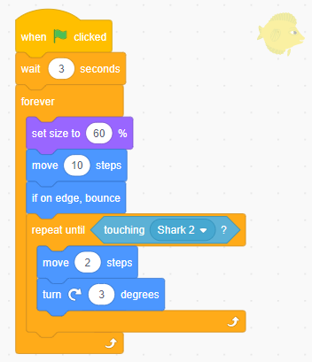
Let’s learn
Think about the rules that other elements of your game should follow, such as the sprites that the player doesn’t control. You could use the pick random block (Operators) and combine this with other blocks to control movement of other sprites, for example the fish and crab.
Let’s do
Program the fish sprites to disappear after they have been eaten by the shark and then appear randomly again.
Create an instruction to the fish program to change its movement when it touches the shark.
  Add a repeat until loop from the Control palette and add the touching? block. Set it to touching Shark 2.
  Add two Motion blocks to make it move 2 steps and turn clockwise 3 degrees, after the shark has touched it.
a
b

Slide 13
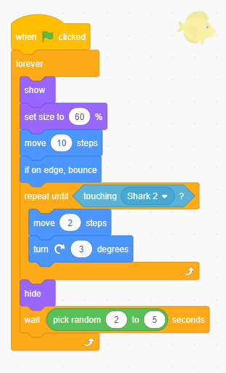
Now instruct the fish to disappear or hide, and then randomly appear again.
  Add a hide block after the repeat until block.
  Then add a wait 2 seconds block and insert a pick random 1 to 10 block. Change the seconds to ‘2 to 5’. This will mean the fish will wait 2 to 5 seconds after hiding.
  Finally you need to instruct the fish to appear again – so add a show block at the start of the forever loop.
  Right-click on the code and choose ‘duplicate’. Drag the code to the Fish 2 sprite. Then duplicate again for the Pufferfish sprite. This will mean that all the fish act the same.
c
a
b

Slide 14
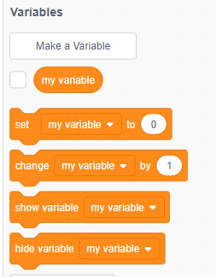
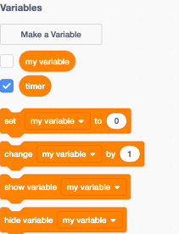
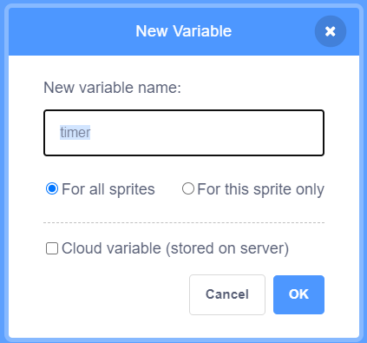
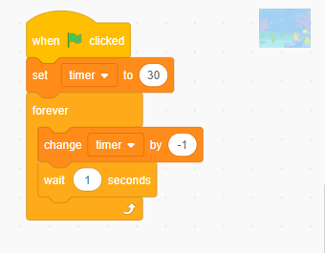
Let’s learn
Include some way of tracking progression, perhaps through scores or a countdown timer. You can use variables to do this.
Let’s do
To add a countdown timer to the game to countdown from 30 in seconds:
Choose make a variable from the Variables palette. Name it ‘timer’.
Set the countdown:
  Click on the backdrop and add a new when green flag clicked block.
  Add a set timer to block. Set it to 30.
  Add a forever block.
  Add a change timer by –1 block inside.
  Add a wait 1 seconds block inside.
1
2
a
b
c
d
e

Slide 15
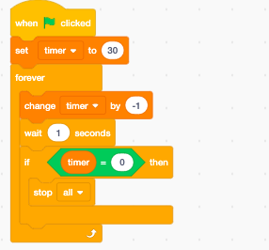
The timer needs completing, so when the time is equal to 0 the game stops:
  Add an if/then loop.
  Insert a green __= __ block.
  Insert the timer variable into the if/then block.
  Add a stop all block.
b
c
a
d

Slide 16
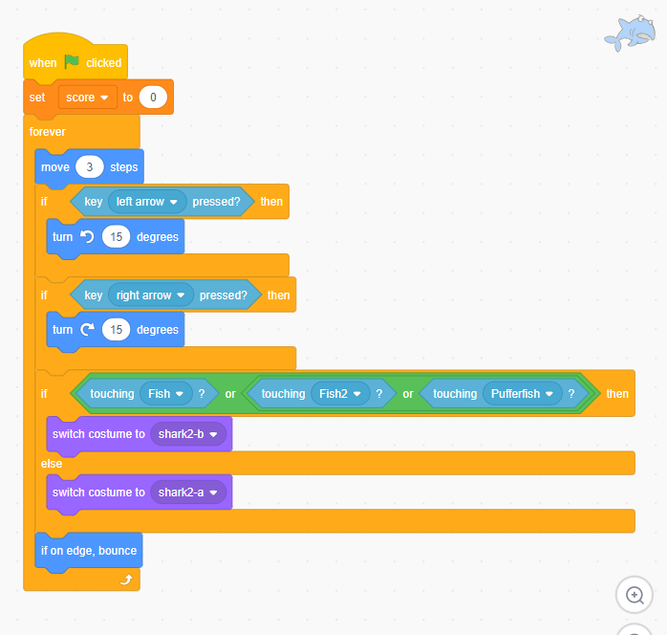
Let’s learn
You can add a scoreboard to track progression, again using variables to do this. For example, a point could be added each time the fish are touched (eaten) by the shark.
First, go to Variables and add a new variable and name it ‘score’. Do you remember how to do this?
Let’s do
In the shark sprite code, start by adding a set score to 0 block after the when green flag clicked block. This will mean the score goes back to 0 each time the game is played.

Slide 17
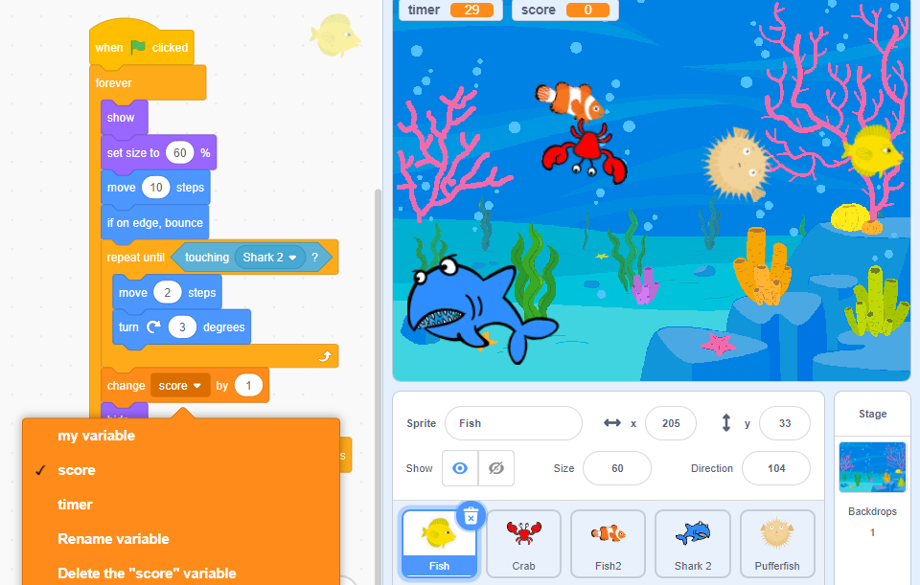
Go to the fish sprite code and add a change my variable by block before the hide block. Set it to read ‘change score by 1’.
Now when the shark eats a fish it will change the score by 1.

